Slide 1
Gender - Sensitive Care
Holly N. Hoffmeyer, Ph.D.
February 13, 2024
UNCLASSIFIED
Notes:
Focus on VA/DoD Womens Mental Health mini-residency

Slide 2
Disclosures
The views expressed in this presentation are those of the author and do not necessarily reflect the official policy or position of the Department of Defense, nor the U.S. Government.
Dr. Holly N. Hoffmeyer has no financial interests to disclose. Commercial support was not received for this activity.
No conflict of interest.
No discussion of non-FDA-approved medications or devices.
There are no case presentations as part of this presentation.
UNCLASSIFIED

Slide 3
Agenda
Gender Sensitive Care
Gender Disparities related to Behavioral Health
Relevant Efforts and Policy
UNCLASSIFIED
Notes:
Today’s agenda is…

Slide 4
3
Working Model of Gender Sensitive Care in the MHS
Gender Disparities
Etiology & Presentation
Awareness of
Gender Disparities
Awareness of gender disparities in health & behavioral health disorders for women
Gender may impact the presentation of psychological disorders, the etiology or the provider’s perception
INTERSECTIONALITY
Gender impact
Etiology &
Presentation
The ways in which multiple socially constructed categories contribute to the individual’s unique experience.
Trauma
Informed
Care
Reproductive Behavioral Health
Trauma-Informed Care
Reproductive factors may play a role as women experience anxiety/depression post partum or psychological distress in response to physical changes
Given the high rates of trauma among military populations such as combat and interpersonal violence
Reproductive
Behavioral
Health
(Hoffmeyer, 2023)
UNCLASSIFIED

Slide 5
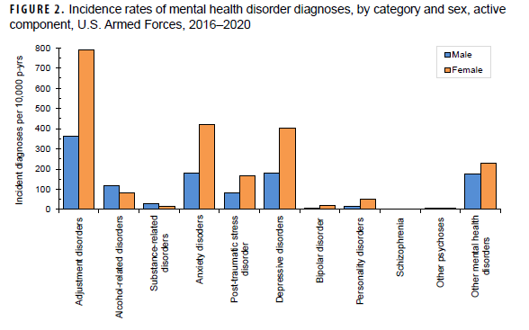
Gender Disparities
6
UNCLASSIFIED
(Armed Forces Health Surveillance Center, 2021)
Notes:
Research from a recent report:
Data collected from 1 JAN 2016-31 December 2020, included all ADSM in Army, Navy, USA, Marine corp
Data collected from Defense Medical Surveillance System (DMSS) for fixed MTFs and civilian (if reimbursed through MHS), also includes those deployed (Theater Medical Data Store)
Included diagnoses in 1st or 2nd position
During this period, 456, 293 ADSM were diagnosed with at least 1 mental health disorder, 199, 945 has more than 1 diagnosis

Slide 6
Gender Disparities
6
Women have nearly double:
Adjustment D/O
Anxiety D/O
Depressive D/O
UNCLASSIFIED
(Armed Forces Health Surveillance Center, 2021)
Notes:
Note: women are reporting significantly more: adjustment D/O, anxiety D/O and depressive D/O

Slide 7
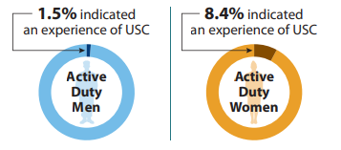
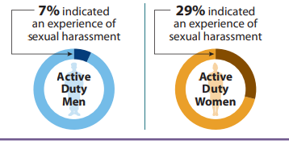
Gender Disparities
7
Unwanted Sexual Contact
Sexual Harassment
(DoD Sexual Assault Prevention and Response Office, 2021)
UNCLASSIFIED
Notes:
DoD Sexual Assault Prevention and Response Office
Workplace and Gender Relations Survey of Active Duty Members, DoD Office of People Analytics. Defense Sexual Assault Incident Data base,
Rates of unwanted sexual contact and sexual harassment are significantly higher for women than for men

Slide 8
Comparable Civilian Data
8
17.6% of American civilian women have been sexually assaulted
3% of American civilian men have been sexually assaulted
UNCLASSIFIED

Slide 9
Proportion of Service members disclosing sexual assault who are sexual minorities
9
12% of the active-duty population did not endorse heterosexual identification
43% of service members who were sexually assaulted identified as other than heterosexual
UNCLASSIFIED
Notes:
I would like to draw your attention to a recent RAND study which found that
A notable percentage of SM do not identify a heterosexual
Of those sexually assaulted, 43% did not identify a heterosexual

Slide 10
Proportion of Service members disclosing sexual assault who are sexual minorities
10
48% of men sexually assaulted in 2018
40% of women sexually assaulted in 2018
UNCLASSIFIED
Notes:
Of those sexually assaulted:
Nearly half of the men did not identify as heterosexual
40% of women did not identify as heterosexual
Thus, LGBT are at greater risk for sexual assault in this context

Slide 11
Behavioral Health Disparities per Millennium Cohort study: PTSD and Depression
10
 | FEMALE |  |  | MALE
 | Hetero Female | Gay/ Lesbian | Bisexual | Hetero Male | Gay | Bisexual
No PTSD/MDD | 84.5% | 79.4% | 66.8% | 86.2% | 79.1% | 68.4%
Depression | 2.8% | 3.7% | 5.7% | 2.0% | 4.0% | 5.1%
PTSD | 5.9% | 7.9% | 12.1% | 5.7% | 7.0% | 12.6%
Both PTSD/MDD | 6.8% | 9.0% | 15.4% | 6.1% | 9.9% | 13.9%
UNCLASSIFIED
Notes:
Carey, F.R., LeardMann, C.A., Lehavot, K., Jacobson, I.G., Kolaja, C.A., Stander, V.A., & Rull, R.P. (in press). Health Disparities Among Lesbian, Gay and Bisexual Service Members and Veterans. American Journal of Preventative Medicine.
It is worth noting that the LGBT is at greater risk for multiple behavioral health issues, note that for bisexual men and women the rates of depression alone, PTSD alone and comorbid PTSD/depression are double those of heterosexual males and females
Data from 2014-2016

Slide 12
Behavioral Health Disparities per Millennium Cohort study: PTSD and Depression
11
 | FEMALE |  |  | MALE
 | Hetero Female | Gay/ Lesbian | Bisexual | Hetero Male | Gay | Bisexual
No PTSD/MDD | 84.5% | 79.4% | 66.8% | 86.2% | 79.1% | 68.4%
Depression | 2.8% | 3.7% | 5.7% | 2.0% | 4.0% | 5.1%
PTSD | 5.9% | 7.9% | 12.1% | 5.7% | 7.0% | 12.6%
Both PTSD/MDD | 6.8% | 9.0% | 15.4% | 6.1% | 9.9% | 13.9%
UNCLASSIFIED
Notes:
Carey, F.R., LeardMann, C.A., Lehavot, K., Jacobson, I.G., Kolaja, C.A., Stander, V.A., & Rull, R.P. (in press). Health Disparities Among Lesbian, Gay and Bisexual Service Members and Veterans. American Journal of Preventative Medicine.
It is worth noting that the LGBT is at greater risk for multiple behavioral health issues, note that for bisexual men and women the rates of depression alone, PTSD alone and comorbid PTSD/depression are double those of heterosexual males and females
Data from 2014-2016

Slide 13
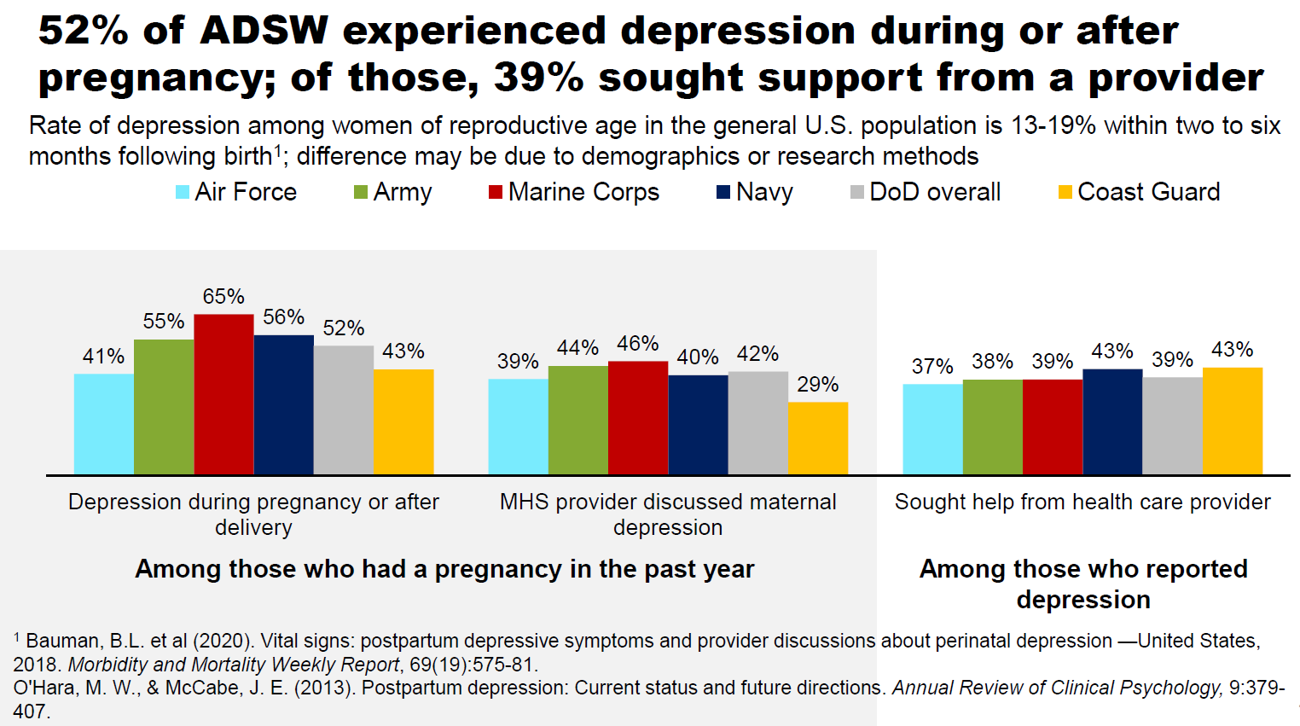
Maternal Depression in the DoD
UNCLASSIFIED
Notes:
Why Now?

Slide 14
DoD Efforts to Implement Gender Sensitive Care
10
Reproductive Health DODI (multi-disciplinary effort in progress)
Behavioral Health Screening and Referral in Pregnancy and Postpartum (Practice Recommendation) July 2022
Reproductive Behavioral Health education pilot (2024)
VA/DoD Women’s Mental Health Mini-Residency (WMHMR)
July 30 – August 1, 2024
UNCLASSIFIED
Notes:
DHA is working to identify needs and standardize care across the life cycle of Service women

Slide 15
Reproductive Behavioral Health (RBH) Education
Screening and treatment of reproductive mental/behavioral health (RBH) concerns differs in some ways from routine behavioral health care
Effective screening, diagnosis and treatment of RBH issues can reduce health care disparities
Educating (consultation) pilot will connect providers to
Behavioral health information
Relevant literature regarding evidence-based treatment
Guidance from VA RMH subject matter experts
UNCLASSIFIED
DoD Image: Photo by G. Montgomery, Carl R. Darnall Army Medical Center

Slide 16
RBH Education Pilot Limitations
Educating consultants do not meet patients or review patients’ charts, therefore can’t provide direct recommendations
Educational consultations are not designed for urgent situations
Average time from request to reply is about 3 business days to allow thorough review and team consensus on replies
UNCLASSIFIED

Slide 17
RBH DoD Pilot
Expansion of the VA Reproductive Mental Health Consultation program to DoD health providers at pilot military medical treatment facilities
Pilot sites have been selected, allowing their health providers to receive consultation services
Launch 2024
Status: Memorandum of Agreement is in coordination
Costs – no additional costs to DHA
UNCLASSIFIED

Slide 18
2024 DoD/VA Women’s Mental Health Mini-Residency (WMHMR)
To be held July 30 - August 1 in Washington, DC
2.5 day conference
Poster session focused on implementation of best practices
DoD has invited 12 SMEs to present breakout and didactic sessions.
200 participant capacity (100 VA and 100 DoD participants)
UNCLASSIFIED

Slide 19
WMHMR Gender-Specific Content
Lifestyle Medicine
Intersectionality
Eating Disorders and Disordered Eating Behaviors
Gender-Affirming Behavioral Health Care
Maternal Behavioral Health
Reproductive Health
Women’s Mental Health Across the Lifespan
And more!
UNCLASSIFIED

Slide 20
FY 2023 VA/DOD WMHMR Feedback
Outcome Survey results showed:
At least 96% of DoD participants in all sessions endorsed “agree” or “strongly agree” to: I will be able to apply the knowledge and skills learned to improve my job performance
Feedback was overwhelmingly positive from the workshops.
“As someone who views myself as a subject matter expert in women’s mental health, I was blown away by the program. I learned so many new things.”
“This is the best training I have attended in my career thus far. The quality of the presenters and presentations and the rich conversations during all sessions are unmatched.”
“The energy from the in-person format was phenomenal.”
UNCLASSIFIED

Slide 21
WMHMR Implementation
WMHMR Session allowing team members to provide feedback to leadership regarding Women’s Behavioral Health
Action planning session
Focused on bringing best practices/resources to home MTF
Small group discussion with input from clinic leaders
Opportunities to network with others in Women’s Behavioral Health across the Military continuum of care (DoD & VA)
Pre-registration information is available at dha.ncr.j-3.mbx.bhcmt-wmh-mini-residency@health.mil
UNCLASSIFIED

Slide 22
Trauma-Informed Care: What is Trauma?
Individual trauma results from an event, series of events, or set of circumstances that is experienced by an individual as physically or emotionally harmful or life threatening and has lasting adverse effects on the individual’s functioning and mental, physical, social, emotional, spiritual well-being.
UNCLASSIFIED
SAMSHA, 2014

Slide 23
Trauma-Informed Care:
A program, organization or system that is trauma-informed
realizes the widespread impact of trauma;…
recognizes the signs and symptoms of trauma in clients and others
responds by fully integrating knowledge about trauma into policies, procedures and practices
seeks to actively resist re-traumatization.
UNCLASSIFIED
SAMSHA, 2014

Slide 24
Relevant Policy and Guidance
Relevant Policy and Guidance
DoDI 6310.09 “Health Care Management for Patients Associated with Sexual Assault,” May 7, 2019 states that care should be…
Trauma-informed
Gender responsive
DoDI 6400.06 “Domestic Abuse Involving DoD Military and Certain Affiliated Personnel,”
“Provide services that are culturally informed and respectful of gender and sexual orientation”
DHA-AI 6490.01 “Behavioral Health System of Care”
Inclusive Behavioral Health mission…in support of the BH needs of women, black, indigenous people, people of color, LGBT communities and other underserved populations
Relevant Policy and Guidance
UNCLASSIFIED

Slide 25
questions
UNCLASSIFIED

Slide 26
References
American Psychological Association, APA Task Force on Race and Ethnicity Guidelines in Psychology. (2019). Race and Ethnicity Guidelines in Psychology: Promoting Responsiveness and Equity. Retrieved from http://www.apa.org/about/policy/race-and-ethnicity-in-psychology.pdf
Armed Forces Health Surveillance Center (AFHSC. (2021). Update: Mental Health Disorders and Mental Health Problems, Active Component, US Armed Forces, 2016-2020. MSMR, 28(8), 2-9.
Defense Advisory Committee on Women in the Services (2020). 2020 Annual Report. Retrieved from DACOWITS 2020 Annual Report WEB.pdf (defense.gov)
Sexual Assault Prevention and Response Office. (2021). Department of Defense Annual Report on Sexual Assault in the Military Fiscal Year 2021. Retrieved from Reports | SAPR
Substance Abuse and Mental Health Services Administration. SAMHSA’S Concept of Trauma and Guidance for a Trauma-Informed Approach. HHS Publication No. (SMA) 14-4884. available at https://samhsa.gov/sites/default/files/sma14-4884.pdf
UNCLASSIFIED

Slide 27
Resources (1 of 2)
Improving cultural competence https://store.samhsa.gov/product/TIP-59-Improving-Cultural-Competence/SMA15-4849
Improving Cultural Competency for Behavioral Health Professionals https://thinkculturalhealth.hhs.gov/education/behavioral-health
Training resources for work with LGBT community https://www.samhsa.gov/behavioral-health-equity/lgbt/curricula
Behavioral Health Equity for Black and African-Americans https://www.samhsa.gov/behavioral-health-equity/black-african-american
Behavioral Health Equity for Latinas https://www.samhsa.gov/behavioral-health-equity/hispanic-latino
Behavioral Health Equity Asian American, Native Hawaiian, and Pacific Islander (AANHPI) https://www.samhsa.gov/behavioral-health-equity/aanhpi
Behavioral Health Equity for LGBT https://www.samhsa.gov/behavioral-health-equity/lgbt
Work with American Indians and Native Alaskans https://store.samhsa.gov/product/American-Indian-and-Alaska-Native-Culture-Card/sma08-4354
UNCLASSIFIED
Notes:
These resources include behavioral health reports and fact sheets as well as programs, initiatives and resources.

Slide 28
Resources (2 of 2)
Reproductive Health - https://health.mil/News/In-the-Spotlight/Ensuring-Access-to-Reproductive-Health-Care
Maternal Mental Health Hotline 24/7
1-833-9-HELP4MOMS (English & Spanish)
Inclusive Behavioral Health Sharepoint https://info.health.mil/sites/hro/CMT/BH/Inclusive/Pages/Home.aspx
Includes current information on VA/DoD Women’s Mental Health Mini-Residency
Gender-affirming care resources
PTSD and racial disparities
TJC Health Care Equity – Accreditation and Standards Resource Site
Accreditation and Compliance Program E-mail
dha.ncr.clinic-support.list.accred-comply-program-owners@health.mil
DHA CQM Home Page
https://info.health.mil/hco/clinicsup/quality/SitePages/CQMHome.aspx
Patient Safety / Infection Prevention and Control
Healthcare Risk Management
Credentialing and Privileging
Accreditation and Compliance
Clinical Measurement Program
Clinical Quality Improvement Program
UNCLASSIFIED

Slide 29
Joint Commission Efforts to Reduce Health Care Disparities
Effective 1 Jan 2023, new and revised requirements to reduce health care disparities now applies to all MTFs accredited by The Joint Commission (TJC) under the Hospital, Ambulatory and Behavioral Health Programs
A new standard in the Leadership Chapter with 6 Elements of Performance (EP) was added
Record of Care standard to collect patient race and ethnicity was revised and applies to all Programs
The Rights and Responsibilities requirement prohibiting discrimination will apply to all Programs
To meet the new requirements, MTFs are required to appoint a Health Care Equity Lead or team to oversee the implementation of TJC Standards applicable to Health Care Equity, assess MTF readiness, and guide ongoing sustainment activities that reduce health care disparities for MTF beneficiaries
Failure to comply, will lead to Requirements for Improvement (aka findings), requiring corrective actions and potential loss of MTF accreditation.
UNCLASSIFIED

