Slide 1
Toxic Exposure Impact to Lung Health, Screening, Research & New Care Approaches

Slide 2
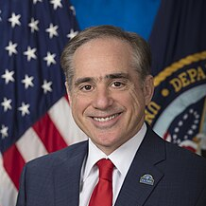
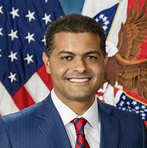
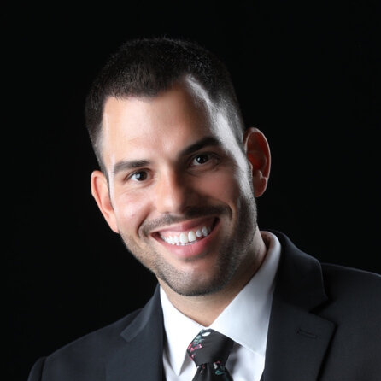
Welcome
The Honorable David J. Shulkin, MD
9th Secretary, Department of Veterans Affairs
Shereef Elnahal, MD, MBA Under Secretary of Health, Veterans Health Affairs
Raul A. Mirza, DO
Dha pheo, Public Health Emergency Official & Chief of Occupational & Environmental Medicine, at Defense Centers for Public Health – Aberdeen
Rosie Lopez Torres Co-founder, Burn Pits 360

Slide 4
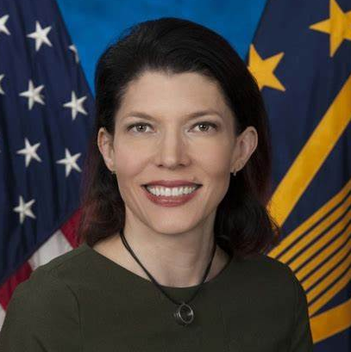
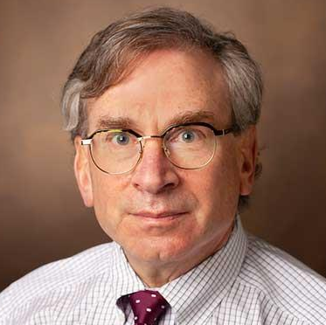
Welcome
Michael J. Falvo, Ph.D
Co-director of Airborne Hazards Open Burn Pit Centers of Excellence, Department of Veterans Health Administration
Rachel B. Ramoni, DMD, Sc.
Chief Research & Development Officer, Department of Veterans Health Administration
Robert F. Miller, MD
Professor of Clinical Medicine Vanderbilt University
Andrea E. Covey, MD
Pulmonary Physician, Kansas City Veterans Affairs Medical Center

