Slide 1
LEFT SHIFT
THE STRATEGIC IMPERATIVE FOR INVESTING IN
WELL-BEING
LTC STEPHANIE HIGHTOWER - FEB 15, 2024

Slide 2
DISCLOSURE OF POTENTIAL CONFLICTS OF INTEREST
I DO NOT HAVE ANY FINANCIAL INTERESTS WITH INELIGIBLE COMPANIES TO DISCLOSE

Slide 3
OBJECTIVES
01
CALL TO ACTION
02
ABSTRACT TO ACTIONABLE
03
MIND THE GAP
04
OPERATIONALIZING WELL-BEING

Slide 4
THE BATTLEGROUND
OLD WORLD ORDER
NEW WORLD CHALLENGES

Slide 5
90%
CHRONIC DISEASE

Slide 6
5B
SUGAR
800K

Slide 7
17
SADNESS

Slide 8
FUTURE
FIGHTING FORCE
71%

Slide 9
INVESTING IN THE CONTINUUM
HIGH LEVEL WELLNESS
PREMATURE DEATH
OPTIMAL
HEALTH
GOOD HEALTH
NEUTRAL
POOR
HEALTH
DISEASE

Slide 10
THE WELL-BEING
CONNECTION

Slide 11
POSTITIVE
CONNECTIONS

Slide 12
DYSFUNCTIONAL CONNECTIONS

Slide 13
DISEASE, SUGAR, SADNESS

Slide 16
REWRITING THE NARRATIVE

Slide 17
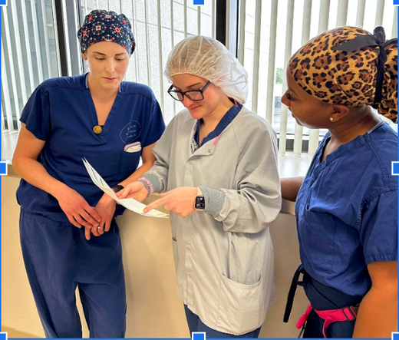
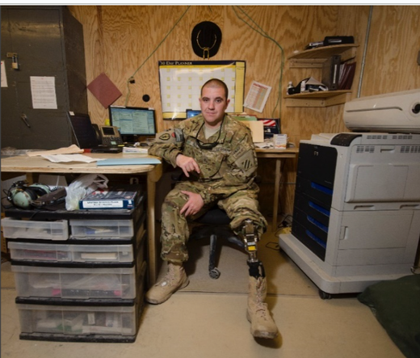
OUR MISSION. OUR PURPOSE. OUR PEOPLE

Slide 18
OUR PURPOSE

Slide 19
BE WELL
DO WELL
LIVE WELL
LTC STEPHANIE HIGHTOWER - FEB 15, 2024

