Slide 1
One Patient, Two Healthcare Systems: DoD and VA Collaboration
Dr. Paul Cordts
February 13, 2024

Slide 2
Disclosures
I have no relevant financial or non-financial interests to disclose.
This continuing education activity is managed and accredited by AffinityCE, in collaboration with AMSUS. AffinityCE and AMSUS staff, as well as planners and reviewers, have no relevant financial interests to disclose. AffinityCE adheres to the ACCME’s Standards for Integrity and Independence in Accredited Continuing Education. Any individuals in a position to control the content of a CME activity, including faculty, planners, reviewers, or others, are required to disclose all relevant financial relationships with ineligible entities (commercial interests). All relevant conflicts of interest have been mitigated prior to the commencement of the activity.
Commercial support was not provided for this activity.

Slide 3
LEARNING OUTCOMES
Describe current state and vision for VA-DoD Clinical Practice Guidelines (CPGs) in EHR
Describe collaboration between DoD and VA for Graduate Medical Education
Describe Patient Safety systems/processes in use by DoD and VA
Describe common conditions upon separation from Active Duty (SHA, IDES) and the inTransition Program

Slide 4
Collaboration Areas
Patient Safety
Graduate Medical Education
Clinical Practice Guidelines
Programs for Separating Service Members
Patient Safety IP
GME IP
CPG IP
Separating SM IP

Slide 5
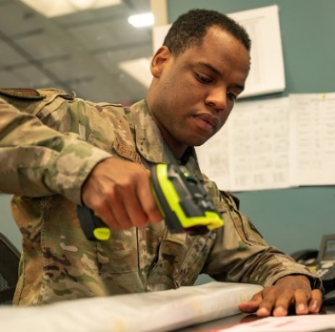
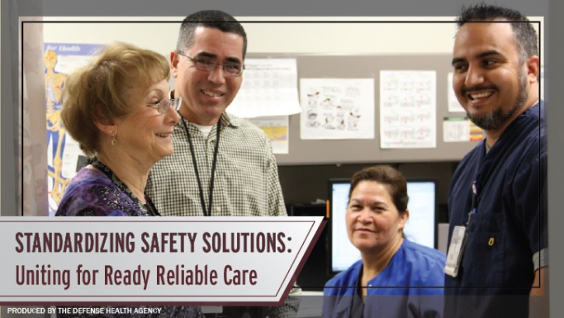
DHA Patient Safety Collaboration with VHA
Joint Patient Safety Reporting (JPSR) Modernization
Joint Incentive Fund (JIF) FY23 project, committed sustainment funding for out-years, provides standardized reporting & investigations automation for DHA, VHA, U.S. TRANSCOM Patient Movement, Operational Target of Oct FY26.
Additional Areas of Collaboration
Sharing PS Lessons Learned on Electronic Health Record roll-out
Bar Code Medication Administration
Focused Reviews on Patient Safety data Trends
Patient Safety Communications – Shared Safety Information
Collaboration for efficiency on common functional domains
Presidential Report on Patient Safety
VHA Community Care and DHA Private Sector Care
Notes:
The second large lift effort is Medication Administration Safety Process Improvements.
With MHS GENESIS implementation waves completed, we now have this capability across DHA MTFs for the first time in our history, BCMA workflows have been adopted across the DHA. The industry standard of barcode medication scanning procedures reduces medication harm events.
Additionally, incentives were awarded through IRIS funding program to reward MTFs that adopted correct workflows and achieved Leapfrog Survey national benchmark scanning rates at (95%).
Upcoming improvement efforts in 2024 will include CPOE and Medication Reconciliation data compliance tracking. In addition, DHA and VHA are planning to release in 2024, a joint IV Infusion Guidebook to standardize across agencies with a joint Tracer (Accreditation Manager Plus software) for DHA and Patient Safety Assessment Tool (PSAT) for VHA) to measure improvement of IV Infusion Safety over time and use as an ongoing self inspection tool.
Some additional Areas of Collaboration between the DHA and VHA include:
Sharing the lessons learned from the roll-out of the new (FEHRM) electronic health record system, highlighting risk areas from trouble tickets and change requests, done within a joint process as changes and enhancements are most often enterprise-wide impact for both organizations
DHA collaborates with VHA, to include VHA data and/or resources when developing Focused Review documents.
DHA and VHA are beginning to collaborate and learn each Agency’s method of developing and disseminating Patient Safety Communications (i.e., Alerts/Advisories/Notices) to identify opportunities to increase efficiency (for example, potential opportunities to develop shared PS Advisories)
Additionally:
DHA and VHA can begin collaboration discussions on opportunities and requirements;
1. Related to actions that can be taken in response to the Sep 23 REPORT TO THE PRESIDENT “A Transformational Effort on Patient Safety” (By PCAST staff)
2. Share lessons learned between the VHA Community Care and DHA Private Sector Care

Slide 6
Additional Collaboration Areas
Graduate Medical Education
VA/DoD GME Integrated Product Team
36 DHA GME Programs with Rotations at VA Hospitals
2 DHA GME Programs have VA Funded Residents
Clinical Practice Guidelines
Evidenced-Based Practice Guideline Work Group
Multidisciplinary Subject Matter Expert Working Group
Programs for Separating Service Members
InTransition
Recovery Coordination Program
Integrated Disability Evaluation System
GME IP
CPG IP
Separating SM IP

Slide 7
How To Claim CE Credit
If you would like to receive continuing education credit for this activity, please visit:
amsus.cds.affinityced.com

