Slide 1
The Next Big Thing:
Spaceports and Emerging Issues in Space Medicine
FAA, NASA, AFMS Panel Discussion
Melchor Antunano, MD, Director Civil Aerospace Medical Institute, FAA
Vincent Michaud, MD, Deputy Chief Health and Medical Officer, NASA HQ
Maj General (Dr) Sean Collins, Director USSF Medical Operations
Col (Dr) Lidia Stana Ilcus, Deputy Director USSF Medical Operations
Notes:
Federal Aviation Administration
National Aeronautics and Space Administration
Air Force Medical Service
Proliferation of Space Launches
Commercialization
Human Space Flight Participants
Human Factors and Safety
Research gaps

Slide 2
DISCLOSURES
Maj Gen Sean Collins, Dr Melchor Antunano and Dr JD Polk have no relevant financial or non-financial interests to disclose.
Disclosure will be made when a product is discussed for an unapproved use.
This continuing education activity is managed and accredited by AffinityCE, in collaboration with AMSUS. AffinityCE and AMSUS staff, as well as planners and reviewers, have no relevant financial interests to disclose. AffinityCE adheres to the ACCME’s Standards for Integrity and Independence in Accredited Continuing Education. Any individuals in a position to control the content of a CME activity, including faculty, planners, reviewers, or others, are required to disclose all relevant financial relationships with ineligible entities (commercial interests). All relevant conflicts of interest have been mitigated prior to the commencement of the activity.
Commercial support was not provided for this activity.

Slide 3
Learning Outcomes
At the conclusion of this activity, participants will be able to:
1. Cite examples of aerospace medical considerations, from an FAA perspective
2. Cite examples of medical considerations, from a NASA perspective
3. Cite examples of medical considerations, from a Department of the Air Force Medical Operations (SGSF) perspective
As of: 1 Jan 23
Notes:
Application of Space Medicine Is being interpreted differently by different vendors
Not standardized or consistent

Slide 4
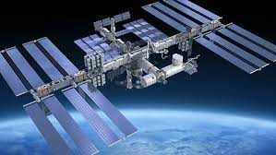
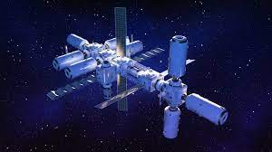
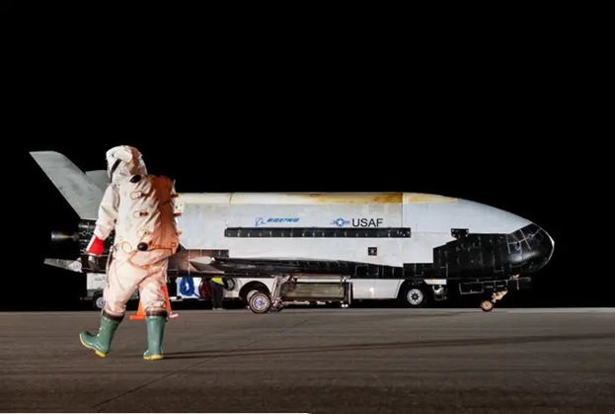
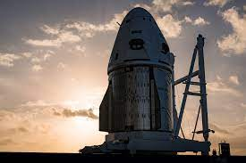
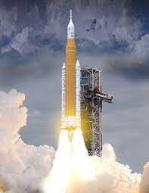
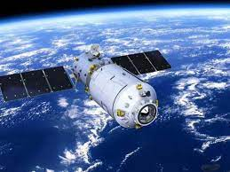
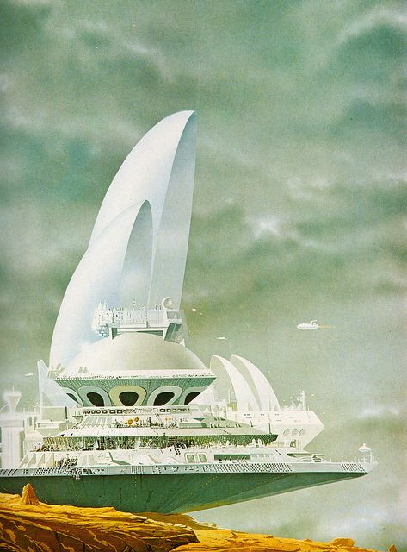
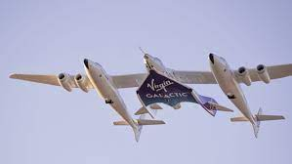
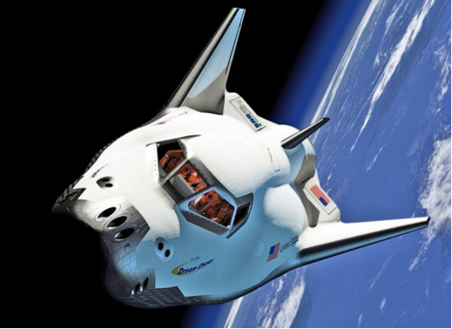
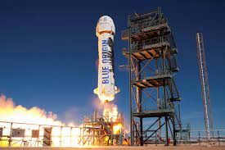
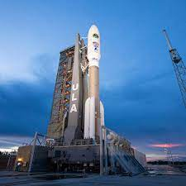
Platforms and Possibilities
Notes:
Proliferation of launches platforms and stations
Disaster plans
Spaceports-A myriad and multitude launching people, satellites and performing tests.
https://www.globalspaceportalliance.com/
X37B, Space X, ULA, NASA Artemis, Virgin Galactic, Blue Origin, Sierra Space, ISS, Axion Space (notional) Tiagngong
Does it have to be a site where rockets/vehicles reach orbit?
FAA requires a spaceport so designated to hold a launch site operators license (mitigate risk)
Title14 Chapter III Subchapter C Part 420 of the US Code of Federal Regulations
§ 420.3 Applicability.
This part applies to any person seeking a license to operate a launch site or to a person licensed under this part. A person operating a site that only supports amateur rocket activities as defined in 14 CFR 1.1, does not need a license under this part to operate the site.
International Space University 2008 “FuturIST:
Future Infrastructure for Space Transportation
Final Report, "An area of land or water that is used or intended
to be used for the launch and recovery of space access
vehicles, and includes its buildings and facilities, if any“
Pre-1950s—ballistic missile launch locations
1960s—Federal, ie military and NASA
1980s Commercial—though that is not the same same as private—commercial is often run by state agencies as infrastructure/pubcli investment not business model
No longer just Kennedy Space Center,
launch facility; regulated “Airspace”
FAA and ICAO
Consider this: in 1978, I bought a Scientific American that had an inspiring article on a Miami Dade County Spaceport (Colin Hay rendition) A futuristic concept
NASA and FAA roles
What about Dept of the AF role?
DAF encompasses USAF and USSF. Cannot get to space without going through the Air.
From USSF webpage: “Operating the largest space program in the world takes the combined efforts and skills of thousands of Guardians.
It’s the responsibility of a Space Systems Operations specialist to do everything from detecting sea-launched ballistic missiles and tracking satellites to assisting in rocket launches and space flight operations.
These highly trained experts must be able to stay calm under pressure and utilize an incredible amount of skill to effectively perform the multiple tasks vital to Space Force missions.”
Civil and Civilian controllers require skill and calm as well-standards, shouldn’t it involve agreed upon medical standards?

Slide 5
The Why
Space is Critical to everyday life and national security
Our daily lives rely on Space--the Space Launch demand is increasing
Growing Space Commercialization generates new opportunities and risks
The FAA, NASA and the AFMS have historically been the cartographers for the human excursion into AeroSpace
1st Medical Focus= Safety: the Space domain is multidimensional→ multi-domain-planning and prevention is key
High risk occupations, and occupations that put others at risk, require standards
Launches and recoveries and on-orbit work are unique, dynamic and rapidly evolving
Considerations beyond human spaceflight and exploration
It’s also now about the, “what if”—
Space flight Participants, training
Occupation, industrial hygiene, ethics, partnerships, Controllers, maintenance, hazards, Federal and international regulaitons
Notes:
growing commercialization leads to decreased costs and increased access. Space tourists are not astronauts
Increasing demand for launch capabilities outpacing current landscape
In 2022, an estimated 6,905 active satellites were orbiting Earth — 2,105 more than in the previous year
Considerations
Landmass/space to launch
environmental assessment
Route to orbit To launch rockets into space, British operators must be licensed by the Civil Aviation Authority (CAA). Part of the license application may be environmental assessment. In the US-CFR 420 License to Operate a Launch Site
Populated areas (near water) vs not populated in case of mishap
Traffic (land, sea, air) of people and migrating birds
Weather-impact on launch platform
Things to consider from CFR include:
Ballistic coefficient means the weight of an object divided by the quantity product of the coefficient of drag of the object and the area of the object.
Compatibility means the chemical property of materials that may be located together without increasing the probability of an accident or, for a given quantity, the magnitude of the effects of such an accident.
Debris dispersion radius (D_{max}) means the estimated maximum distance from a launch point that debris travels given a worst-case launch vehicle failure and flight termination early in flight. For an expendable launch vehicle, flight termination is assumed to occur at 10 seconds into flight.
Downrange area means a portion of a flight corridor beginning where a launch area ends and ending 5,000 nautical miles from the launch point, or where the IIP leaves the surface of the Earth, whichever is shorter, for an orbital launch vehicle; and ending with an impact dispersion area for a guided sub-orbital launch vehicle.
USAF medics must understand that unique mission, train to support, and mitigate operational surprise and coordinate with Sister Services, NASA, FAA, combatant commands and allies and partners if called upon

Slide 6
Notes:
Since 1996, the Federal Aviation Administration's (FAA) Office of the Associate Administrator for Commercial Space Transportation (AST) licensed five spaceports in the United States: California Spaceport at Vandenberg Air Force Base, Spaceport Florida at Cape Canaveral Air Force Station, the Virginia Space Flight Center at Wallops Island, Kodiak Launch Complex on Kodiak Island, Alaska, and - the inland Mojave Spaceport in California.
Overall, 30+operational spaceports are spread out around the planet--most of them government owned and operated. Spaceports: Building up the Space Travel Industry | Space (2006 Space.com)

Slide 7
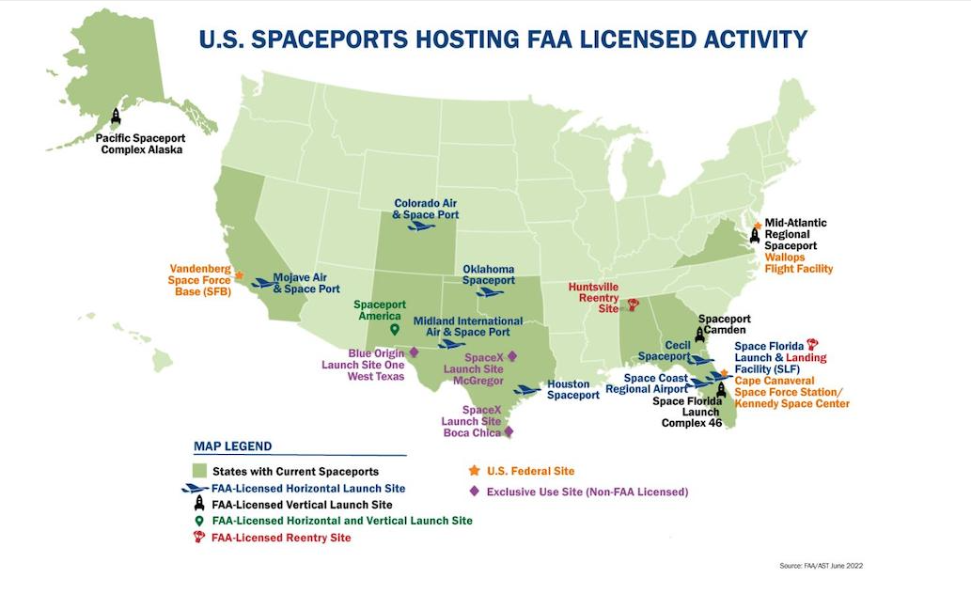
Notes:
National Spaceport Intergovernmental Working Group (NSIWG) https://www.faa.gov/space/spaceports#NSIWG
Vandenberg Emergency Response
“Our nation’s welfare depends on our ability to access space, and the freedom to operate and explore beyond Earth. Regular access to space has been made possible through a rapidly growing space industry, supported by a number of federal launch ranges, state-owned spaceports, and privately-owned launch sites.
Recognizing the importance of space for U.S. economic strength and national security, there is a need for a comprehensive national spaceport strategy to both maximize our space transportation capabilities and ensure our network’s resiliency. Building this strategy requires a dedicated team of experts representing multiple federal government agencies, including the Department of Defense, the Department of State, the Department of Commerce, the U.S. Space Force, and NASA; state governments; industry; and academia.
The FAA is leading a federal government working group to develop a national spaceport strategy that leverages the full network of domestic spaceports to benefit the space transportation industry and the nation as a whole. The strategy will consist of three primary areas of interest:
promote innovation and investment in spaceport infrastructure;
establish consistency in operations and standards at the nation’s spaceports; and
promote cooperation and partnerships between federal and commercial spaceports”
Chaired by the Department of Transportation’s (DoT) Federal Aviation Administration (FAA)
Office of Spaceports (AST), the NSIWG is represented by the following organizations:
• Department of Commerce (DoC)
• Department of State (DoS)
• National Aeronautics and Space Administration (NASA)
• Office of the Secretary of Defense (OSD)
• United States Space Force (USSF)

Slide 8
The How-Humans and Space Ops
Space Medicine involves more than human space flight, includes concepts of preventive health, public health and hazards, and issues of Safety
Identifying the unique performance requirements
Medical Screening-What do we do, What should we do
Medical Standards defined and re-defined
Space never sleeps-but people have to
Support_What does it look like_ how is it codified and contracted
Research gaps
Optimizing human potential
Building the cadre of aerospace medicine support
Partnerships and Interoperability across the globe
Notes:
Directorate—Medical Operations SGSF
Total Force Manpower/Personnel/Resources
Policies and Publications
Readiness-Postured expert Cadre
Partnerships (Civil, Civilian, Military, International, Academia)
Initiatives
Programmatic Medical Standards→Cross-enterprise, whole of govt engagement and support bioenvironmental considerations, mishap response→Human performance/Systems Integration
Research gaps-career astronauts no longer the only ones--beneficial knowledge to all as folks with comorbidities launch

Slide 9
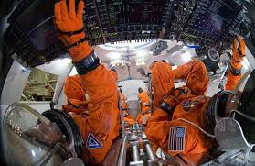
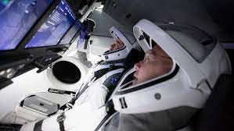
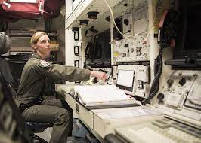
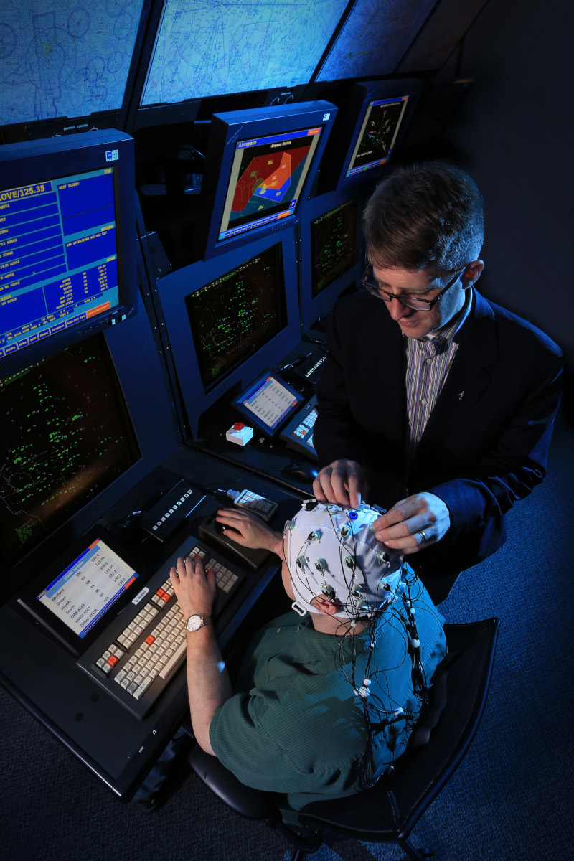
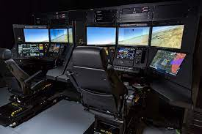
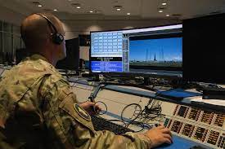
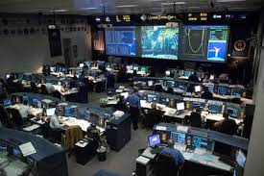
Human Factors
Notes:
Human Machine interface photos
Human factors performance and mishaps
fatigue complacency
Sims
Msn Control
NASA Orion photo
Space x Dragon capsule
USAF and USSF support
Pre, During and Post Controllers and participants and maintainers and everyone in between
§ 420.65 Separation distance requirements for handling division 1.1 and 1.3 explosives
§ 420.66 Separation distance requirements for storage of hydrogen peroxide, hydrazine, and liquid hydrogen and any incompatible energetic liquids stored within an intraline distance.

Slide 10
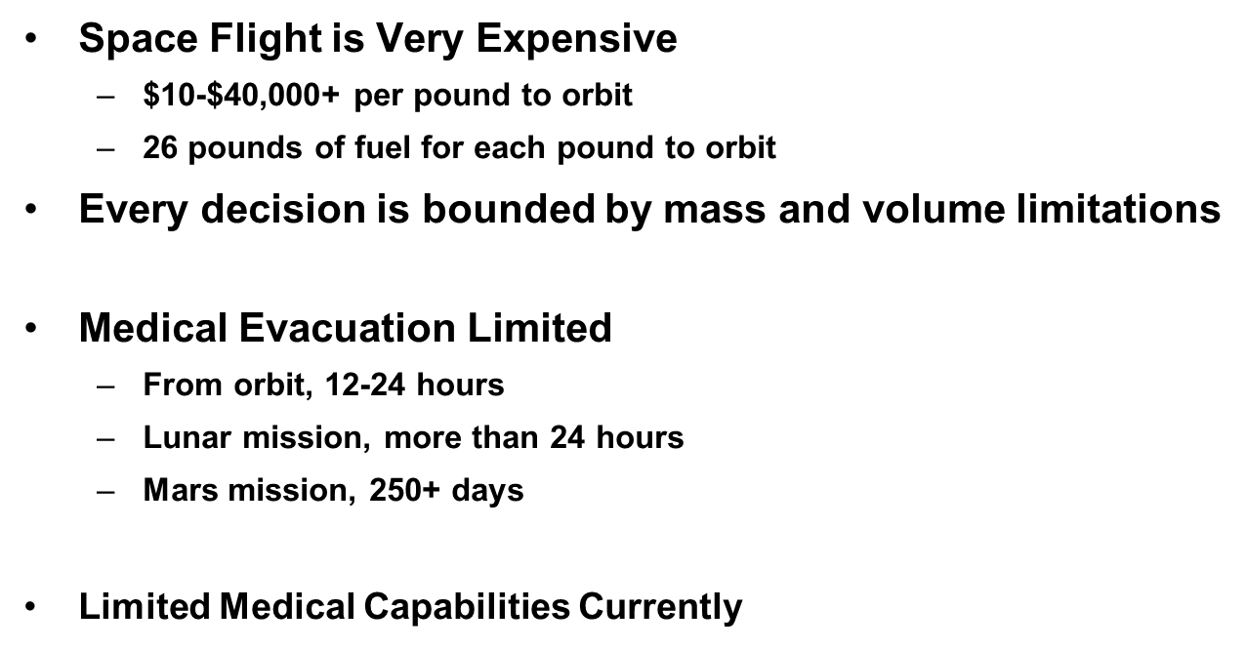
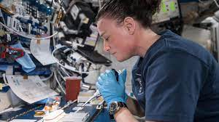
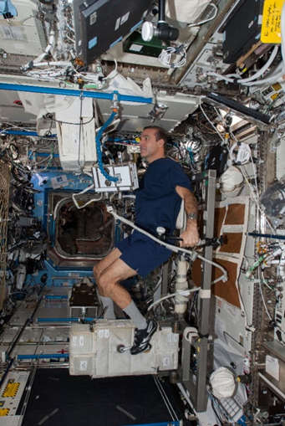
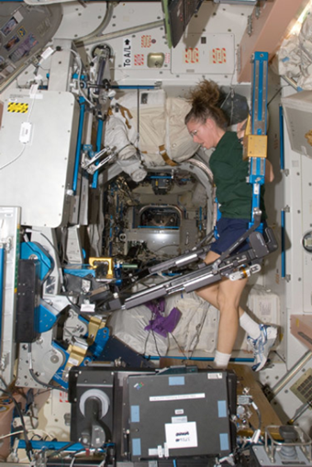
Human Space Flight And Exploration: Mass and Volume
Notes:
Crowded space
Countermeasures
Research
Medical Conditions/considerations
Allergic reaction (mild to moderate)
Mouth ulcer
Ankle sprain/strain Nasal congestion (space adaptation)
Back injury
Neck injury
Back pain (space adaptation)
Nose bleed (space adaptation)
Barotrauma (ear/sinus block)
Otitis externa
Choking/obstructed airway
Otitis media
Constipation (space adaptation)
Paresthesias
Diarrhea
Pharyngitis
Elbow sprain/strain Respiratory infection
Eye abrasion (foreign body) Shoulder sprain/strain
Eye chemical burn Sinusitis
Eye infection
Skin abrasions/infections/lacerations
Finger dislocation
Fingernail delamination (EVA)
Gastroenteritis Skin rash
Headache (CO2 induced)
Smoke inhalation
Headache (late)
Space motion sickness (space adaptation)
Headache (space adaptation)
Urinary incontinence (space adaptation)
Hemorrhoids Urinary retention (space adaptation)
Herpes Zoster reactivation (shingles)
Urinary retention (space adaptation)
Indigestion Urinary tract infection

Slide 11
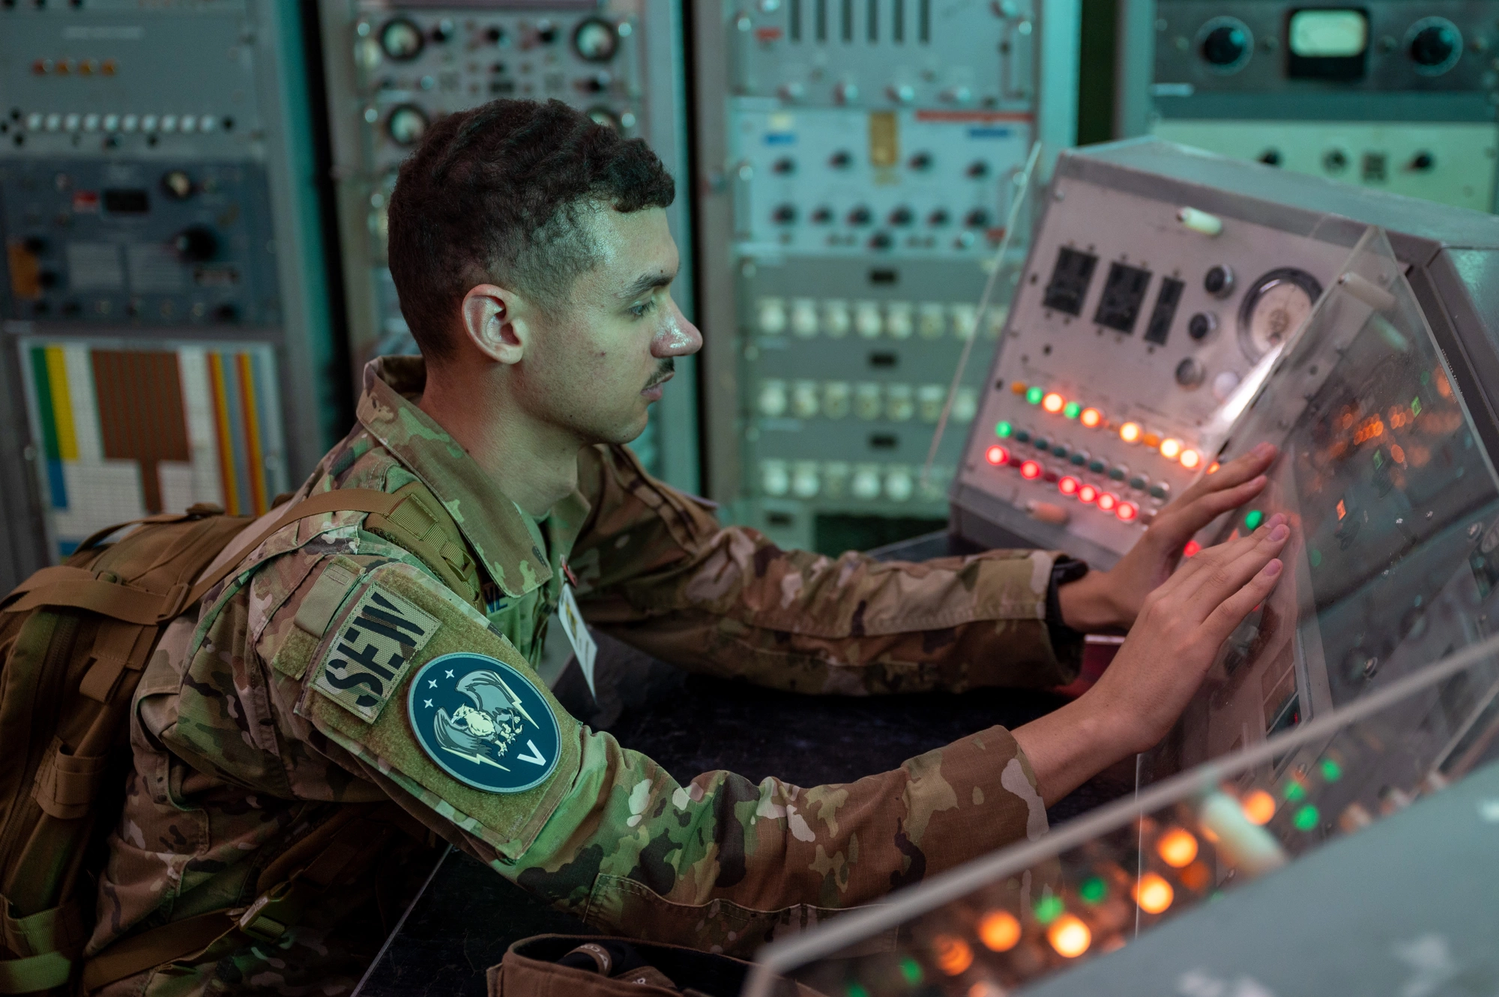
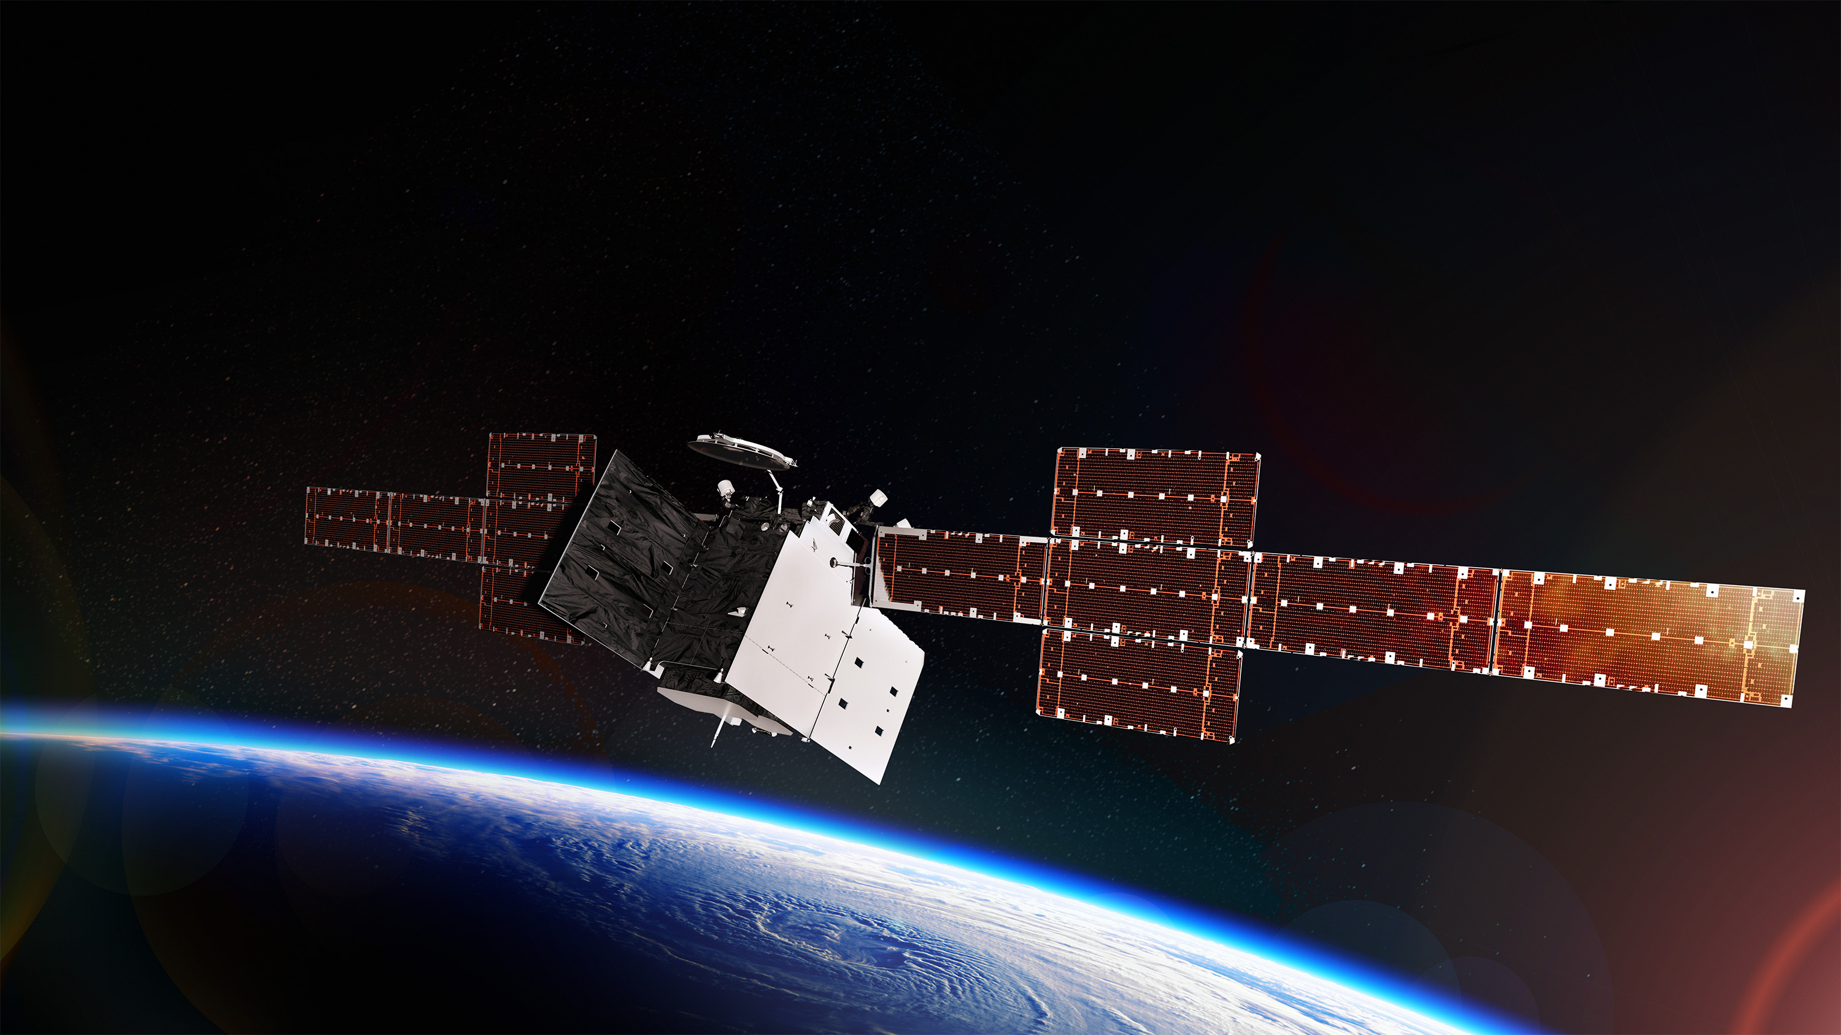
DoD
Space Access
Space Domain Awareness
Medical Operations
Rescue & recovery
Payload security & support
Weather support
Airlift / Sealift & salvage
Communications support
Launch/Landing site support
Notes:
DoD Support to NASA’s Commercial Crew Program, 31 Jan 2014
SECDEF-approved standing execute order directing DoD HSFS for NASA CCP operations and associated testing, training and development events
https://www.whitehouse.gov/wp-content/uploads/2021/12/United-States-Space-Priorities-Framework-_-December-1-2021.pdf
United States Space Priorities Framework; December 2021
The United States will maintain its leadership in space exploration and space science
will advance the development and use of space-based Earth observation capabilities that support action on climate change.
will foster a policy and regulatory environment that enables a competitive and burgeoning U.S. commercial space sector
will protect space-related critical infrastructure and strengthen the security of the U.S. space industrial base.
will defend its national security interests from the growing scope and scale of space and counterspace threats.
will defend its national security interests from the growing scope and scale of space and counterspace threats.
will lead in strengthening global governance of space activities.
will bolster space situational awareness sharing and space traffic coordination
will prioritize space sustainability and planetary protection.

Slide 12
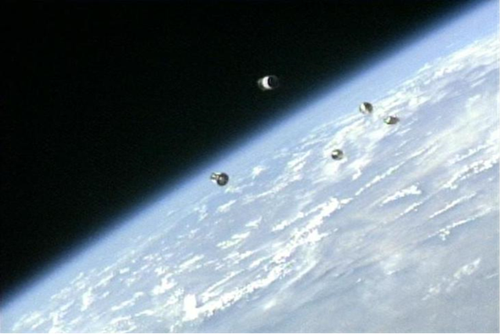
The Next Gen
Leveraging machine learning and artificial Intelligence to exercise the “what-if’s”
Re-thinking aeromedical evacuation, autonomous care, hazmat and medical logistics
The human element of the Space operations ecosystem: Space systems, Launch and Recovery operations, space domain awareness/prediction/management
Human Systems Integration
DATA
Complexity of Missions
Emergency Response
Mishap investigaiton
Training
Specialties-lunar, martian

Slide 13
Questions?

Slide 14
How To Claim CE Credit
If you would like to receive continuing education credit for this activity, please visit:
amsus.cds.affinityced.com

