Slide 1
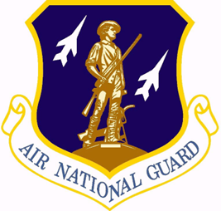
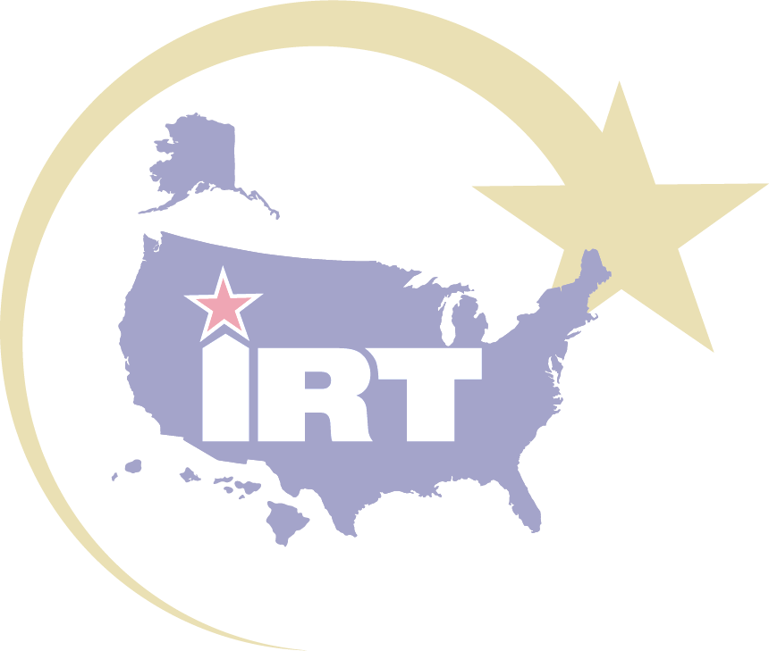
Hoopa Valley Innovative Readiness Training: A Joint Training Exercise
LCDR Erica Stoll, MSN
LTC Rashida Fambro, PharmD
It’s all about… STRATEGIC ENGAGEMENT

Slide 2
2023 Joint Hoopa Valley IRT Team
Notes:
Here have were able to capture a shot of our entire Team that participated in the mission.

Slide 3
Disclaimer
The findings and conclusions of this presentation are those of the author(s). They do not necessarily reflect those of the U.S. Public Health Service Commissioned Corps, the U.S. Department of Health and Human Services, Alabama Air National Guard’s 187th Fighter Wing, Innovative Readiness Training program, or the Department of Defense.

Slide 4
Disclosure
LCDR Erica Stoll and LTC Rashida Fambro have no relevant financial or non-financial interests to disclose.
This continuing education activity is managed and accredited by AffinityCE, in collaboration with AMSUS. AffinityCE and AMSUS staff, as well as planners and reviewers, have no relevant financial interests to disclose. AffinityCE adheres to the ACCME’s Standards for Integrity and Independence in Accredited Continuing Education. Any individuals in a position to control the content of a CME activity, including faculty, planners, reviewers, or others, are required to disclose all relevant financial relationships with ineligible entities (commercial interests). All relevant conflicts of interest have been mitigated prior to the commencement of the activity.
Commercial support was not provided for this activity.
Notes:
This continuing education activity is managed and accredited by Affinity CE, in collaboration with AMSUS.
Affinity CE an AMSUS staff, as well as planners and reviewers, have no relevant financial interests to disclose.

Slide 5
Learning Objectives
Describe the purpose of the Innovative Readiness Training (IRT).
List the capabilities and opportunities afforded by the IRT.
Describe how deployment agility was enhanced among various service components from the IRT.
Explain the service member and community impact provided by the Hoopa Valley IRT Team.
Notes:
We plan to cover the following learning objective during this presentation
#1 Describe the purpose of the Innovative Readiness Training which will be referred to as IRT throughout this presentation.
#2 List the capabilities and opportunities afforded by the IRT.
#3 Describe how deployment agility was enhanced among various service components from the IRT.
#4 Explain the service member and community impact provided by the Hoopa Valley IRT Team.

Slide 6
Overview & Executive Summary
IRT missions are initiated to:
Restore military readiness
Strengthen alliances and attract new partners
Bring business reform to the Department of Defense
Provide joint training opportunities in various military occupations including medical, civil engineering, and public affairs
Hoopa Health Valley IRT, 13- day training exercise from 1 AUG 2023 -13 AUG 2023
Lead Unit: 187th Fighter Wing
Mission Partners: U.S. Public Health Service (USPHS), the Air National Guard (ANG), the U.S Air Force Reserve, Remote Area Medical (RAM) and local community partners
Total 69 joint service personnel: ANG (49), USAF (1), USPHS (18), RAM (1)
Notes:
IRT Provides hands-on, real-world training to improve readiness and survivability in complex contingency environments
IRT strengthens and builds community partnerships, while providing key services for American communities
IRT is a collaborative program that leverages military contributions and community resources to multiply value and cost savings for participants
IRT provides opportunities for units and individuals to train in a variety of military occupational specialties. While medical and civil engineering missions are the most commonly known, our training portfolio includes: public affairs, cross-country transportation services and even cyber training. As you can see, the training and service opportunities are only limited by your imagination!

Slide 7
Hoopa Valley IRT Organizational Structure
Mission CC
Col Jones
Mission OIC
Lt Col Fambro
IRT Program Liaison
1LT Park
Mission AOIC
1Lt Fitzgerald
Community Partner Liaison
Jene Moore
RAM
Audra Fitzgerald
USPHS LNO
CDR Gelviro
Admin/ Reporting OIC Capt Black
Training OIC
Lt Col Cambers
Mission NCOIC
TSgt Wilson
Public Health OIC
Maj Horwitz
PA/Protocol NCOIC
MSgt Barron
Mission 1st SGT / PERSCO
TSgt Franklin
Safety NCOIC
MSgt Mendiola
Chaplain OIC Lt Col Carroll
Medical OIC
LCDR Stoll
Dental OIC
Lt Col Hasslen
Optometry OIC
Lt Col Zingler
FSS/Services NCOIC
MSgt Neeley
Logistics NCOIC
MSgt Caswell
Public Affairs NCOIC
SSgt Tarantino
Infection Control OIC
LT Dixon
Notes:
We like to review the organizational structure for this mission and highlight some key positions where our U.S. Public Health Service (USPHS) members serves in leadership roles.
These positions include USPHS
- commander Gelviro who served as the mission liaison for USPHS
our Medical Office In Charge – Lt Commander Stoll
and our Infection Control Officer In Charge Lt Dixon
The Hoopa Valley IRT was great achievement for USPHS. PHS has always held a LNO role within the IRT leadership, but this was the first time that our service held the Officer in Charge position for the Medical Section of the entire IRT mission and had complete oversight of the medical operations.

Slide 8
Hoopa Valley IRT Mission Impact
Equipment: 2.5 Short Tons ($250K) transported
COVID: 0 positives
Food Services: 2,244 meals
Training Hours: 7,124 hours
Medical Care: 866 encounters, 2142 procedures, FMV $450,320
Notes:
In terms of mission impact of the Hoopa Valley IRT we were able to
a. See over 800 patients, performed over 2000 procedures which equates to Fair Market Value of services of about mated at $450,320
b. We completed over 7000 hours. Training hours completed include
Pre Planning Meetings- 1632
Leadership (Administrative) - 210 hours
Direct Patient Care (Dental,Medical,Optometry) - 2,992 hours
Clinical Skills Training - 1,230 hours
Logistics/Services - 1,060 hours
c. Provided over 2,000 meals
d. maintained 0 positive covid cases amongst military members
e. And transported 2.5 Short Tons ($250K) of equipment.

Slide 9
Optometry
Personnel: Optometrists (3), optometry technician (1), RAM (1)
IRT capabilities
Services: traditional and retinal eye exams, contact and glasses fittings, eye evaluations and treatments, referrals
Deployment agility:
Learned about RAM capabilities and worked collaboratively with new community partner; integrated with the medical team during Diabetes Day to provide comprehensive care to the local diabetic population
Community impact:
Increased community access to eye care with 386 visits, RAM performed eyeglass fitting and fabricated 87 pairs of glasses
Notes:
This was our optometry team.
IRT capabilities
Optometry offered traditional and retinal eye exams, contact and glasses fittings, eye evaluations and treatments as well as referrals
Deployment agility:
The team learned about RAM and collaborated with this new community partner to provides services; they integrated with the medical team during diabetes day to provide comprehensive care to the local diabetic population
Community impact:
Overall, the team increased community access to eye care with over 380 visits, and RAM performed eyeglass fitting and fabricated over 80 pairs of glasses through off-site manufacturing

Slide 10
Dental
Personnel: Dentists (5), Hygienists (3), Technicians (4), plus K’ima:w staff
IRT capabilities
Services: dental cleanings, multiple restorations, pulp therapy, extractions, direct crown restorations, denture repairs, and adjustments. Pediatrics services: exams, restorations, extractions, and sealants
IRT opportunities
IRT 2-week timeline optimal to take minimal time away from duty station
Training, Continued Education, Clinical Practice Hours
Deployment agility
Office Operatory setup vs mobile, delayed electronic health record (EHR) access created need for documentation innovation, rapid learning curve when EHR access was given, and Indian Health Service credentialing
Community impact
Increased access, expanded services; offered pediatric services; resolved dental cleaning backlog; and provided over $107,000 cost-saving to the community in services
Notes:
This was our dental team.
As a joint services team dental offered cleanings, multiple restorations (fillings), pulp therapy, extractions, direct crown restorations, denture repair, adjustments, pediatrics services, which included exams, restorations, extractions, and sealants.
IRT opportunities. USPHS Dental Officers are often listed as mission critical which present challenges with deployments and usually cannot take regular deployments. Similar shortages are seen among the military dental providers. The IRT affords active-duty dental personnel to take minimal time away from their duty station (approx. 2wks) and allows the SM to get deployment credit in a hands-on setting. Additionally, the IRT program allows SM to obtain required training, continued education and clinical practice hours
Deployment agility. Normally in an IRT, dental has a mobile setup in a large gym or hall. dental personnel learn to build their clinic from the ground up. The Hoopa Valley IRT was a unique mission because this site used an established dental clinic. Although, the team were not afforded this experience, deployment agility opportunities were present. The team had to learn the clinic operations, faced delays with access to the electronic dental record in which the team was innovated in creating workarounds by initiating paper charting and creating electronic templates on a desktop application to ensure documentation was complete and timely, when the dental providers gained access to the electronic dental system, they had to learn the system in a relatively short amount of time. Administratively, dental leadership learned the credentialing process for this Indian Health Service dental clinic
Community impact
The Kimaw clinic currently uses contract dental providers to provide services on a 6wk-6months rotation offering limited onsite services like single restorations or extractions causing patients to be referred many times over an hour away or having patients wait a month for care until the next contract cycle started again. Our presence immediately filled provider gaps in healthcare. The dental team was able increase access to care and expanded dental services. Our team also offered pediatrics services which would not perform by the contractors. Lastly, the IRT hygiene team were able to work through the clinic’s back log and caught up the them up. Overall, the dental team provided over a $107,000 in costing saving services to the community

Slide 11
Medical
Personnel: MDs (2), PA (1), NP (1), Podiatrist (1), RNs (2), Pharmacist (1), RT (1), Medics (7), Allied Health (5), Behavioral Health (5).
Total: 26
IRT capabilities
Services: focus problem visit, chronic care, sports and regular physicals, physician home health visits, minor procedures, respiratory therapy interventions, adjunct staff for pre-hospital care, pharmacy consultations, nursing education and triage services
Sites: K’ima:w Medical Clinic, Behavioral Health Clinic, Ambulance
IRT opportunities
Leadership training
Training, Continued Education, Clinical Practice Hours, Hands-on experience
Deployment agility
Met expected/unexpected deliverables, innovative with training
Notes:
The medical team was a 26 multi-discipline team.
Medical capabilities: we offered focus problem appointments, chronic care, sports and regular physicals, physician home health visits, minor procedures, respiratory therapy interventions, we were adjunct staff for pre-hospital care with the local ambulance service, pharmacy consultations, nursing education and triage services. We worked out of four sites: the Kimaw Medical Clinic, the Behavioral Health Clinic, and two ambulance stations. We will review the capabilities of having a joint medical service team in further detail in the next slide
This IRT afforded medical leadership opportunities. Due to the size of the group, 3 leadership positions were created. An Allied Health OIC, a Behavior Health OIC as well as a Non-Commission Officer OIC (NCOIC). This served two purposes: 1 it decreased the span of control for the Medical OIC and 2. it allowed for realistic leadership training opportunities among the different sections. These OICs encountered real life personnel and accountability issues. They were responsible for their section deliverables and administrative duties such as reporting data and attending daily leadership meetings. These OICs performed a phenomenal job and gain valuable knowledge that added to their skillset. Additionally, the IRT afforded completion of required annual training for the Air National Guard personnel, availed trauma and tactical learning opportunities as well as clinical practice hours for PHS officers
Deployment agility: We learned from completing expected and unexpected deliverables. The leadership team expanded their skillset by learning medical administrative operations such as creating Standard Operating Procedures, sick call procedures, personnel scheduling, infection control: needlestick and blood pathogen procedures, data reporting, personnel recognition as well as credentialing within the Indian Health Service. We learned about medical operations with the planning and executing of Diabetes Day. We also learned from unexpected deliverables. Our team identified a gap with a lack of health promotion at the local Sovereign Day Fair. We planned, networked, and coordinated to have different health promotion booths for this event. We will highlight these community events later in this presentation. The IRT team was innovated with training and all the sections had to coordinate their clinics closely because we had a lot of moving parts during the IRT. We offered two structured courses (Medic X and the tactical combat causality course) we also added lunch n learn style training with topic such as combat foot care and respiratory therapy do’s and don’t. This help the IRT maximize training hours and allow for SMs to learned from one another.

Slide 12
Medical Joint Capabilities
Specialists
Educators
Indian Health Service Experts
Community impact
Podiatry, Pharmacy
Dietitians & Physical Therapy
Behavioral Health
Clinical education
Population tailored Mock Codes
Electronic Medical Records
Internal Processes
Expanded services in podiatry, physician home visits, physical therapy, nutrition, behavior health, and staff education
Notes:
Medical Joint Capabilities
The leading unit, 187th Air National Guard from Alabama, was not available to support all the clinical needs for this IRT. Partnering with the USPHS specifically, expanded services and offered specialty care in the areas of podiatry, pharmacy, nutrition, physical therapy, and behavioral health enhancing the mission success and the impact the IRT had on the community.
We came as educators. Pharmacy conducted patient consultations, counseling, drug utilization review and interventions. While Nursing was dedicated to triage, patient education, staff education by leading mock codes. What was covered in the Mock Code?
Being that the community had high rates of substance abuse and among the population, diabetes was most prevalent, we mocked medical emergencies around overdose, hypoglycemic episodes resulting in code blues emphasizing the use of life saving drugs such as Epinephrine, Narcan and D-50. In addition, we reviewed chest pain and EKG protocols, AED use, all while staying in the boundaries of Hoopa Valley clinical scope of care. For process improvement, we shared the importance of interfacility transfer of care reports for those sent to higher level of care and we performed crash cart inventory assessments and policy recommendations.
USPHS had expertise with the Indian Health Service. Many officers were previous stationed at IHS facilities. This allowed the team to serve as Subject Matter Experts. This was especially valuable when working the EHR for data entry, the team was able merged paper documents to individual patient records and assisted with referral processes.
As a joint health team, we had a positive impact in the community and were able expanded services especially in the podiatry, physician home health visits, physical therapy, nutrition, behavior health and staff education

Slide 13
Allied Health Team
Personnel: Dietitians (3), Physical Therapist (2)
IRT capabilities
Services: nutrition counseling, physical therapy evaluations and modalities
Deployment agility
Optimized opportunities
Medic X Physical Therapy Course
Impact
Tripled appointment for nutrition therapy and diabetes education
Physical therapy services
Notes:
This was our Allied Health Team
IRT capabilities: : dietitians offered nutrition counseling, physical therapy offered evaluation and treatment of orthopedic injuries, spinal manipulation, and functional manual therapy for the community and SMs
Deployment agility: This team worked through scheduling conflicts, they adapted, networked, sought opportunities and optimized their services. Our dietitians, refreshed the diabetes shelf with clinic dietitian’s information, hosted healthy food and snack booths at the local grocery stores, provided health foods for mental health patients, assisted in serving at a community elder’s dinner event. Elders Dinner created an opportunity for the providers to connect with the community and the Hoopa Valley Tribe culture beyond the clinic setting. We provided information and answered on-the-spot questions and concerns regarding kidney disease, and diabetes. In return, we experienced traditional foods and witnessed traditional games and competitions put on by the tribe.
In Medic X: The collaboration of the two PHS Physical Therapists with the two Air National Guard Instructors was instrumental in delivering a specialized training session on patient-centered Physical Therapy skills to all Air Force service members and PHS officers at the IRT. Notably, the Air National Guard does not have designated billets for Physical Therapists, making this information particularly sought after. The insights shared during the training were recorded for future reference, highlighting the value of this rare and impactful collaboration.
IRT impact: Overall, the Allied Health team
Tripled appointments for nutrition therapy and diabetes education through services at the medical center, Diabetes Day, and the Sovereign Day Fair
Created access to Physical therapy services, valued service that most patient will have to drive an hour to see this specialty
—- Brainstorming bullets:
Interservice
Community events: Diabetes Day, Sovereign Day, Elder’s Dinner
Medic X
Patient care
TCCC
Deployment Agility
utilizing available time to teach Air Guard Medic X PT centered skills
Lessons Learned
Equipment delay (dry needling) loss in vital treatment to population
Schedule should be in place weeks in advance before IRT begins

Slide 14
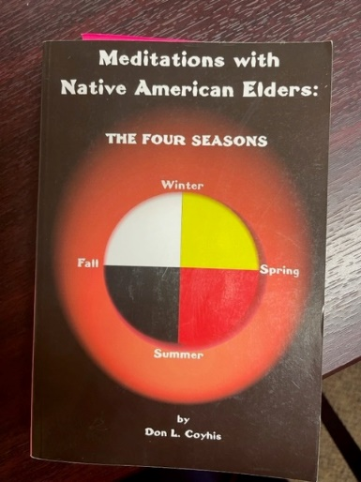
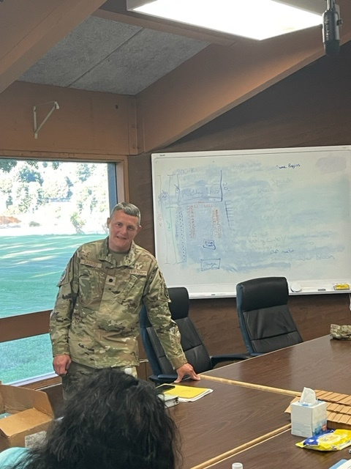
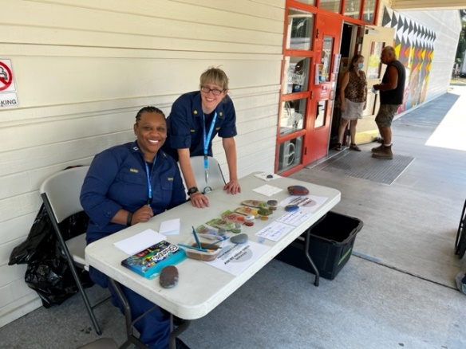
Behavioral Health
Notes:
The first picture are two of the BH providers participating in a weekend wellness clinic where they provided services through creative means (rock painting) – folding the connection with nature that the tribe valued with clinical interventions. The second picture is the culturally sensitive curriculum utilized for the intensive outpatient group therapy. The 3rd picture is National Guard chaplain who is providing grief education during a community tribal event held at the tribe’s community center.

Slide 15
Behavioral Health
Personnel: Clinical Licensed Social Workers (3), Psychiatric Nurse Practitioner (1), Chaplain (1)
IRT capabilities
Services: facilitated group therapy sessions, mental health consultation, patient assessment, wellness education, substance abuse information, psychosocial education, community outreach; Force health protection for SMs
Deployment agility:
1st Behavioral Health Mission to Hoopa Valley IRT, established trust within the community by showcasing professional expertise and skillset; faced and navigated an emotionally charged climate
Community impact:
Adjunct staff allowed for clinic staff to focus to attend other duties; performed 4 outreach events: Diabetes Day, Sovereign Day, Community Center Opioid Education and Community Canvasing; Established rapport leading to continual request for BH services
Notes:
This was our BH.
Capabilities
Services: facilitated group therapy sessions, mental health consultation, patient assessment, wellness education, substance abuse information, psychosocial education on stress management, grief and loss as well as community outreach events; they also served as Force health protection for SMs during the IRT
Deployment agility:
This was the first time in the history of the Hoopa Valley IRT where BH providers were incorporated. This meant that the community and clinic leaders were learning about their capabilities and expertise. The community was hesitant, but the team knew they had to built that trust and showcase their professional expertise and skillset in a cultural competency way. Initially, the team was given general tasks that could have been provided by professionals with more limited credentials, however the team quickly built rapport with the participants. By week two, the BH team were regularly consulted by staff, performed new patient assessments, and were regular facilitators for group therapy. The Hoopa Valley Tribe share some common themes with many native tribes to include a strong connection to family and tribe, understanding of illness and mental health issues through a prism of spiritual and environmental connection, inter-independence, reticence to seek Western mental health treatment, and a high rate of substance abuse, overdoses, inter-generational trauma, and socio-economical challenges. At the time of the mission the tribe was experiencing multiple deaths from overdoses and there was a cumulative experience of grief and loss. The team faced and navigated an emotionally charged climate, but they were able to tailored services to reflect the needs of the community to include education on administering Naloxone during a suspected overdose, wellness education, and therapeutic art. They provided a presentation and training through the tribal community center on opioid abuse, overdose reversal training, and grief reaction
Community Impact
Being adjunct staff allowed the clinic staff to prioritized other duties, the clinic staff were able spent time connecting clients to community resources and services. They were able to re-connect with clients that had stopped participating in the program and brought them back to clinic. The team performed 4 outreach events: Diabetes day, Sovereign day, the Community Center Opioid Education and Community Canvasing, however, the biggest accomplishment the team had was the establishment of trust and rapport with the community leading for additional BH requests in future missions with expanded scope in services.

Slide 16
Joint Community Engagements
Diabetes Day
Sovereign’s Day Community Health Fair
Served population living with Diabetes Mellitus
Offered a day of multi-services via patient passports
Eye & foot exams, medication review, nutrition, medical provider stations
Lesson learned
Communication, event operations and processes, team skillset
Served the local population
Offered Medical, Diabetes, and BH services
Leadership opportunities with shift leads
Engagement
Community event outside the clinic environment
Priority for Hoopa Valley stakeholder
Notes:
Joint Community Engagements. You have heard us mention Diabetes Day and the Sovereign’s Day Community Health Fair. We wanted to highlight these two events because our team did a phenomenal job of coming together and meeting the mission
Diabetes day was resurrected after a decade-long hiatus, this event integrated every aspect of the annual patient check-up into one comprehensive day-long event for patients living with diabetes. The diabetes department wanted to host this event, during one of pre-planning meeting one of our SM suggested using a patient passport, an interactive card that a patient would receive upon check-in that would serve multiple purposes 1. it laid out the services offered during this visit 2. it kept patients accountable to rotate through each station 3. it served as a communication tool for staff to see what services the patient needed to complete. Each patient went through 5 stations: eye exam, foot exam, medication review, medical provider, and nutrition counseling. Upon completing their journey, participants earned the opportunity to enter a raffle for a chance to win health-centric prizes such as fitness gear and cooking utensils. Operationally, this was an excited opportunities for the SMs, we had to plan, coordinate resources, assigned roles, perform group briefings and rehearsals. As the event progressed, we encountered problems that we did not expect and problemed solved as a team. Three main problems that surfaced was communication with patient flow, we put our heads together on the fly and ended up using radios that the Kimaw security team let us borrow, the other two problems we encounters were choke points with medical provider visits and foot exams, we noticed our pharmacist was being under utilized at the beginning of the event and was being used as a standby resource, after a couple of hours we incorporated her to perform medication reconciliations for the medical providers which improved flow.
We also noticed that our podiatrist was having a back log, so we reassessed our personnel and found that one of the dietitians was certified to perform diabetic foot exams, so we pivoted. We decreased nutrition counseling from three stations to two and reassigned LCDR McBride. Overall, the event was successful, it was not perfect, but the team gained valuable experience about medical operations and team problem solving.
The Diabetes Day Event was an expected deliverable that the IRT team knew about during the entire planning process. The Sovereigns' Day Community Health Fair was not.
Sovereign’s Day is a very important day for the members of the Hoopa Valley Tribe. In 1988, President Reagan signed a treaty dividing the Hupa and Yurok (Your-rock) reservations. This treaty officially recognized the Hupa territory as a Sovereign land. This allows the Hoopa tribe authority to govern themselves within their land.
Originally, the medical clinic department heads felt strongly that the IRT team experience Sovereign’s Day and were gave us the day off. This was a surprise. The IRT team were a little confused at first because in IRTs our SM mind-set is that we are there to work and see patients everyday. However, instead of taking the day off if we could participate in the event by having various health booths. What better way to experience their Sovereign than by being fully emerged. The nursing manager hesitated and informed us that the booths had all been reserved and we would have to network with different departments to share space. Well, we went to work and quickly networked all over the medical clinic and divided up the teams. We gather tables, chairs, tents and made it happen.
Medical Tent offered blood pressure readings, blood sugar checks and general health counseling, we disturbed reading glasses through a local no cost program, The diabetes tent offered education with foot exams, nutrition and pharmacy counseling, behavioral health tent offered wellness education and community resources. In Medical Tent we sought out more leadership opportunities by scheduling shift leads with roles and responsibility for accountability, data keeping, and personnel management
This unexpected deliverable had a pleasant ending and allowed for quick thinking, and networking- the three booths increased access of services, it allowed us to reach an audience outside of the medical clinic, it increased visibility of our services. And lastly, we showed our community stakeholders that we were willing to actively participate and share in their celebration. The Sovereign’s Day event was a great way to close the IRT.

Slide 17
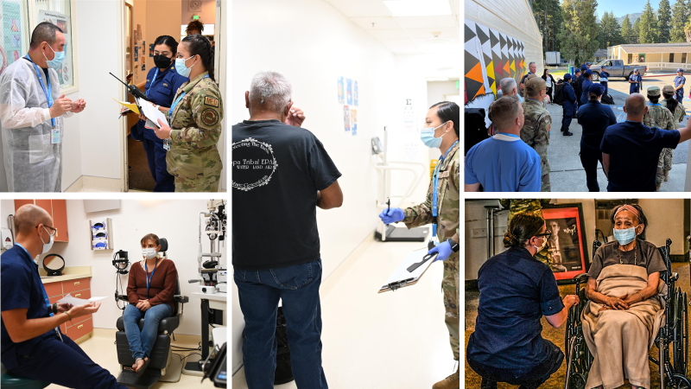
Diabetes Day

Slide 18
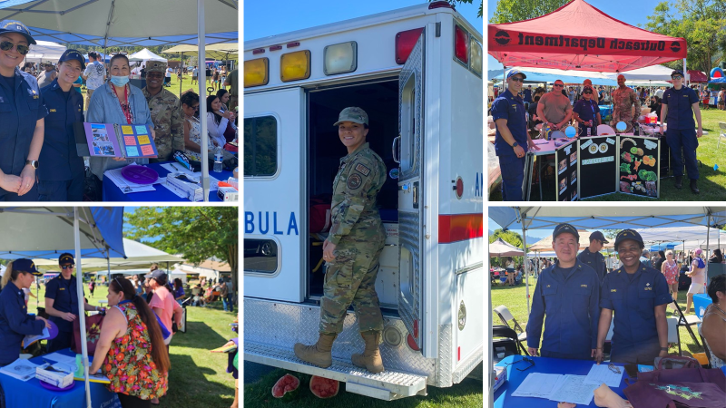
Sovereign’s Day Community Health Fair

Slide 19
Training
Medic X
Tactical Combat Casualty Care
Air Force Surgeon General initiative
Equips all medical personnel with foundational skills to elevate patient care, readiness and casualty management.
Enables collaborative responses during manpower shortages and enhances survival in challenging scenarios
Review different services such as Nursing, Physical Therapy
Coupled with Tactical Combat Casualty Care
Evidence-based course with the focus of teaching life-saving techniques and strategies for providing the best trauma care on the battlefield.
Training ended with a culminating event to showcase skills learned throughout the course.
Offered two types of TCCC courses
Medical Provider, Combat Lifesaver
Air Force National Guard satisfied required training
USPHS offered unique training opportunity

Slide 20
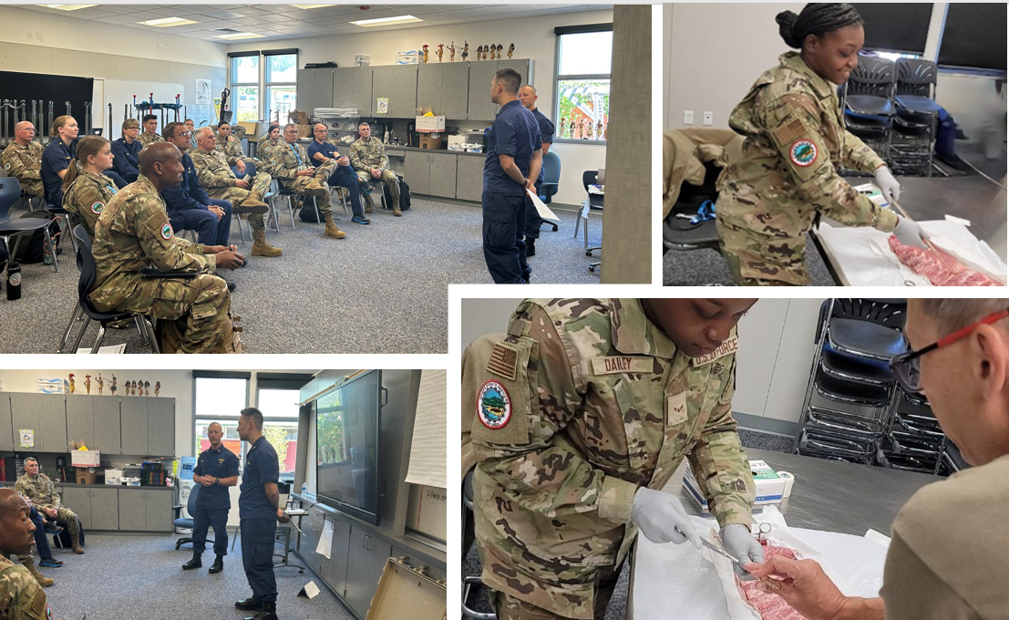
Medic X Training

Slide 21
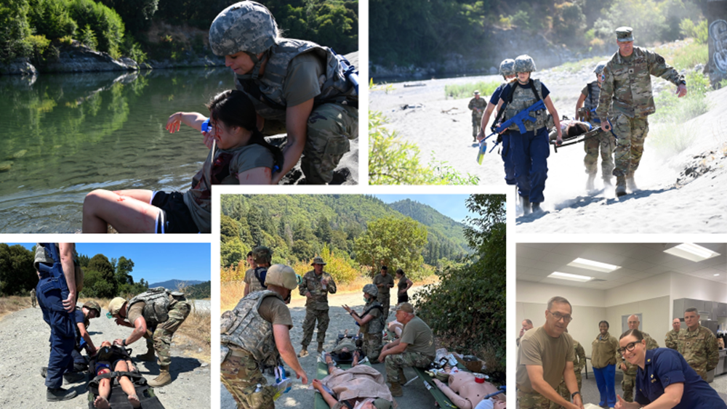
Tactical Combat Casualty Care

Slide 22
Conclusion
IRT is a Department of Defense military training that delivers joint training opportunities to increase deployment readiness
Joint IRT missions afford opportunities to teach and learn each service best practice as well as strengthens inter-service collaboration
The Hoopa Valley IRT Mission afforded servicemembers hands-on clinical, leadership and logistical training in a control environment
The Hoopa Valley IRT team increased the population’s access to care and offered a wider breath of healthcare services with a multi-discipline clinical team and community outreach events
Trauma and tactical care courses focused on life-saving measures in an emergency as well as cross trained troops in medical care as a force multiplier
Overall, the administrative deliverables, clinical operations, patient care, community engagement events, operation planning, logistics needs, and after-action reviews created real-life training increasing in the deployment agility of the Hoopa Valley IRT team

Slide 23
Thank You!
AMSUS Team
Senior Advisors
LTC Jeffrey Chambers
LTC Rashida Fambro
LCDR Mirabelle Adamu
LCDR Kindel Kaelke
LCDR Heather Light
LCDR Rachel McBride
LCDR Stetson Schmitt
LCDR Erica Stoll
CPT Miya Black
LT Danielle Eustace
CAPT David Lau
CDR Rovigel Gelviro

Slide 24
Questions

Slide 25
HOW TO CLAIM CE CREDIT
If you would like to receive continuing education credit for this activity.
Please visit:
amsus.cds.affinityced.com

