Slide 1
AI-Powered Healthcare: Addressing the Transformative Challenges of Today and Anticipating Tomorrow
Anita Samuel PhD, Joshua Duncan MD, Vincent Capaldi II MD, Justin Peacock MD
Uniformed Services University of Health Sciences
Notes:
Title Slide Design

Slide 2
DISCLOSURE
Anita Samuel PhD, Joshua Duncan MD, Vincent Capaldi III MD, Justin Peacock PhD have no relevant financial or non-financial interests to disclose.
This continuing education activity is managed and accredited by AffinityCE, in collaboration with AMSUS. AffinityCE and AMSUS staff, as well as planners and reviewers, have no relevant financial interests to disclose. AffinityCE adheres to the ACCME’s Standards for Integrity and Independence in Accredited Continuing Education. Any individuals in a position to control the content of a CME activity, including faculty, planners, reviewers, or others, are required to disclose all relevant financial relationships with ineligible entities (commercial interests). All relevant conflicts of interest have been mitigated prior to the commencement of the activity.
Commercial support was not provided for this activity.

Slide 3
SESSION OBJECTIVES
Describe Artificial Intelligence
Identify two artificial intelligence tools that can be used in practice
Explain two personal contexts where artificial intelligence can be used in practice

Slide 4
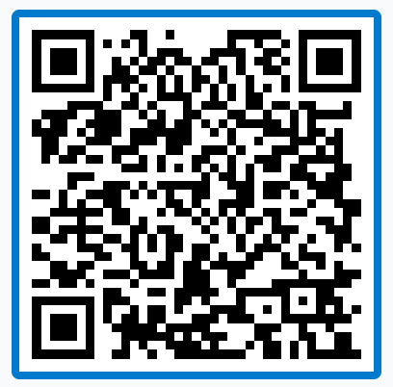
JOIN THE CONVERSATION
Post questions you have for the panelists. We will address them as we progress through the session.

Slide 5
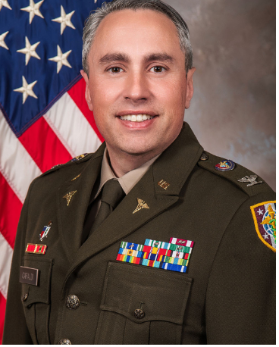
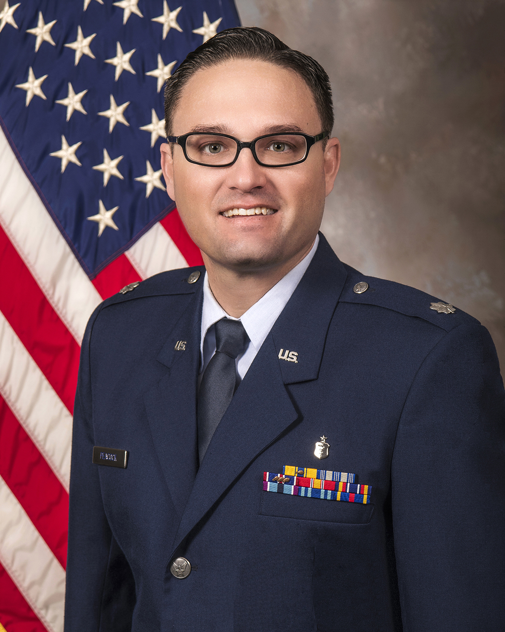
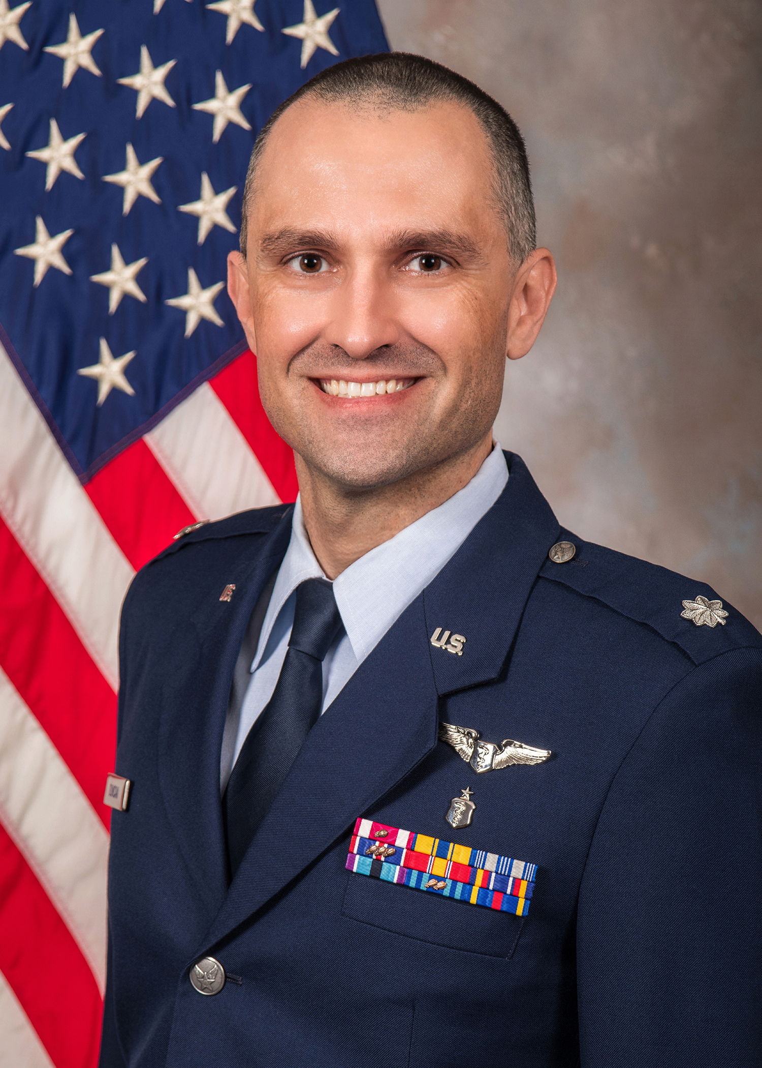
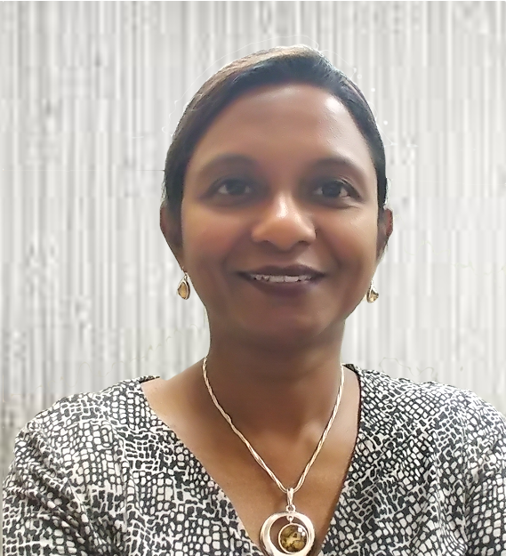
INTRODUCTIONS
COL Vincent F. Capaldi, II, SCM, MD
LtCol Justin G. Peacock, MD, PhD
Lt Col (Dr.) Joshua Duncan
Anita Samuel, PhD

Slide 6
What is Artificial Intelligence in healthcare?
Notes:
Each of you come from very distinct specialties. Within your contexts, what do you see as AI?
- using AI ML identifiying individuals at high rish for suicide - strategically assign care for them
- Ambient dictation – clinical decision from semi structured data – give recommendations

Slide 7
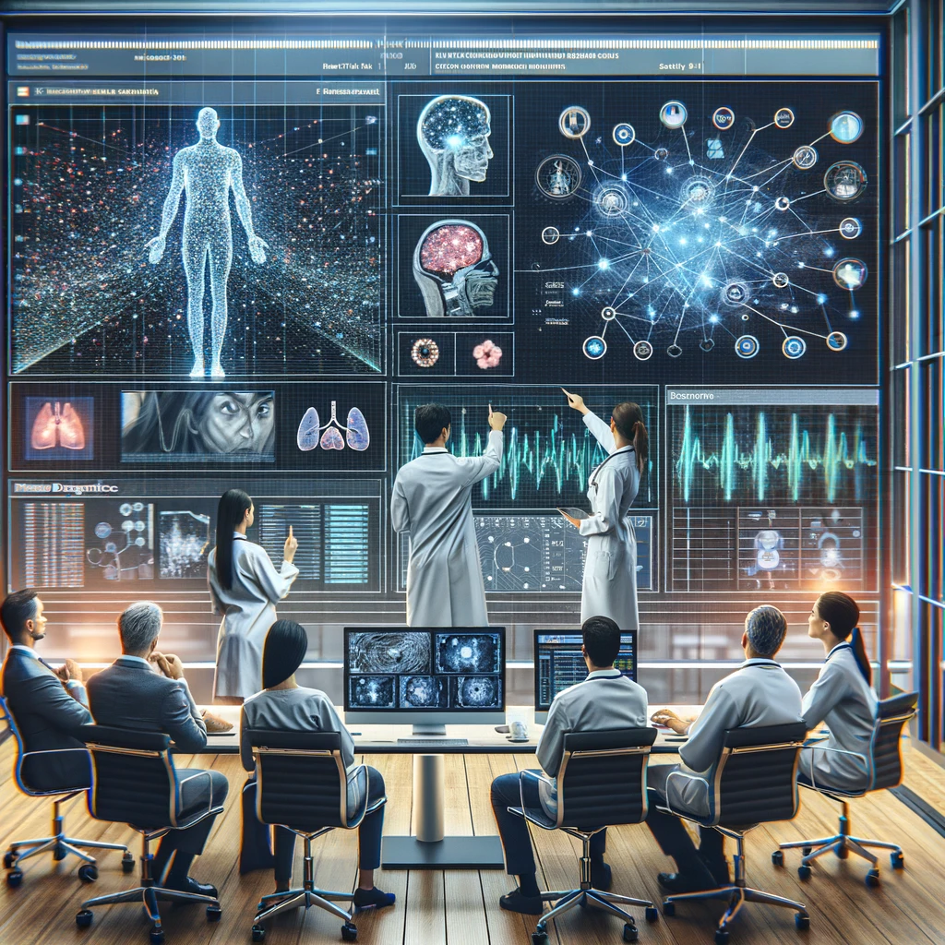
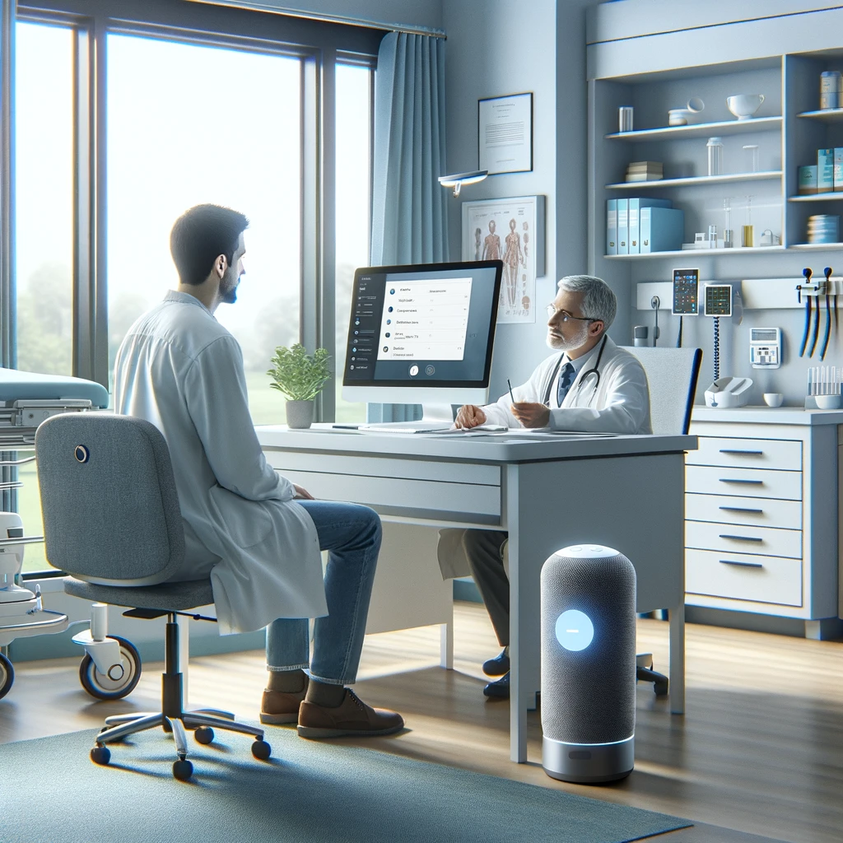
AI-Driven Healthcare

Slide 8
AI-Driven Dictation
https://www.nuance.com/healthcare/diagnostics-solutions/precision-imaging-network.html
Notes:
Current Dictation software (Nuance PowerScribe highlighted here) will boost efficiency through workflow prioritation, proactive notifications, AI-enhanced findings, improved reports, reduction in duplicative imaging, more information for informed clinical decisions, AI-assisted diagnoses and impressions, and improved cost-control analytics.

Slide 9
Report Guideline Integration
https://www.acr.org/Clinical-Resources/ACR-Appropriateness-Criteria
Notes:
RadPartners Inc has developed a suite of clinical AI tools into their reading platform. One builds on the incorporation of the appropriateness criteria in reports: examples AAA, thyroid nodules, pulm nodules

Slide 10
Computer-Aided Detection (CAD)
Saenz Rios F, Movva G, Movva H, Nguyen QD. Cureus. 2020 Dec 19;12(12):e12177.
Notes:
After the Food and Drug Administration (FDA) approved computer-aided detection (CAD) for mammography in 1998, and Centers for Medicare and Medicaid Services (CMS) provided increased payment in 2002, CAD technology disseminated rapidly. Despite sparse evidence that CAD improves accuracy of mammographic interpretations, and costs over $400 million dollars a year, CAD is currently used for the majority of screening mammograms in the U.S.
Results
Screening performance was not improved with computer-aided detection on any metric assessed. Mammography sensitivity was 85.3% (95% confidence interval [CI]=83.6–86.9) with and 87.3% (95% CI 84.5–89.7) without computer-aided detection. Specificity was 91.6% (95% CI=91.0–92.2) with and 91.4% (95% CI=90.6–92.0) without computer-aided detection. There was no difference in cancer detection rate (4.1/1000 women screened with and without computer-aided detection). Computer-aided detection did not improve intra-radiologist performance. Sensitivity was significantly decreased for mammograms interpreted with versus without computer-aided detection in the subset of radiologists who interpreted both with and without computer-aided detection (OR 0.53, 95%CI=0.29–0.97).
Conclusions and Relevance
CAD does not improve diagnostic accuracy of mammography and may result in missed cancers. These results suggest that insurers pay more for computer-aided detection with no established benefit to women.
It may also lead to increased biopsies

Slide 11
What are the most promising AI-driven solutions / tools that are being used in healthcare today?
Notes:
- Psychiatry – LLM synthesize fact sheets / recommendations
- FDA approved
-

Slide 12
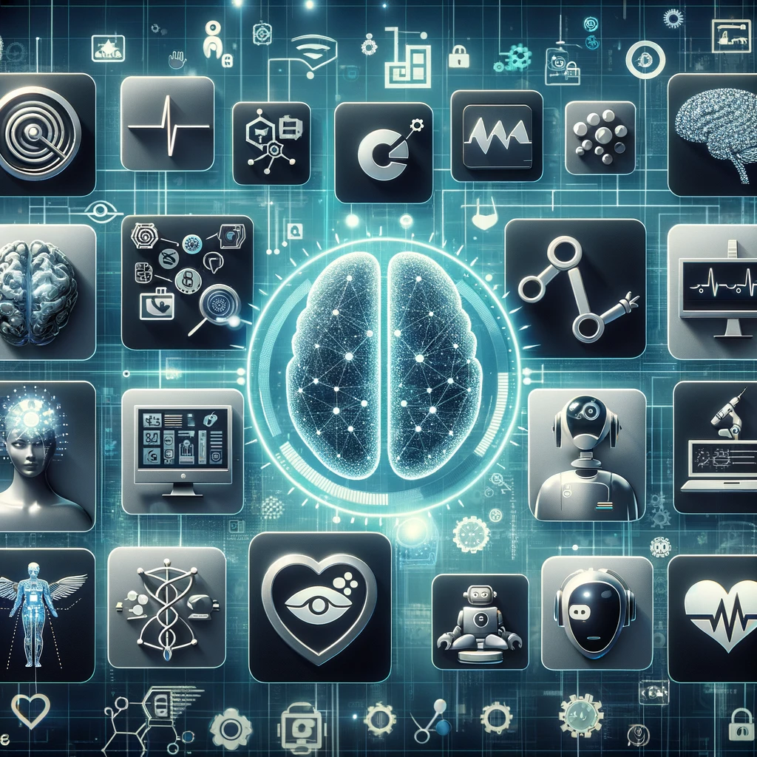
AI Tools

Slide 13
Potential for AI in Radiology
Hosny A, Parmar C, Quackenbush J, Schwartz LH, Aerts HJWL. Artificial intelligence in radiology. Nat Rev Cancer. 2018 Aug;18(8):500-510.

Slide 14
Reducing Dose
Singh R, Wu W, Wang G, Kalra MK. Artificial intelligence in image reconstruction: The change is here. Phys Med. 2020 Nov;79:113-125.

Slide 15
Lesion Detection & Characterization
Liu JA, Yang IY, Tsai EB. Artificial Intelligence (AI) for Lung Nodules, From the AJR Special Series on AI Applications. AJR Am J Roentgenol. 2022 Nov;219(5):703-712.

Slide 16
Organ/Tumor Segmentation
Yousefirizi F, Jha AK, Brosch-Lenz J, Saboury B, Rahmim A. Toward High-Throughput Artificial Intelligence-Based Segmentation in Oncological PET Imaging. PET Clin. 2021 Oct;16(4):577-596.

Slide 17
What are the ethical and legal considerations that need to be addressed as AI becomes more widespread in healthcare?
Notes:
As we talk about the potential of AI, the immediate concerns are ethical. From your perspectives, what are some considerations we need to consider within healthcare?
And what are your personal thoughts on these concerns?
Given these concerns, How can healthcare organizations adopt AI in a way that is ethical and responsible?
Vince – personal data breach
Josh – bias/discrimination – eg
Justin – consistency of responses
- impact on traditional learning
- informed consent / transparency
- accountability / responsibility

Slide 18
What are the challenges that are being faced in the adoption of AI in healthcare?
Notes:
We just discussed the ethical implications.
Beyond that, what are some challenges you see in the adoption of AI?
What can organizations do to address this?
Josh – regulatory challenges
Justin.- unsupervised learning
- MHS – we need to collaborate with outside entities
Vince – data security
- risk of skill fade
- how to ask the right question
-

Slide 19
Personal Experiences
I need to develop a simulation case scenario for fourth-year medical students that assesses their ethical responsibility to self and others, which is one of the AAMC core competencies for medical students. The competency is defined as “Behaves in an honest and ethical manner; cultivates personal and academic integrity; adheres to ethical principles and follows rules and procedures; resists peer pressure to engage in unethical behavior and encourages others to behave in honest and ethical ways; develops and demonstrates ethical and moral reasoning”
Please help develop a case scenario that would effectively assess fourth-year medical students in this core competency.
Help me create an interesting email announcement for Dr. B, who will provide interesting insights into the impact that healthcare and education leaders can have in ushering AI technologies in their organizations.
The title of the presentation is “AI in healthcare: Leadership
concerns and considerations” Please come prepared with questions for Dr. B about AI policy and leadership.
Notes:
We can’t end a session on AI without mentioning LLMs like ChatGPT.
On a lighter and broader note, do you have some AI tools that you’ve used and found helpful.
Can you share how you’ve used them.
Josh - Differentiated / personalized education for patients
Vince –
Justin – admin examples
- letters of recommendation
-

Slide 20
Closing Words
What excites you about AI?
What scares you?
What is 1 key takeaway we should walk out with?
Notes:
As we leave this session, what is 1 key takeaway we should walk out with?
What excites you about AI? What scares you?

