Slide 1
Who’s Data is Right?
Dr. Brian Lein
Notes:
Welcome to the new DHA PowerPoint template. Each slide contains helpful information for making the entire presentation user-friendly and accessible to people of all abilities. **Disclaimer** Additional remediation is required after you add content to this template to ensure 508 compliance.
Please note: if your presentation is being presented online, the PowerPoint file must be converted and remediated as a PDF.
A NOTE ABOUT CONTROL MARKINGS: Once you determine if your presentation needs security markings, please delete the irrelevant marking and re-center the box. This marking should be in the top center of each slide. To put it in the same place ever time, simply copy (Ctrl + C) from one slide and paste (Ctrl + V) on the next slide. There is no need to position a cursor to have it paste in the correct location.

Slide 2
Data for DHA
Workload-What is an FTE?
Access
Quality
Outcomes
MHS G optimization
Human Capital Management
Implications for AI/ML
Patient monitors

Slide 3
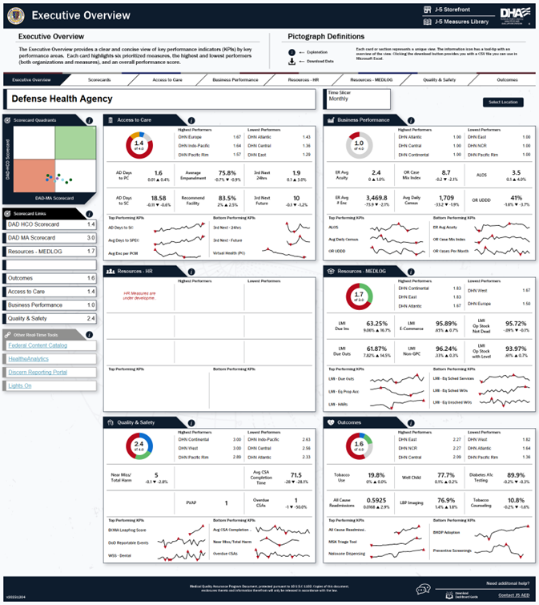
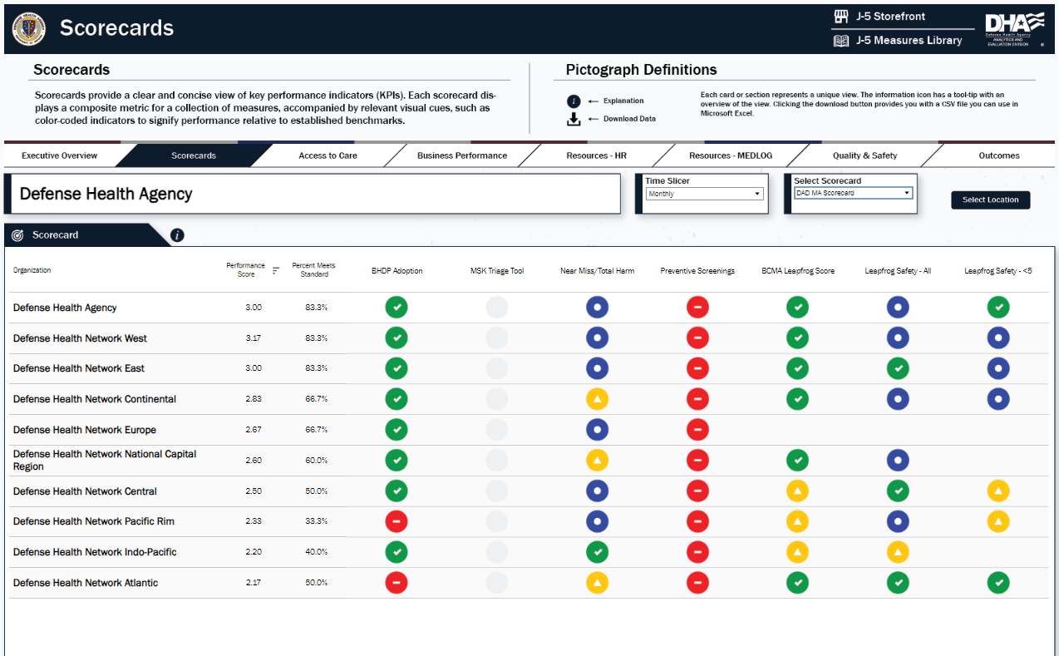
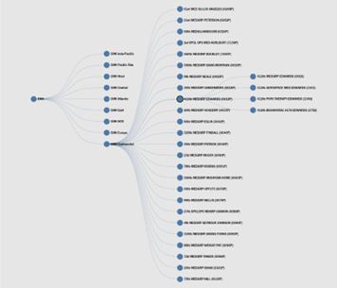
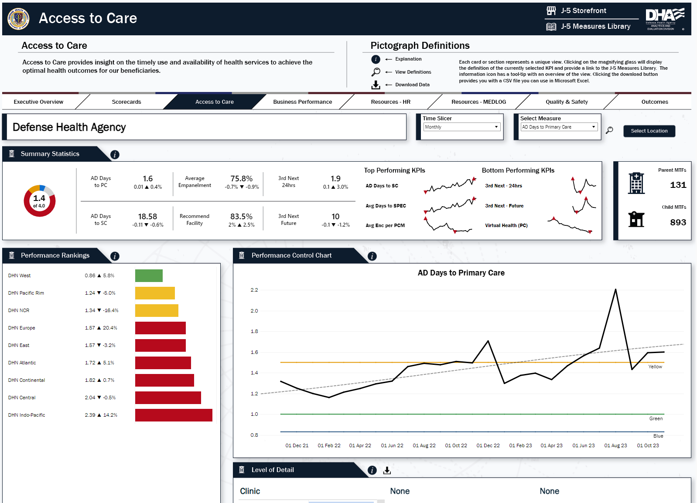
Dashboard Data
Domain-Based KPIs
Available to all Levels
Scorecards & Analytic Tools

Slide 4
Dashboard Data

Slide 5
Dr. Brian Lein Assistant Director,
Health Care Administration
Phone: (703) 681-8433
E-mail: brian.c.lein.civ@health.mil
Follow DHA on Social Media
Twitter: https://twitter.com/DoD_DHA
LinkedIn: https://www.linkedin.com/company/defense-health-agency
Facebook: https://www.facebook.com/DefenseHealthAgency
Website: https://www.health.mil/About-MHS/OASDHA/Defense-Health-Agency
Notes:
Remember to set the reading order “backwards” so the content on each slide is read aloud by assistive technology in the correct order. Select the Home tab, then Arrange and open the Selection pane. Re-order items using the arrows at the bottom of the pane.
Arrange the content on a slide in reverse order (backward from top to bottom) so they are read in the correct order (top to bottom) by assistive technology.
Select the Home tab, then select Arrange.
Open the Selection pane.
Order the content from bottom to top.
Close the Selection and Visibility pane.
Perform a last-minute check of your presentation using the built-in PowerPoint accessibility tool. Remember that the built-in accessibility check should be used only as a convenience tool for locating potential problem areas in the document. It does not scan the document for compliance with all Section 508 standards and should not be used as a replacement for DHA guidance on creating accessible documents.

Slide 6
Questions
Notes:
Remember to set the reading order “backwards” so the content on each slide is read aloud by assistive technology in the correct order. Select the Home tab, then Arrange and open the Selection pane. Re-order items using the arrows at the bottom of the pane.
Arrange the content on a slide in reverse order (backward from top to bottom) so they are read in the correct order (top to bottom) by assistive technology.
Select the Home tab, then select Arrange.
Open the Selection pane.
Order the content from bottom to top.
Close the Selection and Visibility pane.
Perform a last-minute check of your presentation using the built-in PowerPoint accessibility tool. Remember that the built-in accessibility check should be used only as a convenience tool for locating potential problem areas in the document. It does not scan the document for compliance with all Section 508 standards and should not be used as a replacement for DHA guidance on creating accessible documents.

