Slide 1
The Myths of Menopause A mystery no more: Let’s talk menopause with our patients
Deb Friesen MD, MBA, FACP
Farzaneh (Fazi) Sabi, MD
Kaiser Permanente
Notes:
Lead speaker: Kristi – Opening Statement

Slide 2
Notes:
Dr. Friesen and Dr. Sabi to introduce the topic

Slide 3
Presentation Flow
Psychological Safety
Creating a safe space in the room
E.g. ‘say menopause three times out loud’ – how does that feel?
Normalize feelings/different experiences
Why are we talking about it here?
Why it matters to you?
Why should you listen?
Stigma About Menopause
Checking with ADP on strategies they think would work best based on their workplace culture
Agenda Overview
What is menopause? (Title slide from NCAL preso)
History
Jen Gunter – NCAL; Menopause Manifesto
Talk about menopause from a biological/medical/psychological/how it affects the workplace?
Break out symptoms - causes other than aging?
Unusual and A-typical symptoms
Brain Fog
Incontinence
Libido
Weight Gain (redistribution of weight gain)
Sleep
Military readiness
How do symptoms impact how one shows up at work
Interventions (dispelling myths, or fact/fiction)
Treatment Options
Vaginal Estrogen
Estrogen/Progesterone
Over the Counter
Over $800 per year on symptom relief
Over the counter/debunking natural remedies
Non-hormonal treatment
Testing (talking point)
When does it make sense?
Cost of testing/treatment
Bloating/Abdominal Pain
Lack of libido
Incontinence
Non-proven remedies - helping people stay away from them
Over $800 per year on symptom relief
Over the counter/debunking natural remedies
Focus on Equity:
Impacts everyone differently
Differences in coverage/access
Caregiving as a barrier to caring for oneself
Wrap Up
2

Slide 4
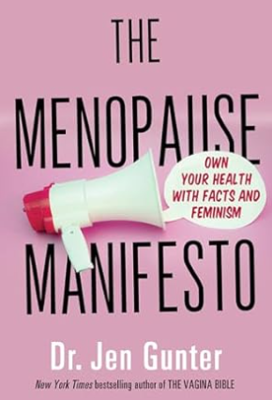
The Manifesto
2
Notes:
Share a little background on Dr. Gunter and her book
Slide to create psychologically safe space
Audience: ADP and clinicians

Slide 5
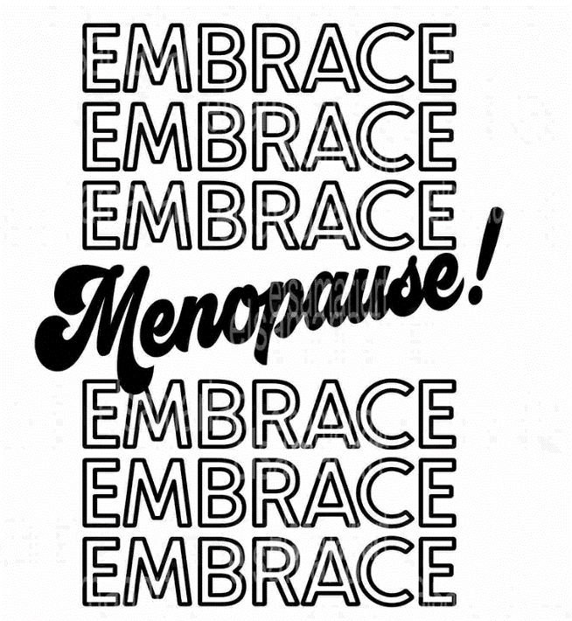
Not Your Mother’s Menopause… Our generation is finally talking about menopause…
We are finally talking about menopause
Oprah Winfrey: “I thought I was going to die every night.” Around the time that she experienced menopause, Winfrey explained that she began to feel listless and unable to focus long enough to read, a symptom that Winfrey says caused her to end Oprah's Book Club.
Abby Wambach: “It is so wild to me that many of us will experience symptoms of menopause that can dramatically affect our life for up to 20 years but so few of us know about what is happening to us, and what we can do to improve our quality of life.”
Michelle Obama: "There is not a lot of conversation about menopause. I'm going through it, and I know all of my friends are going through it. And the information is sparse.“
Notes:
Audience: Both

Slide 6
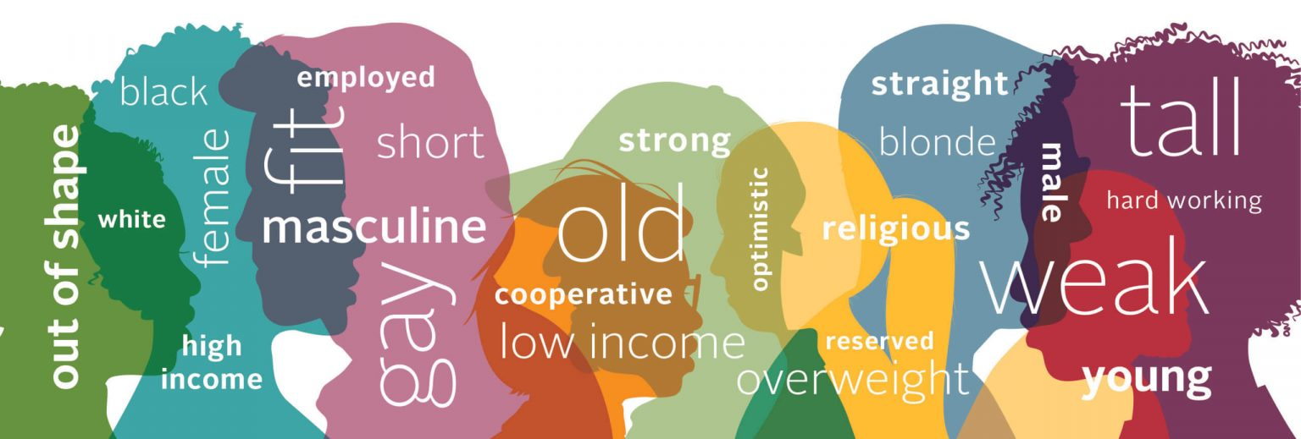
Psychological Safety
Notes:
Audience: Both

Slide 7
Why it matters
Menopausal symptoms may affect roughly 25% of the US working population at any given time*
*Source: https://www.cnn.com/2023/08/22/success/menopause-symptoms-at-work/index.html
Graphic Source: The Evernow 2021 Menopause Study; Collected over 40,000 women
Notes:
Audience: Both

Slide 8
Why it matters continued…
11% of people experiencing menopause miss work due to symptoms
This contributes to global productivity losses due to menopause of $150 billion a year.
One in 10 women quit their job altogether due to menopause symptoms, shortening the career span of many employees in leadership positions.
(source)
Notes:
Audience: Both
Possibly speakers notes for clinician presentation

Slide 9
Agenda
How do we define the symptoms?
Interventions: Understanding fact from fiction
Equity in Menopause
Addressing stigma around menopause
Notes:
Audience: Both

Slide 10
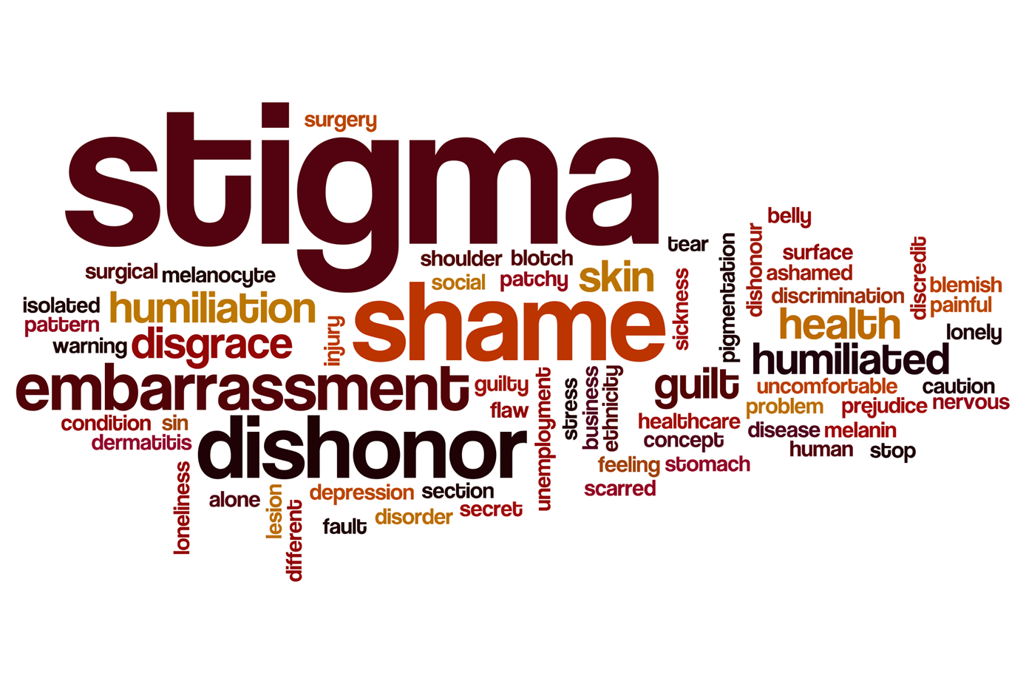
Why is menopause stigmatized?
Notes:
Audience: Both
It has been stigmatized in the past because it's so tied to aging. You know, the mean age of menopause in the United States is 52.
It's also a mysterious women's event and just like menstrual cycles, and puberty and all of that sort of thing. You know, pregnancy, childbirth, lactation, it's been one of those things. It's not as talked about, but I think it's doubly so for menopause because it's tied to aging as well.
If you look up Google images of menopause, you see harried hot, sweaty, angry women. And you know, that's not the reality for most of us, but it does have a negative stigma. Menopause is ubiquitous, so why is it often stigmatized and ignored? | PBS News Weekend
Although it affects about half of the world’s population, ageism and sexism are contributing to a veil of silence around menopause that runs the risk of leaving some women feeling excluded and alone. The silence surrounding menopause is putting women’s lives at risk - The Health Policy Partnership
It also happens to overlap exactly with the age at which employees are most likely to be qualified to advance into top leadership positions — and the authors’ new research shows that people experiencing menopause are often judged as less leader-like, thus creating yet another barrier that holds women back in the workplace.
when women talk openly about going through menopause, it can reduce this bias, helping them to come across as having high leadership potential regardless of menopausal status. Research: Workplace Stigma Around Menopause Is Real (hbr.org)

Slide 11
Notes:
Audience: Both – could we change the jacket color?
Menopause happens to overlap exactly with the age at which employees are most likely to be qualified to advance into top leadership positions — and the authors’ new research shows that people experiencing menopause are often judged as less leader-like, thus creating yet another barrier that holds women back in the workplace.
Actions workplaces can take to address/decrease the stigma
managers must normalize the open discussion of menopause (since many women are afraid to mention such a stigmatized topic at work), create psychologically safe workplaces that empower everyone to share and ask for support without fear of retribution or discrimination, and proactively ensure that all employees feel supported — not silenced — as they progress through the phases of their careers and lives. Research: Workplace Stigma Around Menopause Is Real (hbr.org)
Menopause at work—An organisation‐based case study
https://www.ncbi.nlm.nih.gov/pmc/articles/PMC10721947/
Menopause typically occurs in the midlife period between the ages of 45 and 55 years (NHS England, 2022), with the average age of women reaching menopause in the United Kingdom by 51–52 year though women can experience menopausal symptoms outside this timeframe, with 1 in 100 women experiencing menopausal symptoms before the age of 40 (NHS England, 2022; NICE, 2022). Menopause is perceived to be a natural transition in a woman's life which includes three stages, perimenopause, menopause and post‐menopause; this transition can start up to 5 years prior to the last menstruation and is completed after 12 months without menstruation (Royal Collage of Nursing, 2020). Schaedel and Ryder (2022) report that while menopause is a natural part of ageing affecting 50% of the population, this fact is not reflected in society or our healthcare systems; and consequently, menopause is a neglected life event. Furthermore, Office for National Statistic (2021) reported the median age of death for UK women is 85.8 years, which will mean a significant majority of women will live their life in the postmenopausal phase. The lack of teaching on menopause in schools and minimal education for healthcare professionals has only exacerbated this issue contributing to the lack of knowledge and its negative impact on attitudes and perceptions in women's health (Aljumah et al., 2023).
The global population is ageing and living longer (World Health Organisation (WHO), 2007) meaning people are working and employed longer. UK working women aged over 45 form the fastest growing workforce and Office for National Statistic (2021) estimated by mid‐2019 there would be over 7 million women aged 45–60 working and working one third of their lives with menopause (Lobo & Gompel, 2022). Noticeably, women adopt more roles in the caring professions like nursing, teaching, and care work (Devine & Foley, 2020). In the United Kingdom, it is reported that 89.3% registered nurses are female and 10.7%; male, with this higher percentage of female working past the age of 45 years and likely to experience to impact of menopause in the workplace (Royal Collage of Nursing, 2020). Consequently, understanding the health related to the menopause transition should be a focus for all global women health strategies.

Slide 12
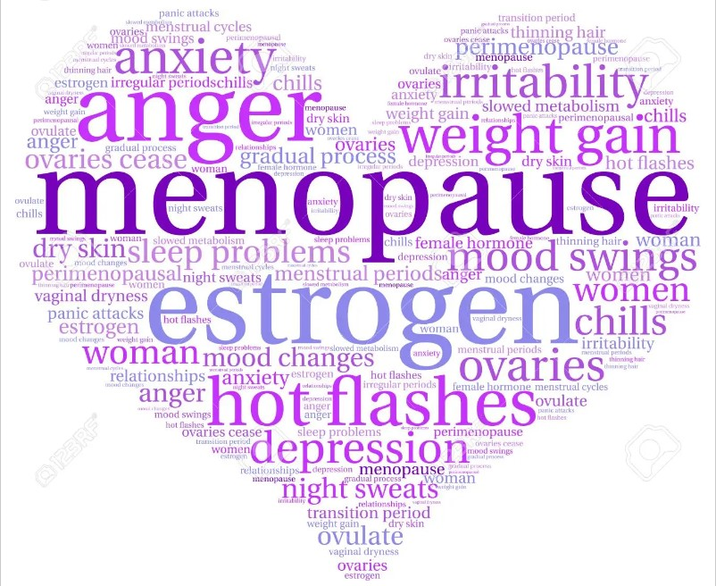
How do we define symptoms?
Notes:
Individualized Care -

Slide 13
Menopause 101…
When am I in menopause?
12 months of no menstrual period
Occurs when ovaries are removed or biologically stop producing estrogen and progesterone or as a result of treatment side effects
Average age 51-52 years old
What is Perimenopause?
The beginning of physiologic changes (menstrual cycle changes, symptoms that can be mild or severe)
On average – begins 4 years before menopause
How long does it last? 2 years to 7 years
Should we test my hormones? Rarely helpful for symptom management
Notes:
Audience: Both
Average 51- we know AA women →2 years earlier ;
POF – AA women 3 x more likely
2 to 7 years: longer in some ethnic groups – Black and Hispanic women may be closer to 10 years of symptoms
Hormone testing:
Common and reasonable question
- r/o POF in 40 yo who or posthyst to know status
We don’t test hormones in teens/puberty
→ Menopause is a normal biological transition into post-reproductive living; may come at inconvenient time

Slide 14
What are the common symptoms of menopause?
Menstrual cycle irregularities similar to when you were a teenager
Hot flashes, night sweats, difficulty sleeping
Irritability, anxiety, depression, fuzzy thinking
Difficulty losing weight, “spare tire” around the middle
Dry vagina, painful sex, leaky bladder, joint pain, dry skin/eyes, thinning hair
Notes:
Audience: ADP
Menstrual cycle irregularities for those with a uterus: Mirror image; cycles closer together (every 21-26 days, bleeding > 8 days, heavy and crampy)
irregular ovulation is the cause – sometimes ovary releases two eggs in a month, sometimes fails to ovulate > hormone imbalance
Estrogen = lubricating hormone
Bottom line:
No two women experience the same menopause- no one approach to managing symptoms works for everyone
Next several slides – going to review the symptoms and what you can do about them

Slide 15
Interventions:
Understanding Fact from Fiction
Lifestyle Modifications
Stress Reduction
Healthy Eating
Exercise
Sleep
Over the Counter
Herbs
Acupuncture
Nonhormal
Pharmaceuticals
Prescriptions
Systemic Hormones
Vaginal Hormones
SSRI’s
Notes:
Personalized Treatment Goals:
Preservation of quality of life now and into the future
Audience: Both – make larger
Interventions/Treatments

Slide 16
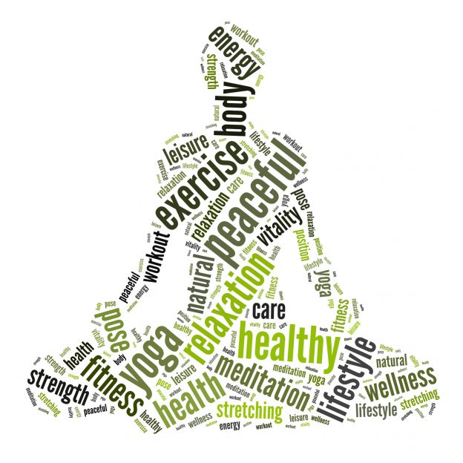
Healthy eating
Less refined carbs and processed foods and more real foods including rainbow foods
Less sugar, less animal fats
Sleep Hygiene
Reduce screen time, scheduled sleep time, make the bedroom where you sleep
Exercise
Do what you can and what you enjoy!
Make a schedule, commit to it; turn into social support opportunity
High intensity interval training to develop lean muscle mass> more efficient calorie burn
Regular exercise can help you sleep better>> Exercise may be more important than sleep!
Stress reduction
Cortisol levels increase 20% in menopausal women
>increases insulin->> too much insulin>> converted to abdominal fat “visceral fat”
What lowers cortisol? (meditation, dance, reading, art, connection)
Lifestyle modifications
Notes:
Audience: Both
Find some studies that we can use on this slide?

Slide 17
Hormone therapy: pendulum swing
2002: Women’s Health Initiative Study >impact on prescribing
2013: New conclusions that hormones safe when used in low-risk women ages 50-59 years
2020: The Women’s Health Initiative trials of menopausal hormone therapy: lessons learned
2023 Options:
Low dose birth control pills
Estrogen: systemic: pill/patch vs local: vaginal cream/pill/ring
Progesterone: to protect the uterus- pill, IUD
Notes:
Audience: Both
The Women's Health Initiative trials of menopausal hormone therapy: lessons learned - PubMed (nih.gov)
Objective: The Women's Health Initiative (WHI) assessed oral conjugated equine estrogens (CEE) taken with or without medroxyprogesterone acetate (MPA) for prevention of chronic disease in postmenopausal women aged 50-79 years.
Methods: Women with an intact uterus (n = 16,608) were randomized to CEE+ MPA therapy or placebo for a median of 5.6 years; women with hysterectomy (n = 10,739) were randomized to CEE-alone therapy or placebo for a median of 7.2 years. Both cohorts have been followed for 18 years.
Results: In the overall study population (mean age, 63 y), neither estrogen-progestin therapy (EPT) nor estrogen-only therapy prevented coronary heart disease or led to a favorable balance of chronic-disease benefits and risks. Subgroup analyses, however, suggest that timing of hormone therapy (HT) initiation influences the relation between HT and coronary risk, as well as its overall benefit-risk balance, with more favorable effects in women who are younger (age < 60 year) or recently menopausal (within 10 year) than in women who are older or further past the menopausal transition. In younger women who entered the trial of estrogen-only therapy with oophorectomy, the intervention was associated with a significant 32% reduction in all-cause mortality over long-term follow-up.
Conclusions: WHI findings indicate important differences in HT-related clinical outcomes by age and time since menopause. Systemic HT has an acceptable safety profile for menopause management when initiated among healthy women who are younger (or recently menopausal) and not at elevated risk for cardiovascular disease or breast cancer. Initiation of treatment in older women who are distant from menopause onset, however, should be avoided. Other HT formulations and routes of delivery warrant further study.(WHI clinicaltrials.gov identifier: NCT00000611).
I’m old enough to remember as a resident…
2002: WHI – stopped mid study due to observed increased incidence of blood clots, heart disease, breast cancer
Average age 63 – already higher risk
Reexamined 2013- for patients with symptoms – hormones considered much safer in women 50-59
Birth control pills likely safe in most low risk women up to age 55 yo (perimenopause)
Systemic vs vaginal estrogen
Bioidentical – Includes FDA approved meds but generally refers to class of meds largely developed after WHI results came out, not FDA approved, come in creams, capsules, dissolvable troches, injectables : not any safer than any traditional hormones,
ACOG/NAMS – do not support the use of these unregulated hormones

Slide 18
Hormone Therapy (HT) in low-risk 50–59-year-old women
Benefits
Most effective treatment for hot flashes/night sweats
Prevent osteoporosis, type 2 diabetes, colon cancer, and may reduce heart disease
Unable to prove: prevention of dementia
Risks
Blood clots, stroke, heart disease: 3-5/1000 over 5 years (*less with patch form of estrogen)
Breast cancer: slight increase after 5 years
Uterine cancer: rare – higher if progestin not used
Side effects:
Irregular bleeding, breast tenderness, headaches. Weight not impacted by HT
Goal: Use the lowest dose for the shortest duration and revisit the benefits/risks every 1-2 years with your clinician; controversy over whether safe to continue after age 65yo
Notes:
Audience: ADP – talking points for AMSUS
Nod to – lucrative area for pharmaceutical companies will work on – as physicians we need to ensure that is safe before we prescribe it
Viosa discussion – alternative for treating hot flashes
What qualifies as low risk? Cannot have the following:
Unexplained vaginal bleeding
Liver disease
h/o VTE/Stroke/MI/prior CHD or known blood clotting disorder or thrombophilia
Personal h/o breast and other estrogen dependent cancer
Known hypersensitivity to hormone therapy
Risks/benefits:
3 more women/1000 over 5 years may develop blood clots/stroke/breast cancer and actually hormones
Benefits: reduced rates of adult onset diabetes, osteoporosis, may even have preventive impact on heart disease if started early in menopause
“ low dose” short period of time
** Not for everyone: Experience with hormonal birth control predictive

Slide 19
Non-Pharmacological Treatment Options
Notes:
Audience: Both
Benign vs. harmful
Herbs and supplements (black cohosh, bee pollen for hot flashes, melatonin/valerian for sleep)
Progesterone creams
Non-Pharmacologic Treatment: ( most with either little or no evidence-supporting therapy, but relatively risk free)
Avoiding triggers (hot drinks, heavy blankets, stress)
Mind-body approaches
Mindfulness, Yoga
Triggers: reasonable to try
Herbs/supplements aka “phytoestrogens” (eg black cohosh– found in soy, lentils, chick peas – not very many studies, - done in small numbers, for 2-3 months at at time and there is little evidence that they work any better than placebo
Breast cancer survivors often ask: I do not recommend for this indication
(though use in moderation in diet is OK)

Slide 20
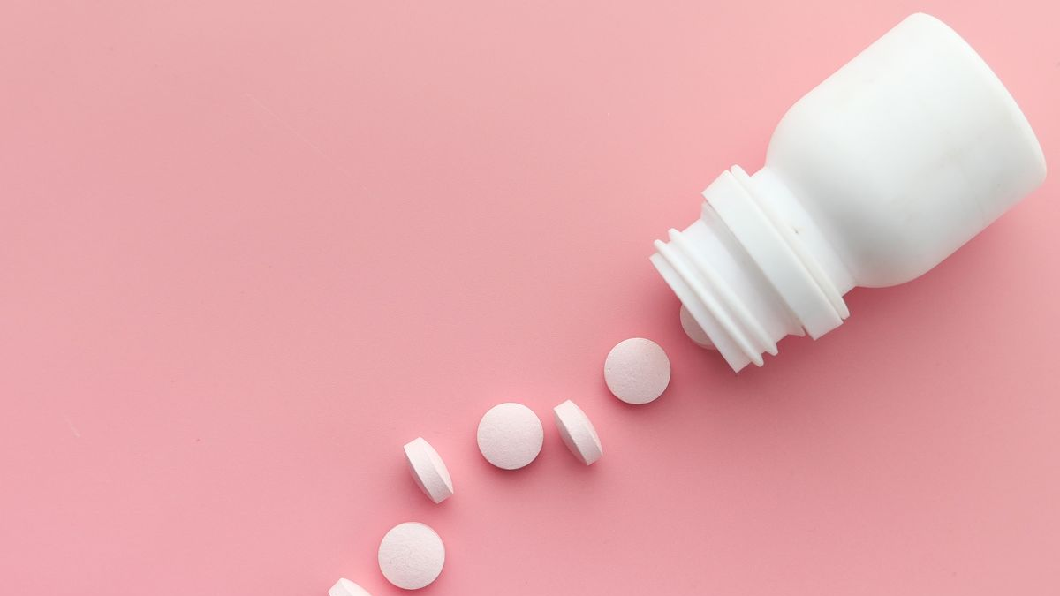
Nonhormonal Prescription Medications
Notes:
Audience: Both
SSRI’s/SNRI’s – used for depression/anxiety such as Celexa, Lexapro, Paxil or Effexor can be effective in low doses. Not recommended when taking tamoxifen
Trazodone – used for depression and sleep. Can cause some residual sleepiness
Clonidine – blood pressure medication patch. Can take 3 months to see full benefit. Side effects can include headache, dizziness, sedation and constipation
When compared to placebo- improve symptoms by 30-50%

Slide 21
The impacts of silence…
21
Notes:
Audience: Both
In some populations – increased risk of Fibroids
Some cultures women are seen as less than if they are no longer able to bare children
The silence surrounding menopause is putting women’s lives at risk - The Health Policy Partnership
Many women are not able to access the treatment they need. A UK survey of more than 5,000 women experiencing menopause or perimenopause found that although 79% visited their GP about menopause symptoms, only 37% were given menopausal hormone therapy. Despite national menopause guidelines clearly stating that antidepressants are not a suitable first-line treatment, 23% of the women were prescribed them instead.
The survey also highlighted significant delays in care, with 44% of the women who received treatment waiting a year or longer, and 12% waiting more than five years. As a result of this waiting time, many women who can afford to pay for healthcare turn to private clinics, contributing to health inequalities.
These challenges are worrying for all women, but they may disproportionately affect those belonging to ethnic minority groups and LGBTQ+ communities. These individuals have reported having negative experiences when seeking appropriate care and feeling under-represented in the research and narratives surrounding menopause.
[2:46 PM] Deb Friesen
The Menopause Research Equity Act would require the Director of the National Institutes of Health (NIH) to determine the amount of funding allocated by the NIH for such research over the past five fiscal years and to submit a report with their findings and a strategic plan to address the identified gaps in knowledge ...
Let's Talk Menopause
Advocacy-home
This Privacy Policy is meant to help you understand what information we collect. Our Site may use cookies, pixel tags, Local Shared Objects and more

Slide 22
Gender equity and diversity drive better business performance
Businesses that invest in gender equality and more equitable health policies in the workplace achieve:¹
• Reduced absenteeism
• Greater job satisfaction and employee engagement
• Better financial performance
Companies with above-average diversity on their management teams report innovation revenue 19 percentage points higher than that of companies with less diverse leadership.²
1. Martin and Gammelgård, OpenGlobalRights, December 10, 2020. 2. ”How Diverse Leadership Teams Boost Innovation,” BCG, January 23, 2018.
Notes:
Audience: Both
“Innovation revenue” is revenue from products and services launched in the past 3 years.
A diverse management team can help reshape a company’s innovation efforts in areas like fair employment practices, such as equal pay; participative leadership, with different views being heard and valued; a strategic emphasis on diversity led by the CEO; frequent and open communication; and a culture of openness to new ideas.

Slide 23
Call to Action
Notes:
Audience: Both
Generate questions/plant in the audience – Michelle S. and Aric to ask questions
Have the conversation
Not everything that women go through between 45-59 is menopause
If you see someone suffering
Can’t use a cookie cutter approach to menopause
Treat every patient uniquely

Slide 24
Questions
2
Notes:
Audience: Both

Slide 25
Helpful References/Resources
Creating a Menopause Friendly Workplace: Employer’s Resource:
Creating A Menopause Friendly Workplace | Equity
Let’s Talk Menopause
Let's Talk Menopause
Menopause, STATPEARLS
Menopause - StatPearls - NCBI Bookshelf (nih.gov)
Menopause and work: A narrative literature review about menopause, work and health
Menopause and work: A narrative literature review about menopause, work and health - PMC (nih.gov)
Menopause at work – An organization-based case study
https://www.ncbi.nlm.nih.gov/pmc/articles/PMC10721947/
Menopause is ubiquitous, so why is it often stigmatized and ignored?
Menopause is ubiquitous, so why is it often stigmatized and ignored? | PBS News Weekend
Research: Workplace Stigma Around Menopause Is Real
Research: Workplace Stigma Around Menopause Is Real (hbr.org)
Study Shows Staggering Cost of Menopause for Women in the Work Force
https://www.nytimes.com/2023/04/28/well/live/menopause-symptoms-work-women.html
The Silence surrounding menopause is putting women’s lives at risk
The silence surrounding menopause is putting women’s lives at risk - The Health Policy Partnership
The Women's Health Initiative trials of menopausal hormone therapy: lessons learned
https://pubmed.ncbi.nlm.nih.gov/32345788/
"They see me as mentally ill": the stigmatization experiences of Chinese menopausal women in the family
"They see me as mentally ill": the stigmatization experiences of Chinese menopausal women in the family - PMC (nih.gov)
Women Have Been Misled About Menopause
Menopause is ubiquitous, so why is it often stigmatized and ignored? | PBS News Weekend
26
Notes:
Audience: Both

