Slide 1
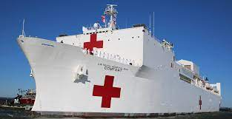
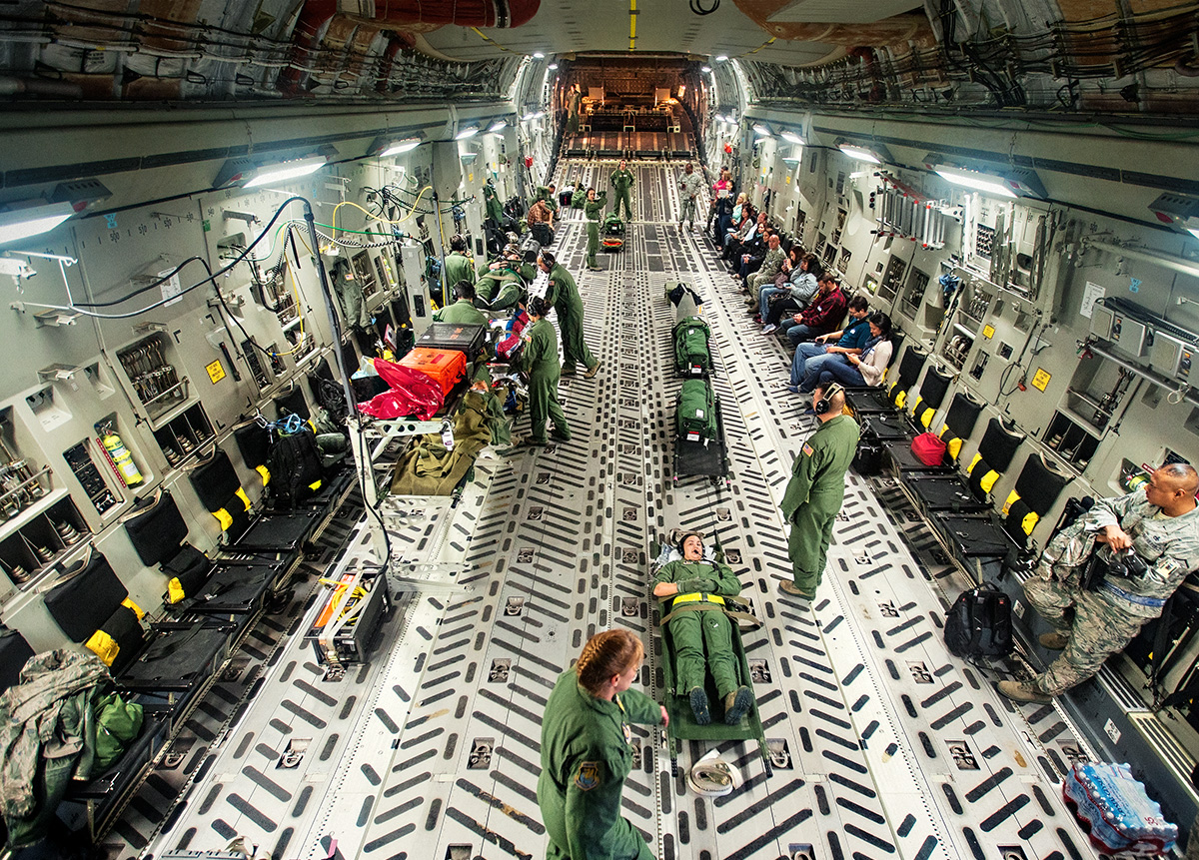
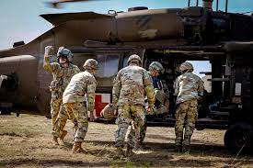
Joint Military Medical Estimate: Today’s Risk; Tomorrow’s Challenge
John R. Andrus, MD, MPH
Brig Gen, USAF, MC, CFS
Joint Staff Surgeon
UNCLASSIFIED

Slide 2
Desired Learning Outcomes
At the conclusion of this activity, participants will be able to:
Describe the Military Health System risk areas identified in the Joint Medical Estimate
Understand the joint process to elevate medical risk areas
Appreciate the Military Health System from a system perspective
Articulate the unity of effort needed to become better prepared to support warfighting

Slide 3
Learning Questions
What is the Joint Medical Estimate?
How does the Joint Medical Estimate influence resourcing?
Which to prioritize: readiness or healthcare delivery?
What should I expect from leaders in the Military Health System?

Slide 4
Joint Strategic Planning System
CJCSI 3100.E Joint Strategic Planning System (JSPS)
Joint Force Readiness Review
Readiness Report to Congress
Readiness Assessment
CCMD Assessment Review & IPLs
Annual Joint Assessment
Strategy
Congress
Briefings and engagements
Chairman’s Risk Assessment
National
Military
Strategy
JME
Chairman’s Program Recommendation
Defense Planning Guidance
Legend
Joint Medical Estimate
JSPS Products
JSPS Products with
JME Inputs
JME Inputs
JME Outputs
Joint Staff Independent Risk Assessment
(JSIRA)
Capability Gap Assessment
Joint Warfighting Concept
DoD Component and DHP Program Objective Memoranda

Slide 5
Joint Medical Estimate
Signed 21 December 2023
Health Service Capability Area Assessments
Ready Medical Force Generation
Patient Management
Patient Movement
Occupational & Environmental Health
Medical Logistics
Medical Mission Command
Global Health Engagement
Risk Assessment
Consequence
Probability

Slide 6
Joint Medical Estimate
Themes
Readiness
MTF Workforce Challenges
Patient Reception in CONUS
Patient Movement
Medical Logistics
Operational Medical Information Technology
Blood Availability
Emerging Biothreats
Risk Mitigation Activities
Integrated CONUS Medical Operations Planning
Capability Portfolio Management Reviews (MedLog, Patient Movement)
Scenario Based Analysis – Operational Medicine
Lifesaving Battlefield Response
Early Intervention
Rapid hemorrhage control
Early blood administration

Slide 7
The U.S. Military Health System

Slide 8
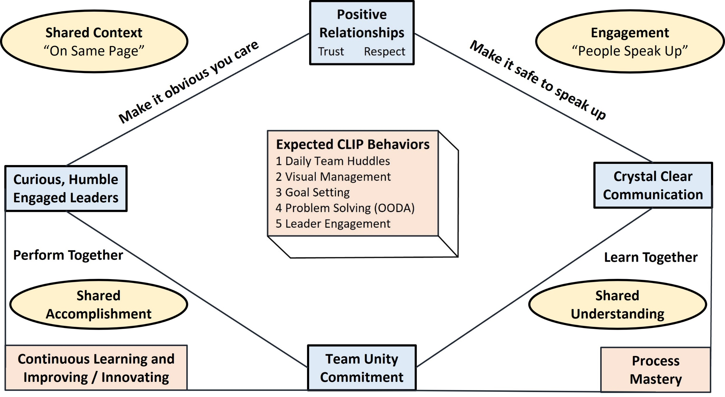
Leadership Matters

Slide 9
Discussion Questions
How do we better operate together in the system called the Military Health System?
How do we understand risk as we combine skills with Allies and Partners?
Are we capable of and committed to mitigating identified risk?
How well are we creating innovative future concepts as we mitigate risk?
If you would like to receive continuing education credit for this activity, please visit: amsus.cds.affinityced.com

