Slide 1
Sanitätsdienst
The Bundeswehr Medical Service
AMSUS
The Society of Federal Health Professionals
February 13, 2024
Brigadier General Dr. Meyer

Slide 2
Structure – German Armed Forces
Federal Ministry of Defence
Bundeswehr
Armed Forces
Services
Army
Air Force
Parliamentary army with legal separation between armed forces and Bundeswehr administration
Navy
Joint Medical Service
German Joint Support and Enabling Service
Cyber and Information Domain
Notes:
Before diving deeper into the structure of the medical service, here we have a brief overview about the overall structure of the Bundeswehr.
Our armed forces are mandated by the parliament. Hence, it is the government that decides on the deployment of the armed forces. It also decides on the personnel and material equipment.
To be clear, the armed forces and the Federal Defence Administration are strictly separated from each other by the constitution - for better or for worse.
So we see the military organisational areas here as part of the armed forces. And as part of the administration, we see three civilian organisational areas.
For sake of completeness - on the right side are units that are directly subordinate to our Inspector General.
I will now focus on the Joint Medical Service, which is highlighted here in red.

Slide 3
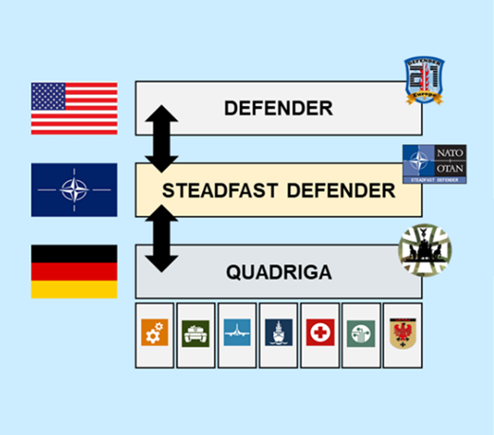
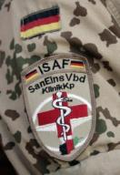
Current Structure Development
increase readiness
Division 2025
based on:
National/Collective Defence
structure 2020
based on
International Crisis Management
Capability Profile 2020
UNCLASSIFIED

Slide 4
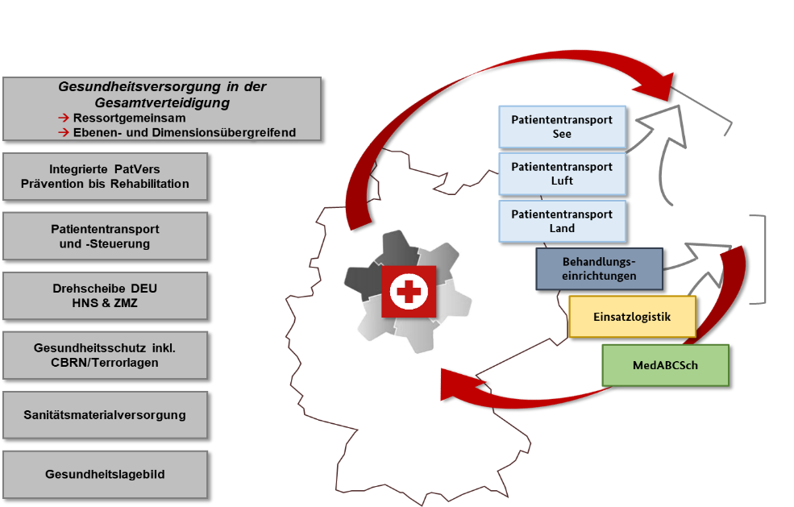
Health Care Mission and space at a glance
Health care in overall defence
→ Interministerial
→ Across levels and domains
Maritime medical evacuation
Integrated patient care
From prevention to rehabilitation
Aeromedical evacuation
Patient evacuation and patient flow management
Ground medical evacuation
Medical treatment facilities
Germany as a hub
HNS & Civil-military cooperation
Bundeswehr Joint Medical Service Logistics
Health protection incl. CBRN threat/terror situations
CBRN medical defence
Medical logistics
+ International Crisis Management
& disaster relief
+
ICM & disaster assistance
Health Situation Picture

Slide 5
Sanitätsdienst
The Bundeswehr Medical Service
AMSUS
The Society of Federal Health Professionals
February 13, 2024
Brigadier General Dr. Meyer

