Slide 1
Data Modeling to Support Suicide Prevention: The Atlas Project
13 February 2024
2024 AMSUS Annual Meeting

Slide 2
Key Takeaways
Suicide Prevention begins with Research
Bridging synthetic data to real-world data – game changer in suicide prevention
Practitioner-led screening algorithms enhance clinical practice guidelines

Slide 3
Dr. Vicki Hart, Director of Epidemiology & Biostatistics
Career Highlights
Award-winning Researcher and Professor
15 years of experience in evidence-based health research and education
Leader in public health, study design, protocol development, and analysis
Expertise in analysis of complex data, including electronic health records
Research content areas include substance abuse, cancer, reproductive health, and health behaviors
Adjunct faculty at the University of Vermont Larner College of Medicine

Slide 4
Research methods …. help and hinder our understanding of suicide risk
Five broad risk factor categories in suicidal thoughts and behavior (STB) research
Demographics
Internalizing Symptoms
Externalizing Symptoms
Social Factors
Prior STBs
Increasingly homogenous
Limited predictive ability
Franklin JC, Ribeiro JD, Fox KR, Bentley KH, Kleiman EM, Huang X, et al. Risk factors for suicidal thoughts and behaviors: A meta-analysis of 50 years of research. Psychol Bull. 2017. Feb;143(2):187–232. doi: 10.1037/bul0000084

Slide 5
Research methods …. help and hinder our understanding of suicide risk
STB risk is dynamic
Risk factors and vulnerability may change over time
Risk and mitigating factors may combine and interact
Risk factors at baseline may not predict STB outcomes at later time periods
Long-term outcomes do not capture periods of acute risk
Hypothesis-driven research may be limiting advancement
Exploratory methods are needed

Slide 6
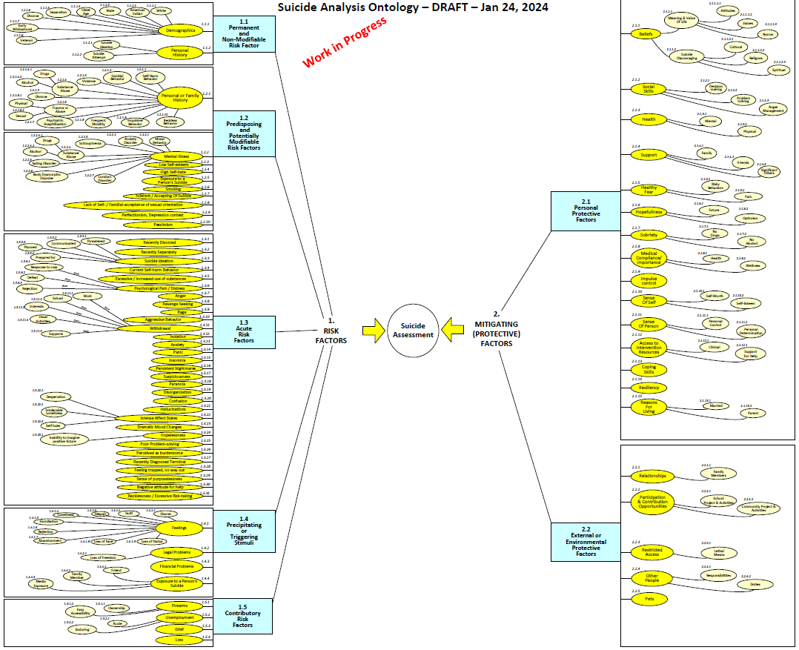
Research methods …. adapt to advance understanding

Slide 7
Research methods …. adapt to advance understanding
Machine learning to create suicide risk scores (Kessler, JAMA 2015)
Data abstracted from multiple systems (sociodemographic, US Army career, criminal justice, and medical or pharmacy)
Evaluated cross-validated linear, nonlinear, and interactive predictive associations
52.9% of suicides occurred in top 5% of risk score
Data lying dormant in medical and administrative records
Predictive ability of machine learning (Nock, JAMA 2022)
Clinician prediction + EHR data + Patient self report
Clinician prediction: AUC = 0.67
EHR data: AUC = 0.71
Self report + EHR + Clinician: AUC = 0.77
Kessler RC, Warner CH, Ivany C, et al. Predicting Suicides After Psychiatric Hospitalization in US Army Soldiers: The Army Study to Assess Risk and Resilience in Servicemembers (Army STARRS). JAMA Psychiatry. 2015;72(1):49–57. doi:10.1001/jamapsychiatry.2014.1754
Nock MK, Millner AJ, Ross EL, et al. Prediction of Suicide Attempts Using Clinician Assessment, Patient Self-report, and Electronic Health Records. JAMA Netw Open. 2022;5(1):e2144373. doi:10.1001/jamanetworkopen.2021.44373

Slide 8
The Atlas Project
Synthesize complex combinations and interactions of risk and mitigating factors
Multiple diverse data sources
Updated dynamically as new data are available
Data-driven outputs
Large datasets required to “train” and validate models
Provide clinicians with dynamically informed data on risk
An informative tool designed to be used with clinical input
Bridge the knowledge-practice gap
Tie prediction to prevention

Slide 9
Mr. Juan Odenwood, Computer Scientist and Researcher
Career Highlights
Developed Worldwide Military Command and Control System (WWMCCS) Data Models and Analytics
11+ years Computational Physics and Data Analytics, Los Alamos National Lab
3+ decades active experience in AI, ML & Data Analytics
Areas of Expertise: ontologies, AI / ML, advanced mathematical analytics, command & control, adaptive planning

Slide 10
Data Science Management / Synthetic Data Generation
Our Approach Combines
Data Engineering & Management
Provides:
Data Collection
Extraction, Transformation
Load into Repository
Data Structures supporting Analytics
with Data Science & Analytics
Provides:
Machine Learning / AI
Data Mining
NLP for Text-based sources
Unstructured to Structured Data
Exploratory Data Analytics
Manages Data
Manages Analytics

Slide 11
Data Science Management Platform
1.
DATA ENGINEERING
Data Collection, ETL, Dynamic Ingestion,
(via Semantic Ontology),
Curation,
Provenance,
Catalogs,
Data Storage
Repository / Warehouse
2.
DATA ANALYTICS
Feature Extraction,
Data Behavior,
NLP / AI,
Analysis Tool Suite,
Machine Learning
Algorithm Suite,
Process Management
Tools
3.
SUPPORTING
INFRASTRUCTURE
Resource Management,
Services,
Identity, Credential
&
Access
Management
-ICAM-
Configuration
User Interface
Clinician
User Interface
Privileged Access
User Interface

Slide 12
Data Science Algorithm & Model Examples
Regression methods
Instance-based Learning models
Regularization
Decision Trees
Bayesian modeling
Cluster Analysis
Association Rule learning
Neural Networks
Dimensionality reduction
Ensemble methods
Numerous others

Slide 13
Synthetic Data Generation enables Analytics Progress
Generate Synthetic Data
Support Exploratory Data Analytics
100+ Identified Risk Factors
40+ Mitigating Factors
Wide Variety of Distributions & Correlations between above
Simulate Multiple Data Sources
Disparate Data Elements
Varying Formats
Employ Monte Carlo Methods
Explore Synthesizing non-Suicide Population
Simulate wide variety of factor combinations for Analytics
Permits exploration of possibilities
Upon Receipt of Actual Data
Update synthetic data generators to match actual data
Use Generative Adversarial Networks (GANs)
Supplements Amount of Actual Data
Exploratory Data Analytics
Test Ability to Properly Identify Correlations
Apply Analytics on Synthetic & Actual Data
These Activities Help Explore Applicable Analytics in Preparation of Actual Data Receipt

Slide 14
Dr. Kris Peterson, MD, Colonel, USA (Ret), Clinical Advisor
Career Highlights
Highly distinguished and proven physician, practitioner, military leader, author, and clinical leader for over 30 years.
Colonel, Medical Corps, USA (Ret) Multiple Combat Deployments.
Established centers for treatment of PTSD, Depression and anxiety through novel interventions, Transcranial Magnetic Stimulation (TMS) with Touchstone TMS in Lakewood WA.
AREAS of expertise: TMS treatment, PTSD, Military Families, Novel Mental Health Treatments for PTSD, Depression, and Anxiety disorders, Systems of Mental Health Care.

Slide 15
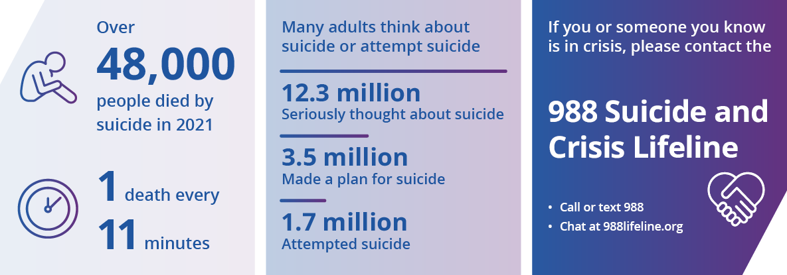
SCOPE of this problem
Notes:
--Public Health Concern of significant Magnitude Over one in every 100 deaths 1.3% is the result of suicide.
Mortality from Suicide: 700,000 deaths per year worldwide
The suicide rate is more than twice as high for men than women, and more than half of all suicide deaths occur before the age of 50.
Those surviving a suicide attempt 33% come to Emergency Department
Suicide and suicidal behavior are a public health concern. Among people surviving a suicide attempt, about one-third come to the emergency department for help [2].

Slide 16
SCOPE: Suicide Clinical Dive
Suicide rates increased approximately 36% between 2000–2021.
In 2021, suicide was among the top 9 leading causes of death for people ages 10-64
Suicide was the second leading cause of death for people ages 10-14 and 20-34.
Suicide rates vary by race/ethnicity, age, and other factors, such as where someone lives
Groups with the highest rates are non-Hispanic American Indian/Alaska Native people followed by non-Hispanic White people.
Higher-than-average rates of suicide are veterans, people who live in rural areas
Notes:
Since 1999 US suicide rates increased about 35% until 2018
Since 1999 US drug overdose death rates increased 350% resulting in 70,000 deaths in 2019
Military suicides up as much as 20% in COVID era 2020

Slide 17
SCOPE: Impact beyond
For Every Suicide Death there are about:
3 hospitalizations for self harm
8 emergency department visits related to suicide
38 self reported suicide attempts in the past year
265 people who seriously considered suicide in the past year
***Source: HCUP National Inpatient Sample (2020)
***Source: CDC WISQARS (2020)
****Source: SAMHSA National Survey on Drug Use and Health (2021)
Notes:
Among people surviving a suicide attempt, about one-third come to the emergency department for help [2].

Slide 18
Clinical View- Assessing for Suicidal Behavior
--Challenge for mental health practice is assessing risk for suicide and providers alone are not much better than chance (why?)
--Data usually taken from self report questionnaire, original history and follow up at appointments. (Accurate? Thorough? Truthful?)
Personal history of suicide attempt is the most significant factor
Severe mental illness
Higher risk or recurrence in years following the first attempt
Out of Survivors subgroups more likely to attempt again-Substance users, Personality disorder and young
--Inpatient helps short term but after discharge from MH services higher risk within 2 weeks

Slide 19
Clinical View- Assessing for Suicidal Behavior
Providers are looking at data/predictor signals looking to form a therapeutic course of action.
Increase monitoring or frequency of visits
Higher level of care/ Inpatient/ Intensive Outpatient
Medication augmentation or change/ rTMS/ Esketamine/Ketamine
Demographics- provider translates internally are they at higher risk? (elderly, male higher likely to complete, female, younger more likely to attempt)
Internalizing Symptoms- what is the personality/ valance of the patient (depressed, perfectionistic, pessimistic how are they presenting)
Externalizing Symptoms (anger, outbursts, impulsive) provider interprets
Prior Self Injurious thought and behavior (what’s the history, do I have collateral data? Are they admitting to this, did they recently purchase a handgun?)
Life Events- how much information did I get in the short time I had (did they share what is really going on?)
Notes:
Suicide risk assessment of these patients is a daily challenge in psychiatric practice. The personal and family history, particularly of suicide attempts, plays a major role in assessing suicide risk. Personal history of suicide attempt is the most significant factor in the risk of death by suicide [2]. Patients with severe mental illness, in particular mood disorder, borderline personality disorder, and anorexia nervosa, are more likely to attempt suicide [3,4]. They are at higher risk of recurrence in the years following the first attempt [5]. Among patients who survived a suicide attempt, a study found that certain subgroups (alcohol consumption, personality disorder, and young age) were also more likely to attempt suicide again, and others were more likely to die by suicide after a first attempt (elderly patients) [6]. In clinical practice, particular attention must also be given to the period of discharge from the care services. The risk appears to be increased within the 2 weeks following discharge from the hospital [2].

Slide 20
Mind of the Clinician
Causal Factor
* Entrapment- how do you measure
Hopelessness- ask the patient, the degree the intensity?
Defeat- How can you assess this?
Depression- Questionnaires can help, self report, chronicity, degree
Previous ideation- Current ideation- Current Plan
Acute Stress- assessing takes time: ED, medication management appointment- how deep can you go to assess
Intoxication-Substance use history how often do we miss
Mitigators
Individualized Safety Planning
Compassionate Care from Providers
Religious affiliation
Mission or purpose
Pregnancy/ Children at home/family
Access to mental health care
Sense of connectedness
Problem-solving skills
Physical health
Employment
Social and emotional well-being
Notes:
All these data points trying to assess
The personal and family history, particularly of suicide attempts, plays a major role in assessing suicide risk. Personal history of suicide attempt is the most significant factor in the risk of death by suicide [2]. Patients with severe mental illness, in particular mood disorder, borderline personality disorder, and anorexia nervosa, are more likely to attempt suicide [3,4]. They are at higher risk of recurrence in the years following the first attempt [5]. Among patients who survived a suicide attempt, a study found that certain subgroups (alcohol consumption, personality disorder, and young age) were also more likely to attempt suicide again, and others were more likely to die by suicide after a first attempt (elderly patients) [6]. In clinical practice, particular attention must also be given to the period of discharge from the care services. The risk appears to be increased within the 2 weeks following discharge from the hospital [2].

Slide 21
Culture and Differences in the meaning of data Military Vs Non/ Methods Involved 2019
Suicide rates vary by race/ethnicity, age, and other factors, such as where someone lives
Groups with the highest rates are non-Hispanic American Indian/Alaska Native people followed by non-Hispanic White people.
Higher-than-average rates of suicide are veterans, people who live in rural areas, occupational differences
Illustrative is firearm use in military to complete suicide
Firearms accounted for 70.2% of male veteran suicides in 2019 (up from 69.6% in 2018) and 49.8% of female suicides up from 41.1% in 2018.
Firearm: non-veteran population 47.9%- male53% female 31.3%
Poisoning: Veteran 8.4% Male7.5% Female26.3% (non-veteran 13.9%, male8.5% female 31%)
Suffocation: Veterans 16.9%, male 16.8%, female 20.5% (non-veteran population 29.6%, male-30.2%, female 27.7%)
Other: Veterans 5.4% Non-veterans: 8.7%
2019 data VA
Notes:
This is illustrative of the different cultural impact; data is different for different groups, cultures etc.

Slide 22
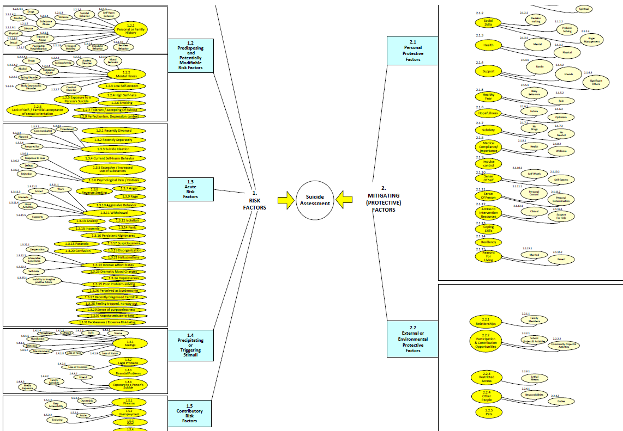
Research methods …. can adapt to build on new knowledge
Machine Learning Methods
Complex combinations and interactions of risk and mitigating factors
Large datasets required to “train” and validate models
Multiple diverse data sources
Notes:
Artificial intelligence (AI) and machine learning (ML) have emerged as ways to improve risk detection [12]. These techniques require a large database (big data) to extract a patient’s profile or significant risk factors [13]. AI platforms can identify patterns in the dataset to generate risk algorithms and determine the effect of risk and protective factors on suicide [9]. AI has already been successfully applied to other medical disciplines (imagery, pathology, dermatology, etc.). In these disciplines, it is already faster than medical experts, with equivalent accuracy, for the diagnosis of certain pathologies. Although the diagnostic accuracy never reaches 100%, this technology combined with the skills of the clinician could greatly improve overall performance [14]. In psychiatry, AI could be used for diagnostic purposes, to support daily patient assessment or drug prescription. Beyond its medical value, AI could show a clear economical benefit [12]. It can improve outcomes. It can satisfy risk
AI Based Suicide Prediction or informing: Infer
Facebook, (analyzes social media content such as words like “Goodbye” Main text classifier “Where are you??” Comment classifier then takes into account time of day, day of week, post type- scores that are ‘high enough’ the case will escalate to Facebook community operations which may result in calling police for a health and welfare. These symptoms are unscientific, no oversite, no standards, (these could be making things worse).
Crisis text line, objective zero, Gaggle (marketed to school districts monitor millions of students; monitor text messages, emails and social activity for signs of harmful interactions and content; total surveylance0, GoGuardian Bark (offers for free)--- all of these are making inferences
If the product is free then you are the product

Slide 23
What Next? Significant Question is if identified then?
Institutional
Increase allocation of resources that address depression, addiction
Increase applications of technology that will extend providers or work proactively
Programs that address prevention
Programs that reduce substance use
Programs that support Servicemembers and Families
Regulation of Firearms
Development of AI related support/outreach
Provider
Refer to crisis services
Reduce barriers to treatment or care
Proactive reaching out
Increasing appointment frequency
Amplify resources that extend providers and are effective in treatment of depression
Identify best treatment protocols to reduce suicidal behavior
Easier access to inpatient care and follow up post inpatient/ additional support
Notes:
We are not predicting but informing or inferring
Important that this is the case (predicting useful in helping the clinician) Very valuable given to the provider
Use as a tool going to get back a list of factors that are associated with this person
ATLAS is an informative tool It is used with a clinical input it is not a predictive, plausible inference.
It is informing TOOL Helping Cutting edge that is informative and helpful.
Needs to be backed by resources and clinical guidelines
Build protocols to address the Atlas generating a high informative inference of suicidal behavior with interventions that make a difference.

Slide 24
FEARS: Unintended Consequences/Ramifications
Report says high risk what do you do with limited resources?
You make your best call on the data and bad outcome- medical legal consequences
Patient is stigmatized as a high risk still a high percent will not harm self.
False Positive ‘oops sorry’
Potential for Involuntary commitment going up- does not necessarily prevent and high risk when discharged
Who is right? AI or clinician? The algorithm or the provider?
Clinician patient relationship may suffer.
Patient feels can no longer trust their provider.
Escalation of patient self injurious behaviors
False reassurance of safety if AI says ok (false negatives)
It is not a prediction it is providing useful data, inferring, categorizing as higher at risk but will others (family, legal) see it that way.
Notes:
AI raises ethical concerns within the medical community [44,45], especially regarding the use of data, the place of the practitioner in care, and ethical and medico-legal responsibility.
Patients’ data already have an important place in the assessment and management of suicidal behavior. Practitioners use patients’ data, such as their personal and familial history, their care history, their socio-demographic, and ethnical characteristics, to evaluate the risk of suicide attempt. AI can optimize the analysis of these data and thus yields a better efficiency. The application of AI to health data will require robust cyber security, as well as a clear legal framework.
AI is complementary to the medical assessment and does not replace it. Optimal performance will probably be reached through the proper use of AI by the physician, with holistic patient care. The doctor–patient relationship will remain essential in patient care. AI could raise a responsibility problem. This question remains unresolved. AI could allow an information gain. The clinicians will have more elements to assess a situation and lead his management. It seems to us that the responsibility will always go to the clinician, once he is informed of the performance and limitations of this technology in precise clinical situations. The physician will then be able to organize personalized care. The medical profession is already proceeding in this way for other technologies used in medicine. Current data suggest an interesting performance of AI in suicide prevention and justify a more precise exploration of this tool.

Slide 25
What is out there now; data mining
Facebook, (analyzes social media content such as words like “Goodbye” Main text classifier “Where are you??” Comment classifier then takes into account time of day, day of week, post type- scores that are ‘high enough’ the case will escalate to Facebook community operations which may result in calling police for a health and welfare. These symptoms are unscientific, no oversite, no standards, (these could be making things worse).
Gaggle (K-12 Online Safety Management software) -marketed to school districts monitor millions of students; text messages, emails and social activity for signs of harmful interactions and content; total surveillance
GoGuardian and Bark (offers for free)--- all of these are making inferences (If the product is free then you are the product)

Slide 26
Wellness checks/ out there now
Initiated by calls from internet platforms
Police can enter homes without a warrant
Detention, involuntary hospitalization potential for restraints and forced medications
Can paradoxically increase suicide risk (two weeks after highest)
Trauma and Stigmatization
Sources of Bias: suicide prediction algorithms
Internet platform employees
First responders
School officials
Health care providers
Algorithmic decision Makers
Notes:
AI Based Suicide Prediction or informing: Infer
Facebook, (analyzes social media content such as words like “Goodbye” Main text classifier “Where are you??” Comment classifier then takes into account time of day, day of week, post type- scores that are ‘high enough’ the case will escalate to Facebook community operations which may result in calling police for a health and welfare. These symptoms are unscientific, no oversite, no standards, (these could be making things worse).
Crisis text line, objective zero, Gaggle (marketed to school districts monitor millions of students; monitor text messages, emails and social activity for signs of harmful interactions and content; total surveylance0, GoGuardian Bark (offers for free)--- all of these are making inferences
If the product is free then you are the product

Slide 27
Conclusions
AI raises ethical concerns within the medical community
The place of the practitioner in care, and ethical and medico-legal responsibility has to be addressed and supported.
Patients/peoples data is used to evaluate the risk of suicide attempt. AI can optimize the analysis of these data and be helpful
AI yields a better efficiency. The application of AI to health data will require robust cyber security, as well as a clear legal framework.
AI is complementary to the medical assessment and does not replace it.
Optimal performance will probably be reached through the proper use of AI by the physician, with holistic patient care.
The doctor–patient relationship will remain essential in patient care.
AI is a tool that will help identify who is at higher risk and a clinician who is enabled with interventions and courses of action that are evidence informed will result in reduction in completed suicide.
Notes:
AI raises ethical concerns within the medical community [44,45], especially regarding the use of data, the place of the practitioner in care, and ethical and medico-legal responsibility.
Patients’ data already have an important place in the assessment and management of suicidal behavior. Practitioners use patients’ data, such as their personal and familial history, their care history, their socio-demographic, and ethnical characteristics, to evaluate the risk of suicide attempt. AI can optimize the analysis of these data and thus yields a better efficiency. The application of AI to health data will require robust cyber security, as well as a clear legal framework.
AI is complementary to the medical assessment and does not replace it. Optimal performance will probably be reached through the proper use of AI by the physician, with holistic patient care. The doctor–patient relationship will remain essential in patient care. AI could raise a responsibility problem. This question remains unresolved. AI could allow an information gain.

Slide 28
Recommendations: current issues
Transparency- most systems are now ‘black box’ and algorithms not known
Accountability (when handed off this ends)
No accountability for later stages of process
Causing Harm
Testing for safety and efficacy
Respect for autonomy
Opt in or opt out for suicide or behavioral health monitoring
Response options (call family? Call first responders?)
Specialized training for providers using this as well as first responders
FDA regulation- does regulate software as a medical device should also be involved with suicide inference/prediction
Notes:
Mason Marks Copyright 2020 Institute for technology in Psychiatry McLean Hospital

Slide 29
Benefit of AI and Prediction
The clinicians will have more elements to assess a situation and lead their management. The responsibility should go to the clinician, once they are informed of the performance and limitations of this technology in precise clinical situations they will be able to utilize it to benefit patient care.
The physician will have better information and then be able to organize personalized care. The medical profession is already proceeding in this way for other technologies used in medicine. Current data suggest an interesting performance of AI in suicide prevention and justify a more precise exploration of this tool.
Better outcomes can be expected with physician input and care delivered in mental health but safeguards and standards need to be in place.
Notes:
The clinicians will have more elements to assess a situation and lead his management. It seems to us that the responsibility will always go to the clinician, once he is informed of the performance and limitations of this technology in precise clinical situations. The physician will then be able to organize personalized care. The medical profession is already proceeding in this way for other technologies used in medicine. Current data suggest an interesting performance of AI in suicide prevention and justify a more precise exploration of this tool.
Inferring

