Slide 1
HEC Joint Incentive Fund (JIF)
Information Brief
Ms. Catherine Simpson
JIF Program Manager, DoD/VA Program Office

Slide 2
Disclosures
Catherine Simpson has no relevant financial or non-financial interests to disclose.
Disclosure will be made when a product is discussed for an unapproved use.
This continuing education activity is managed and accredited by AffinityCE, in collaboration with
AMSUS. AffinityCE and AMSUS staff, as well as planners and reviewers, have no relevant financial interests to disclose. AffinityCE adheres to the ACCME’s Standards for Integrity and Independence in Accredited Continuing Education. Any individuals in a position to control the content of a CME activity, including faculty, planners, reviewers, or others, are required to disclose all relevant financial relationships with ineligible entities (commercial interests). All relevant conflicts of interest have been mitigated prior to the commencement of the activity.
Commercial support was not provided for this activity.

Slide 3
Learning outcomes
At the conclusion of this activity, participants will be able to:
Recognize the Congressional authority for the JIF Program
Summarize the approved uses of the Joint Incentive Fund
Demonstrate an understanding of the application and execution requirements of the JIF program
Prepare a successful JIF proposal

Slide 4
Authority
Section 721(d), FY 2003 National Defense Authorization Act (NDAA), P.L. 107-314, and VA/DoD Joint Strategic Plan, Objective 2.3.3. under Goal 2 - High Quality Health Care.
Provide incentive for creating mutual healthcare sharing initiatives at the facility, regional and national levels.
Proposals are accepted from JEC and HEC Workgroups, HA, VHA, DHA, USUHS and local Sharing Partners
Eliminate budgetary constraints as a possible deterrent to healthcare sharing by providing funding for start-up costs.
NDAA 2003 requires each Department to contribute $15M annually.
The VA-DoD Joint Executive Council delegated the implementation of the fund to the Health Executive Committee (HEC).
Notes:
Currently goes through 2020, but we are currently working on legislation to extend through 2025

Slide 5
Selection Process
Formal calls released annually; two step submission process:
One Page “Concept Papers”
Proposal
Utilizes Connect.gov platform to jointly insert, track and update JIF documents
Electronic coordination and management
Centralized storage
Joint information sharing
Initiatives must support at least one of the following:
Department / Joint Priorities
Readiness / GME
Quality, safety
Cost Savings
Network Recapture
Increased access to beneficiaries
Concepts/Proposals must have a VA and DoD partner for the project
Projects should be self-sustaining within TWO years or be a one time purchase

Slide 6
Timeline
December – Call for New Concept Papers
February – Concept Approval Announced
July – Full JIF Proposals submitted in Connect.gov
November – Recommendations submitted for HEC approval
February – JIF Selections Announced
March – New Project Manager Training and Fund Distribution
Notes:
General timeline.

Slide 7
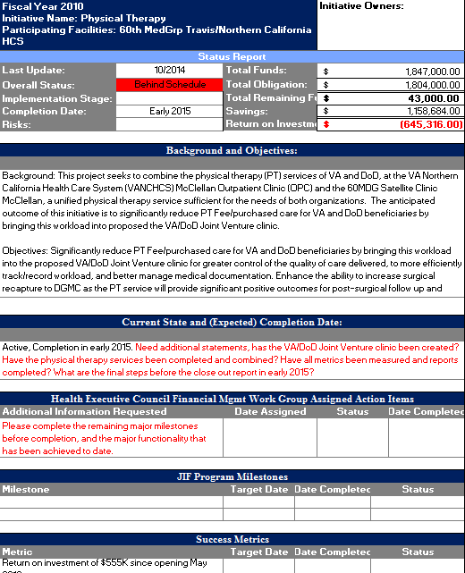
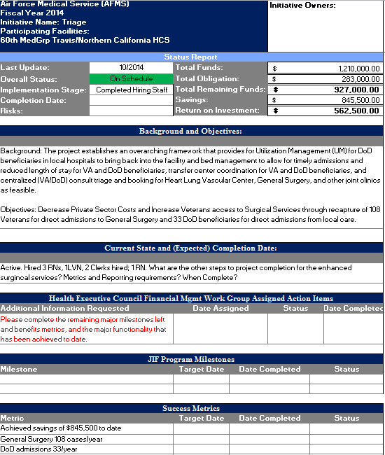
Quarterly Progress Reports
Project Managers of approved projects submit joint status reports
Overall Status of implementation
Funding, Obligation, Savings, ROI
Current State, Time to Completion
Milestones and Accomplishments (with dates), Upcoming Tasks
Success Metrics
Issues/Barriers Encountered
Notes:
Quarterly IPRs – update on project schedule, accomplishments, barriers, and spending.

Slide 8
Elements of Success
Elements of Success
Beginning
Partnering – Establish and maintain the relationship
Leadership Driven – Gain support early, coordinate with SME’s
Proposal
Keep it Simple – Don’t combine initiatives. Be clear and concise
Consider Your Audience as Investors – Most effective use of capital
Realistic Costs – Current cost, proposed cost & savings
Performance Metrics – Base lined, measurable and relevant
Projected Benefit – Valid, data based
Post Selection
Begin Immediately – Plan on completion within 24 months
Sustainability – Have a plan and start early

Slide 9
Special Considerations
Special Considerations
Contracting and personnel hiring issues
Draft Statement of Work as soon as approved
Make contracting an early priority in project activities
Begin the recruitment of key personnel early
Real time funding
Carefully manage your funding
Work closely with your budget official for timely distribution of funds

Slide 10
Questions?
DoD:
Ms. Catherine Simpson (Administrative Oversight) catherine.a.simpson@health.mil
VA:
Mr. Mike Gardner michael.gardner2@va.gov

Slide 11
How To Claim CE Credit
If you would like to receive continuing education credit for this activity, please visit:
amsus.cds.affinityced.com

