Slide 1
AFMS Support to Optimize Airmen & Guardian Performance – Bridging the Gaps
Brig Gen James Parry
Acting Director, Medical Operations
14 February 2024
Unclassified

Slide 2
Developmental-Behavioral Family Readiness Center (DBFRC) Model
As of: 23 Jan 24
Unclassified

Slide 3
Problem: Resource Constrained Locations
The military operates in remote locations for strategic reasons (air space, stealth, proximity, etc.)
Remote locations create medical difficulties for the military and its families
Not enough network medical resources
Not enough patient volume to keep medical resources
IMPACT ON MILITARY OPERATIONS
Increased: Travel denials, reassignments, TDYs
Greatest impact on senior
personnel
High impact on
readiness
IMPACT ON THE HEALTH OF MILITARY FAMILIES
Delayed diagnoses and care
Insufficient care
Decreased military family resiliency
Notes:
The military operates in remote or resource constrained locations for a variety of strategic reasons (air space, stealth, proximity to the mission, etc)
Operating out of remote locations creates medical difficulties for the military and its families
Not enough network medical resources to care for even mild to moderate conditions
Network medical resources do not stay due to lack of adequate patient volume
IMPACT ON MILITARY OPERATIONS
High Exceptional Family Member Program (EFMP) travel denial rate
High EFMP Reassignment rates
Increased medical TDYs
Greatest impact on senior
Personnel
High impact on
readiness
IMPACT ON THE HEALTH OF MILITARY FAMILIES
Delayed diagnoses and care
Insufficient care
Decreased military family resiliency

Slide 4
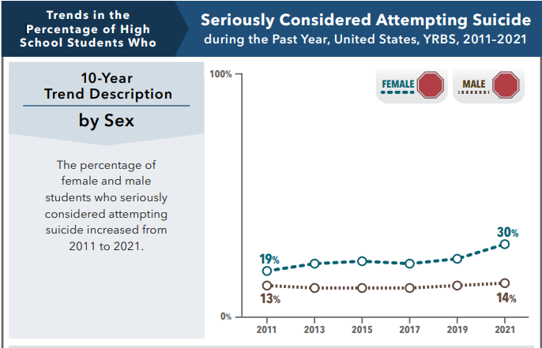
Problem: Growing Developmental and Behavioral Health Need
47% increase in annual military behavioral health clinic visits since 2013
65% increase in annual Tricare behavioral health referrals since 2013
Notes:
MH Clinics increased from 16K-28K annual appointments and 5.5K-15.5K annual Tricare referrals from 2013-2022
The percentage of girls seriously considering suicide increased by 11% from 2011 to 2021
The prevalence of autism increased from 1:150 in 2007 to 1 in 36 in 2023

Slide 5
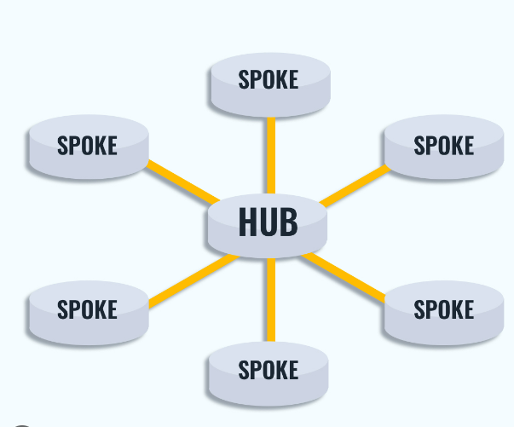
What is needed?
A way to provide care to multiple remote locations from a single resourced location
A way to leverage video telehealth abilities combined with in-person itinerant care and specialist extenders
A focus on the highest impact medical specialty areas
A build-up of local network resources
Cooperation with local civic and medical leaders

Slide 6
DBFRC Model: Effective, Efficient, & Sustainable
The DBFRC was created to address developmental and behavioral medical capabilities deficits in resource constrained locations in an effective, efficient, and sustainable manner
DBFRC Health Care Delivery
Video-telehealth visits, in-person visits, provider extender services
Hub and spoke
Allows multiple bases to be covered by the same medical team
Makes specialty care available to smaller bases
Gives specialists enough patient volume to be fully utilized
DBFRC Staffing
Provider types selected based off of highest impact for EFMP families
(54% of EFMP enrolled children require these provider types)
Developmental-Behavioral Pediatrics
Child and Adolescent Psychiatry
Child and Adolescent Psychology
Autism Therapy
Improving specialty health care availability at remote locations improves readiness, availability of personnel, and health care
Notes:
Child and adolescents make up 53% of AF EFMP enrollment
54% of child and adolescent EFMP enrollment is due to developmental and behavioral conditions

Slide 7
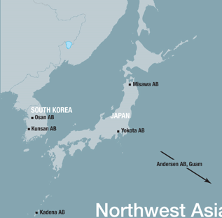
DBFRC Demonstrated Results
DBFRC started as a Pacific Air Forces (PACAF) program
A 4-person team (1 DBP, 2 Child and Adolescent Psychiatrists, 1 Child and Adolescent Psychologist) was inserted into PACAF to cover:
Osan AB, Misawa AB, Yokota AB, Kadena AB, Andersen AFB, JBER, Eielson AFB
Kadena AB
1 Developmental & Beh Pediatrician
1 Child and Adolescent Psychiatrist
1 Child and Adolescent Psychologist
JBER
1 Child and Adolescent Psychiatrist
Notes:
Child and adolescents make up 53% of AF EFMP enrollment
54% of child and adolescent EFMP enrollment is due to developmental and behavioral conditions

Slide 8
DBFRC Demonstrated Results
Results:
50-60% decrease in EFMP travel denials for DBFRC specialties each year
Prevention of 80 relocations, 240 medical TDYs, and 6 hospitalizations average per year
Decreased wait time for autism evaluations by over 50% compared to the network
Average estimated savings of $2.4M annually in network care, reassignment, and medical TDY costs and $1-1.5M annually in emergency transportation, and hospitalization costs
Program expansion started in 2021; now at 9 sites in various stages of manning
Notes:
Child and adolescents make up 53% of AF EFMP enrollment
54% of child and adolescent EFMP enrollment is due to developmental and behavioral conditions

Slide 9
DBFRC Locations and Expansion
Growth since 2021:
Increased from 1 to 9 hubs
Increased from 4 to 24 providers and from 0 to 5 support staff
All 9 hubs have a Developmental and Behavioral Pediatrician
5 hubs provide autism therapy (PLAY Project Consultant)
3 hubs have a Child and Adolescent Psychiatrist (2 more in 2024)
4 hubs have a Child and Adolescent Psychologist

Slide 10
DBFRC Scope and Limitations
The DBFRC
Does not duplicate services
Makes it possible for the families of patients with
mild to moderate symptoms to be located at more remote locations
not patients with severe symptoms; increasing readiness while minimizing risk
Provides care for patients with new-onset symptoms, reducing EFMP reassignments
Decreases wait times for high-demand specialists
Maintains in-person component to maintain standard of care for services that can only be delivered in-person
Services are dependent on specialist staffing
The addition of 1 provider improves care and readiness at multiple bases
Notes:
DBFRC providers will not duplicate services that already exist
The DBFRC makes it possible for the families of patients with
mild to moderate symptoms to be located at more remote locations
not patients with severe symptoms; increasing readiness while minimizing risk
The DBFRC makes it possible for more patients who develop new-onset symptoms to receive care at their current duty assignment instead of requiring an EFMP reassignment
decreasing wait time, improving medical care, and improving readiness
The DBFRC decreases wait times for high-demand specialists
improving health care benefit delivery
The DBFRC Maintains in-person component to maintain standard of care for services that can only be delivered in-person
ie, specialized psychiatric physical examinations for drug side effects
direct autism testing, etc
DBFRC services are dependent on specialist staffing

Slide 11
DBFRC Scope and Limitations
The DBFRC
Does not duplicate services
Makes it possible for the families of patients with
mild to moderate symptoms to be located at more remote locations
not patients with severe symptoms; increasing readiness while minimizing risk
Provides care for patients with new-onset symptoms, reducing EFMP reassignments
Decreases wait times for high-demand specialists
Maintains in-person component to maintain standard of care for services that can only be delivered in-person
Services are dependent on specialist staffing
The addition of 1 provider improves care and readiness at multiple bases
Notes:
DBFRC providers will not duplicate services that already exist
The DBFRC makes it possible for the families of patients with
mild to moderate symptoms to be located at more remote locations
not patients with severe symptoms; increasing readiness while minimizing risk
The DBFRC makes it possible for more patients who develop new-onset symptoms to receive care at their current duty assignment instead of requiring an EFMP reassignment
decreasing wait time, improving medical care, and improving readiness
The DBFRC decreases wait times for high-demand specialists
improving health care benefit delivery
The DBFRC Maintains in-person component to maintain standard of care for services that can only be delivered in-person
ie, specialized psychiatric physical examinations for drug side effects
direct autism testing, etc
DBFRC services are dependent on specialist staffing

Slide 12
Mental Health: Targeted Care
As of: 23 Jan 24
Unclassified

Slide 13
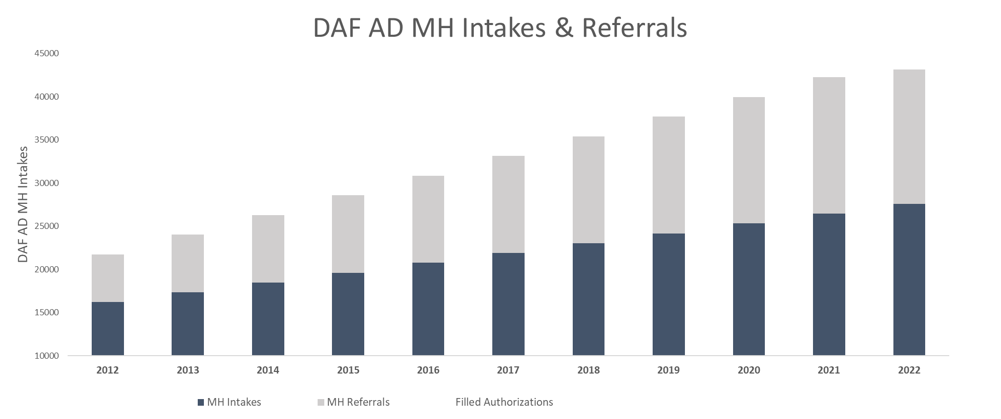
AF Mental Health: Current State
Problems
↑ MH Utilization
Unclassified

Slide 14
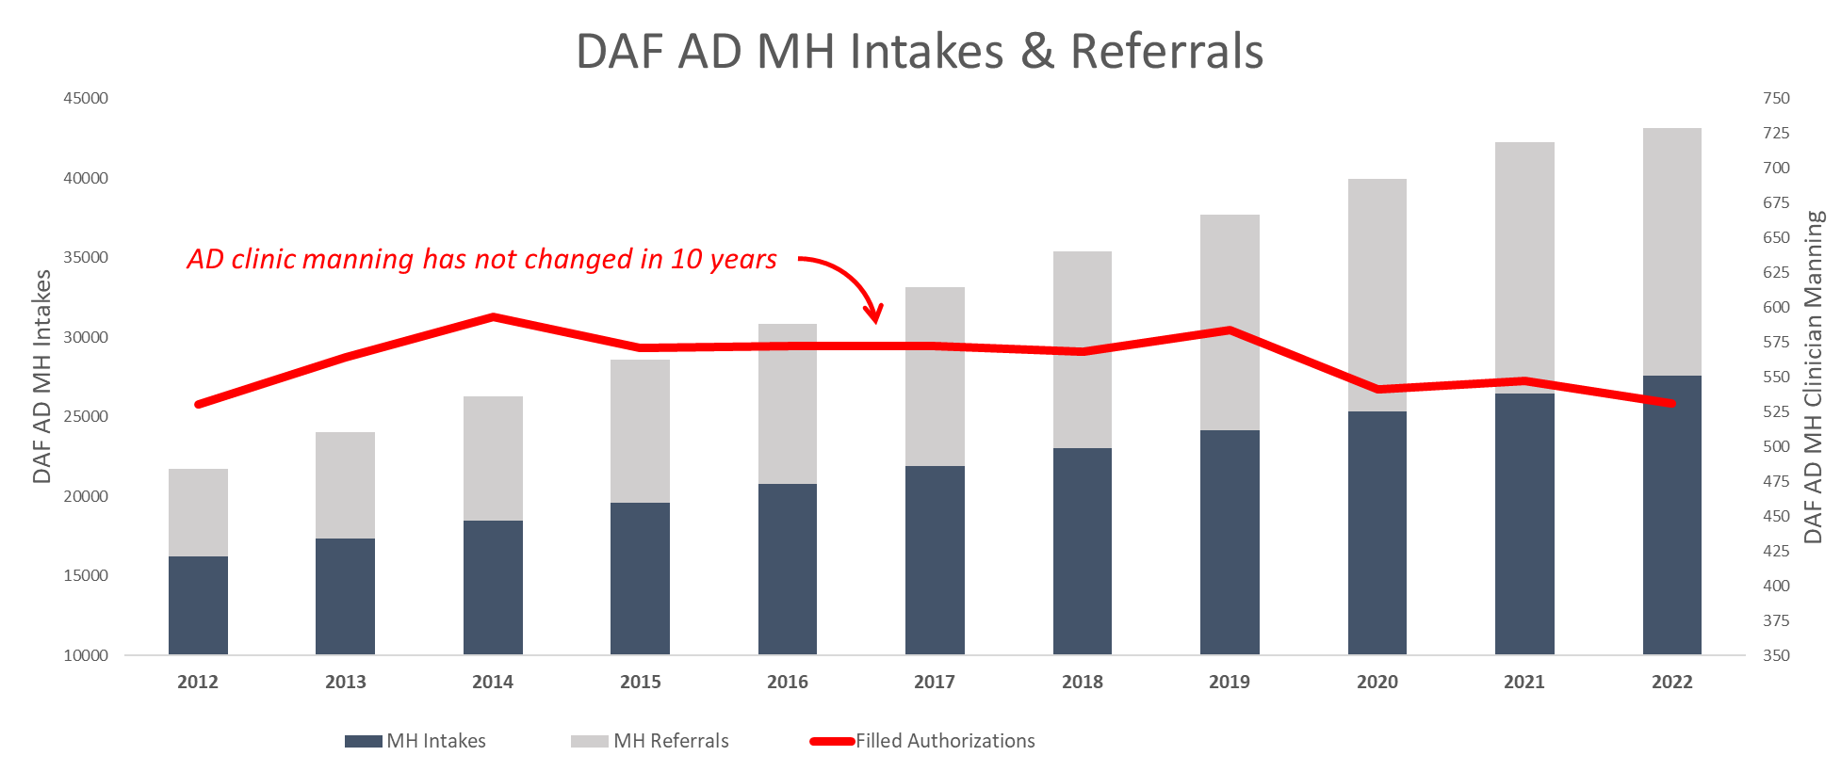
AF Mental Health: Current State
Problems
↑ MH Utilization
Static AD MH Manning
Unclassified

Slide 15
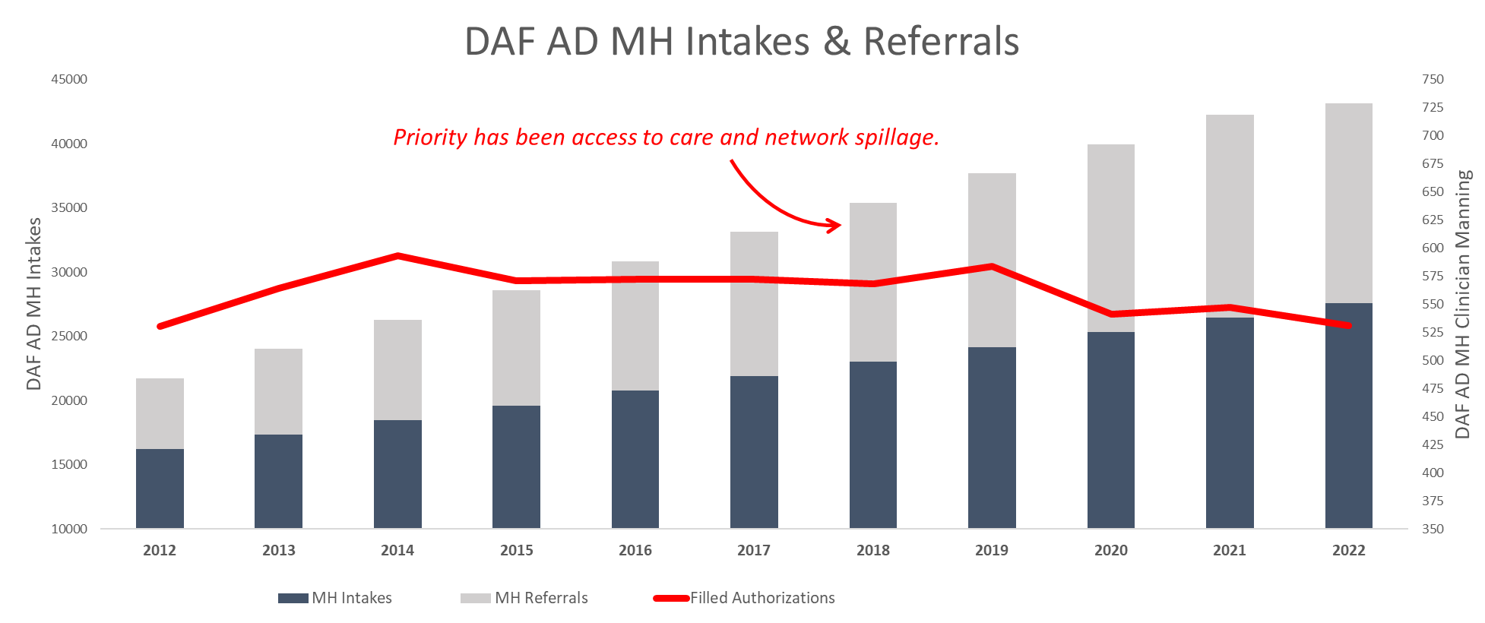
AF Mental Health: Current State
Problems
↑ MH Utilization
Static AD MH Manning
↑ Network Spillage
Unclassified

Slide 16
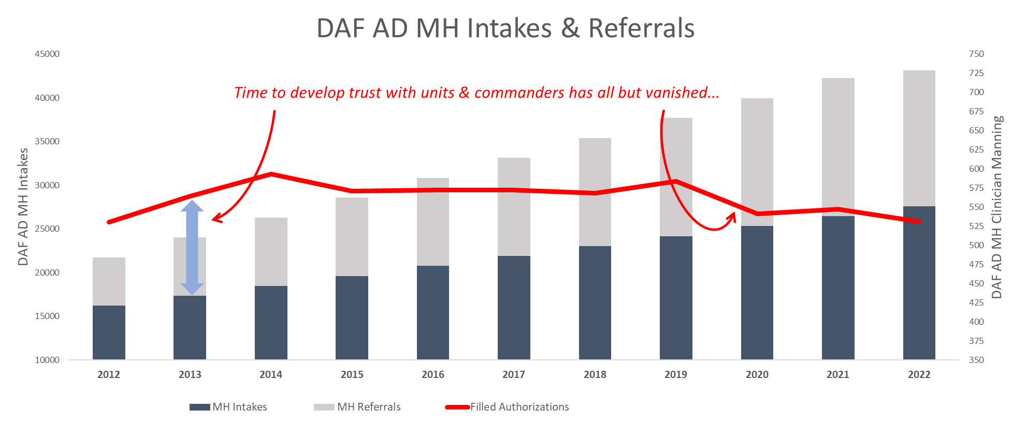
AF Mental Health: Current State
Problems
↑ MH Utilization
Static AD MH Manning
↑ Network Spillage
↓ AD MH Outreach
↓ AD MH Readiness
↓ Commander Trust
Unclassified

Slide 17
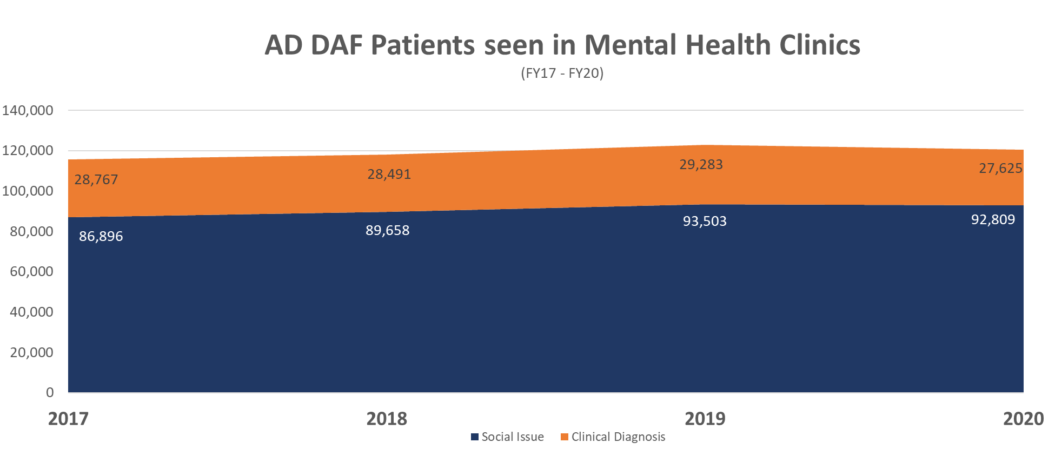
AF Mental Health: Current State
Problems
↑ MH Utilization
Static AD MH Manning
↑ Network Spillage
↓ AD MH Outreach
↓ AD MH Readiness
↓ Commander Trust
↓ Civ MH Manning
Misutilization of MH
Unclassified

Slide 18
Targeted Care
Traditional AF Mental Health (MH) Model
Treat nearly everyone in the specialty MH care setting no matter what
One-on-One, weekly 50-minute appointments
No coordination with other base counseling resources
Targeted Care
Each person walking-in or calling MH is assessed quickly to determine their optimal available counseling resource
Members Connected to all installation helping resources (e.g., PCBH, MFLC, Chaplain, OneSource, Embedded care, etc.)
Use of group therapy for most members seeking services
Reserves One-on-One care for those assessed as most in need

Slide 19
Targeted Care
Workflow components
Vectoring-Triage process that connects Active Duty Service Members (ADSM) to appropriate resource
Evidence-based group therapy as a primary intervention
Operational Medicine focus
Leveraging MH Technician/paraprofessional skillset
Anchored by warm hand-off approach

Slide 20
Targeted Care

Slide 21
Integrated Operational Support
As of: 23 Jan 24

Slide 22
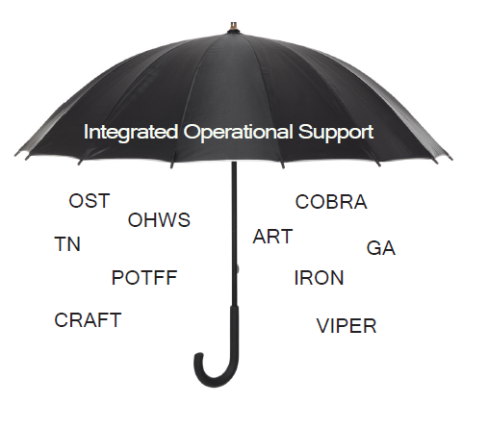
Integrated Operational Support
Integrated Operational Support (IOS) is a DAF strategy that incorporates the tenets of Total Force Fitness (TFF) to strengthen resilience & optimize human performance in service members
DAF funded vs Defense Health Program funded
Execute preventive & performance services to
limited clinical care directly in operational units
Services target the physical, psychological, nutritional, social,
environmental, spiritual & medical preventive care domains
to sustain, enhance, and/or optimize specific performance
Program composition is dependent on mission needs &
composes of multi-disciplinary teams
IOS is the conceptual umbrella term used to describe integrated medical assets across DAF
Notes:
What gap does IOS fill?

Slide 23
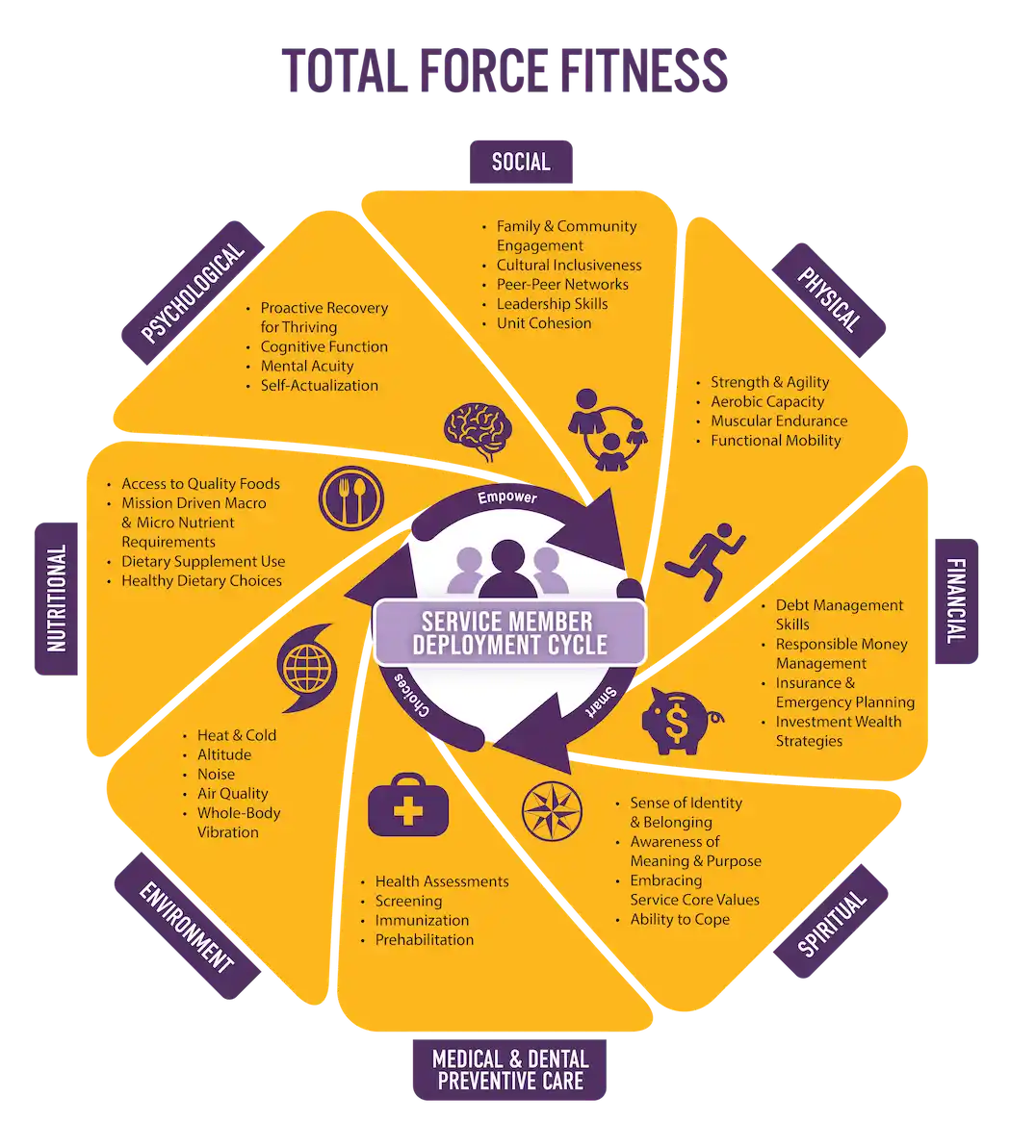
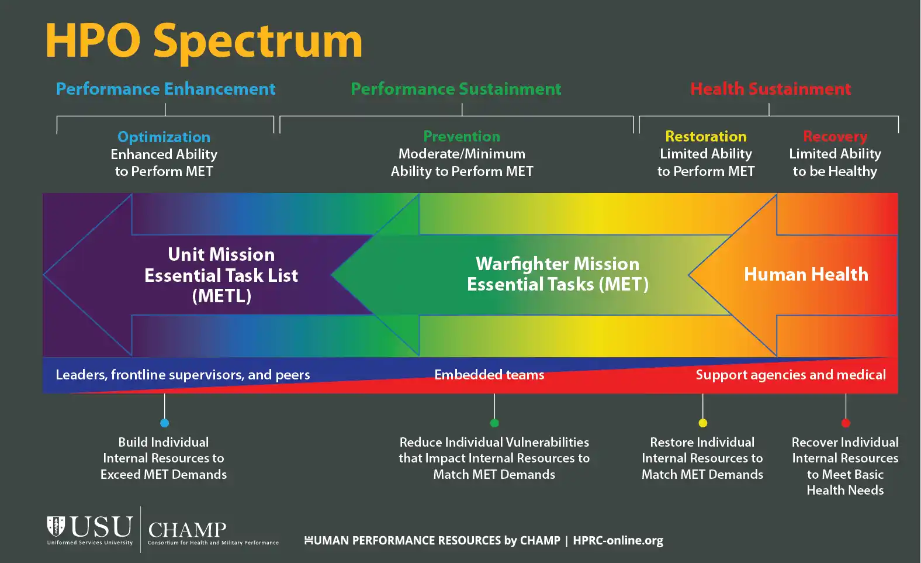
Human Performance Optimization (HPO)
IOS Programs extend beyond the delivery of health to delivering human performance outcomes

Slide 24
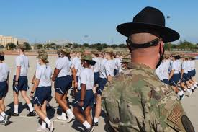
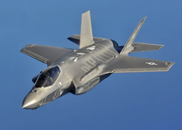
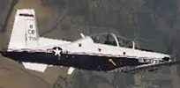
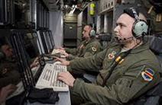
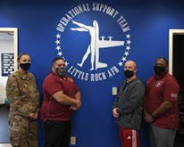
Integrated Operational Support
27 known programs
1800 medical personnel (AD, Civ, Ctr)
11 different medical assets
Operational Support Team
Notes:
There are over 27 known programs that fall into what is currently referred to as Integrated Operational Support, with over 1,800 personnel in these programs, divided between AD, Civ, and CTR personnel. 97% of these personnel are non-MC type positions.
Officer
42B Physical Therapist
42G Physician Assistant
42P Psychologist
42S Social Worker
43D Registered Dietitian
44F Family Practice & Sports Med
48R Flight Medicine
44E3A Emergency Medicine Physician
46N Registered Nurse (including ER/CC)
46F Flight Nurses
46Y Nurse Practitioners & CRNA
Enlisted
4A (1) Medical Admin (Logistics)
4C Mental Health Technician
4D Diet Therapy Technician
4N Medical Technician (includes IDMT & AE)
4J Physical Medicine Technician
Civilian / Contractor
Athletic Trainer
Strength & Conditioning Specialist
Massage Therapist
Cognitive Performance Specialist
24

Slide 25
Operational Support Team (OST)
SG sponsored OST’s were designed to be a standardized, data-driven solution serving every unit on 73 DAF installations
Standard team composition:
Driven by MTF visits (>50% attributed to musculoskeletal &/or mental health diagnoses)
Psychologist, Licensed Clinical Social Worker, Physical Therapist, Team Specialist, Strength & Conditioning Specialist
Conduct time-limited (3-8 month) integration into highest-risk units across the installation
Provide short-term musculoskeletal (MSK) care and low-acuity mental health (MH) care to unit members
With unit leadership, builds an evidence-based Unit Action Plan (UAP) to target identified trends/stressors, implements UAP, collects outcome data, and provides regular updates/out brief to command
Notes:
AFMS integrated concept to support the “everyday” Airmen

Slide 26
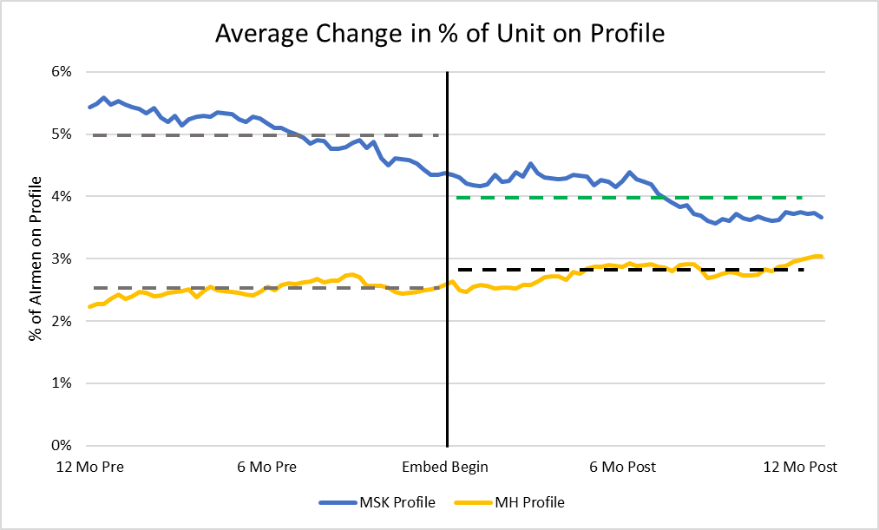
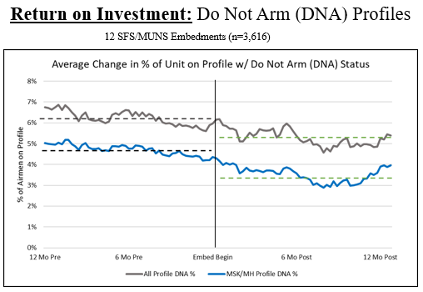
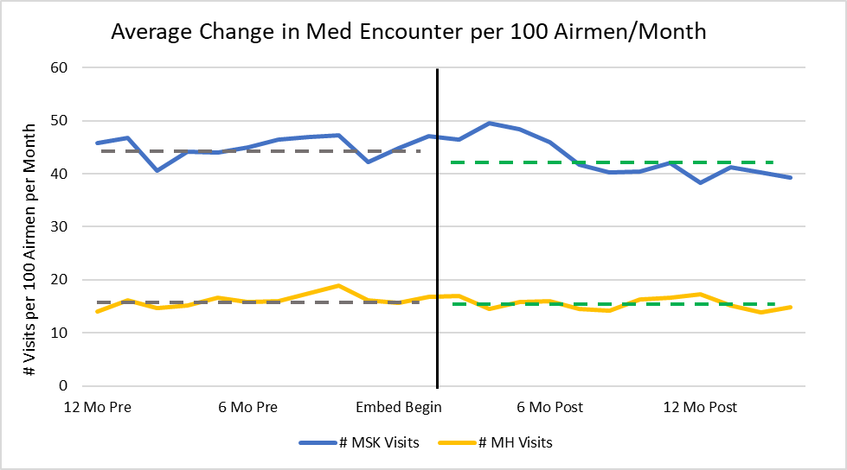
OST Impact (63 Units, 16,084 Personnel)
20% decrease MSK profiles
11% increase MH profiles
ROI: $14.4M saved
5% decrease MSK visit
4% decrease MH visit

Slide 27
OST Operational Effectiveness
Security Forces Squadron Arming Use of Force Status (Whiteman AFB)
Identified by Squadron Commander as key performance metric
41% (41/100) decrease in personnel on “Do Not Arm” status
41 FTEs Returned To Duty ($9.1M cost savings)
Improved Maintenance Squadron Quality Assurance Inspection Outcomes
In pilot study, preliminary results indicated improved pass rates in QA inspections
Expanded study currently on-going
Highly Effective on Unit Readiness (Sheppard AFB)
On a recent Vertical Inspection, the IG noted several Mental Health initiatives bolstered mental health and resilience,
Enabled SFS/CC to transition from 12 to 8-hour shifts for 500+ member squadron
22% decrease in inspection failures
Resulting in a Highly Effective unit rating

Slide 28
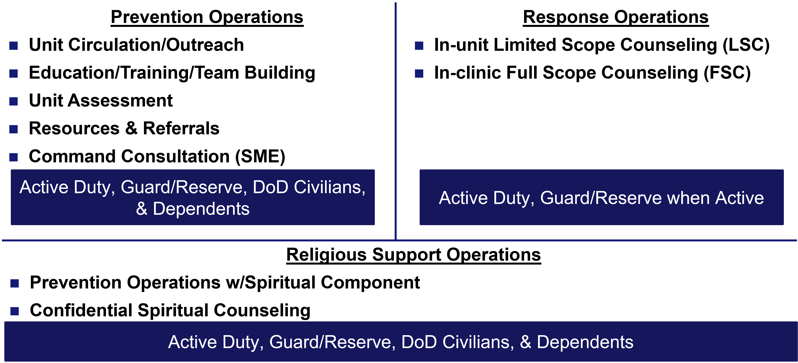
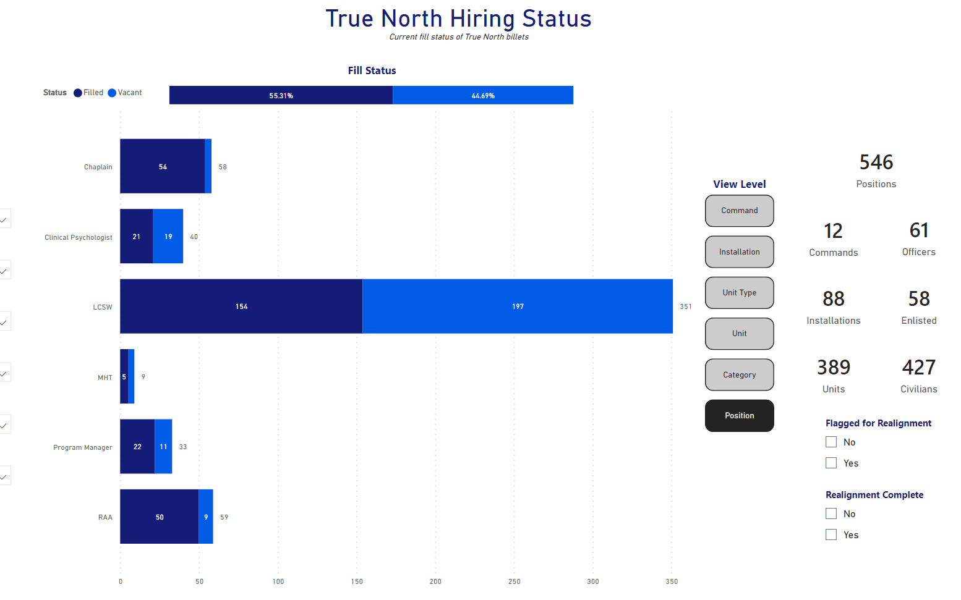
True North Current State
Interpersonal & self-directed violence prevention focused
Seeks to build a resilient force and family, promote positive outcomes and create a more efficient human weapons system through in-unit placement of behavioral health and spiritual care
asd
Operational at 90 installations
First 16 installations:
ASOS, Rescue, AFOSI, Security Forces
& Maintenance units w/>75 AD
Notes:
Thru realignment, TN is now operational at 70 installations; realignment did bring some structure changes to TN, but mostly affecting embedded behavioral health providers.
Program frozen at 58 RSTs, mostly aligned at the original 16 locations, ASOS & Rescue
Enabled MAJCOMs to move RSTs based on need and data
561 NOS at Peterson did not get an embedded provider – ACC requested and was approved to move an RST from JBSA to that unit due to their need for embedded care
Some MAJCOMs have funded their own RSTs and aligning them with TN
TN RST Functions
Confidential Spiritual counseling – being able to include qualified dependents & DoD Civilians is a big win since EMH cannot medically treat dependents / civilians
Cooperative programs & activities – encourage TN RSTs to work with the EMH providers at their installations on opportunities to collaborate on training/education/team building activities
RSTs funded with $~90K – was given to RSTs for their ability to spend / EMH only funded at $2K/year
Unit assessment / command consultation – received great feedback on RSTs from Commanders & Airmen at site visits

Slide 29
True North+
Proposed Mission: To optimize a Warfighter’s mission readiness through education & services in psychological, physical, and spiritual domains
True North
Program Office
OST
Program Office
RST
Program Office
A1
SG
HC
SG
True North+
A1
HC
Coming Fall 2024
Notes:
Operational Support Teams and True North are programs executed DAF-wide and are not targeted to a specific AFSC. Combined, these 2 programs alone account for approximately 48% of the personnel assigned to IOS programming. These large, DAF-wide programs make an obvious opportunity to pursue optimization.
Unifying the TN and OST had been discussed in the past, but really had not made significant progress until this year. In 2021, discussions between the OST and TN program offices on how to collaborate more never took off. A year later, a joint CPI by SG3/4 and A1Z made initial progress but became OBE. These efforts had been reinvigorated earlier this year between SG3/4 and A1Z and then rapidly evolved when General Allvin also took interest in unifying these two programs through the Barriers to Mental Health, Resilience, and Wellness Cross Functional Team (CFT) Sprint.
Two decisions were made coming out of CORONA Fall ‘23 – 1. The SG will be the OPR of the unified program, and 2. The installation commander will use data provided by the unified program office and their knowledge of the mission/needs of their units to determine how to vector their assets.
The intent of this integration is to give Wing Commanders flexibility to make data driven decisions on how to best deploy support to our Airmen to optimize their warfighting status. Both programs have similar missions and efficiencies can be gained in combined program office functions to standardize support across the DAF.
A program management office oversees the process of planning, preparing, organizing, and integrating the combined efforts of the programs of an organization to meet operational and mission requirements. A program management office focuses on the success of broad organizational programs and the overall business strategy.
Purpose: Link to Organizational Goals, Win Support for Important Initiatives, Standardized Methodologies, Leveraging Tools, Support, and Mentoring
Outcomes:
continually assess & adjust to their environment
maintain balance with physical endurance, emotional stamina, and spiritual well-being to thrive & carry out the mission.
Self-mitigate operational stressors
Behavior that shows emphasis on injury prevention
Optimized operational work processes

Slide 30
IOS Takeaways
IOS programs target numerous domains of TFF, but largely focus on mental and musculoskeletal health
IOS programs focus on the prevention/optimization and traditional MTF care is in recovery and restoration
True North+ is a maturing of the existing TN and OST, seeking to leverage efficiencies and data driven decisions to optimize human performance in our Airmen and Guardians

Slide 31
Questions?

Slide 32
Backup Slides

Slide 33
Notional POAM
6 Lines of Effort:
Manpower and Organization, SG OPR: SG1/8
Design & resource a new TN
Function and Workflow, SG OPR: SG3/4
Codify workflow/relationships
Personnel Administration, SG OPR: SG1/8
Personnel transition (AD and Civ)
Professional Development - Education/Training, SG OPR: SG1/8
Training (look at health promotion model)
Strategic Marketing/Communication, SG OPR: SGL
Right message, right audience, right time
Measures of Performance & Effectiveness/Data
Execute, Monitor, Update
Dec 2024
Aug 2024
FOC
Jun 2024
Publish AFI
May 2024
IOC
Initial Steps:
Initial Strat Comm Plan – Nov 23
CPI - Nov 23 – Jan 24
Guidance Letter – Jan 24
Jan 2024
Draft AFI
Nov 2023 – Jan 2024
Interim Guidance Letter
Nov 2023
Conduct CPI
Nov 2023
POAM Development
Oct 2023
✓
Fall Corona Discussion
✓
Strategic Communication sent to the field
TN/OST Briefing to LTG C. Miller and LTG R. Miller on OPR and COA recommendation

Slide 34
Takeaways
True North+ combines TN and OST into a single program office (OPR: SG, OCR: A1)
POAM is being develop; updates will be strategically communicated to the field
Resource neutral exercise
No immediate changes to TN and OST as they are currently executed
You are a critical stakeholder!
Notes:
You are a critical stakeholder – your support is needed for the success of this large, SG led program
Liaison w/ MAJCOM and other line leaders
As with all medical care – whether within the walls of the MTF or outside – it is our responsibility to ensure the provision of Trusted Quality Care

