Slide 1
Individual Longitudinal Exposure Record (ILER)
DoD and VA Sponsors:
Mr. Steve Jones, MPH
Director, Force Readiness and Health Assurance Policy
Office of Deputy Assistant Secretary for Health Readiness Policy & Oversight, DoD
Dr. Eric Shuping MD, MPH
Director of Operations
VA Health Outcomes of Military Exposures (HOME), VA

Slide 2
Disclosures
Steve Jones has no relevant financial or non-financial interests to disclose.
This continuing education activity is managed and accredited by AffinityCE, in collaboration with AMSUS.
AffinityCE and AMSUS staff, as well as planners and reviewers, have no relevant financial interests to disclose. AffinityCE adheres to the ACCME’s Standards for Integrity and Independence in Accredited Continuing Education. Any individuals in a position to control the content of a CME activity, including faculty, planners, reviewers, or others, are required to disclose all relevant financial relationships with ineligible entities (commercial interests). All relevant conflicts of interest have been mitigated prior to the commencement of the activity.
Commercial support was not provided for this activity.

Slide 3
Learning Outcomes
Identify the purpose of ILER and its role in linking Service members and Veterans to known exposures;
Explain the enhanced capabilities of ILER and their impacts on promoting efficient and effective continuity of health care;
Understand the benefits of ILER in supporting health effects research and exposure mitigation measures; and
Understand the impact of ILER on providing proof for disability benefits.

Slide 4
What is ILER?
ILER is a web application that compiles, collates, and presents available occupational and environmental exposure information in a individual/person-centric format
ILER delivers the capability to:
Create a longitudinal (historic) record of service-related exposures
Improve the medical care for those who have exposure-related health outcomes
Research and support epidemiology studies of exposed cohorts
Create cohorts based on location, date, time, and exposure
Improve both medical surveillance and occupational environmental health surveillance by detecting emerging (latent) health conditions on personnel returning from deployment
Assist Veteran disability evaluations and benefits determination
ILER is intended to represent the complete record of service-related exposures and serve as an authoritative data source for all Occupational and Environmental Health Surveillance data to include hazardous OEH exposures to Service Members in theater and critical non-theater OEH exposures that impact Service Members and Veterans.
Notes:
Modernizing Exposure Monitoring & Human Health Continuum

Slide 5
ILER Key Functionality and Capabilities
Key Functionality:
Search by Individual – View Individual Exposure Summary on the User Interface.
Search by Exposure – View all documented exposure events develop cohorts based on exposure route and or type (i.e., Asbestos, Burn Pit Inhalation, Bacteriological, Chemical, Radiological, etc.)
Search by Location – View all documented exposure events in a location and develop cohorts based on key personnel attributes (i.e.by unit, by age, by gender, length of deployment, etc.)
Search by Health Effects – View and develop exposure related cohorts based on health outcomes and conditions.
Ad Hoc Reporting – Provides researcher access to backend supporting data to create custom reports and queries using an enterprise analytical tool (Business Objects).
Key Capabilities:
Health Care - Improve the quality of information needed to facilitate quality, exposure-related health care.
Benefits - Improve disability claim functions, increasing the accuracy and decreasing processing time of claims and benefits determinations. It will relieve the Veteran from “burden of proof” disability evaluations and benefits determinations.
Collaborations - Increase transparency between VA, DoD, Congress, beneficiaries, and other stakeholders (such as Veterans Service Organizations).
Research - Provide a foundation for prospectively following exposed cohorts for long-term or latent health effects that could be attributable to exposures.
Registries - Integrate the environmental health registries, including the Agent Orange Registry, Gulf War Registry, Airborne Hazards and Open Burn Pit Registry, Ionizing Radiation Registry. The Toxic Embedded Fragment Surveillance Center and Depleted Uranium Follow-Up Program registries will not be included.
Notes:
Modernizing Exposure Monitoring & Human Health Continuum

Slide 6
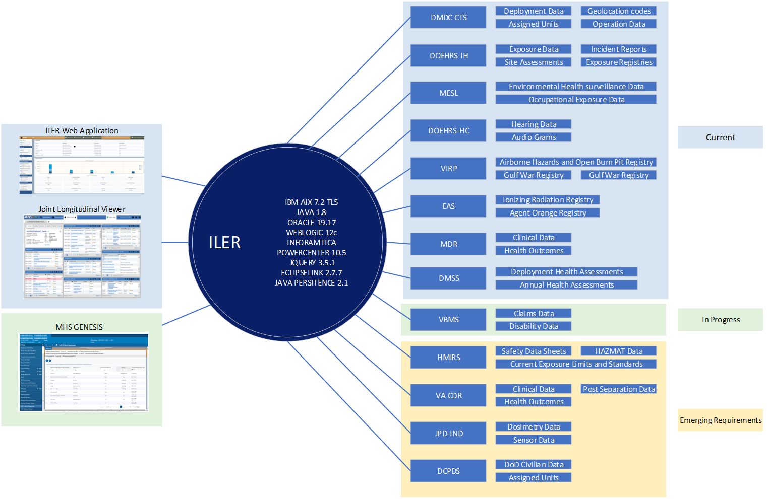
ILER Technical Overview
Ad Hoc (structured) reporting – Completed on 21 APR 023.
Direct interface with VA Airborne Hazards and Open Burn Pit Registry – Completed on 28 OCT 2022.
Adding four (4) data sources
VA Gulf War Registry – Completed on 19 JAN 2023.
DOEHRS-HC – Completed on 17 MAR 2023.
VA Agent Orange Registry – Completed on 09 JUN 2023.
VA Ionizing Radiation Registry – Completed on 09 JUN 2023.
‘Search by Health Effects’ function -Completed on 19 JAN 2023.

Slide 7
ILER Conceptual View
Garrison Locations
Individual Daily Location Data
>25.7M Records
EDIPI
Name
Geolocation (City, State, Latitude / Longitude
Location Start and End Dates
Deployment Location 2
Deployment Location 1
TIER 1: Confirmed / Probable Exposures
(10 Meters)
Individual Monitoring Data vs. Exposure Limit Values
Potential Hazard and Health Concerns
Potentially Targeted Organs and Symptoms
TIER 2: Possible Exposures
(50 Meters)
Deployment Health Assessments
Self Reported Exposures and Symptoms
Possible Exposure Pathways
TIER 3: Supplementary Ambient Monitoring Data
(> 100 Meters)
Area Monitoring Reports
Area Chemical, Biological, Radiological and Nuclear Defense (CBRN) Sensor Data
Area Health Risks
Filters Only Exposures Associated with the Location and Data
Exposure Data
>2M Records and Attachments
Exposure Incident Reports
Occupational And Environmental Health Site Assessments (OEHSAs)
Periodic Occupational and Environmental Monitoring Summary (POEMS)
Medical Encounter and Health Assessment Data
>23.3M Records
Comprehensive Encounter Records
Inpatient Medical Encounter Reports
Theater Medical Encounter Reports
Clinical Diagnosis Codes
Deployment Related Health Assessments
Filters the Individual’s Medical Encounters with Health Effects Associated with Exposures

Slide 8
ILER Contact Information
ILER Account Requests:
https://iler.csd.disa.mil/iler/
For more information, contact:
ILER DoD Sponsor: Steve Jones Director, Force Readiness and Health Assurance Policy
(703) 681-7335
steven.p.jones10.civ@health.mil
ILER VA Sponsor: Dr. Eric Shuping, Director of Operations, VA Office of Health Outcomes of Military Exposures (HOME)
(202) 266-4561
Eric.Shuping@va.gov
ILER Program Manager: James Copeland, ILER Product Manager
(703) 882-3876
james.d.copeland.civ@health.mil
ILER Project Controller: Larry Vandergrift
(703 )505-2470
larry.g.vandergrift.ctr@health.mil

Slide 9
How To Claim CE Credits
If you would like to receive continuing education credit for this activity, please visit:
www.amsus.cds.affinityced.com

