Slide 1
DoD Global Health Engagements for Expeditionary Medical Platform Readiness and KSA sustainment
Jason Longwell, M.D.
CAPT, MC, USN
Chief Medical Officer
Naval Medical Forces Atlantic
Jennifer Gurney, M.D.
COL, USN
Chief, Joint Trauma System
Naval Medical Forces Atlantic
Ricardo Aviles, M.D.
Medical Liaison Officer
Joint Task Force Bravo
Christine Sears, M.D.
CAPT, MC, USN (Ret.)
Former Command Surgeon
United States Southern Command
Reduce Costs – Improve Processes – Please Participants
-
©️ 2023 AffinityCE

Slide 2
Disclosures
CAPT Longwell, COL Gurney, CAPT Sears, and Dr. Aviles have no relevant financial or non-financial interests to disclose.
This continuing education activity is managed and accredited by AffinityCE, in collaboration with
AMSUS. AffinityCE and AMSUS staff, as well as planners and reviewers, have no relevant financial interests to disclose. AffinityCE adheres to the ACCME’s Standards for Integrity and Independence in Accredited Continuing Education. Any individuals in a position to control the content of a CME activity, including faculty, planners, reviewers, or others, are required to disclose all relevant financial relationships with ineligible entities (commercial interests). All relevant conflicts of interest have been mitigated prior to the commencement of the activity.
Commercial support was not provided for this activity.
©️ 2023 AffinityCE

Slide 3
Learning outcomes
At the conclusion of this activity, participants will be able to:
Understand the history of humanitarian civic assistance missions and how they have supported DoD readiness
Understand KSA program development and sustainment
Understand how to use global health engagement missions to sustain expeditionary medical readiness
©️ 2023 AffinityCE

Slide 4
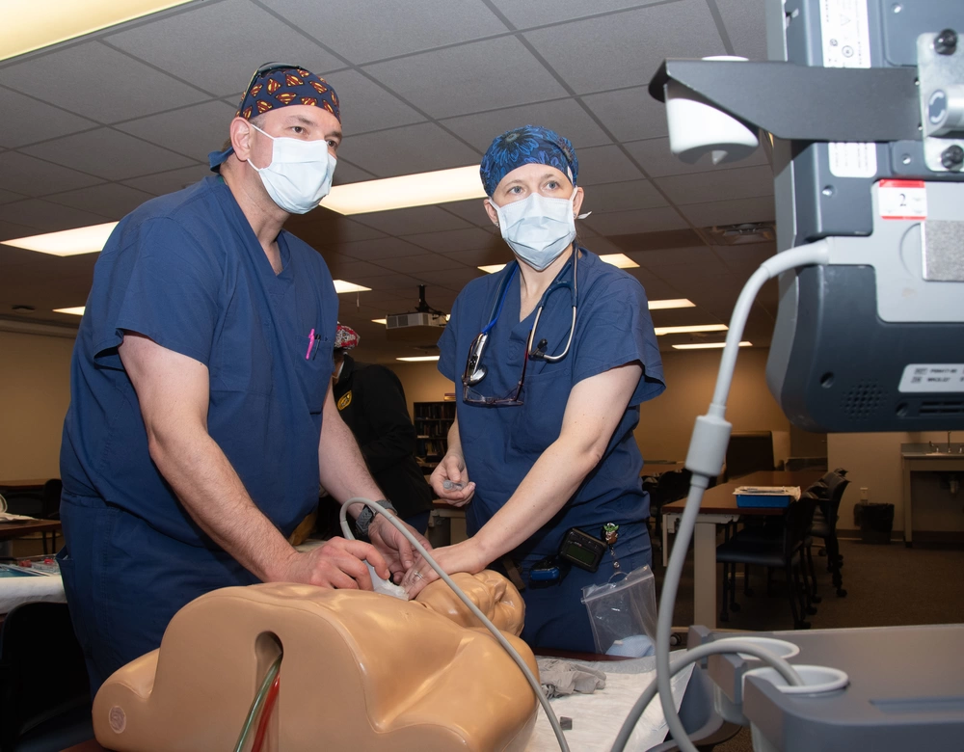
What are the skill sustainment gaps faced by our forward deployed medical teams?

Slide 5
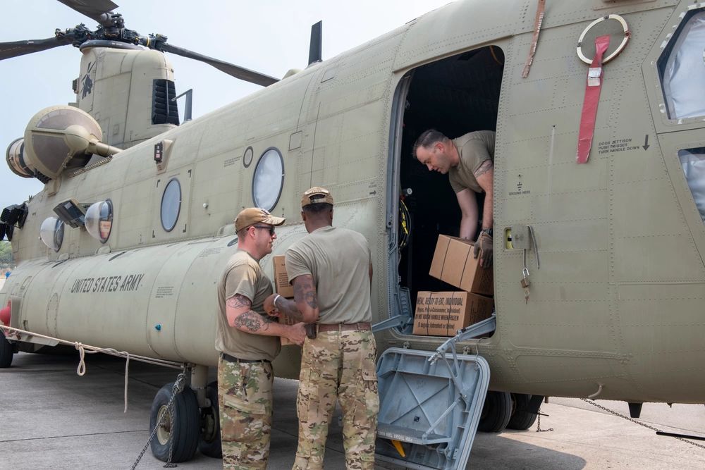
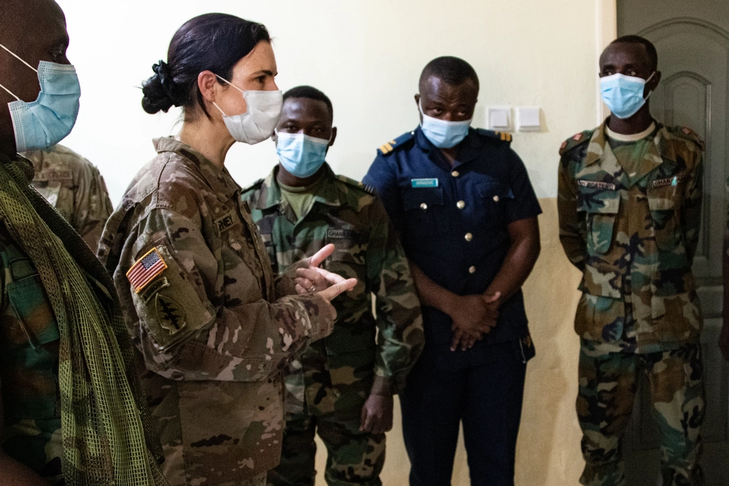
In addition to sustaining knowledge, skills, and abilities (KSAs), what are the unique benefits of global health engagements?

Slide 6
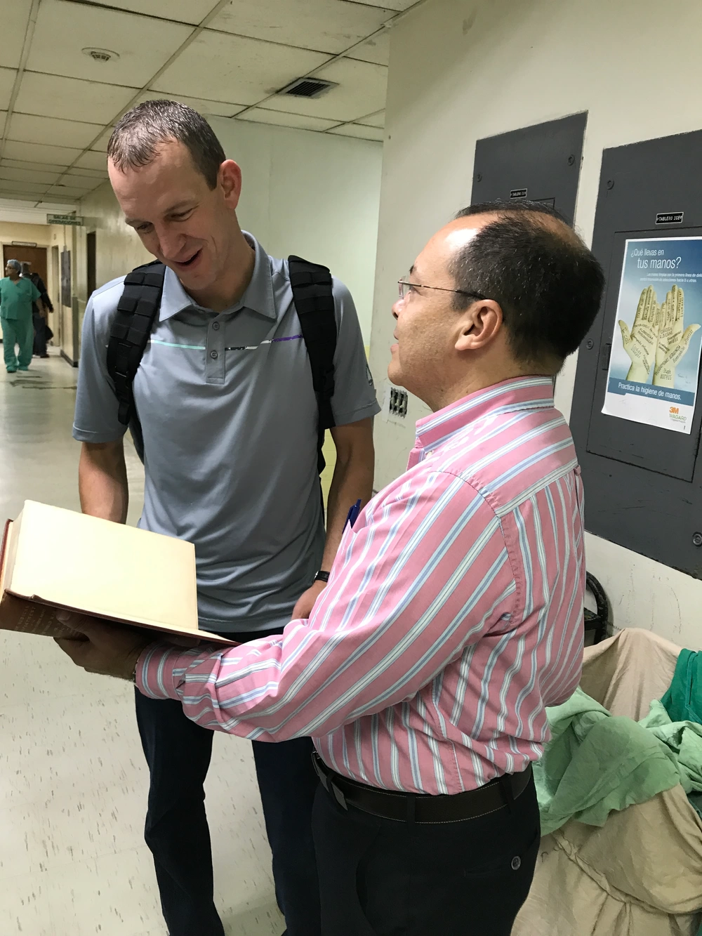
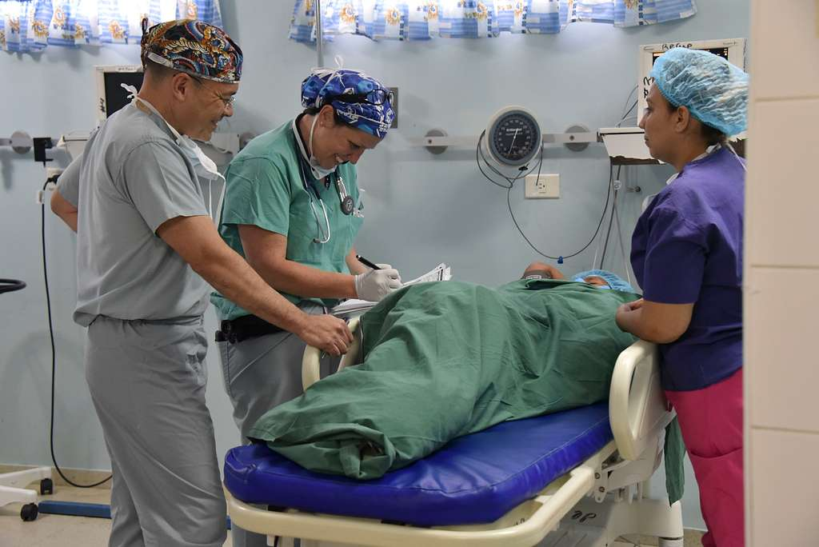
What risks do global health engagements pose to skill sustainment within military treatment facilities?

Slide 7
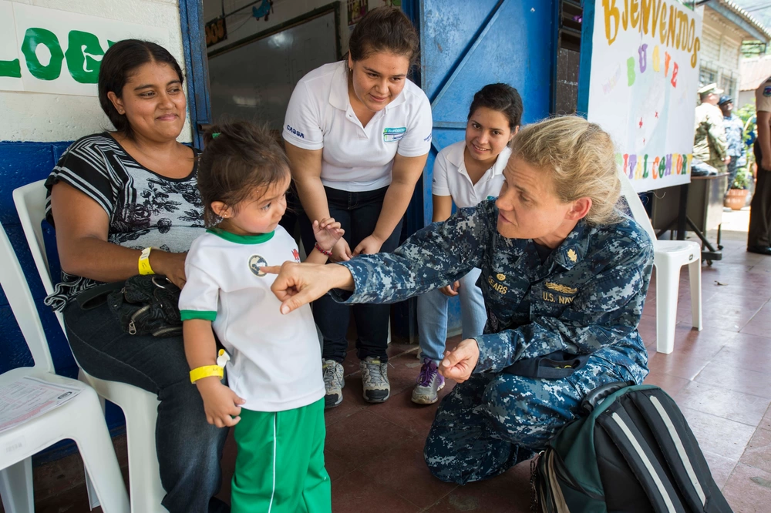
How are stakeholder needs being balanced to ensure sustainable health security cooperation?

Slide 8
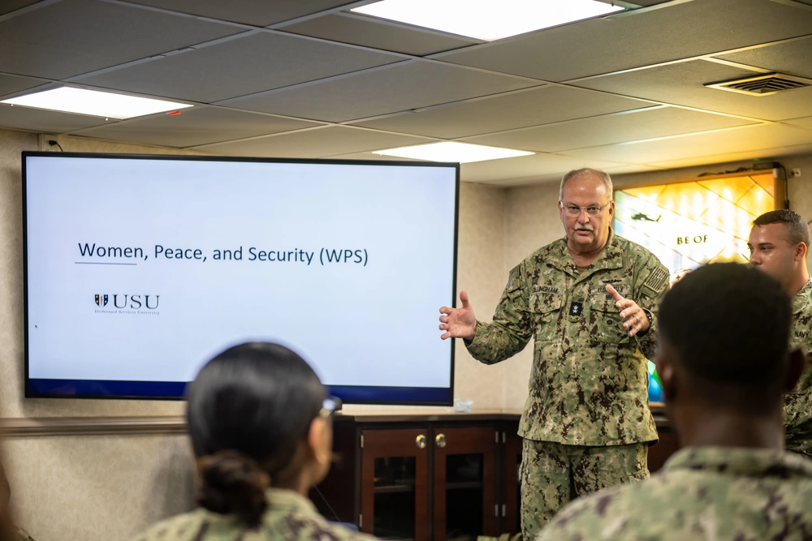
How do we define better measures of effectiveness for global health engagements? How are our current measures working?

Slide 9
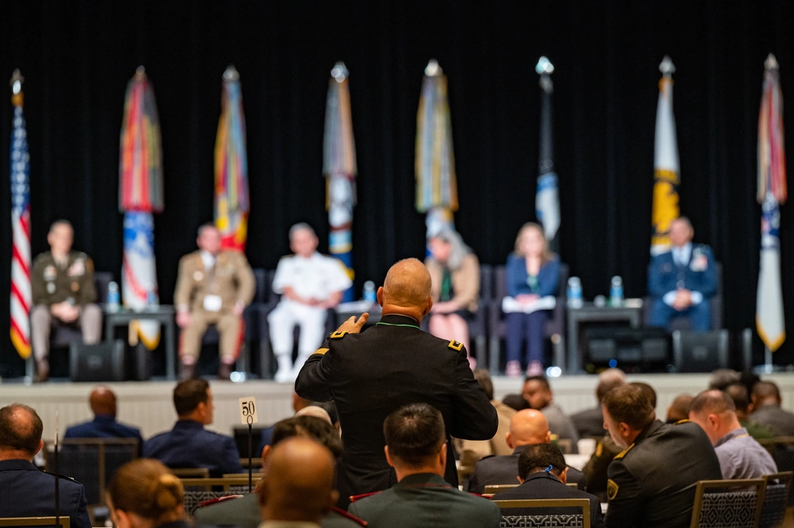
Where should the funding for Global Health Engagements come from?

Slide 10
How To Claim CE Credit
If you would like to receive continuing education credit for this activity, please visit:
amsus.cds.affinityced.com
©️ 2023 AffinityCE

