Slide 1
Veterans Health Administration (VHA) The State of U.S. Federal Healthcare
AMSUS, The Society of Federal Health Professionals
VHA Executive Leaders
February 13, 2024

Slide 2
Learning Objectives
After this session learners will be able to:
Discuss the current state of the U.S. healthcare system, presented through the lens of the U.S. Department of Veterans Affairs, the largest integrated healthcare organization in the United States of America.
Discuss the outlook for the U.S. healthcare system in 2024 and beyond, exploring the opportunities and risks that exist today.
Discuss the current strain on the healthcare workforce as well as the innovative environment that we as healthcare leaders find ourselves in following the end of the COVID-19 public health emergency.

Slide 3
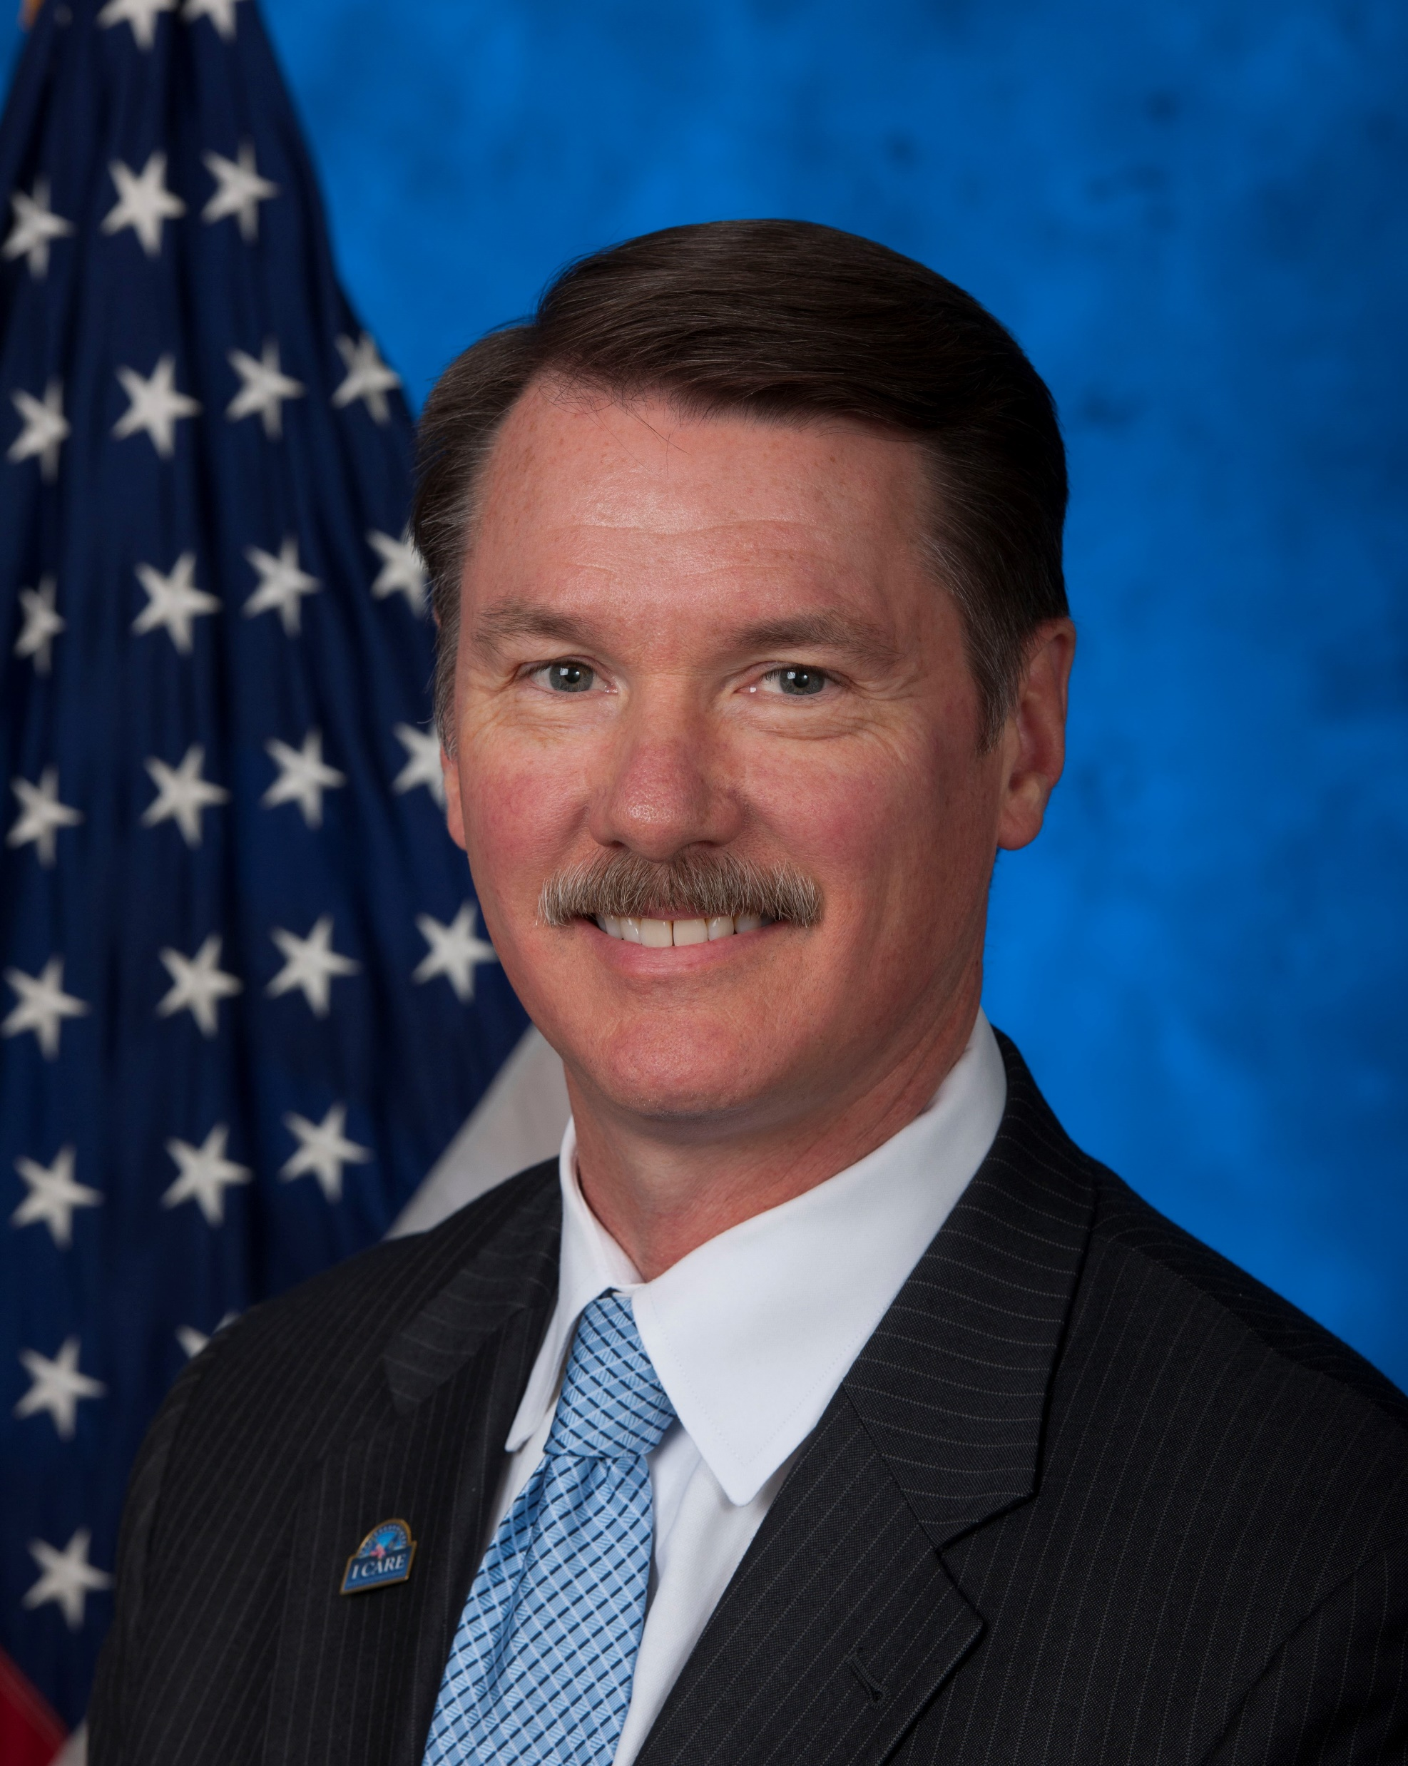
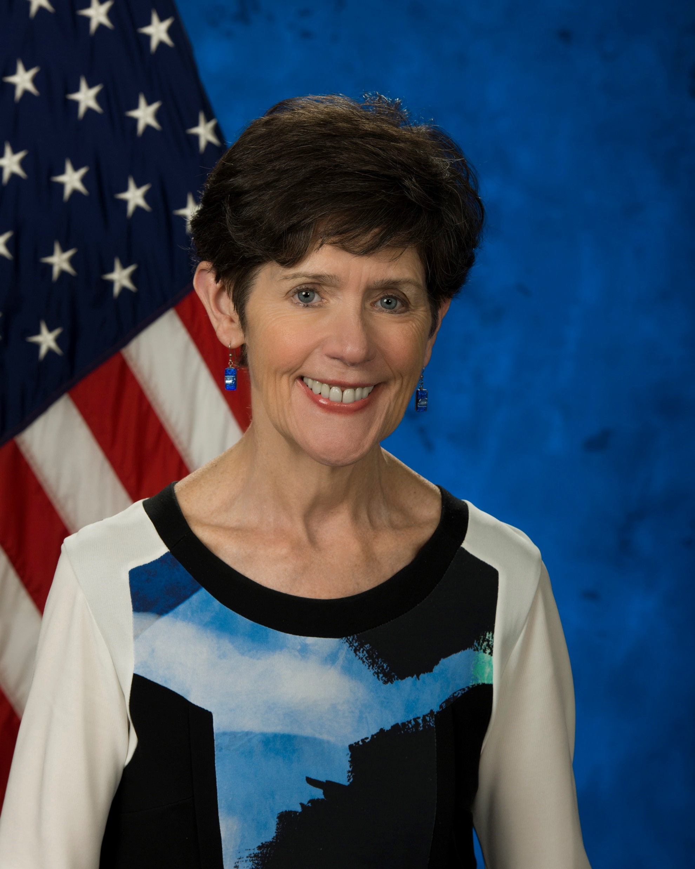
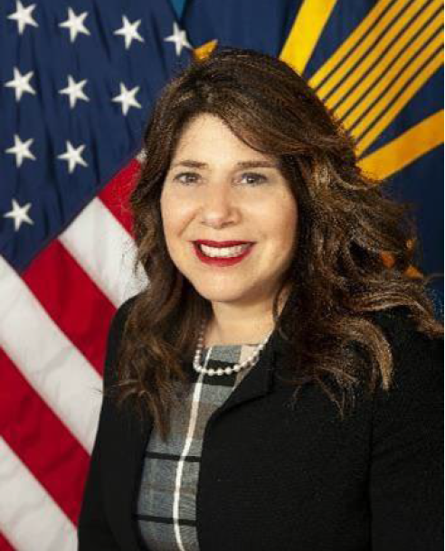
Veterans Health Administration Panelists
Erica Scavella, M.D., FACP, FACHE, Moderator
Assistant Under Secretary for Health for Clinical Services
Gerard R. Cox, M.D., MHA, Panelist
Assistant Under Secretary for Health for Quality and Patient Safety
Carolyn Clancy, M.D., MACP, Panelist
Assistant Under Secretary for Health for Discovery, Education and Affiliate Networks (DEAN)
Susan R. Kirsh, M.D., MPH, Panelist
Deputy Assistant Under Secretary for Health for DEAN

Slide 4
Assistant Under Secretary for Health for Quality and Patient Safety
Gerard R. Cox, MD, MHA
Dr. Cox was appointed Assistant Under Secretary for Health for Quality and Patient Safety in June 2020
Held several senior executive positions in VA including:
Assistant Deputy Under Secretary for Health for Policy and Services
Interim Medical Inspector
Assistant Deputy Under Secretary for Health for Integrity
Deputy Undersecretary of Health for Organizational Excellence
30-year military career in the US Navy
Board-certified in Emergency Medicine, Occupational Medicine, and health care administration (FACHE)

Slide 5
Assistant Under Secretary for Health for Discovery Education and Affiliate Networks
Carolyn Clancy, M.D., MACP
Dr. Clancy was appointed the Assistant Under Secretary for Health (AUSH) for Discovery, Education & Affiliate Networks (DEAN), Veterans Health Administration (VHA) in 2018.
Previously served as:
Acting VA Deputy Secretary
VHA Executive in Charge, with the authority to perform the functions and duties of the Under Secretary for Health
Assistant Under Secretary for Health for Organizational Excellence
Director, Agency for Healthcare Research and Quality
Academic appointment at George Washington University School of Medicine and serves as Senior Associate Editor, Health Services Research Journal.

Slide 6
Deputy Assistant Under Secretary for Health for Discovery, Education and Affiliate Networks
Susan R. Kirsh, M.D., MPH
Dr. Kirsh serves as the Deputy Assistant Under Secretary for Health (AUSH) for Discovery, Education & Affiliate Networks (DEAN),
25-year career with the Veterans Health Administration in clinical care
at Cleveland VAMC and at VA Central Office
Board Certified Internist and Master of Public Health (MPH)
Faculty Scholar in the VA Quality Scholar Program
Professor of Medicine appointment at Case Western Reserve University and Assistant Professor at the Georgetown University School of Health

Slide 7
Discussion Questions
What are the biggest opportunities for U.S. healthcare in the next year?
What initiatives/breakthroughs are going to be most critical and why?
What are the biggest threats to U.S. healthcare?
What keeps you up at night?

