Slide 1
DHA Innovation Strategy Naomi Escoffery, PMP Chief Accelerator Officer | Innovation Program Manager
06 FEB 2024

Slide 2
DHA Innovation Strategy Overview
The DHA Innovation Strategy builds on the existing framework for the DHA Innovation Cell and existing MHS and DHA strategic plans and priorities, as well as key innovation values.
Defining the current and future definitions of Innovation ensures clear understanding and provides direction for how Innovation will evolve to meet the ever-changing needs of healthcare.
Existing MHS/DHA Strategic Guidance
DHA Innovation
Defined
A clear set of purpose, vision, values, and priorities ensures clarity and direction, alignment and focus, and motivation and engagement for everyone involved with DHA Innovation.
DHA Maturity Model
DHA Innovation Strategy
Purpose, Vision, Values, and Priorities
The Strategic Goals and Objectives; Transform, Inspire, Partner, and Enable are the guiding principles and focus areas that will ensure the success and sustainment of Innovation throughout DHA.
Strategic Goals and Objectives
The DHA Innovation Maturity Model is the guiding principle that defines the stages of growth for the organization, guides improvement efforts, and enables informed decision-making to meet the evolving needs of our 9.6 million beneficiaries.

Slide 3
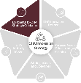
DHA Innovation Strategy Alignment
DHA’s Innovation Strategy sets the foundation for transformative innovation across DHA. The strategy is aligned to the MHS and DHA Strategic Plans, to achieve DHA’s overarching Strategic Goals and Objectives, and the Director’s priorities.
Rooted in DHA’s focus on enabling combat support to the Joint Force, building a modernized and integrated health delivery system, and inspiring teams to drive towards military health’s next evolution, DHA Innovation will unlock advancements in technological advancements to further improve health outcomes and lower cost of care across the health enterprise. The Innovation Cell, Accelerator, and AI Working Group position DHA to achieve this strategy.
MHS Strategic Plan
DHA Director
Priorities
DHA Strategy
DHA Innovation Strategy
AI Working Group
Innovation Cell
Accelerator

Slide 4
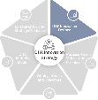
Expanding the Definition of Innovation
DHA’s current state definition of Innovation is intentionally focused on disruptive technology. However, as the Innovation Strategy matures, the DHA will continue expand this definition to include additional focus areas that will help build a scalable, future-state culture of innovation.
Innovation Current State Definition
Innovation Future State Definition
New Technology
New Services
New Care Models
New Policy
New Healthcare Products
New Culture of Innovation
Technology that will bring value, that we can implement quickly and that we can scale across our system.
Technology in support of enterprise performance that is disruptive, and significantly changes the performance of the organization.
Innovation MATURITY

Slide 5
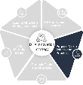
DHA Innovation: Purpose, Vision, Values, Priorities
“Health systems worldwide must transform to keep up with the pace of rapid Innovation.” Military Health System Strategy for Fiscal years 2024-2029
Purpose
Vision
Discover and operationalize innovation and technology to improve the health and experiences of patients and providers.
To pioneer technology and care delivery solutions that improve health outcomes and build readiness.
DHA Innovation
Strategy
Values
Priorities
Alignment
Integration
Risk Taking
Speed
Focus
No Beneficiary Left Behind
Digital First
People-Centered
Integrated System of Care

Slide 6
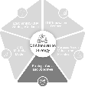
DHA Innovation Strategic Goals and Objectives
Strategic Goals
Objectives
Outcomes
Identify and Pursue the Right Innovation
Identify and assess innovation demand across the enterprise
Invest in new technology capabilities and areas of growth
Ensure value generation through mission-based innovation
Innovation is Aligned with Strategy and Produces Measurable Impact
TRANSFORM
Advance innovation acumen through innovation training programs
Develop functions to incubate grassroots innovation across the MTFs
Champion cultural change management and strategic communications
A Culture of Innovation Improves Engagement and Motivates Innovation Development
INSPIRE
Develop the Next Generation of Innovators
Establish Innovation Partnerships with Industry and Academia
Develop a brand as an innovation leader
Create partnership pathways between DHA, Industry, and Academia
Collaborate with government and industry to cultivate innovation solutions
Multiply Innovation Advancement and Reduce Risks
PARTNER
Create repeatable innovation processes to identify and scale innovations
Establish Innovation governance structure and funding mechanisms
Improve visibility and integration with innovation efforts across DHA
Resources and a Standardized Operating Model Create Innovation Investment Efficiency and Focus
Implement Enabling Infrastructure to Sustain and Scale Innovation
ENABLE

Slide 7
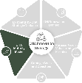
DHA Innovation Maturity Model
Advanced
DHA Current State
Wave 3: Converged Ecosystems
Wave 2: Digitalization
Wave 3 is pinnacle of healthcare innovation transformation where technology augments and empowers both providers and patients and drives significant strategic performance outcomes for the health system.
TECHNOLOGY
Wave 1: Digitize
Wave 2 elevates healthcare delivery from basic digitization to a data-driven, interconnected, and patient-centric system. The Innovation ecosystem becomes an anchor of health system performance.
Wave 0: Legacy Health System
Wave 1 prioritizes investments in infrastructure and technology to demonstrate value through improved efficiency and data-driving decisions.
Transformational Innovation Infrastructure:
Utilizes strategic foresight to inform long-term, ‘big bets’ investments
Expands portfolio beyond technology- based innovations
Consistently achieves value from new business models for innovation
Continuously enables tools and behaviors for disruption and improvement
Wave 0 is the baseline phase where vision and significant investment catalyze change.
Operational Innovation Infrastructure:
Has active systems for sourcing and scaling ideas across the organization
Provides an active portfolio of innovations that requires immediate ‘act now’ investments
Develops functions to equip the organization with a culture of risk taking and curiosity
Introduces and captures early value from new business models for innovation
No Formal Innovation Infrastructure:
Siloed innovation efforts
Individual, dispersed innovation vision
Undefined innovation portfolio
Focus on optimization and modernization
Foundational knowledge of innovation best practices and a desire to explore opportunities
Experimenting /Exploring Innovation Infrastructure:
Develops a shared vision for innovation at the organization based on demand signals
Experiments with digitals technologies, innovation engagements, and partnership pathways through small-scale pilots
Limited
Informal
MATURITY
Transformational
Notes:
Wave 0 is the baseline phase where vision and significant investment catalyze change.
Wave 1 prioritizes investments in infrastructure and technology to demonstrate value through improved efficiency and data-driving decisions.
Wave 2 elevates healthcare delivery from basic digitization to a data-driven, interconnected, and patient-centric system. The Innovation ecosystem becomes an anchor of health system performance.
Wave 3 is the pinnacle of healthcare digital transformation where technology augments and empowers both providing and patients. This level of maturity is an ongoing journey that requires continuous innovation and adaptation to navigate the ever-evolving healthcare landscape.

Slide 8
Transform

Slide 9
Sources of Innovation Demand
Innovation demand is sourced from various channels and may present as a problem statement or as a proposed solution. To achieve mission-based innovation, DHA will cultivate and ensure ongoing access to these channels to identify and prioritize the right problems and solutions.
Beneficiaries
Frontline Staff
Program Offices
Executive
Leadership
Provide direct feedback on their care experiences, needs, and wants
Provide perspective on clinical, operational, and administrative challenges at the local level
Provide insight on challenges encountered within specific functional or clinical areas
Provide directives, strategic plans, and system wide challenges across the DHA enterprise
Defense Health
Networks
Congress
Academia
Industry
Provides oversight and funding that informs DHA’s strategy to improve readiness and care delivery
Provides leading research and insights on innovations in healthcare delivery and emerging technologies
Provide insight on emerging trends to include breakthrough tech and evolving clinical standards of practice
Provide insight on network-wide challenges and needs specific to their region

Slide 10
Ensuring Value Generation for Innovation
Mission-driven innovation requires a holistic view across multiple dimensions of performance and focuses innovation on what matters most to DHA, its staff, and its beneficiaries.
Value-Driven Innovation Improves Health Outcomes & Readiness
Access to Care
Quality and Patient Safety
Value drivers for innovation allow for innovations to be assessed upfront based on their promise to return value and increase performance, while measuring health outcomes downstream
Provider Experience
Employee Satisfaction
Patient Experience

Slide 11
Innovation Demand Drivers
Value generation is the primary driver of innovation demand. An additional driver is the development of new capabilities. Value- and capability-driven demand lead the discovery of solutions for fit within the innovation portfolio.
Value-Driven Demand
Sources of Demand
Innovation Demand (Illustrative)
Innovation Portfolio
1
2
3
The Sources of Innovation Demand identify problems impacting clinical, operational, or administrative performance and seek to improve performance through innovation
Improve Patient Experience
Beneficiaries
Remote Patient Monitoring
Digital Front Door
Innovation Demand drives how solutions are sourced, evaluated, and prioritized in the portfolio.
Frontline Staff
Program Offices
Reduce Clinician Admin. Burden
Executive Leadership
VR for Surgical Prep
Capability Driven Demand
Reduce RX Costs
Defense Health Networks
In some cases, the Sources of Innovation Demand may identify technologies that are attractive in advancing performance or the overarching strategy. Capability driven demand should always align with value-driven demand.
Congress
AI for Radiology
Academia
Improve Behavioral Health Access
Industry

Slide 12
DHA’s Innovation Lanes of Effort
Informed by current trends in healthcare, DHA’s evolving innovation lanes of effort are a direct response to the demand signals for innovation and help focus the innovation portfolio.
Current Innovation Lanes of Effort
Matching Innovation Demand to the Right Technology Lane of Effort
(Illustrative Scenario)
Artificial Intelligence (AI): Encompasses solutions that enable computers to solve problems and perform tasks that would normally require human capabilities and intelligence.
Demand for Innovation
RESTORE THE WELLBEING OF PERSONNEL
Artificial
Intelligence
What challenges is the organization focused on? How can innovation enable increase outcomes?
Digital Health: Encompasses a broad scope of tools that can improve health care, enable lifestyle change and create operational efficiencies.
Digital Health
Innovation Lanes of Effort
Immersive Technology
Artificial
Intelligence
Digital Health
Robotics
Immersive Technologies: Group of technologies (e.g. AR, VR, MR, 360) are defined by a group of technologies presenting artificial environments.
What capabilities are technically feasible to address this mission challenge?
Immersive
Technology
Technology Application
Robotics: Solutions that leverage robots to carry out various tasks that enhance patient care and operations.
Immersive Technology
How are emerging technologies being applied to address this challenge?
‘Burnout and Resilience’ Virtual Reality Training for Clinicians
Robotics

Slide 13
Innovation Lanes of Effort: Artificial Intelligence (AI)
The AI portfolio is anchored by solutions that transform the DHA through the power of data. With the increasing volume and diversity of data at DHA, we will evaluate AI solutions that drive new insights and faster decision support or perform data tasks more confidently and efficiently.
Types of AI | Application
Task Automation Execute narrow, deterministic tasks in a static environment | Robotic Process Automation – Software technology that emulates humans’ actions interacting with digital systems and software Expert Systems – Computer emulating decision-making capability of a human expert
Pattern Recognition Uncover patterns in data and use them to act in static environments | Computer Vision – Uses deep learning to analyze visual data Natural Language Processing & engines – Enables machines to understand and respond to text or voice data
Contextual Reasoning Derive context from multiple data sources and use it to act in dynamic environments | Contextual AI – Next evolution of AI that allows systems to understand, respond, and adapt to different user contexts, in the same way a human would
ADOPTING AI WITH PURPOSE
USING AI TO IMPROVE EHR DOCUMENTATION
+ DHA can leverage AI solutions to study dialogue and complete EHR documentation during visits
+ DHA can leverage AI to predict the evolving care needs and demand for services for each Defense Health Network
USING AI TO PREDICT CARE UTILIZATION
USING AI TO DETECT ANOMALIES IN CARE
+ DHA can leverage AI to support radiologists and pathologists with diagnostic medical imaging
Adopting AI solutions are dependent on having AI-ready data. Solutions in this portfolio require a commitment to data transformation to include data management and governance.
See Appendix for Summary of AI Strategy

Slide 14
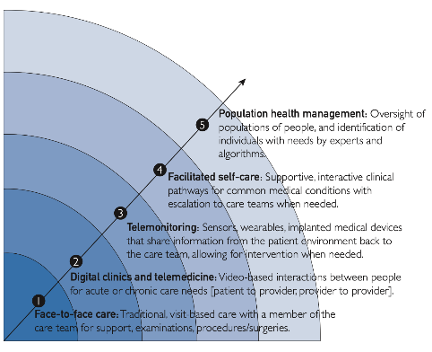
Innovation Lanes of Effort: Digital Health
Digital Health solutions empower providers, patients, and populations to engage with healthcare outside of traditional facility-based or analog methods. These solutions range from telemedicine, to wearables, mobile health, and other health IT applications or devices. These solutions most commonly advance healthcare outcomes through their application in Digital Access, Digital Medicine, or Digital Therapeutics.
Examples of Digital Health Application at DHA
Digital Access
Digital Medicine
Digital Therapeutics
+ Aims to extend relationships to where people live
+ Enable more efficient care delivery processes
+ Digital diagnostics
+ Digital biomarkers
+ Remote patient monitoring
+ Treat disease
+ Improve or manage disease
+ Prevent disease
Example:
Example:
Example:
Through its Digital Front Door Venture, DHA is deploying a virtual care platform, Amwell, to enable connected care from the home, hospital, and battlefield
DHA can adopt sensor and diagnostic technologies to enable hospital-at-home care delivery models (e.g. diagnostics and continuous monitoring from home)
DHA can improve access to behavioral health services through remote tools for behavioral therapy support
Mayo Clinic’s Digital Care Horizon: A Framework for Extending Health Care Through Digital Transformation
Notes:
Philpot LM, Sagar Dugani, Singla A, DeZutter MA, Ebbert JO. Digital Care Horizon: A Framework for Extending Health Care Through Digital Transformation. PubMed. 2023;1(3):210-216.
doi: https://doi.org/10.1016/j.mcpdig.2023.05.005

Slide 15
Innovation Lanes of Effort: Immersive Technologies
Immersive technologies are defined by a group of technologies presenting artificial environments that either enhance or replicate the real world. Immersive technologies have a variety of applications including clinical training, facility planning, and clinical performance.
Immersive Use Case Examples and Illustrative Scenarios:
Places the user in an entirely simulated environment
Facility Planning
Mission rehearsals
Facilities & infrastructure planning
Operational & logistical planning
Emergency planning
REINVEST IN MTFs
DHA can leverage immersive technology and digital twins to facilitate construction management and operational planning at facilities
VR
Overlays digital content into the user's real-world environment
VIRTUAL REALITY
IMMERSIVE
Creates multisensory digital experience, through any of these technologies
Training
Training in Emergency Environments
Equipment Training
Emergency Response Training
Task Assistance
SUSTAIN CLINICAL COMPENTENCIES
DHA can leverage immersive technology to provide immersive learning experiences for clinicians and students at the Military Education Training Center
360
AR
Enables a user to view video in any direction
AUGMENTED REALITY
Clinical Performance
Neurological sensor integration
Scan pattern tracking
Biological feedback
MODERNIZE THE MHS
DHA can leverage immersive technology to improve surgical planning and help reduce surgical complications
MR
Allows a person to interact with physical objects in a virtual world
MIXED REALITY

Slide 16
Innovation Lanes of Effort: Robotics
Robotics refers to a branch of engineering and computer science that involves the conception, design, manufacture and operation of robots. In healthcare, robots are increasingly being adopted to carry out various tasks that enhance patient care. At DHA, healthcare robotics has application across the battlefield, operations, and care delivery.
Battlefield
Operations
Care Delivery
Delivery and Transport
Robots used for the transfer of items between areas
Surgical Application
Robots used to assist in performing surgical procedures
Supply Management
Robots that assist with the management and delivery of services
Socially Assistive
Robots that provide support in areas such as companionship and service provision
DHA can leverage robotics to deliver medical supplies, while on the battlefield, or across hospital units
DHA can leverage robotics to improve surgical planning and outcomes
DHA can leverage robotics to improve operations when restocking pharmacies and/or warehouses
DHA can leverage robotics to supplement behavioral health interventions

Slide 17
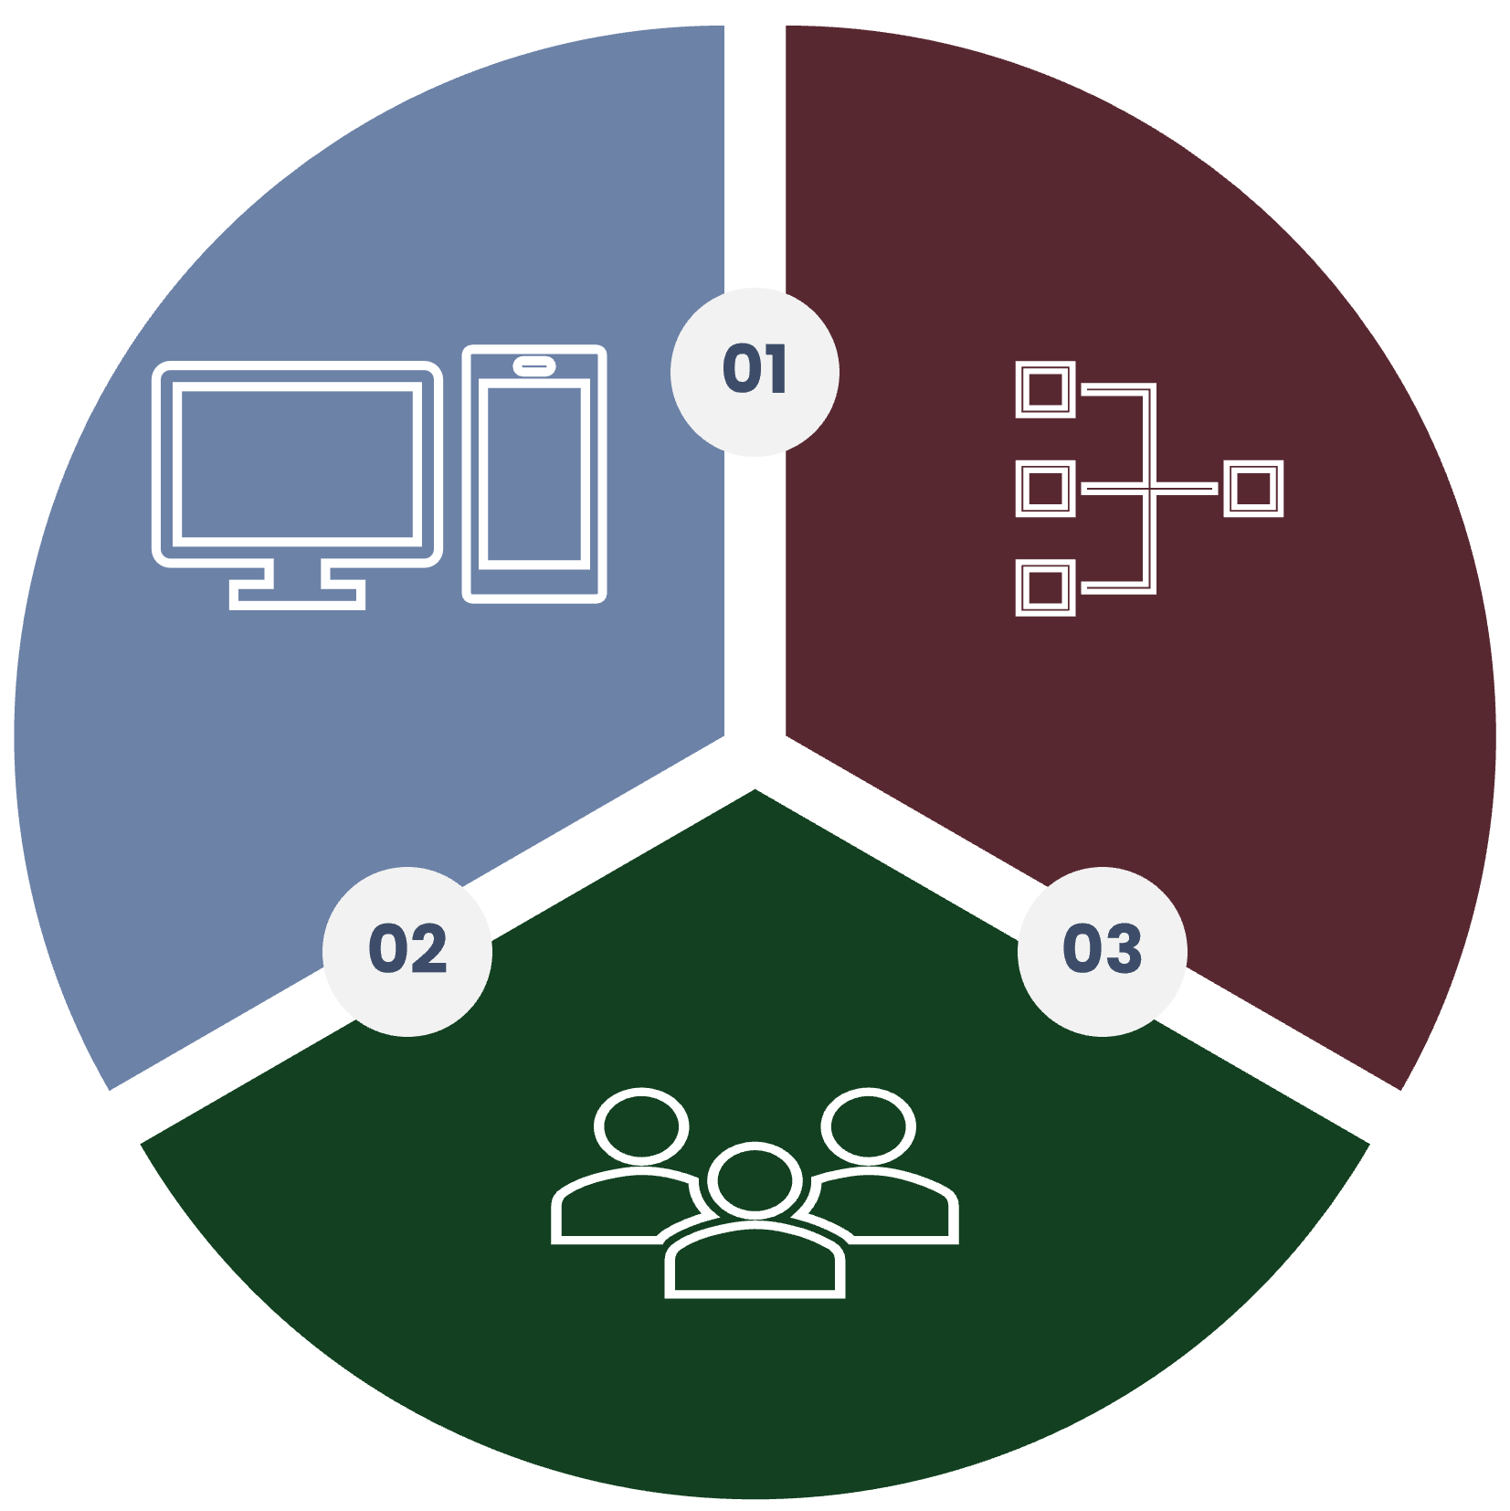
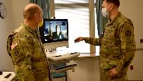
DHA Innovation Cell Priorities
To drive the transformational agenda, when reviewing technology investments DHA Innovation Cell will use its (3) priorities to assess the organizational fit of solutions. An innovation that aligns to one or more of DHA Innovation Cell’s Priority Areas is an innovation that DHA Innovation Cell should further assess for usability, feasibility, and viability.
DHA Innovation Cell Priorities
Solutions that align to “DHA Innovation Cell Priorities” and directly respond to innovation demand
Initial focus on improving behavioral health and primary care outcomes
Digital First
People-Centered
Integrated System of Care

Slide 18
Innovation Cell Portfolio Development
The Innovation Portfolio is comprised of submissions (innovative ideas or problem statements) and projects. At launch of the Innovation Cell, an initial 63 innovation submissions were provided by DHA employees, showcasing current state understanding and interests of these stakeholders¹.
Portfolio Fit
Technology Fit
Value Fit
Sample Submissions
Interactive Virtual Human Body (IVHB) Grant Proposal
Lack of Interactive A & P modeling for Educational and Training…it is an excellent opportunity to implement teaching tools that can reduce the overall attrition rates…
Evaluation of UAV/Drone technology for medical resupply in operational and resource limited environments
In resource limited environments, access to medical supplies may be limited…Small, inexpensive UAVs or drones may help resupply medical facilities on the battlefield.
In Scope
Out of Scope
Artificial Intelligence
Digital Health
Immersive
Robotics
Efficiency/Cost
Quality/ Patient Safety
Access
Patient
Experience
Provider
Experience
Employee Satisfaction
As a trainer I can tell/see when a provider is having a problem completing their documentation on time…Providers veer from using workflows all the time… DAX is an AI that can build provider notes within seconds….
Out of the 63 submissions, 76% are considered ‘in scope’ based on Innovation Cell’s Priorities
Artificial Intelligence (52%) and Digital Health (44%) were the top tech-categories.
“Efficiency/Cost” (36%) was the largest value-driver, “Employee Experience” (1%) was the least common.
Using AI to document patient care
1. The initial list of submissions is not necessarily a representative sample of the organization, but rather the result of initial communication efforts at Innovation Cell launch, and do not necessarily represent active projects.

Slide 19
Innovation Cell Portfolio Development: Maturation
As the Innovation Strategy matures, we will evaluate and steer portfolio diversity and balance (value impact and technology lanes of effort) to ensure ongoing alignment with DHA strategic priorities. For example, initial submissions skewed the portfolio composition to efficiency and cost reduction. In the future, the portfolio may expand to include more even spread of value-drivers.
The Innovation lanes of efforts may evolve over time to include other or newly emerging technologies. Ongoing efforts to balance and re-balance the portfolio will ensure the innovation portfolio focuses on what matters most.
Notional Example of Innovation Cell’s Future Portfolio
Portfolio Fit
Technology Fit
Value Fit
Today
Tomorrow
Immersive
Technology
Digital Health
Immersive
Technology
Digital Health
3D Printing
In Scope
Out of Scope
Artificial Intelligence
Immersive
Robotics
Efficiency/Cost
Quality/ Patient Safety
Access
Digital Health
3D Printing
Patient
Experience
Provider
Experience
Employee Satisfaction
Robotics
Artificial Intelligence
Robotics
Artificial Intelligence
Increased marketing and communications, will increase the quality of in-scope submissions
As technology evolves the innovations represented in the portfolio will expand to represent best-fit solutions
Value-drivers represented in the portfolio will grow inline with organizational priorities.

Slide 20
DRAFT
Developing DHA’s Industry Presence as an Innovator
To foster partnerships with industry, DHA Innovation Cell will develop its presence as an innovator through 3 lanes that showcase its commitment to and appetite for innovation
Industry Events
Notional
Judge or panelist at leading innovation conferences such as South by Southwest (SXSW) Conference
Speaker at leading healthcare conferences such as Healthcare Information and Management Systems Society (HIMSS) Conference
Host Annual DHA Innovation Symposium to showcase innovation across the enterprise
Host Reverse Industry Days (e.g. industry partners provides insight on specific solution, such as immersive solutions for DHA)
Thought- Leadership
Notional
Publications in New England Journal of Medicine (NEJM) Innovation Catalyst
Facilitate roundtables with leading health systems and government agencies
Digital Presence
Notional
Develop social media presence celebrating the agency’s innovators and innovations
Publish press releases celebrating partnerships with industry
Create digital pathways for industry to submit collaboration ideas
Publish blogs through internal channels or external channels (e.g. medium)

Slide 21
DRAFT
Identify the Best Partners (Attributes)
Knowing who to partner with and what a strong partner looks like will focus DHA Innovation Cell’s engagement and outreach to potential partners
Types of Partners
Attributes of Partners
Strong partners for DHA Innovation Cell provide
Shared risk-taking
Subject matter expertise
Validated solutions
Access to unique IP and/or capabilities that compliment needs
Commitment to goal and shared vision
Strong understanding of military health’s governance, process, and organizational alignment
Strong innovation reputation/ brand
Nimble and open to change
Strong cultural fit
DHA Program Offices
Academia
Partnerships with program offices and existing innovation entities help ensure solutions are sourced with their functional/clinical expertise, while also garnering them as functional champions
Academic partnerships provide a differentiated channel to innovations, subject matter expertise, and services, such as entrepreneurial programs.
External Industry
Government Agencies
Partnerships with external industry provide a means to differentiated technology, services, or expertise, such as emerging technology from industry startups
Partnerships with government agencies provide a means to co-invest in cross agency challenges , such as behavioral health, access to primary care, etc.

