Slide 1
Operation Magnolia: An Active-Duty Training Model, Creating Future Training Evolutions for the U.S. Public Health Service Reserve Commissioned Corps
CAPT Stefanie Glenn, DNP, ANP-BC, ACNP-BC, FAANP; CAPT C. Kyle Gropp, PharmD, MBA, MEDM
Division, Reserve Commissioned Corps

Slide 2
Disclosures
CAPT Stefanie Glenn and CAPT Clinton K. Gropp, have no relevant financial or non-financial interest to disclose.
This continuing education activity is managed and accredited by AffinityCE, in collaboration with AMSUS. AffinityCE and AMSUS staff, as well as planners and reviewers, have no relevant financial interests to disclose. AffinityCE adheres to the ACCME’s Standards for Integrity and Independence in Accredited Continuing Education. Any individuals in a position to control the content of a CME activity, including faculty, planners, reviewers, or others, are required to disclose all relevant financial relationships with ineligible entities (commercial interests). All relevant conflicts of interest have been mitigated prior to the commencement of the activity.
Notes:
Use slide/wording provided by AMSUS

Slide 3
Learning Objectives:
Describe how the inaugural training created a reproducible model for future U. S. Public Health Service Commissioned Corps trainings.
Describe how the RCC Regional Command Teams identified strengths, and opportunities for continued field, organizational and team development trainings.
Describe how the RCC Regional Command Teams develop, implement, execute, and evaluate training evolutions for multiple clinical and non-clinical disciplines in deployment scenarios.
Chronicle how the RCC Regional Command Team quickly and collectively collaborated, planned, executed, and evaluated the training in a resource constrained environment.

Slide 4
Background
Mission of the U.S. Public Health Service Reserve Commissioned Corps is to provide trained, ready, and equipped public health professionals, capable of mobilizing and deploying to augment the Active Duty USPHS Commissioned Corps, under the authorities of the Secretary for Health in response to regional, national, and global public health emergencies
Reserve Commissioned Corps was funded and authorized by the Coronavirus Aid, Relief, and Economic Security (CARES) Act, 27 March 2020
First Reservists Commissioned July 2021 – 11 Officers Attended OBC
Reserve Officer meet the Same Appointment Requirement as Regular Corps Officers
Currently, 95 Reserve Officers
Annual Training (AT) – 15 days of Active-Duty Training required per year
Inactive Duty for Training (IDT) – one weekend per month

Slide 5
Background
Annual Training (AT)
Extensive training program continues to be expanded
Mission Essential Training Lists (METL)
Purpose
Prepare for deployments in austere environments
Building capacity to function in Incident Command Structure (ICS)
Build team cohesion
Enhance critical thinking skills
Build resiliency
Ensure basic deployability readiness
Fulfill AT requirements
Create a model for enhanced future training

Slide 6
Preparation
Original plan was to partner with the National Guard Bureau (NGB)
Regional Commanders (2) attended Patriot Exercise Arctic Eagle 2022
Joint Base Elmendorf-Richardson, Anchorage, AK
Regional Commander worked collaboratively with the NGB to plan Patriot ‘23
Patriot ‘23 was postponed until 2024
Regional Commander was at Camp Shelby Joint Forces Training Center (CSJFTC) outside of Hattiesburg, MS for the final Master Scenario Event List (MSEL) sync when canceled
Met with Troop Issue regarding housing, training buildings
Met with Mississippi Emergency Management Agency (MEMA) and Mississippi State Department of Health (MSDOH) to coordinate trainings
Notes:
Final Planning meeting for Patriot 2023 was to be held on 16 Feb 2023. I traveled to Camp Shelby on 15 Feb 2023. Enroute at 11:51 am, the Patriot 2023 was postponed to 2024. 6 weeks prior to the training exercise, we were left with nothing. I literally got dizzy, didn’t sleep well that evening, got up and knew what I needed to do. Regional Command staff came together and created a training program in less than 6 weeks!

Slide 7
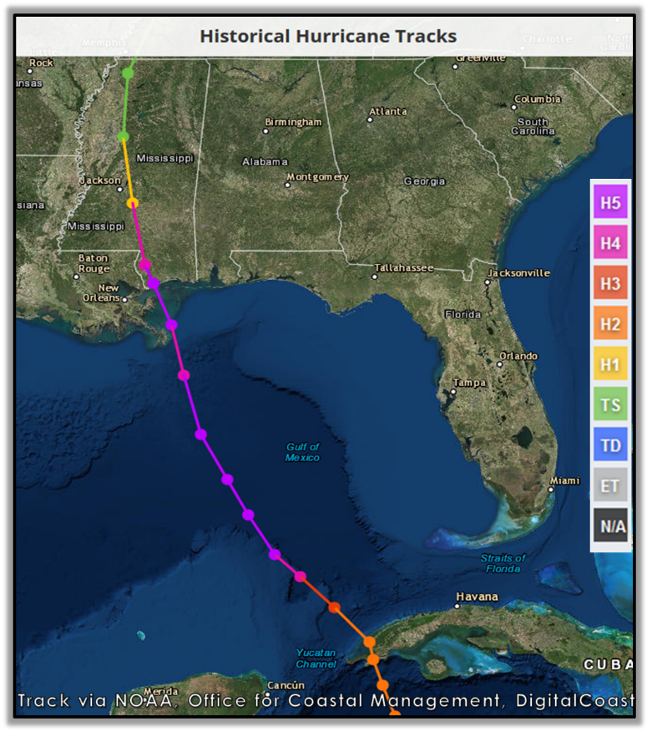
Planning
Operation Magnolia was the first large scale exercise completed by the Reserve Commissioned Corps
Location - Camp Shelby Joint Forces Training Center (CSJFTC) outside of Hattiesburg, MS
Training Dates:
OIC/SOFR/Logs brief on 17 Mar 2023
Pre-Deployment (Training) brief on 23 Mar 2023
Trainer Controller Teams travel to CSJFTC on 25 Mar 2023
Reservists traveled to CSJFTC on 26 Mar 2023
All staffed departed CSJFTC on 06 Apr 2023
12 full days of training

Slide 8
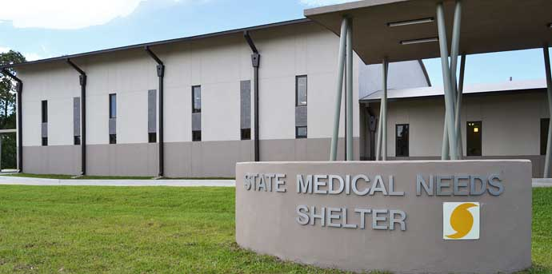
Challenges – Real World Events
Semper Gumby
Patriot ‘23 Postponed – but we are still required to complete AT
Location? – no established relationships
Logistics – supplies, lodging, facilities, travel/transport
Partnerships
MEMA
MSDOH
Tornado Outbreak – March 24-26
EF-4 Rolling Fork, Midnight, Silver City
EF-3 Winona, Amory

Slide 9
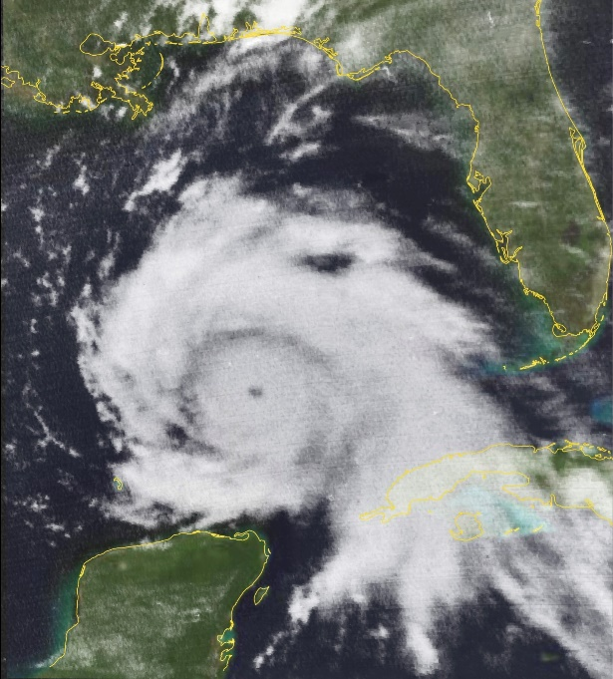
Training Included:
Readiness Requirements
33 of 34 completed BLS
33 of 34 completed APFT
3 completed PHU
Simulated Hurricane Response
“Fail Safely”
ICS Roles utilized, and ICS forms completed throughout the exercise
Learned about potential partners during response operations – MSDOH, MEMA, Team Rubicon
Learned how to function in an austere environment
Staffed 24/7 operation to include overnight simulation
Additional Trainings
Customs and courtesies
Drill and ceremony
Demonstrated ability to work with vulnerable populations through community service events
Demonstrated cultural awareness
Notes:
Picture = Camille, 1969

Slide 10
Training Tools and Terms:
Commissioned Corps Task List (CCTL)
Essential Tasks needed to support mission accomplishment
Critical knowledge and skills
Mission Essential Tasks (MET)
Essential Task is a focused action, process, or activity deemed critical to mission
Core – critical, focused activities that enable execution of the mission
Core plus – prepares individual commands/regions to deploy
Mission Essential Task List (METL)
Common reference used across the USPHS Commissioned Corps
Can be tailored to the specific mission
Based on CCTL
Master Scenario Event List (MSEL)
List of events that occur during a full-scale training exercise
Used to teach, assess, and incorporate METs to enhance learning and agency interplay
Inject
Learning scenario or event designed to challenge participants
Observer, Controller, Trainer (OCT) – trainers who control the injects during the exercise
Notes:
Picture = Camille, 1969

Slide 11
Baggage – Training Inject
Lost Baggage – Go Bag Preparedness
When: During Mobilization (Day – 0)
Purpose: Ensure officers know and understand the “Go Bag” versus the Deployment Bag
Officers should be able to sustain themselves for 72 hours
METL
OIC-AM-2004 – Optimize Resources
OIC-OD-2002 – Apply Core Values
OIC-EM-2006 – Identify Trauma and Resiliency
OIC-OD-2003 – Apply Emotional Intelligence
At airport all deployment bags (large bags) were collected by the Observer/Controller/Trainers (OCT) and were not returned until the following day
Real-world event: Airline actually lost reservist’s deployment bag.
Result: Reservists were able to survive without their deployment bag, a few uniform components were missing

Slide 12
Drill and Ceremony
When: Starting Day 1
Purpose: Demonstrate Drill and Ceremony to enhance integration with National Guard and other DoD partners. Ensure accountability
METL
OBC-BS-1019 – Conduct Basic Drill
OBC-BS-1006 – Apply Operational Dress Uniform Standards
OBC-BS-1001 – Identify Rank Structure
OBC-BS-1002 – Identify Uniformed Service Courtesies
Drill and Ceremony taught outside and assembly with accountability performed daily
Result: Reservists able to assemble, perform Drill and Ceremony and ensure officer accountability throughout the training.

Slide 13
Baggage – Inject 2
Go Bag/jump bag exercise – Heavy Baggage exercise
When: Day 4 – Start of Main Exercise
Purpose: Ensure proper packing and not over-packing
METL
OBC-BS-1012 – Identify Basic Readiness
OIC-OD-2002 – Apply Core Values
OBC-OD-1002 – Develop Resiliency
OIC-OD-2003 – Apply Emotional Intelligence
Inject: Storm shifted, evacuation of current location is needed.
All belongings should be able to be carried or rolled over uneven and possibly muddy terrain.
Real-world event: Injury necessitated officers to assist fellow officer with their belongings
Result: Reiterated the importance of proper packing, ability and necessity of being able to carry all deployment bags in less than ideal situations.
Notes:
**Note: no reservists were injured during the execution of this inject

Slide 14
Classroom
Access and Functional Needs
Geographic Information System (GIS)
Presentation and Tabletop exercise
Joint Patient Assessment and Tracking System (JPATS)
Team Emotional Intelligence
Resiliency
Incident Command Structure (ICS) Roles Training
Basic Life Support (BLS)

Slide 15
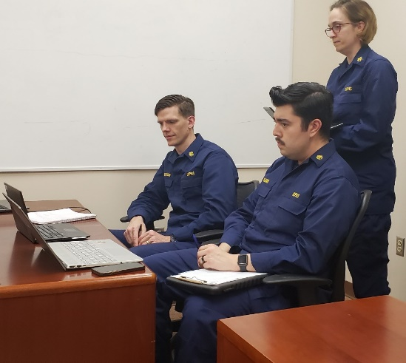
Capstone - Overnight Austere Simulation
When: Afternoon – Day 4
Purpose: provide 24/7 coverage for a simulated Federal Medical Station (FMS); Build Resiliency, Build Capacity to Function in an ICS; Develop Team Cohesion and Enhance Critical Thinking and Communication Skills
METL
OBC-EM-1001 – 1014 (all 14 Emergency Management METLs)
Inject: Hurricane made landfall; Governor of Mississippi requested declaration of emergency. USPHS team prepositioned along with FMS Cache at Camp Shelby. Assignments/Roles need to be made by Incident Commanders, needs assessments and inventory needed, daily battle rhythm established.
Real-world event: 24/7 coverage necessitated sleeping arrangements
Result: This was the main and most fun part of the training exercise. ICS forms were completed, providing reservists with a deeper understanding of their use and need.

Slide 16
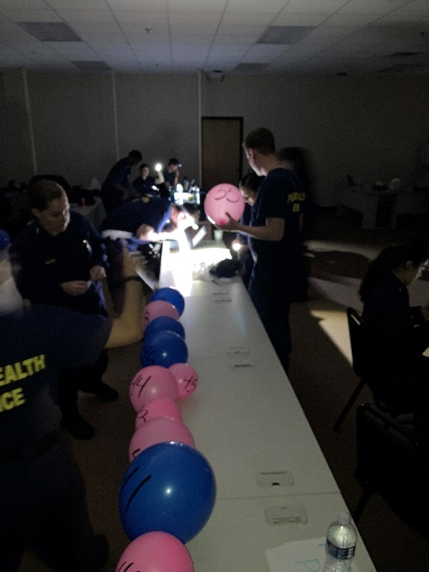
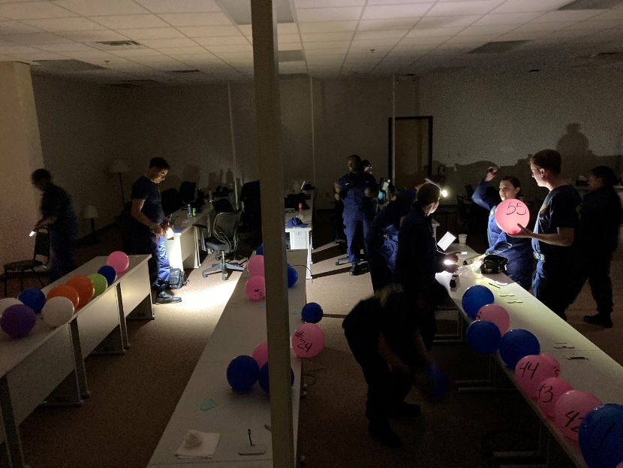
Capstone - Overnight Austere Simulation
When: Early morning Day 5 (during Capstone)
Purpose: Ensure proper equipment and supplies are available in deployment bag, Understand communication requirements, SPOT Reports, proper use of ICS forms, Enhance communications
METL
OIC-AM-2004 – Optimize Resources
OIC-IM-2002 – Perform Effective Communication
OIC-OD-2008 – Perform Decision Making Problem Solving
OIC-OD-2003 – Apply Emotional Intelligence
Inject: Loss of power, loss of communication, patient injury, officer injury, difficult patients and caregivers, pets, storm damage to shelter/FMS, patient surge, co-worker decompensating,
Result: Reservists did an outstanding job. All but one of the objective were met (Transfer of Command not performed). Solidified the ICS structure and forms.

Slide 17
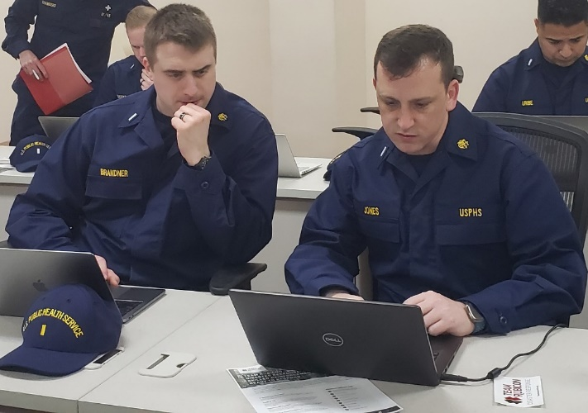
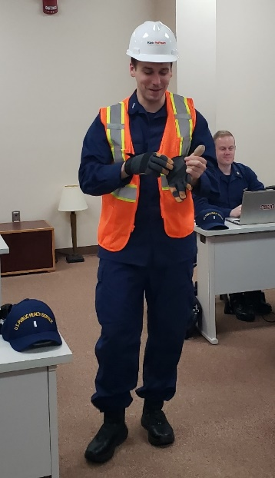
Capstone – Full Scale Simulation
When: Day 4
Purpose: Demonstrate duties, responsibilities and capabilities of an effective responder in ICS Roles
OIC, Safety Officer, PIO, LNO, Operations, Planning, Logistics, Administration/Finance
Understand and Use ICS Forms
Effectively run meetings, meet reporting requirements
METL
OBC-EM-1001 – 1014 (all 14 Emergency Management METLs)
Inject: Given the scenario, develop a response framework including assignments of available team members to appropriate ICS roles. Establish a battle rhythm complete with appropriate section meetings, staff meetings, reporting and accountability
Result: Reservists assigned to ICS roles. Completed all requirements appropriate for the given role. All but one of the objectives were met (Transfer of Command not performed). Solidified the ICS structure and forms.

Slide 18
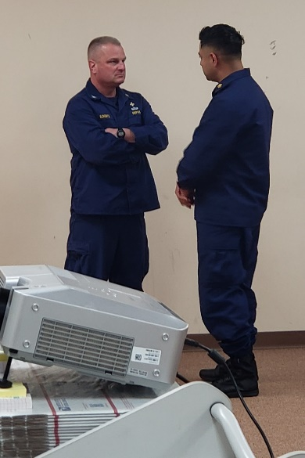
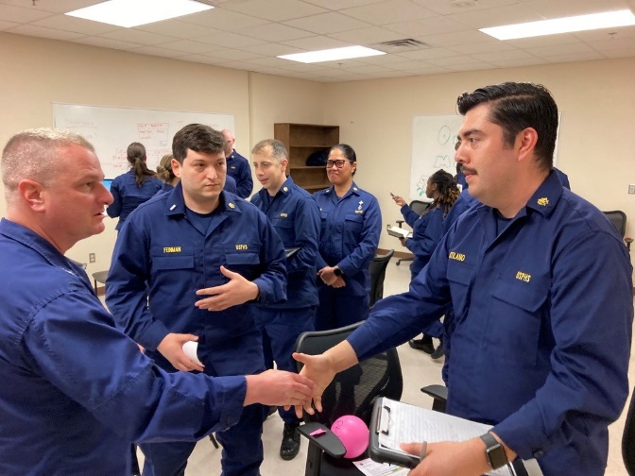
VIP Guest RDML Schobitz as “Mayor Rick” Training Inject
When: Day 4
Purpose: Understand and demonstrate the responsibilities of the Public Information Officer (PIO).
METL
OBC-EM-1002 – Perform Public Health Emergency Communication
OBC-EM-1004 – Identify Responder Health and Safety
OIC-IM-2001 – Conduct Effective Communication
OIC-IM-2001 – Perform Professional Writing
OIC-OD-2003 – Apply Emotional Intelligence
Inject: VIP visitor, Local Mayor Rick Schobitz visits the FMS and wants updates and information.
Real-world event: RDML Schobitz is a VIP and appropriate communication, and information sharing was performed by Reservists
Result: Feedback from RDML Schobitz was positive and the inject was successful.

Slide 19
Habitat For Humanity of the Pine Belt – Habitat Restore
When: Day 9
Purpose: Understand and demonstrate the responsibilities of the Public Information Officer (PIO). Community Outreach
METL
OBC-EM-1002 – Perform Public Health Emergency Communication
OBC-EM-1004 – Identify Responder Health and Safety
OIC-IM-2001 – Conduct Effective Communication
OIC-IM-2001 – Perform Professional Writing
OIC-OD-2003 – Apply Emotional Intelligence
Inject: Partner with local response agencies. Public Health Week
Real-world event: Due to the weather, location, and safety issues of being in a worksite/warehouse, Safety Officers also demonstrated mission essential tasks.
Result: Habitat Restore for Habitat for Humanity of the Pine Belt received much needed assistance. PIO provided talking points, effective and efficient communication. Liaison officer (LNO) connected the team with partners.

Slide 20
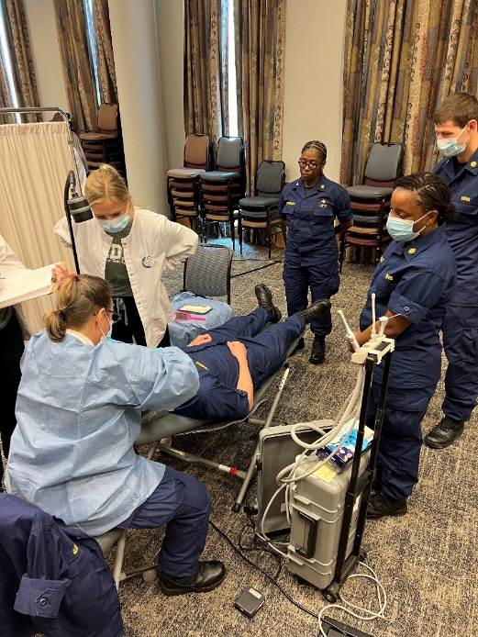
Head and Neck Cancer Screening, Forrest General Hospital
When: Day 9
Purpose: Understand and demonstrate the responsibilities of the Public Information Officer (PIO). Community Outreach in a real-world setting.
METL
OBC-EM-1002 – Perform Public Health Emergency Communication
OBC-EM-1004 – Identify Responder Health and Safety
OIC-IM-2001 – Conduct Effective Communication
OIC-IM-2001 – Perform Professional Writing
Inject: Partner with local response agencies. Public Health Week
Real-world event: During Public Health Week, Forrest General Hospital was performing head and neck cancer screening as part of a health fair.
Result: PIO and LNO partnered with the point-of-contact at the hospital to allow the team to provide a vital service to the community.

Slide 21
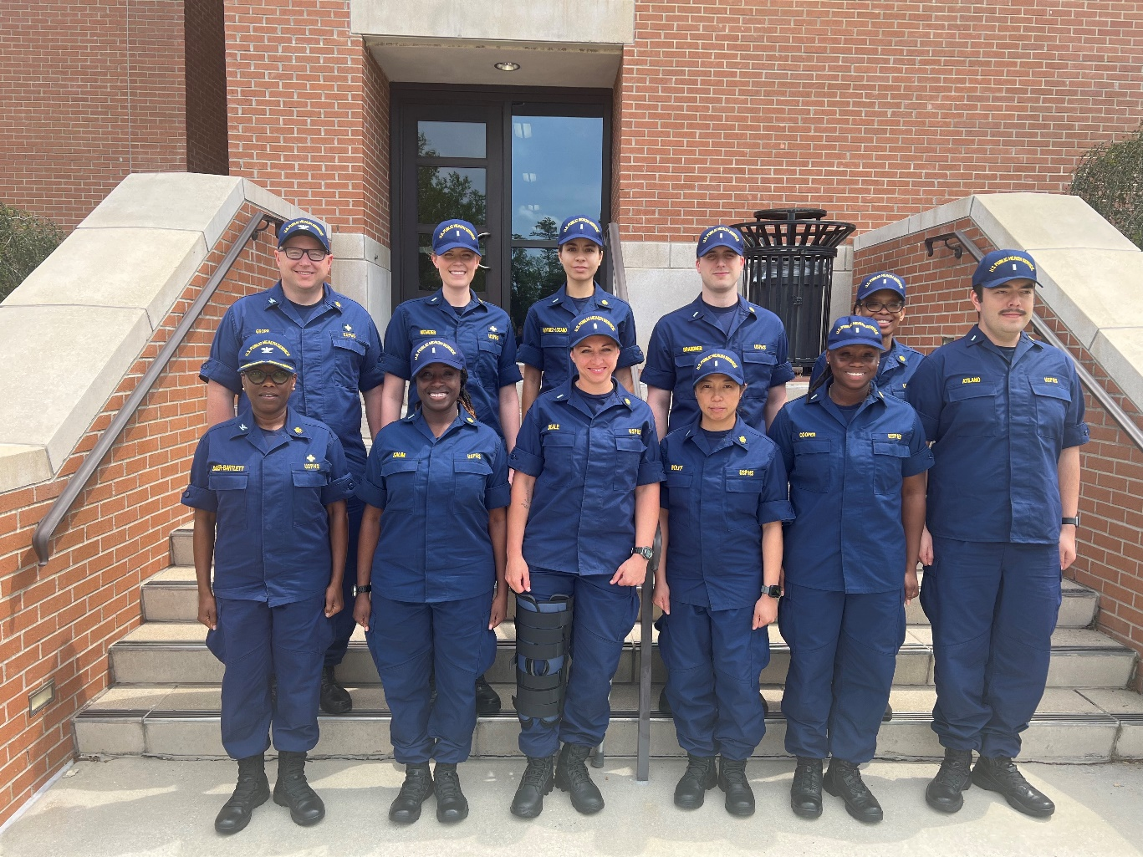
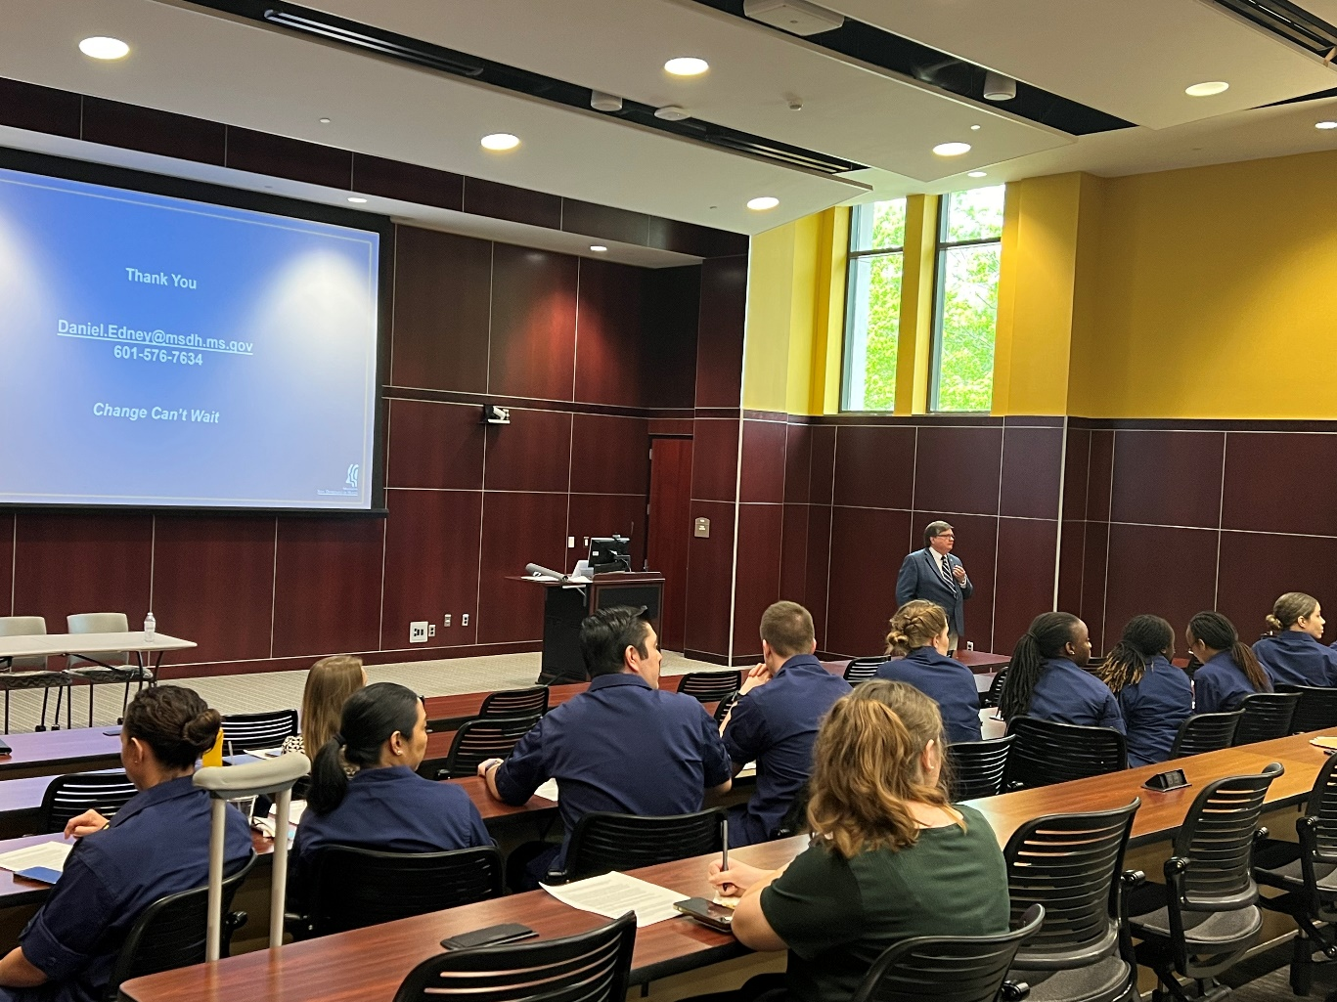
University of Southern Mississippi School of Public Health, Special Guests for National Public Health Week Symposium

Slide 22
After Action Reviews What went well?
The Regional Command Teams (RCT) and Reserve Training Branch worked together for a successful exercise
Cost effectiveness of training at CSJFTC
The RCTs maintained their operational oversite of their assigned regions while leading this exercise
34 Reservists received 12 days of Active Duty for Training-Annual Training (ADT-AT)
Partnership with travel team assisted in smoother travel process

Slide 23
After Action Review: Opportunities for Improvement
Reserve Commissioned Corps needs the ability to purchase items
Supplies
Barracks on CSJFTC
CPR Certification
Lack of realism
Balloons for patients
FMS Cache inventory list
Unable to distinguish who was in specific roles

Slide 24
Recommendations
Purchase Card for Training Chief in RCC
New York Medical College, Center for Disaster Medicine MOA
Continue to work with Travel for future trainings
Re-evaluate forms needed for travel
Investment Justification Request (IJR) versus Letter of Intent (LOI)
Notification of Mobilizations
1662s for reservists
Plan for Patriot Exercise (Feb 2024) and Operation Blue Crab (Spring 2024)
Obtain FMS Training Cache for RCC
Obtain Technology Cache for RCC
Enhance partnership between CCHQ Training Branch, RDB, and ASPR

Slide 25
Current and Future Trainings
Operation Blue Crab Training Exercise
Second full-scale training
Location – Fort Walker, Virginia
Military Facility Annual Trainings (MFAT)
Womack Army Medical Center, Fort Liberty, North Carolina
Madigan Army Medical Center, Joint Base Lewis-McCord, Washington
Patriot Exercises
National Guard Bureau
Location - FY’24 Camp Shelby, Combat Readiness Training Center, MS
Remote Area Medical (RAM) exercises

Slide 26
Questions?

Slide 27
How to Claim CE Credit
If you would like to receive continuing education credit for this activity, please visit:
amsus.cds.affinityced.com

