Slide 1
The Bridge Builders: Reaching Back to Move Forward
Moderator: Althea Green, Command Sergeant Major, USA (Ret)
Panelists:
Clinton Garrett Sr., Master Chief Petty Officer, USN (Ret)
Benjamin H.S. Scott Jr., Command Sergeant Major, USA (Ret)
Mark Withers, Chief Master Sergeant, USAF (Ret)
Notes:
Title Slide Design

Slide 2
Disclosures
The Presenters have no relevant financial or non-financial interests to disclose.​
This continuing education activity is managed and accredited by AffinityCE, in collaboration with AMSUS. AffinityCE and AMSUS staff, as well as planners and reviewers, have no relevant financial interests to disclose. AffinityCE adheres to the ACCME’s Standards for Integrity and Independence in Accredited Continuing Education. Any individuals in a position to control the content of a CME activity, including faculty, planners, reviewers, or others, are required to disclose all relevant financial relationships with ineligible entities (commercial interests). All relevant conflicts of interest have been mitigated prior to the commencement of the activity.​
Commercial support was not provided for this activity.

Slide 3
Disclaimers
The views expressed in this presentation are those of the presenters and do not reflect the official policy or position of the Department of Defense or of the U.S. Government.

Slide 4
Learning Outcomes
Discuss two techniques for effective change management.
Describe one challenge for senior enlisted leaders in a multi-service environment.
Describe one method to connect people with ideas.

Slide 5
40 Years of Change…
Single Service Medical Commands
Military Operations Other Than War (MOOTW)
Field Hospital
CHAMPUS
Public Health
Defense Health Agency (DHA)
Platinum 10 mins
Defense Medical Oversight Committee (DMOC)
Doc Cooke Report
CASEVAC
MEDCOM
NDAA
Global War on Terror (GWOT)
Combat Support Hospital (CSH)
Cold War
Medical Research
Medical Unit, Self-contained, Transportable (MUST)
Forward Surgical Team (FST)
Joint Medical Command (JMC)
733 Study
Full Spectrum Operations
Graduate Medical Education
Unified Medical Command
JTF-CAPMED
TRICARE
AFMS
Evacuation Hospital
MEDEVAC
Medical Education
Multi-Domain Operations
Medical Regulating (MEDREG)
Rice Commission
CHAMPUS
BUMED
Expeditionary Medical Support (EMEDS)
Mobile Army Surgical Hospital (MASH)
Defense Health Program (DHP)
Critical Care Air Transport Team (CCATT)
Grace Committee
Unified Medical Command
Deployable Medical Systems (DEPMEDS)
Golden Hour

Slide 6
Change Management Models

Slide 7
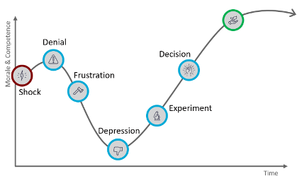
The Change Journey (Kubler-Ross Change Curve)
Adapted from chaucher.com

Slide 8
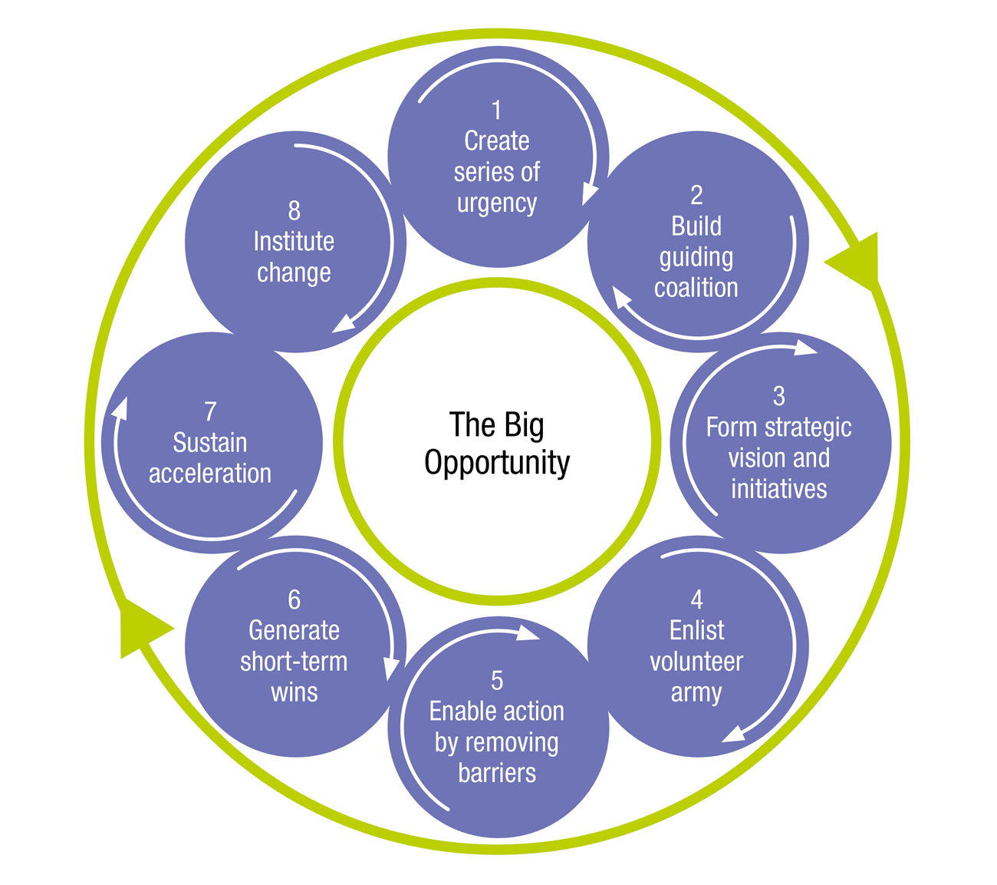
Kotter’s 8-Step Change Model
Adapted from kotterinc.com

Slide 9
Deming Cycle (PDCA)

Slide 10
Discussion

Slide 11
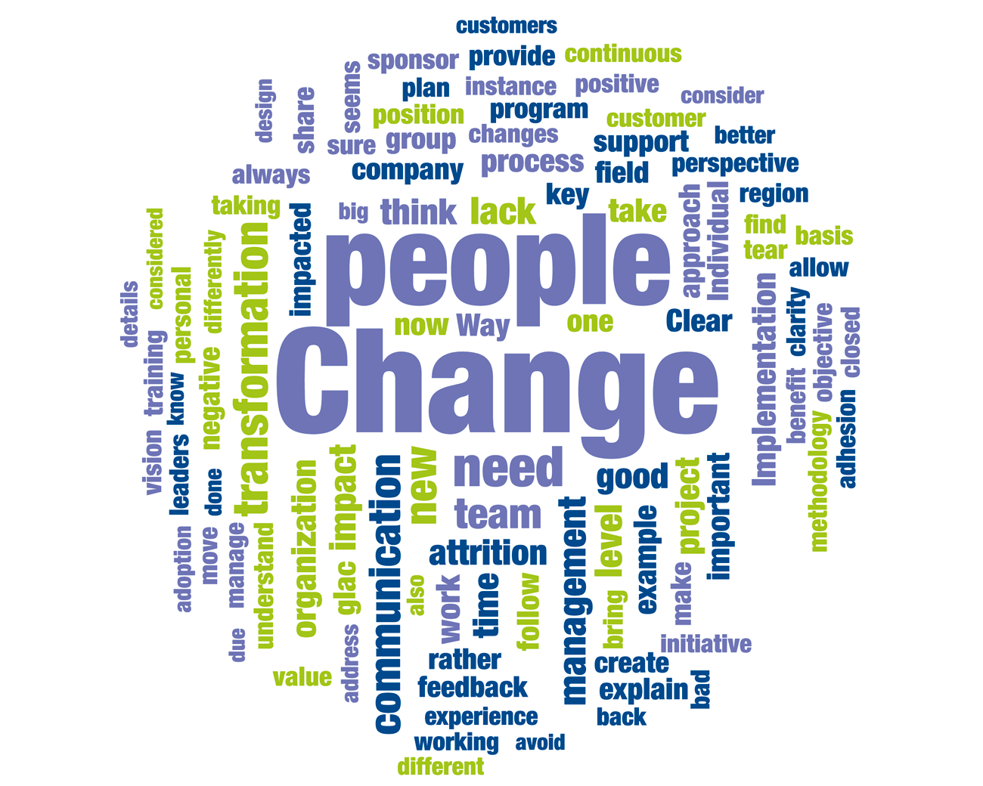
Change is People-Centered

Slide 12
Summary
No organization can operate the same way forever.
People make change happen.
How well an organization endures change depends on how leaders deal with the process.
It takes an investment of time and energy to create the environment that connects people with ideas.
Noncommissioned officers operate at the level where there is the biggest impact on organizational people and processes.

Slide 13
Thank you for your participation!

Slide 14
How to Claim CE Credit
If you would like to receive continuing education credit for this activity, please visit:​
amsus.cds.affinityced.com​

