Slide 1
NATO Force Model: Canadian Armed Forces Capabilities to deliver 10-1-2(+2) in the Land Environment 2024 AMSUS Annual Meeting
BGen Scott F. Malcolm MSC, CD, MD
Canadian Armed Forces Surgeon General

Slide 2
Background
Op REASSURANCE began in 2014 as Canada’s contributions to the NATO Assurance & Deterrence mission in Eastern Europe. It has included efforts in all domains, including:
Air
CF-18 deployments to conduct NATO air policing missions in Romania. Lithuania, and Iceland.
CP 140 deployments to conduct NATO surveillance missions across SACEUR’s area of operations.
Maritime
Deployments of Frigates and Maritime Coastal Defence Vessels to the Standing NATO Maritime Groups and Standing NATO Mine Countermeasures Groups.
Land
The deployment of a Land Task Force to Poland from 2014-2017.
Leadership of the NATO Enhanced Forward Presence (eFP) Battle Group in Latvia since June 2017.

Slide 3
NATO Mission – Posture Adaptation
In response to the Russian invasion of Ukraine, NATO Supreme Allied Commander Europe (SACEUR), recommended that NATO change its force posture in Europe.
This led immediately to the expansion of the eFP Battle Group program from four to eight locations, adding new BGs in Slovakia, Hungary, Romania, and Bulgaria.
At the June 2022 NATO Madrid Summit, NATO nations agreed to an increased posture that included developing plans to reinforce the eight eFP Battle Groups with high readiness combat-capable reinforcements to rapidly expand to brigade size formations in both peacetime and crisis.
The new force posture transitions NATO forces from a deterrence mission to deter, and if necessary, defend against Russian aggression.

Slide 4
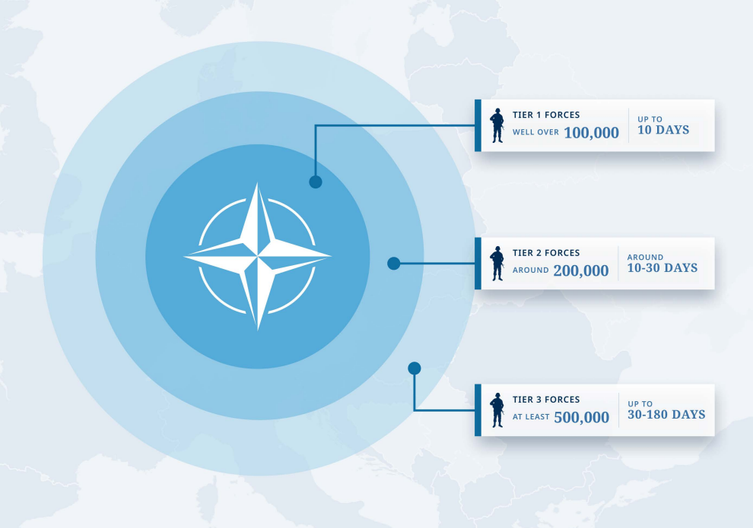
New NATO Force Model
At the 2022 NATO Summit in Madrid leaders agreed to a new NATO Force Model.
The NFM will move from 40,000 NATO soldiers being available at 15 days' notice to over 300,000 soldiers available at high readiness within 30 days and additional 500,000 available within 6 months.
The Canadian-led Multinational Brigade in Latvia will be a Tier 1 Force.

Slide 5
Direction from Government
Canada and Latvia Joint Declaration + Roadmap
Canada will continue to be the NATO Framework Nation in Latvia as we expand from the eFP Battle Group to an eFP Brigade
Canada will invest in capabilities and infrastructure to support the Brigade, including increasing forward-deployed equipment and materiel within Latvia
In Fall 2024, the enhanced Forward Presence Brigade will conduct its first Brigade exercise and NATO Combat Readiness Evaluation
Memorandum to Cabinet – Renewal of Op REASSURANCE
Government commitment to deploy up to 2,200 CAF members to Op REASSURANCE with $2.6B in dedicated funding

Slide 6
Surgeon General – Multinational Medical Unit (MMU) Strategic Priorities
SG Strategic Priorities - MMU Campaign Plan Lines of Effort (LoE)
SG Strategic Priority
1
Enhancing Integration of HS Training in Latvia
1
LoE 1 – Personnel
2
4
5
6
8
2
Real-life Support
3
Understanding Latvia's Healthcare System
2
LoE 2 – Equipment
7
4
MMU Concept and Vulnerabilities
5
Clarifying Mandates
3
LoE 3 – Training
1
6
NATO Operation Orders
7
Assessment of Ambulances in Theatre
8
Operational Medicine (TCCC)
4
LoE 4 – Sustainment
3
Sub-priority
H1 2024
H2 2024
H1 2025
H2 2025
H1 2026
H2 2026
H1 2027
Planned Exercise Timeline
BDE HQ Integration Ex
MNB-L TOCA
OAK RESOLVE SPRING 25
OAK RESOLVE FALL 25
OAK RESOLVE SPRING 26
OAK RESOLVE SPRING 27
EX STEADFAST DEFENDER 27
MEDICAL NATO CREVAL
OAK RESOLVE FALL 26
EX STEADFAST DEFENDER 24

Slide 7
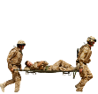
CAF Capabilities to deliver 10-1-2(+2) in the Land Environment
POI
CCP
II
UMS
POI
ASF
CCP
UMS w/DCR Team
R2B co-located with BMS
II
R3
POI
CCP
Provided by Other Nation
X
R2E
Continuum of care – Progressive Resuscitation (increasing Capability/Capacity)
X
Time and Space: 10-1-2 (+2) Clinical timelines
10 (minutes)
Combat First Aid / TCCC
1 (hour)
Damage Control Resuscitation (DCR)
2 (hours)
Damage Control Surgery (DCS)
+2 (hours)
Definitive Surgery
Legend
ASF Aeromedical Staging Facility
BMS Brigade Medical Station
CCP Casualty Collection Point
DCR Damage Control Resuscitation
FST Forward Surgical Team
UMS Unit Medical Station
POI Point of Injury
R2B Role 2 Basic
R2E Role 2 Enhanced
R3 Role 3
Prolonged Casualty Care

Slide 8
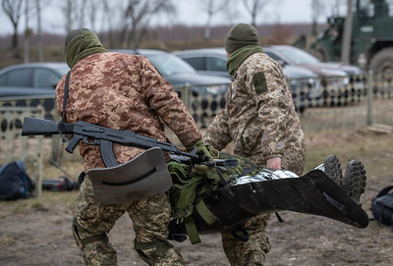
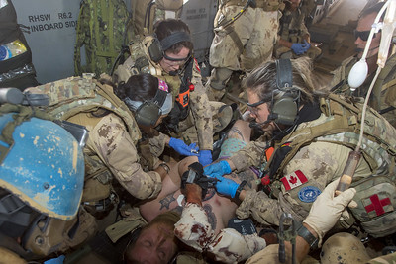
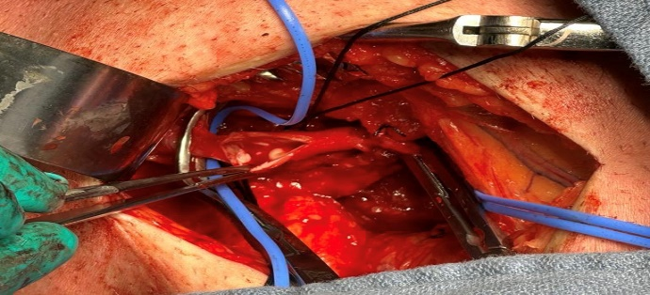
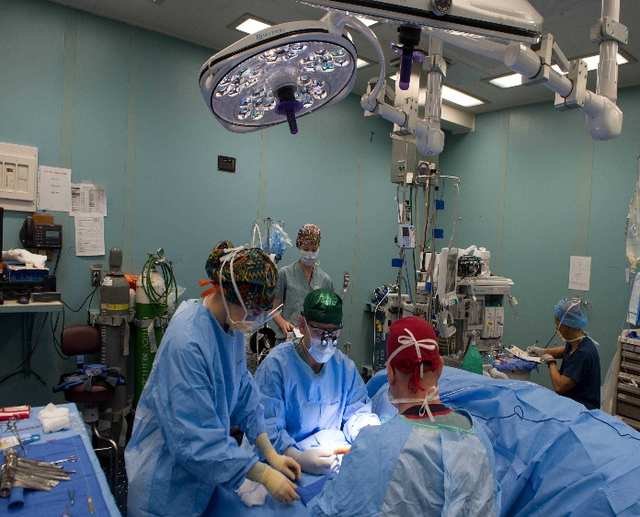
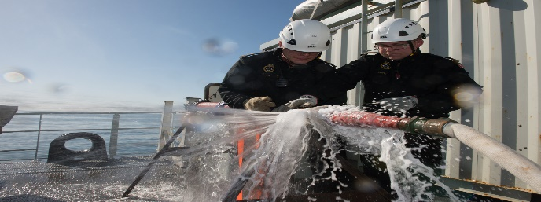
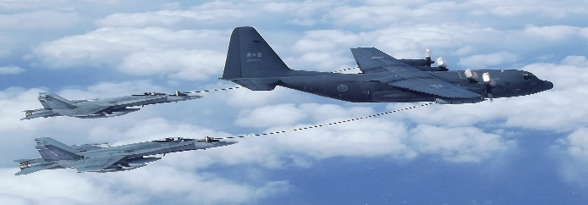
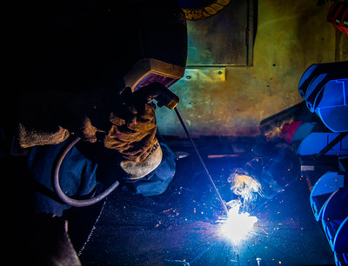
CAF Capabilities to deliver 10-1-2(+2) in the Land Environment - Overview
POI
CCP
II
UMS
POI
ASF
CCP
UMS w/DCR Team
R2B co-located with BMS
II
R3
POI
CCP
Provided by Other Nation
X
R2E
X
10 (minutes)
1 (hour)
2 (hours)
+2 (hours)
Combat First Aid / TCCC
Immediate life-saving interventions
Damage Control Resuscitation (DCR)
Top up of fluids (Blood and Blood products)
Damage Control Surgery (DCS)
Surgical stabilization to prepare for further evacuation
Definitive Surgery
Specialist Surgical Care before Strategic Aeromedical Evacuation to a Role 4

Slide 9
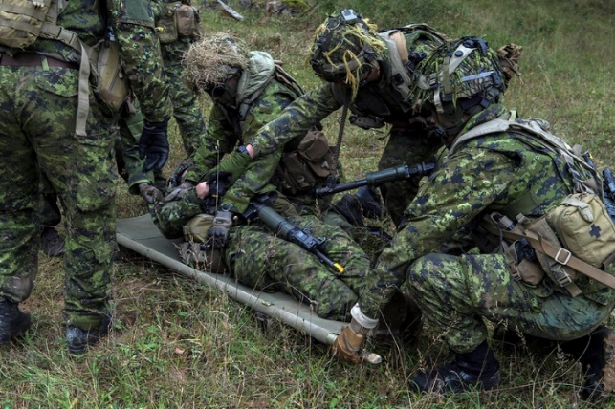
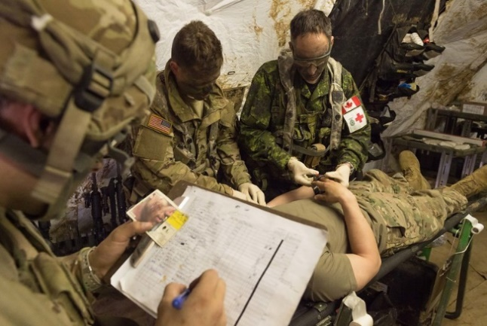
CAF Capabilities to deliver 10-1-2(+2) – Combat Medic and Combat Paramedic
POI
CCP
II
UMS
POI
ASF
CCP
UMS w/DCR Team
R2B co-located with BMS
II
R3
POI
CCP
Provided by Other Nation
X
Soldier Skills
R2E
More Clinical Skills / Less personnel
TCCC
BLUF
X
Troops will need more CFA/TCCC Training
&
Medics will need more soldier skills training
Combat Medic
Combat Paramedic
Nurses
Combat Medic
Combat Paramedic
Life-saving interventions at point of injury and rapid evacuation.
Life-saving interventions, possible DCR and continued evacuation
MO
10 (minutes)
Combat First Aid / TCCC
1 (hour)
Damage Control Resuscitation (DCR)
2 (hours)
Damage Control Surgery (DCS)
+2 (hours)
Definitive Surgery

Slide 10
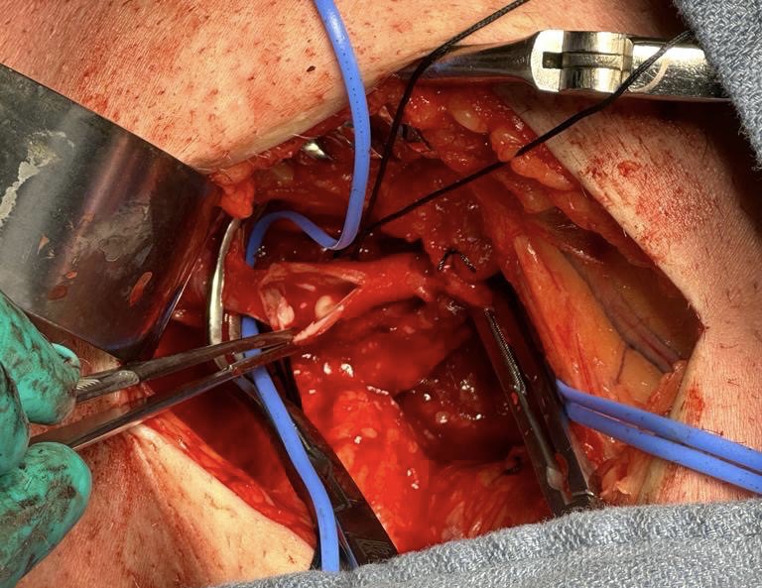
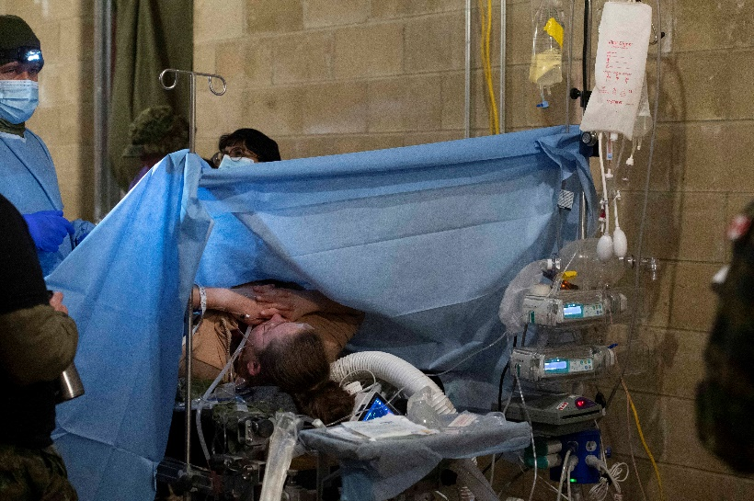
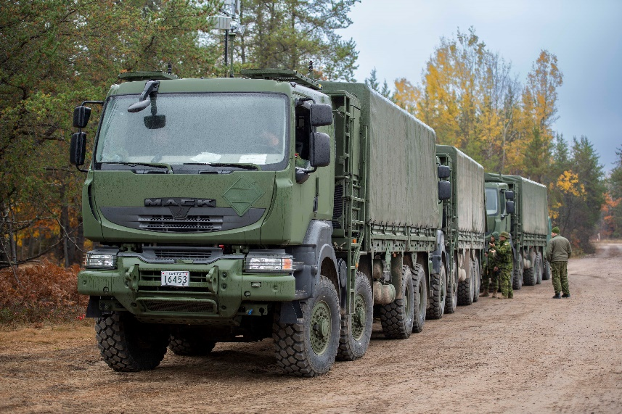
Capabilities to Deliver 10-1-2(+2) – Forward Surgical Team
POI
CCP
II
UMS
POI
ASF
CCP
R2B co-located with BMS
II
R3
UMS w/FST
POI
CCP
Provided by Other Nation
X
R2E
Forward Surgical Team (FST)
X
Damage Control Surgery
Austere Environment
Adaptive dispersed operations
10 (minutes)
Combat First Aid / TCCC
1 (hour)
Damage Control Resuscitation (DCR)
2 (hours)
Damage Control Surgery (DCS)
+2 (hours)
Definitive Surgery

Slide 11
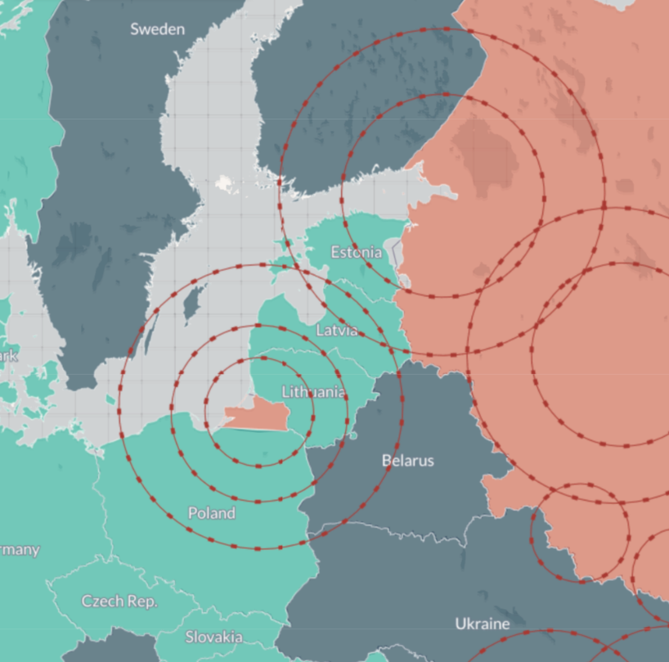
Capabilities to Deliver 10-1-2(+2) – Ground Evacuation
POI
CCP
II
UMS
POI
ASF
CCP
R2B co-located with BMS
II
R3
UMS w/FST
POI
CCP
Provided by Other Nation
X
R2E
Ground evacuation plays a crucial role in military operations, particularly in the context of Russia’s Anti-Access/Area Denial (A2AD) capabilities. Russia has invested significantly in developing A2AD capabilities, which could complicate NATO’s ability to access key areas such as the Baltics or Poland in a crisis.
In such scenarios, the presence of A2AD capabilities on the battlefield could restrict aerial evacuation, forcing reliance on ground evacuation for all categories of patients.
Therefore, effective ground evacuation strategies are essential to ensure the safety and survival of military personnel in the face of advanced A2AD capabilities.
X
Russia’s assessed A2AD capabilities around the Baltics. Source: CSIS – Missile Threat Project
Ground Evacuation Chain
10 (minutes)
Combat First Aid / TCCC
1 (hour)
Damage Control Resuscitation (DCR)
2 (hours)
Damage Control Surgery (DCS)
+2 (hours)
Definitive Surgery

Slide 12
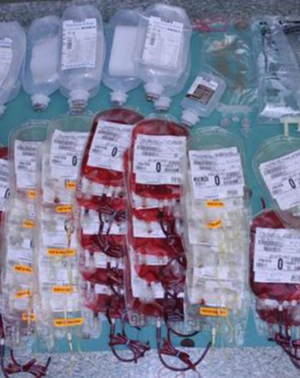
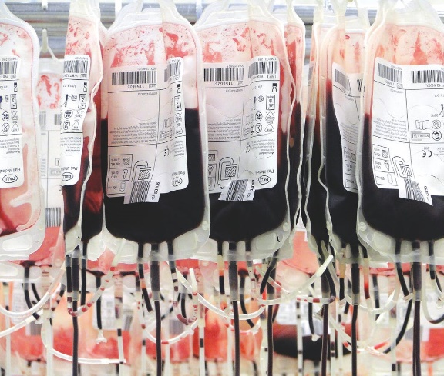
Capabilities to Deliver 10-1-2(+2) – Blood Logistics
POI
CCP
UMS
II
POI
ASF
CCP
R2B co-located with BMS
II
R3
UMS w/FST
POI
CCP
Provided by Other Nation
X
R2E
Low Titre O Whole Blood Emergency Donor Panel Grouped and Screened Whole Blood / Targeted Component Therapy
X
NATO Estimates: ~20% of casualties will require blood. Each casualty will require 8 units of WB or WB equivalent.
Blood sharing between allies is expected to be required to meet demands in peer-peer conflict. Emergency Donor Panels can help fill immediate shortages and decrease logistical concerns in crisis Putting LtOWB in the hands of Medics far forward in the battle space is logistically difficult but will save lives.
CAF blood is acquired through Canadian Blood Services on contract. Supply is finite and reliant on civi donation Blood transported to and within theatre using Credo Cubes
10 (minutes)
Combat First Aid / TCCC
1 (hour)
Damage Control Resuscitation (DCR)
2 (hours)
Damage Control Surgery (DCS)
+2 (hours)
Definitive Surgery

Slide 13
Towards Collective Resilience

Slide 14
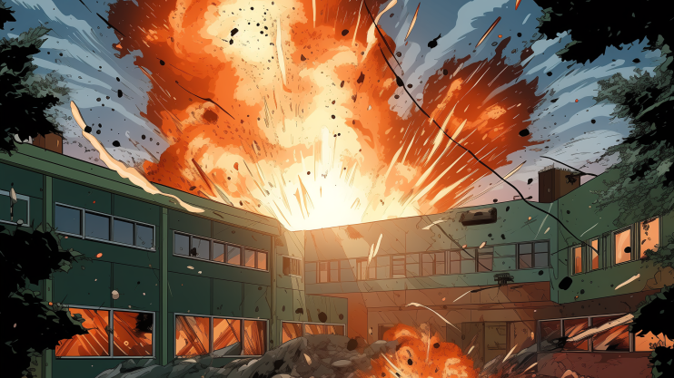
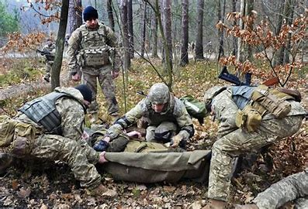
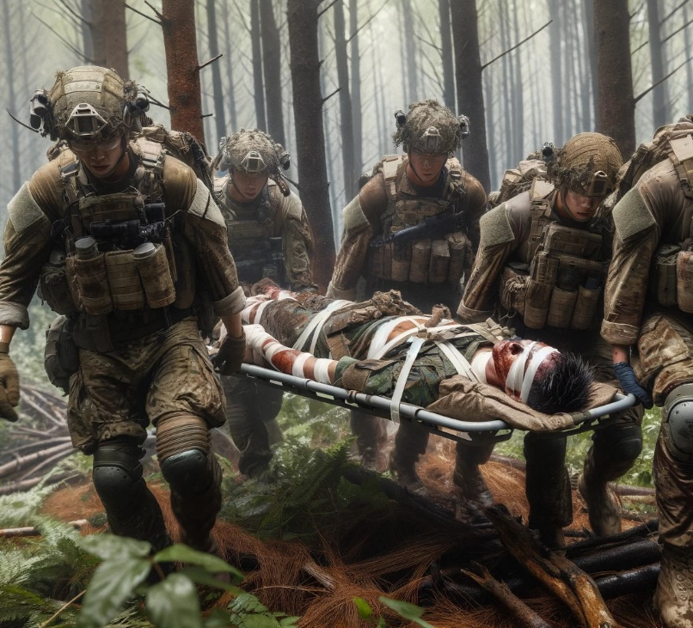
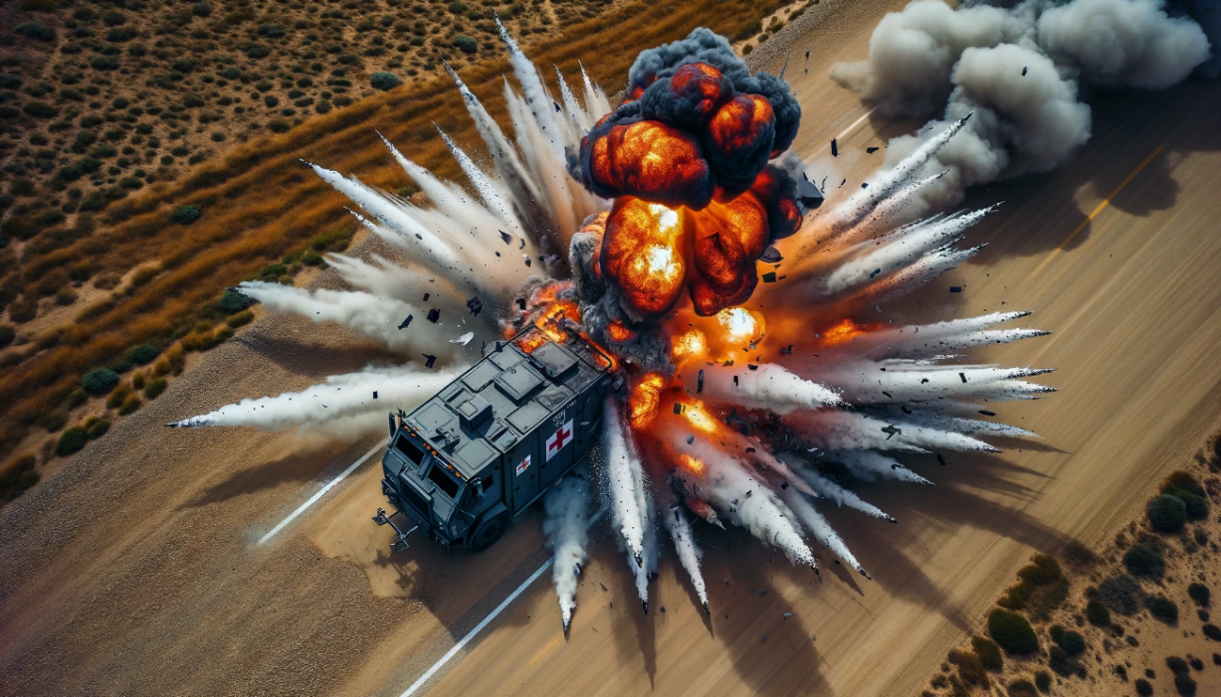
Preserving Combat Power, Protecting Medical Assets & Saving Soldiers

Slide 15
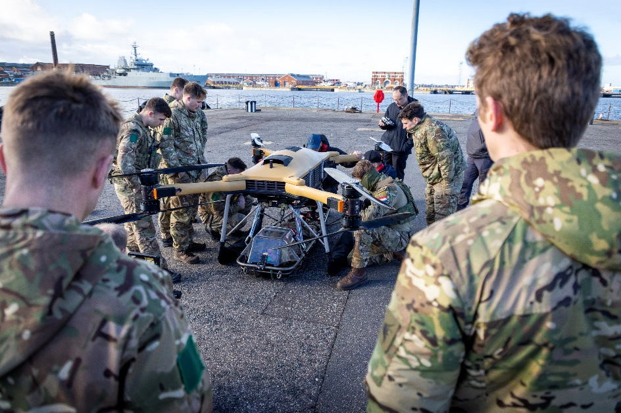
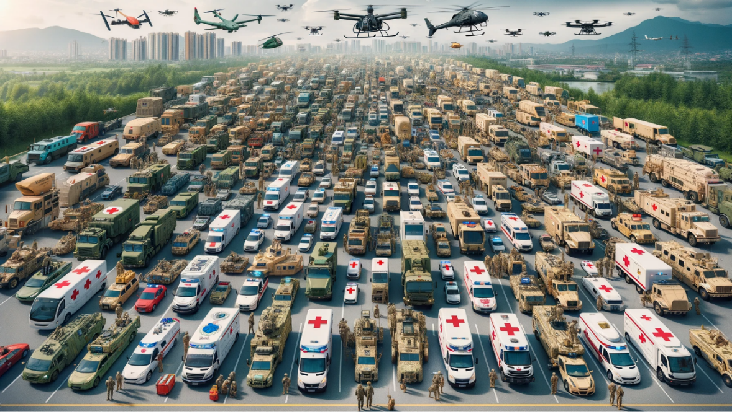
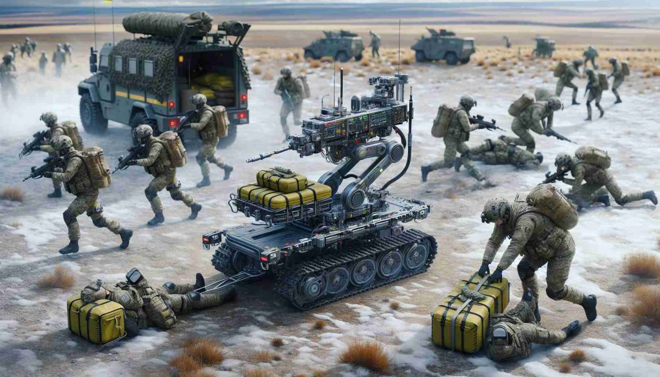
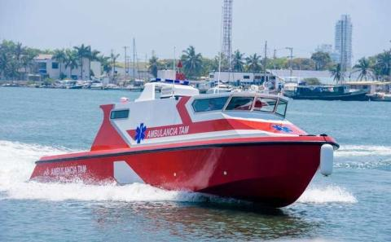
Preserving Combat Power, Protecting Medical Assets & Saving Soldiers

