Slide 1
DHN ATLANTIC Project Caladrius CAPT Brian L. Feldman NMC Portsmouth, Director

Slide 2
QPP-28890 Project Caladrius - Performance
OPR: Jen Caruso (JKSA)
Measure of Effectiveness:
Recapture care that is deferred to network (>15%)
Reduction in Bag 2 costs by 15%
Increase KSA completion across corps with goal to increase CCCT by 25%
NMCP JKSA Clinical Activity baseline (Dec 2022 – Nov 2023)
NMC Portsmouth
Specialty | # Personnel Assigned | # Personnel Above Threshold | % Personnel Above Threshold
Cardiothoracic Surgery | 1 | 0 | 0%
Critical Care | 6 | 0 | 0%
Emergency Medicine | 26 | 20 | 77%
ENT | 6 | 6 | 100%
General Surgery | 10 | 0 | 0%
Neurosurgery | 4 | 0 | 0%
OMS | 8 | 4 | 50%
Ophthalmology | 4 | 0 | 0%
Orthopedic Surgery | 19 | 6 | 32%
Plastic Surgery | 2 | 2 | 100%
Trauma Surgery | 3 | 1 | 33%
Urology | 6 | 5 | 83%
Vascular Surgery | 1 | 0 | 0%
Total Personnel | 96 | 44 | 46%
Data source:
Number of Inpatient Admissions
US average network inpatient care cost/admission*
JKSA Dashboards
 | Number of Patients | Bag 2 recapture (total)
November | 1 | $63,525
December | 1 | n/a
January | 0 | 0
Notes:
-2021 A3 design targeted patient satisfaction JOES/TRISS, JKSAs, and bag 2 cost avoidance as performance metrics that would improve in the ideal state
-Recommend targeting TRISS and specific questionnaire to be deployed as all patients will be in an inpatient status
-JKSA data will need to be monitored overtime, to date it is not possible to pull skills gained from each individual patient – more information on the next slide in the notes section
-Current cost avoidance $ amount is based on the cost of an NMCP admission for the initial patient. Will need Humana/DHA support to convert this figure into a local network civilian healthcare cost for the same admission
*Cost methodology: Using average cost of care, US² = $63,525.00 (daily $3,025.00) or $2,692.01 MORE than NMCP
Most recent data from 2022 from Kaiser Family Foundation (KFF), from https://www.kff.org/health-costs/state-indicator/expenses-per-inpatient-day/?currentTimeframe=0&sortModel=%7B%22colId%22:%22Location%22,%22sort%22:%22asc%22%7D) average cost of care in the United States is $3,025.00.

Slide 3
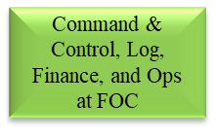
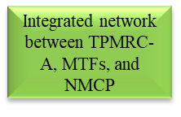
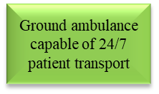
QPP-28890 Project Caladrius - POA&M
OPR: Jen Caruso (JKSA)
Funding Requested: $5M
Funding Provided: $7.370M
Caladrius C2 established
SOPs and Patient Care protocols developed and implemented
Current operations utilize GTP for patient movement for communication between MTFs and NMCP
Ground transport team established at NMCP
Contract Paramedic award est 13 March 24, new EMS vehicles arrived Nov 2023
Notes:
Two type 1 ambulances, staffed by ADSMs, 200-mile radius from NMCP
120 ADSMs trained to date in ambulance-based enroute care, to include Corpsmen (NREMT certified), Respiratory Therapists, Registered Nurses, and Emergency Medicine Residents
Development and launch of quarterly Emergency Medical Technician (EMT) refresher course to prepare Corpsmen for the National Registry exam to self-sustain enroute care teams
22 EMTs certified to date
Other disciplines and specialties can schedule ride-along time for enroute care exposure (i.e., Pediatrics, USNS COMFORT staff, etc.)
Current BLS/ALS coverage constrained by AD staffing, will be 24/7 once contractors on board

Slide 4
QPP-28890 Project Caladrius - POA&M
OPR: Jen Caruso (JKSA)
Funding Requested: $5M
Funding Provided: $7.370M
Diagnosis High Pay Off Target List
Neurological/Neurosurgical
Cardiopulmonary & Circulatory
Advanced/complicated malignancies
Axial & Appendicular fractures
Complex diseases of the digestive & hepatobiliary systems
Notes:
LOE 4 - Individual MTF sessions being scheduled during the month of February
LOE 5- Pilot completing certification flights in Feb to be allowed to land at GTMO due to air space restrictions

Slide 5
Resource Overview
New requirement or expansion of existing requirement:
New requirement
Total initial funding requested:
$5M
Ramp year:
Pending
Total funding received in the current Fiscal Year:
$7.370M (FY23) GFEBS WBS: S.0092767.3.23
Summary of resource execution strategy and timeline milestones to FOC:
FY23 Funding and Contract Award: 2 June 23: $7.370M provided via FAD 23-L8-011821 22 Sep 23: Contract award $8.188M (base plus one option). Additional $46.6k Specialized Transportation and Support Services (STSS) fee charged by USTRANSCOM 26 Nov 23: Contract mission capable Contract invoicing a/o 6 Feb: $1.563M (contract) and $46.6k (STSS fee) Flight hours used/remaining: 15 hours used, 585 hours remain FY24: UFR submitted for $7.908M to exercise option year of contract. Funds required Q4.
Notes:
NMCP provided the additional funding to cover both the final contract award and STSS fee from FY23 contract de-obligation efforts.
Contract awarded to CSI Aviation Inc
STSS fee for FY23 is 0.57% of the FY23 award amount

Slide 6
Resource Execution
Detailed Execution and Projection for Requirement Funding ($ in Millions)
 | Identify O&M BAG and/or RDT&E or PROC | Description | Enter $ in Millions (e.g. $123K is 0.123) | Enter $ in Millions (e.g. $123K is 0.123) | Enter $ in Millions (e.g. $123K is 0.123)
 |  |  | Actuals FY22-23 | Actuals to Date | Projected Totals
 |  |  |  | FY24 | FY24 | FY25 | FY26 | FY27 | FY28 | FYDP
Personnel
Civilian FTEs (labor) | O&M/BAG 1 | 2 GS-11 RN support to Transfer Center | .582 | .044 | .314 | .333 | .352 | .374 | .397 | 1.770
Contract FTEs (labor) | O&M/BAG 1 | 10 FTE Paramedic Contract | 0 | 0 | 1.056 | 1.090 | 1.124 | .832 | 0 | 4.102
Active Duty (labor) | MILPERS | Active-Duty support to Transfer Center and Ground Transportation | 2.522 | .449 | 1.348 | 1.429 | 1.515 | 1.606 | 1.686 | 7.584
Contracts (non-labor) | O&M/BAG 1 | CSI Aviation Inc (aircraft) | 8.235 | 0 | 7.950 | 8.428 | 8.934 | 9.470 | 10.038 | 44.820
Equipment | O&M/BAG 1 | Equipment to outfit ambulances | .132 | 0 | 0 | 0 | 0 | 0 | .131 | .131
Supplies | O&M/BAG 1 | Supplies to stock ambulances supported via Emergency Department budget
Travel | O&M/BAG 1 | EMS Conference Attendance | 0 | .002 | .002 | 0 | 0 | 0 | 0 | .002
Pharmaceuticals |  | Pharmaceuticals to stock ambulances supported via Emergency Department budget
Other | O&M/BAG 1 | Ambulance Lease (x2) | .087 | .007 | .069 | .073 | .078 | .082 | .087 | .389
Total |  |  | 11.558 | .053 | 10.739 | 11.353 | 12.003 | 12.364 | 12.339 | 58.798
Cost Avoidance/ Return on Investment: |  |  |  | .062
Notes:
DHA direct funding support (FY24 UFR and 25-28 est) highlighted in red.
NMCP is supporting the Transfer Center for Caladrius from its current staffing, equipment, and supplies which are sunk cost estimated at $1.441M for FY24.
Contract FTE – 10 paramedics – 12-month base (POP start 13 March) with three option years required to support Trauma and recapture capture.
Active Duty FTE – currently no dedicated FTEs. If sustained, will need 8 FTEs dedicated active duty for the Transfer Center and 10 FTEs (2 full time and 8 staffed from rotations) for ground transportation.
Equipment – FY28 est lifecycle replacement for Zoll defibrillators purchased FY23
Travel – patient travel TBD for commercial air return flights to home duty station. NMCP to fund to capture all cost during pilot with $0 YTD patient travel expenses for this project.
Other- Ambulance lease will continue regardless as we are utilizing for local recapture and ground IFT – sunk cost
NMCP’s UBO created insurance bill first patient at $62k; assessing the conversion to cost avoidance if admission was at local civilian hospital
Notes: 1) 6% inflation used for FYs 25-28 estimates. Exceptions – aircraft contract FY24 is the option year (FY25-28 adds 6%) and paramedic contract is the anticipated contract award amount by FY
2) MILPERS estimate completed using DOD Active Duty Composite Rates for FYs 22-24, 6% inflation FYs 25-28. 8 E3s supporting Transfer Center; 2 E5s and 8 E4s supporting Ground Transportation

Slide 7
COA 1: Sustain Funding and Continue Monitoring
COA 1: Recommended | Impact to Funding | Impact to Manpower | Impact to Infrastructure | Required Time to Implement
Sustain funding and continue monitoring | $7.908M UFR (FY 24) submitted to exercise option year. All other costs covered by existing budget | Until paramedic contract awarded and positions filled, difficult to operate ground transportation 24/7, expand NMCP transfer center manning to support initiative | None | 6 to 12 months
Risk/Opportunity to DHA for COA 1
Opportunities: Expand capability throughout the SE region, include beneficiaries from GTMO. Once NMCP ground transportation 24/7 capable, discussion with 633d MedGrp (Langley) to reduce or eliminate $574k ambulance contract (on last option year POP ending 12 Sep 24) Risks: Under utilization of service, poor retention of contract staff (fixed-wing) due to lack of mission demand, performance of new paramedic contract

Slide 8
COA 3: Stop Funding
COA 3: Recommended | Impact to Funding | Impact to Manpower | Impact to Infrastructure | Required Time to Implement
Stop funding | FY24 DHA saves $7.908M (contract) and NMCP saves $42k (est STSS fee) | none | none | none
Risk/Opportunity to DHA for COA 3
Opportunities: Expand ground transport and NMCP transfer center to Tidewater region. Once NMCP ground transportation 24/7 capable, discussion with 633d MedGrp (Langley) to reduce or eliminate $574k ambulance contract (on last option year POP ending 12 Sep 24) Risks: Continued leakage to the market at smaller MTFs

Slide 9
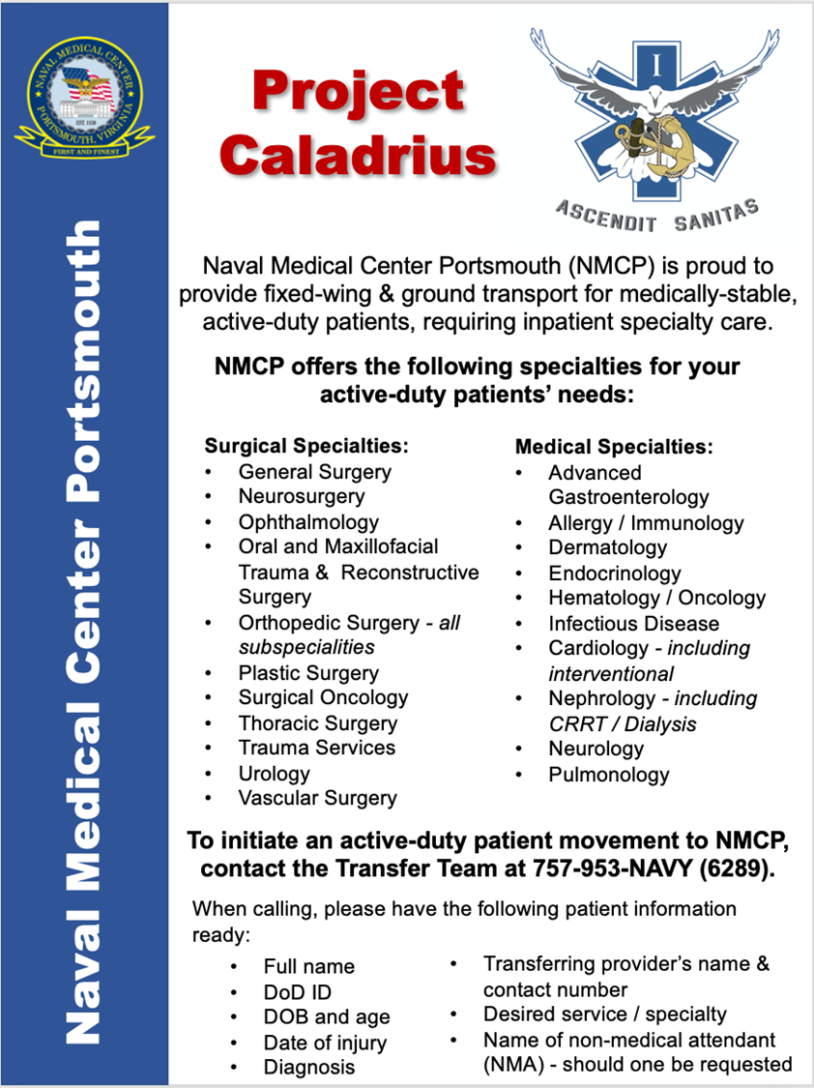
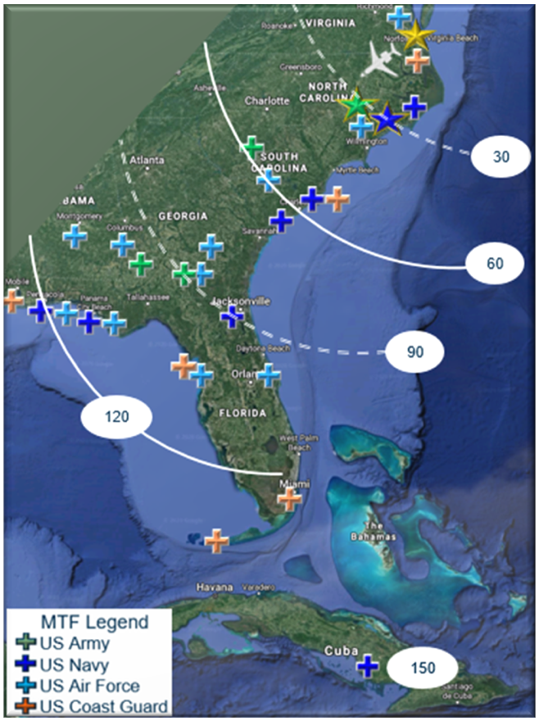

Slide 10
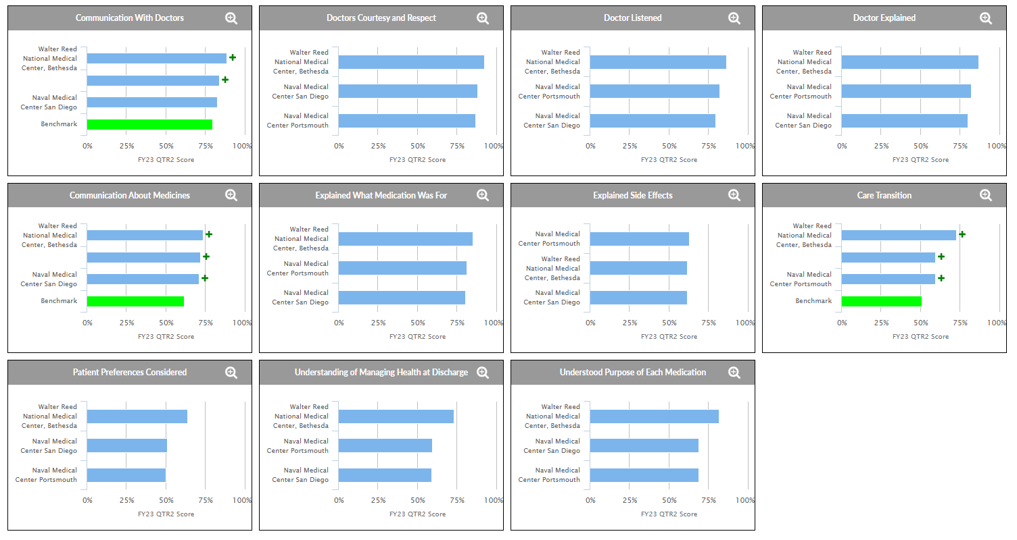
QPP-28890 Project Caladrius - Performance
OPR: Jen Caruso (JKSA)
Notes:
1) Baseline TRISS data
2) Will monitor overtime, developing Caladrius specific questionnaire to better understand the patient satisfaction impact

