Slide 1
MEDICAL CENTER OF EXCELLENCE
UNCLACUISSIFIED
Modernizing the Army Health System
to support MDO!
COL James J. Jones, PhD, PA-C Director, Medical Capability Development Integration Directorate james.j.jones68.mil@army.mil 571-282-8669
Unclassified
UNCLASSIFIED
1

Slide 2
DISCLOSURES
COL James Jones has no relevant financial or non-financial interests to disclose.
This continuing education activity is managed and accredited by AffinityCE, in collaboration with AMSUS. AffinityCE and AMSUS staff, as well as planners and reviewers, have no relevant financial interests to disclose. AffinityCE adheres to the ACCME’s Standards for Integrity and Independence in Accredited Continuing Education. Any individuals in a position to control the content of a CME activity, including faculty, planners, reviewers, or others, are required to disclose all relevant financial relationships with ineligible entities (commercial interests). All relevant conflicts of interest have been mitigated prior to the commencement of the activity. Commercial support was not provided for this activity

Slide 3
LEARNING OUTCOMES:
At the conclusion of this activity, participants will be able to:
1) Describe how the AHS will maximize Return to Duty far Forward.
2) Analysis how the AHS will optimize Ground, Air, and Sea Evacuation.
3) Determine how the AHS will overcome contested logistics.

Slide 4
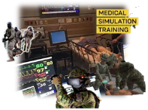
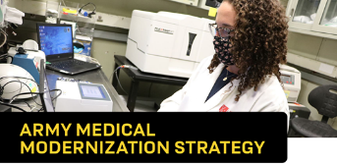
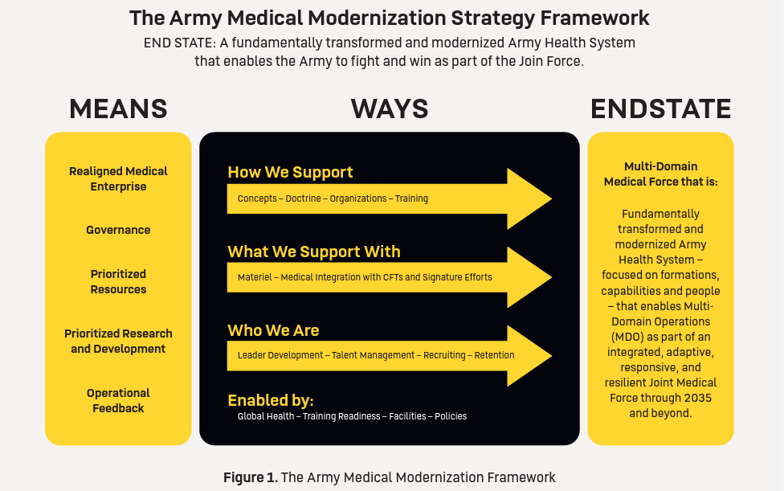

Slide 5
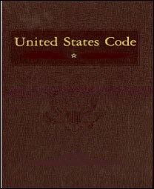
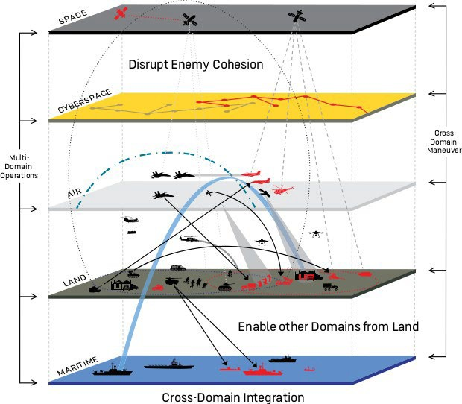
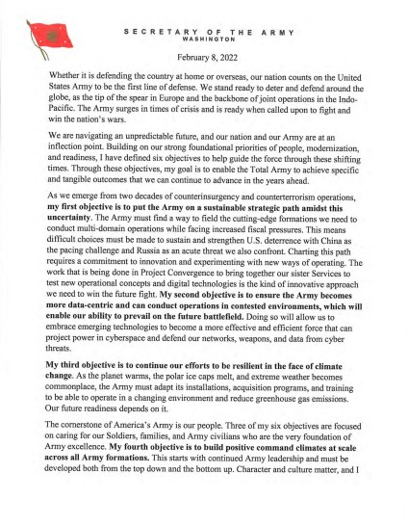
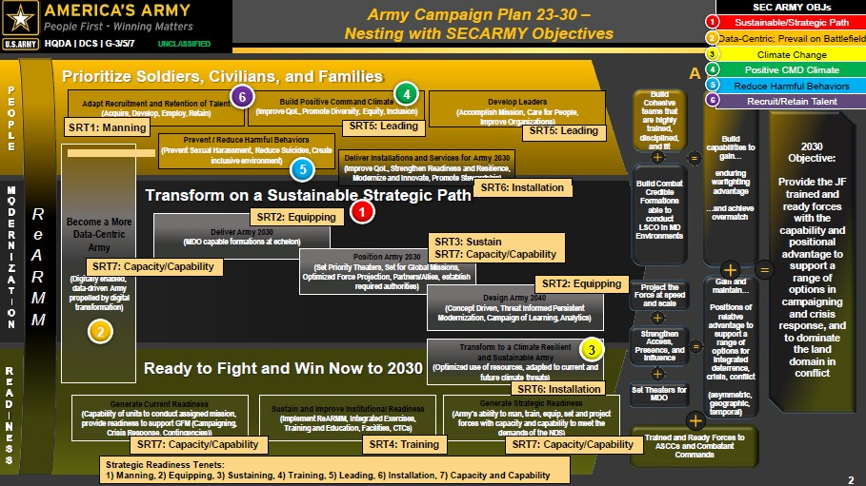
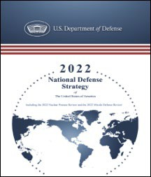
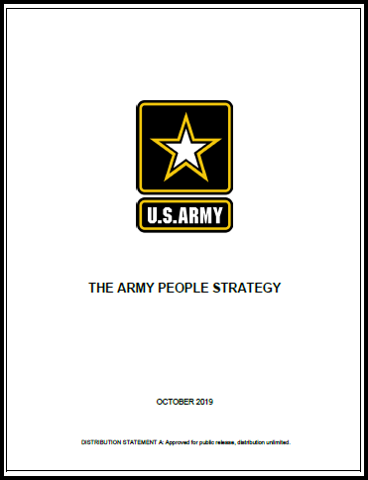
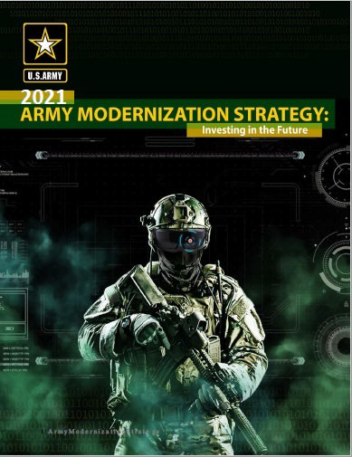
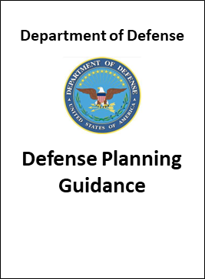
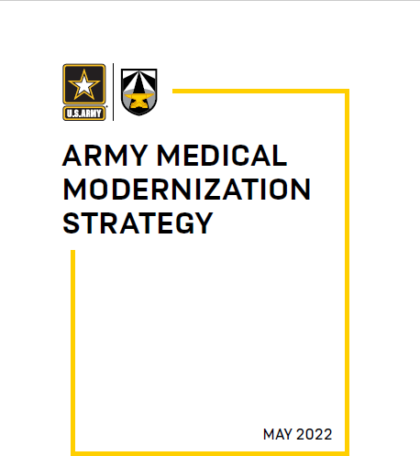
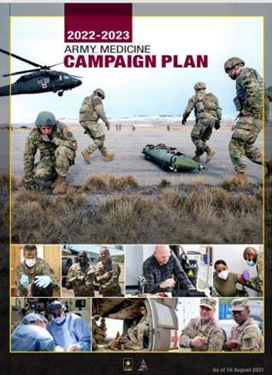
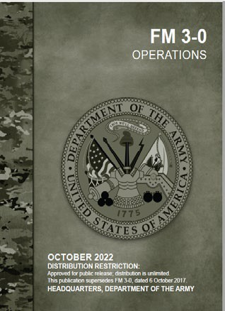
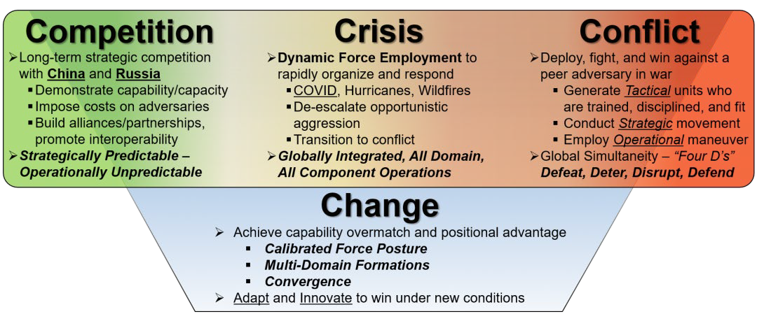
The Strategic Landscape
National & Joint Strategy
Multi-Domain Operations
Army Strategic Guidance
D - MDO / LSCO / Convergence
O - MDO Task Forces / SFAB / Cyber
T - Synthetic Training Environment
M - Modernization Priorities / CFTs
L/P - Talent Management / CAP / IPPS-A
Source: “The Question at the Center of Army Readiness: Ready for What?,” LTG Charles Flynn, 13 OCT 2020, Modern War Institute at West Point
“Adapt and Innovate to win under new conditions”
UNCLASSIFIED

Slide 6
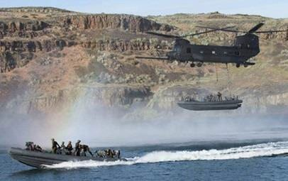
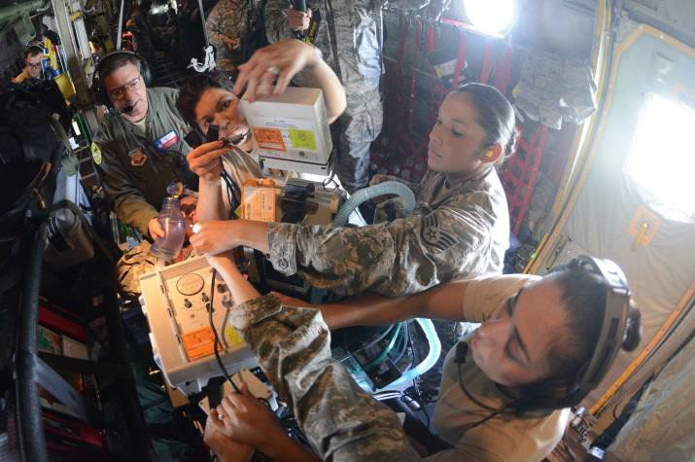
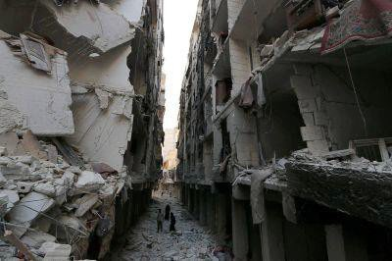
Challenges in the Future Operating Environment
More violent, highly lethal operating environment
Under constant observation – all forms of contact
Lack of air superiority / on-demand evacuation
Contested communications & logistics
Survivability necessitates mobility
High casualty volumes (>10K/ 60 days)
Attrition of Medical Assets
No “Golden Hour”
Fort-to-Port challenges
CBRNE Employment

Slide 7
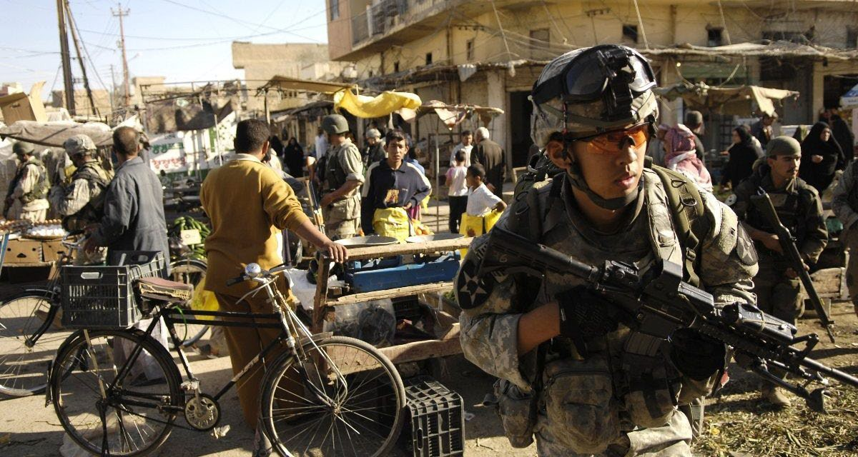
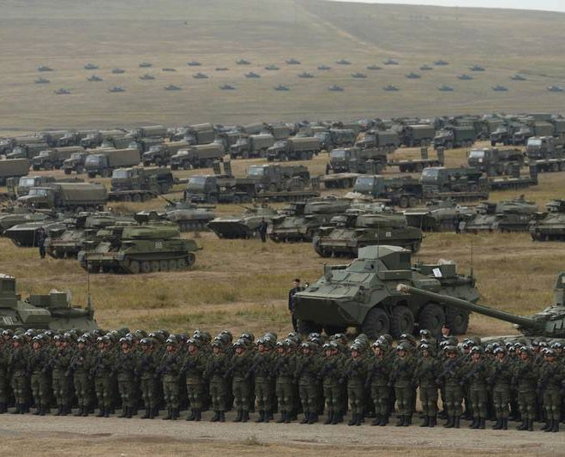
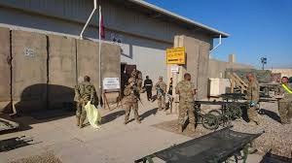
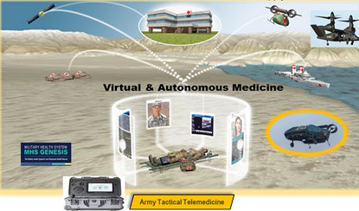
Key Initiatives
Momentum for Transformation Doctrine
FM 4-02.2 / JP 4-02 / AMMS
COIN
Organization
Theater MED CMD / DIV SPT Hospital / PCAD
LSCO
Golden Hour Evacuation
A2AD/Prolonged Care
Training
Limited Objective Experiments/Theater-level Exercises AOC/MOS/POI Recalibration
Materiel
OMIS-A / PC-22 Technologies / FLRAA / Key RD&A
“Golden Window” Evacuation
Stationary EAB Hospitals
Observations from RUS-UKR Conflict
Hospitalization at EAB
MED C2 at MED BDE/CSH
Theater and EAD MED C2
Unintegrated Med Info Req
Leader Development
Integrated MEDCOP
Modernized PME / LTHET/ Civilian Education / IDPs
Low CBRN Threat
Personnel
Talent Management / 68W Evolution / H2F/ Accreditations
Enhanced Bio-surveillance
Robust CL VIII/Maintenance
Robotic Autonomous Sys
Facilities
MSTC Modernization/Camp Bullis of the Future
Tele-medicine/maintenance
Policy
Partnerships/ Total Force Integration / Autonomous Evac
Distributed Operations
FOB Centric
Modernization for Army 2030
UNCLASSIFIED

Slide 8
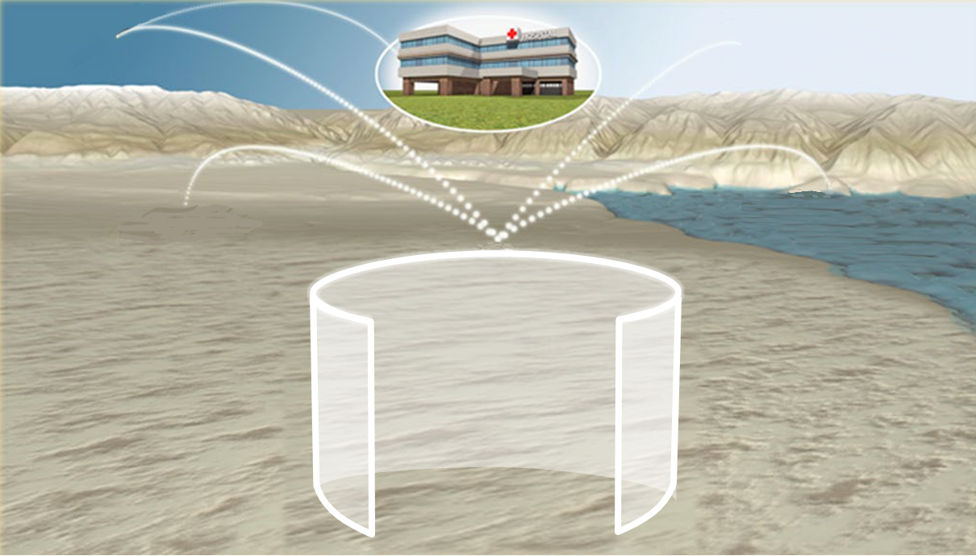
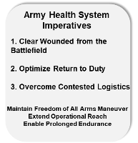
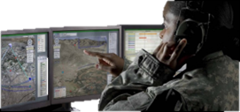
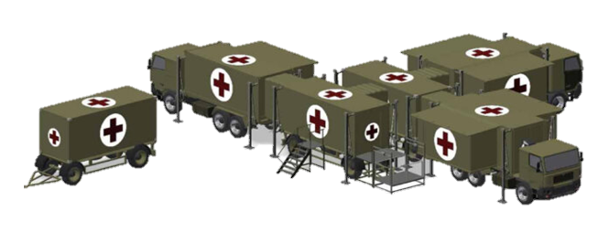
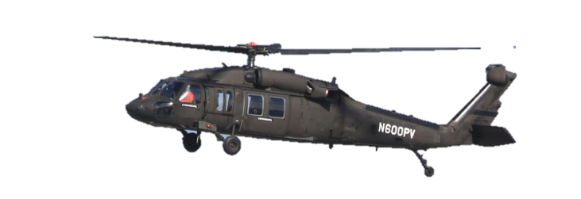
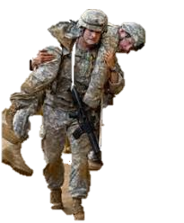
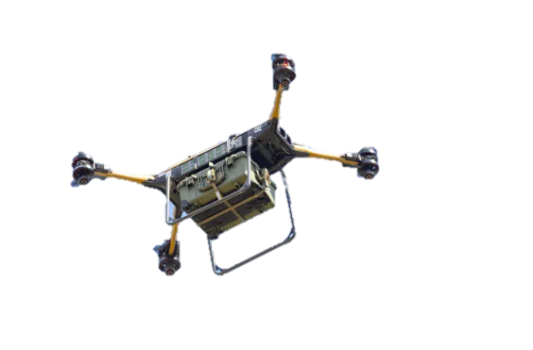
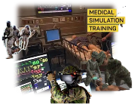
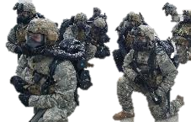
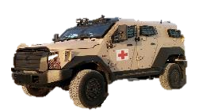
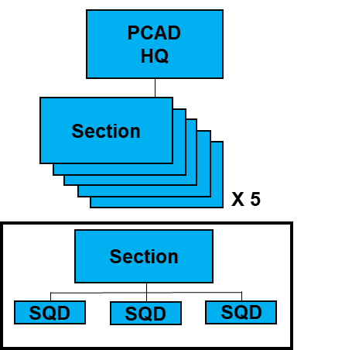
MTFs and Allied Hospitals
Future Long-Range Assault/Ambulance Aircraft
Joint and Allied MEDCOP
Division Surgical Hospital
New Role 3 (Smaller/Lighter Mobile)
C2 in a Denied, Disrupted, Intermittent, and Limited (bandwidth) Environment
Tele-Med
M
Freeze Dried Plasma
LD
MED C2/TMC
Family of Health IT Solutions
Robotic / Autonomous Resupply
Multimodal MEDEVAC/CASEVAC
Casualty Accountability and Data collection at Point of Need
OMIS-A
T
68W Modernization
MEDLOG in Campaigning
LSCO Academy
P
SFAC Paramedic
BATDOK
F
NextGen MSTC
O
PCAD
FRSD
GMFL
Protected Wheel Ambulance
D
JP 4.02
FM 4-02
ATP 4-02.2
ATP 4-02.1
P
Blood at PoN
CIV to MIL Training
CBRNE Countermeasures
Blood & Freeze-Dried Plasma at Point of Need
Center of Gravity
68W Medic
Prolong Care

Slide 9
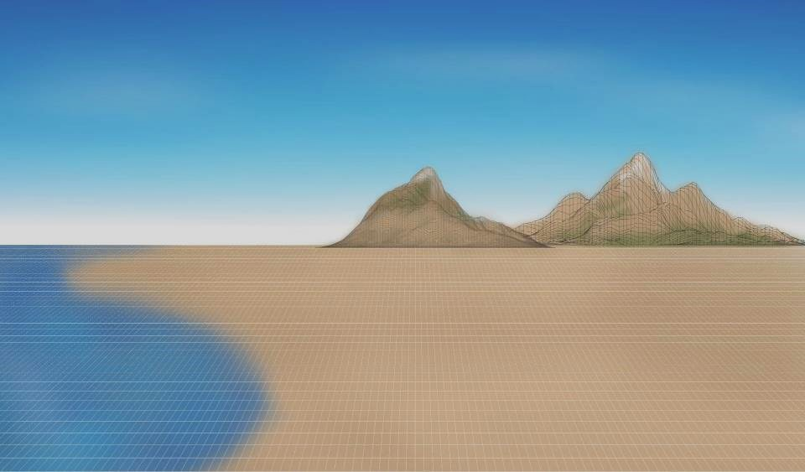
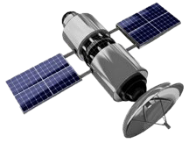
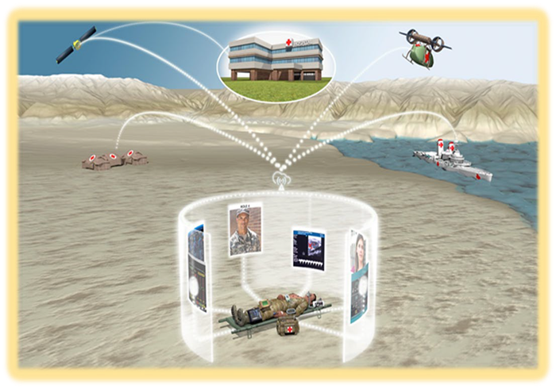
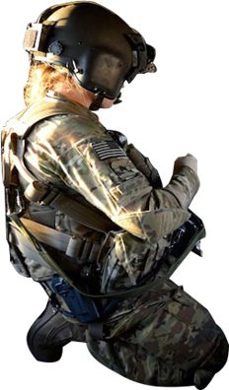
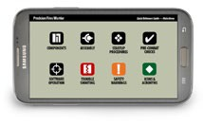
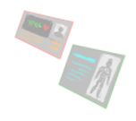
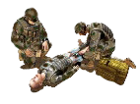
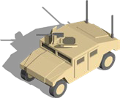
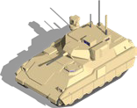
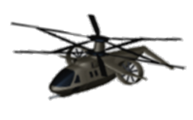
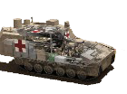
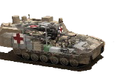
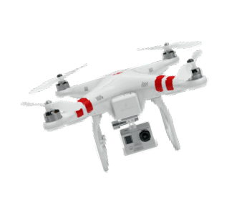
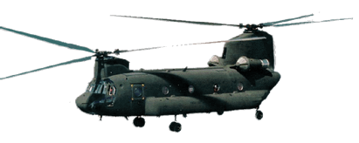
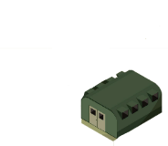
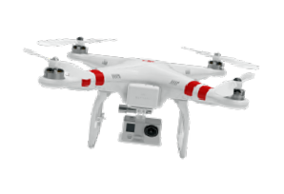
Medically Intelligent System of Systems
Scenario
In this scenario, 1st Armored Division is conducting an area defense when enemy elements attack. The enemy attacks friendly forces using simultaneous long-range precision fires, rocket and self-propelled artillery, tank and other supporting forces. The effects of the enemy strike and follow-on combat operations have resulted, in a short period of time, in 500 critical casualties across the division.
Solution Synopsis
11. Empower CDRs with medical aspects of C2 (Med C2 Formations, UAP Health System Alignment, MEDCOP, AI Credentialing System)
22. Enable the Operational Forces (Treatment for Enhanced SMs, Remotely Conduct FHP, Health Surveillance Risk Communication/Biodefense)
33. Provide Med Spt Fwd to enable semi-independent operations (Strategic Reach-back, Extend Operational Reach, Point of Need Production)
44. Optimize evacuation and maximize RTD (Intelligently Task Ground/Air Assets, Expeditionary Mobility, Hospitalization Variations, Modernized Air Ambulances, RAS Transportation Platforms)
Futures and Concepts Center
MED COP
1 2 3 4
AI-Assisted
Clinical Decision Support System
MEDEVAC / CASEVAC
1
X
CCP
POI
Supporting Ideas at Echelon
Roles 1/2: CASEVAC vehicle kits, TC3 training for non-med pers, RAS Extraction, AI decision support, MEDCOP, unmanned technologies Role 3: Leader-Follower Technology for ground MEDEVAC/CASEVAC, MEDCOP, unmanned technologies
1
2
MEDBDE
4
AXP
BAS
2
AXP Prlg Care
2
I
3
MCAS
SPT
FLRAA MEDEVAC
4
BSMC
AXP
CCP
POI
R3-
1
FRSD
BAS
4
4
RAS MEDEVAC
Robotic Asst Surgery ₃
II
CASEVAC
3
RAS CASEVAC
4
R3
++
NOTE
Additional experimentation is required. CASEVAC should be addressed in every experimentation event.
XX | X
2
Med
1

Slide 10
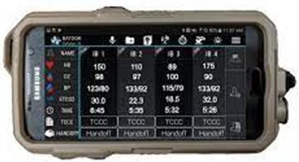
Medical Technologies Driving Change
BATDOK
Battlefield Assisted Trauma Distributed Observation Kit
ESiT
Environmental Sensors in Training
Tempus Pro
HALO
Health Assessment Lite Operations
MEDIC CDSS
Medic Clinical Decision Support System
NETCCN
National Emergency Tele Critical Care Network
LOHIT
Logistics Operational Health Information Technology
Crimson
ALIAS
Aircrew Labor In-Cockpit Automation System
HRAPS
Health Readiness and Performance System
Concussion Dosimeter
UNCLASSIFIED

Slide 11
Questions? HOW TO CLAIM CE CREDIT
COL James Jones
james.j.jones68.mil@army.mil 571-282-8669
If you would like to receive continuing education credit for this activity, please visit:
amsus.cds.affinityced.com

