Slide 1
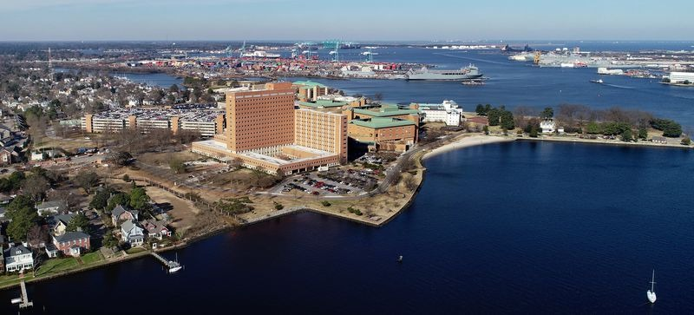
Capturing Complex Medical Care Enhances Medical Readiness at a Military Medical Center – Trauma, Comprehensive Cancer Care, and Transportation
CDR Timothy Donahue
Trauma Medical Director
CDR Jonathan Halbach
Chair, Dept of Surgery
CAPT Timothy Platz
Cancer Coordination Center Director
CAPT Joseph Kotora
Project Caladrius
Notes:
Busy slide – open for remodeling

Slide 2
Disclosures
Timothy Donahue et al. have no relevant financial or non-financial interests to disclose.
This continuing education activity is managed and accredited by AffinityCE, in collaboration with AMSUS. AffinityCE and AMSUS staff, as well as planners and reviewers, have no relevant financial interests to disclose. AffinityCE adheres to the ACCME’s Standards for Integrity and Independence in Accredited Continuing Education. Any individuals in a position to control the content of a CME activity, including faculty, planners, reviewers, or others, are required to disclose all relevant financial relationships with ineligible entities (commercial interests). All relevant conflicts of interest have been mitigated prior to the commencement of the activity.
Commercial support was not provided for this activity.
Notes:
Mando slide

Slide 3
Learning Outcomes
Become familiar with the process/obstacles to becoming a trauma center and educate participants on state and ACS requirements for designation.
Understand how the pursuit of a trauma designation affects non-surgical departments such as medical services, lab, and blood bank.
Review KSAs for general surgeons and how capturing trauma and cancer patients may generate KSAs.
Understand military cancer populations and the expected volume and type of recaptured cancer patients from a civilian network.
How coordinating complex transportation to military facilities can result in improved outcomes and continuity.
Notes:
Mando slide

Slide 4
National Defense Strategy
2022 National Defense Strategy highlights the importance of a future force that is “agile”, “forward”, “distributed”, and “sustainable”. One that is “resilient” in the face of battlefield degradation.
Our Medical Forces – and SYSTEMS – are working hard to achieve and maintain these attributes serving our National Defense Strategy.
Notes:
2022 National Defense Strategy highlights the importance of a future force that is “agile”, “forward”, “distributed”, and “sustainable”. One that is “resilient” in the face of battlefield degradation.
Our Medical Forces – and SYSTEMS – are working hard to achieve and maintain these attributes that serve our National Defense Strategy.

Slide 5
National Defense Strategy
Ready Medical Force
MTF Volume and Complexity of Care
Civ-Mil Partnerships
Readiness Training
MTF Volume
Trauma
Cancer Care
Transportation
Notes:
There are numerous ways we currently work to increase the readiness of our medical forces to serve our National Defense Strategy in the face of emerging and diverse potentials for conflict.
Some of these strategies involve civilian and military partnerships – taking providers and staff out of the MTF and placing them in civilian facilities to learn from the volume and complexity at those institutions. There is no question civilian partnerships improve exposure to complex care, increase KSAs for those individual providers, and enhance professional development. Those providers can then bring those skills to the battlefield or back to the MTF.
Taking individuals out of the MTF and placing them in Civ-Mil partnerships has consequences and individual provider readiness is not our only goal. Our MTFs have suffered the consequences of decreased complexity and volume in their ORs, ICUs, wards, and clinics. With decreased volume and complexity at ALL MTFs, systems within the Medical Force have suffered.
A Ready Medical Force is not just a ready surgeon, physician, or nurse. A Ready Medical Force is created and maintained by Ready Medical Systems.
We believe that the path toward a Ready Medical Force is through complex care at the MTF. The creation of a trauma center, retaining and recapturing complex cancer care, and removing barriers to complex care by providing transportation all push our MTF to maintain not only a Ready Medical Force, but a Ready Medical System.
This is what has driven these three projects. Today we are going to talk about how we are increasing complexity at our MTF, some roadblocks, and hopefully answer some questions you may have about how to do the same at your facility.

Slide 6
Trauma Center Designation
Command leadership initiative and support
Establish Trauma Program
State/ACS trauma manuals
Set a plan of action and milestones
Posture system to receive trauma patients
Build and refine Performance Improvement Process
Notes:
LO: Become familiar with the process/obstacles to becoming a trauma center and educate participants on state and ACS requirements for designation.
Establish goal of trauma center designation
select team members, TMD, TPM, PI coordinator, registrar (obtain trauma registry) and trauma liaisons
Understand state/ACS requirements
Develop program policies, procedures and clinical guidelines in accordance with trauma manuals
Trauma team meet with command leadership regularly
Hold monthly trauma systems meetings
Disseminate information widely throughout hospital
State/ACS consult visit
Engage local trauma centers, participate in regional trauma advisory counsels
Consult with outside expertise
Attend state and regional/local trauma meetings
Establish, reaffirm regional healthcare partnerships

Slide 7
State and ACS requirements
Notes:
LO: Become familiar with the process/obstacles to becoming a trauma center and educate participants on state and ACS requirements for designation.

Slide 8
Challenges
Establishing a new normal
Ensure staffing requirements met
Necessary equipment and resources
Follow on care for non-beneficiaries
Operational requirements
Notes:
LO: Become familiar with the process/obstacles to becoming a trauma center and educate participants on state and ACS requirements for designation.
Sea change in hospital mission
Buy in from not only all hospital staff but also base command
Bare minimum staff and equipment requirements as described in trauma manuals
Follow up care for complex injuries and medical problems for civilian non-beneficiaries
Incorporating civilians into trauma program and system wide, help mitigate operational requirements

Slide 9
“Trauma touches all”
Trauma patients often cross multiple service lines in the hospital
ED, OR, ICU, Radiology
Lab services
Blood bank
Surgical and Non-surgical sub-specialists
Notes:
LO: Understand how the pursuit of a trauma designation affects non-surgical departments such as medical services, lab, and blood bank.
From the ED to radiology, trauma service, operating room and anesthesia, intensive care unit, laboratory and blood bank services. Not to mention other ancillary services such as internal medicine and their sub-specialty providers.
Preparing radiology techs to acquire and process imaging for radiologists to expeditiously interpret
Establish a trauma OR and make ready an alert team of OR nurses, corpsmen and physicians to respond to emergent procedures
Lab: respond to need for emergent lab draws and rapid results to affect patient care
BB: develops and refines transfusion policies through Massive Transfusion Protocols and rapid release of blood

Slide 10
Knowledge, Skills, Abilities
KSAs are specialty-specific Knowledge, Skills, and Abilities, KSAs: generated from CPT codes, utilized by the expeditionary clinician.
Developed by clinicians based on JTS CPGs, case registries, and relevant literature
Mapping KSAs to peacetime workload yields a readiness indicator (KSA score) for each clinician, MTF, and market
Notes:
LO: Review KSAs for general surgeons and how capturing trauma and cancer patients may generate KSAs.

Slide 11
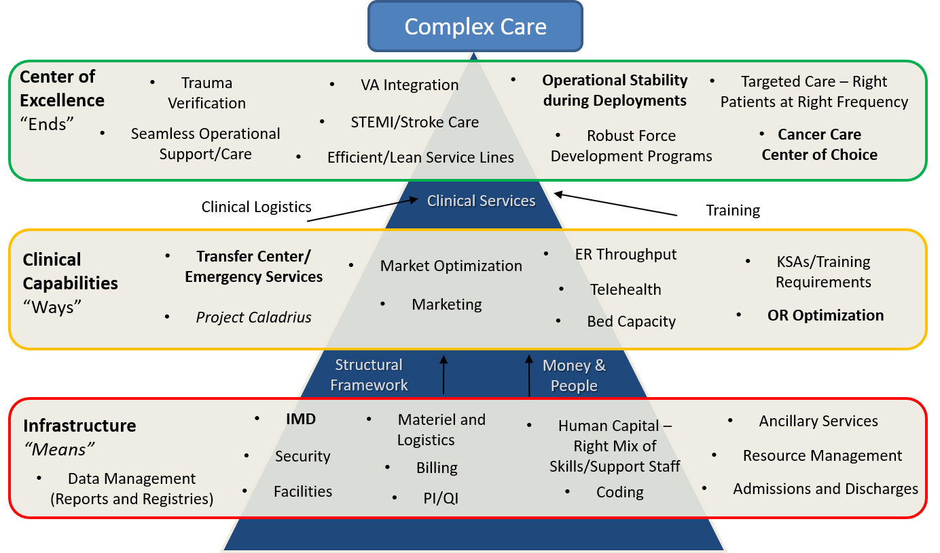
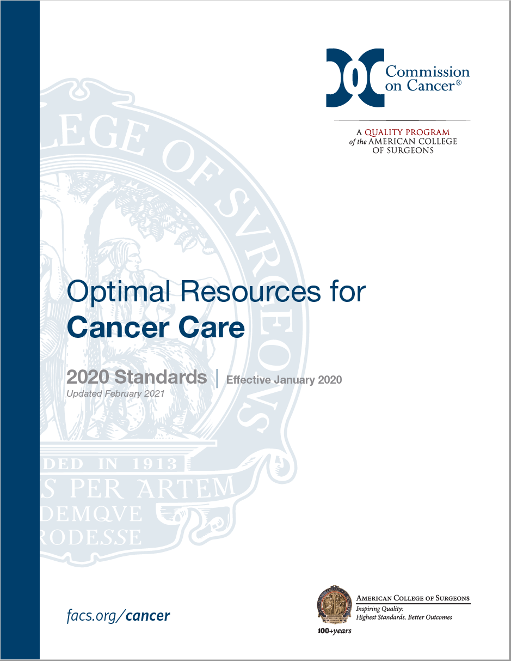
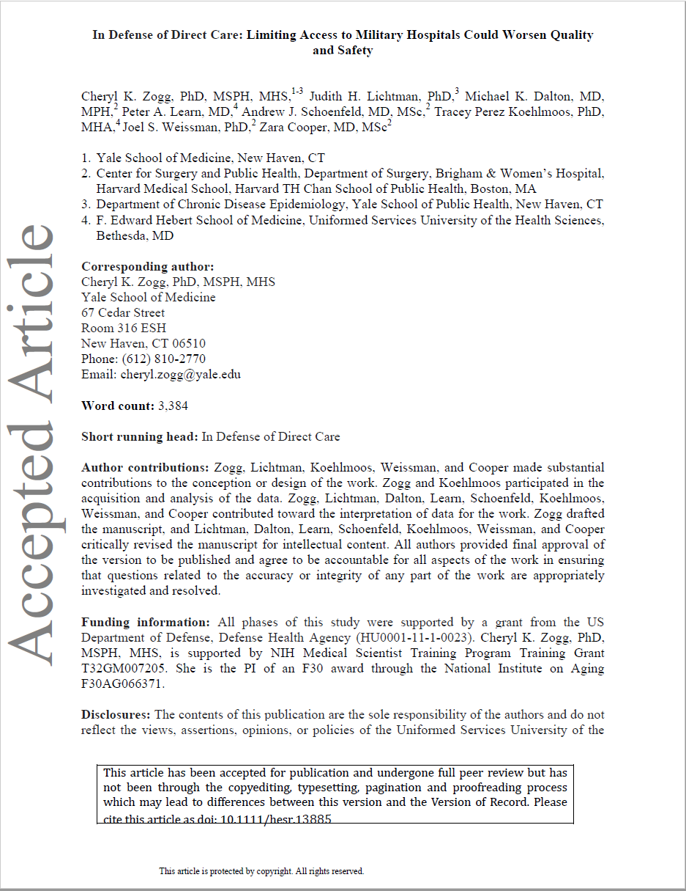
Cancer Coordination Center
Context: The CCC will capture cancer patients, direct care, and serve as a patient-centered resource.
Purpose: Provide the workflow for consults / Message Pool traffic
Outcome: Become familiar with the mission and vision of the CCC and update
1
Notes:
This presentation is just a wave tops discussion of 5 questions with a decision at the end… the decision is going to have 3 choices.
What’s the Requirement?
What is Cancer Care?
Presentation
Diagnosis/Staging
Cancer therapy
What’s the problem?
IOM report. –worse with the number of steps required, each one having safe and unsafe options.
“In defense of direct care” paper
DHA/NAVMED/”divestiture”
What’s the plan?
Charette Cancer Cooperative (Co-op)
Scheduling: H&N example -
Reporting
Research
Seed of leadership. Most (if not all) people in the proposed organization already work here– they just work under a lot of different directorates. A consolidated chain of Command with better accountability to the CO will reduce bureaucratic friction, and help make sure we use our resources well.
What’s the decision?
Department
Special Advisor
Directorate

Slide 12
Cancer Coordination Center
Leadership and Administration
NMCP/NMRTC-P
Commanding Officer
Executive Officer
DSS
Department Head
CAPT Timothy Platz
Assistant DH
Lt Col Bethany Mikles
Chair, Cancer Committee
Cancer Program Manager
ACS Cancer Liaison Physician
Scheduling
Reporting
Research
Administrative
Nurse Nav : (Breast)
Whitney Ogle
Naval Regional Tumor Registry Supervisor (NRTRS)
Helen R. Green
NCTN Research Coordinator
Melvina Queen
Administrative Assistant
Nurse Nav : (Med Onc)
Melinda Powers
ACR Contractor
Holly Laperriere
Consult Nurse
Lead Cancer Registrar, Certified Tumor Registrar
Carolyn A, Harris
Nurse Navigator
HJF Contractor, Path
Heather Scott
Nurse Navigator
Certified Tumor Registrar Lisa V. Smith
DPE/CID Contract
GAPPED
Cancer Registrar
Gwendolyn M. Tyler
DMS/Peds
Carrie Hadden
Cancer Registrar
Carol P. Young
DMS/Peds
Lucy Jatho
COA #2: DSS
4

Slide 13
Four Lines of Effort Capture, Scheduling, Reporting, & Research
Capture
CCC Broad guidelines for referrals
Scheduling
Nurse navigation of care
Reporting
NCDB Cancer Registry and Registrars
Research
Research Coordinators/Nurses
2
Notes:
Capture: Broad Guidelines
Scheduling: Nurse Navigation
Med Onc, Rad Onc, Surgery (includes all sub-specialties)
Interventional Radiology (IR), Pathology, Radiology, Ambulatory Infusion Center (AIC), Lab, Genetics, Nutrition, PT, Speech Path, Audiology, Dental, Social Work, Palliative Care, Hospice, Operational/Training/Fleet/Transfer Center.
Reporting: NCDB Cancer Registry and Registrars
Leading Metric: Abstracted Cases (500)
Lagging Metric: Commission on Cancer (CoC) Accreditation (CY 2024)
Research: Research Coordinators/Nurses
Leading Metric: National Cancer Trials Network (NCTN) Treatment Intervention Enrollments (3, 15, 25)
Lagging Metric: NRG Membership Review (CY 2023)

Slide 14
Consultation Tracker
9 Trackers in all:
Workup
Breast
ENT
GI
Gynecology
Neurology/Neurosurgery
Orthopedics
Pediatrics
Thoracic
Urology

Slide 15
Project Caladrius
PROBLEM STATEMENT
The present state of Interfacility transport within the DoD is deficient in command and control, resulting in significant lapses in patient regulation. USTRANSCOM is the sole source for global patient movement and has a mature medical regulating cell. However, there is a great deal of unregulated patient movement outside USTRANSCOM’s control, resulting in increases in purchased care via admission to civilian facilities. Many of these cases are suitable for transport to one of the DoD’s Medical Centers.
Caladrius will serve to decrease the unregulated patient movement by affording DoD facilities within SE CONUS with a dedicated “Alert Aircraft” capable of retrieving a patient within 3-8 hours of request and transporting the service member to the closest, most appropriate MTF. This model supports recapture of purchased care within a high quality MHS integrated health system and tiered centers of excellence to optimize health care outcomes. In turn, this will improve patient access to definitive care, medical KSAs, and medical regulation/C2.
Notes:
LO: How coordinating complex transportation to military facilities can result in improved outcomes and continuity.

Slide 16
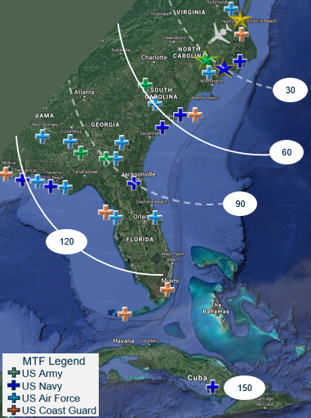
Project Caladrius
MISSION & INTENT
Project Caladrius will unify the missions of the DHA, DoD medical commands, and DoD line units by directing Active-Duty patients in the Southeastern United States in need of complex and critical care to Naval Medical Center Portsmouth. Caladrius will assist the DHA in achieving its Quadruple Aim Performance Plan (QPP) via the following criteria:
Better Care:
Faster access to definitive care via a dedicated enroute care asset.
Increase in military healthcare value via validated healthcare metrics.
Increased Readiness:
Reduction in Limited Duty days via streamlined access to required care.
Improved KSA metrics for military healthcare providers across corps and disciplines.
Tighter integration with parent commands → improved C2 and reporting of ill/injured.
Better Health Value:
Improved patient satisfaction via JOES and TRISS survey results
Lower Cost:
Increases in BAG 1 direct care expenditures and reduction in BAG 2 purchased care

Slide 17
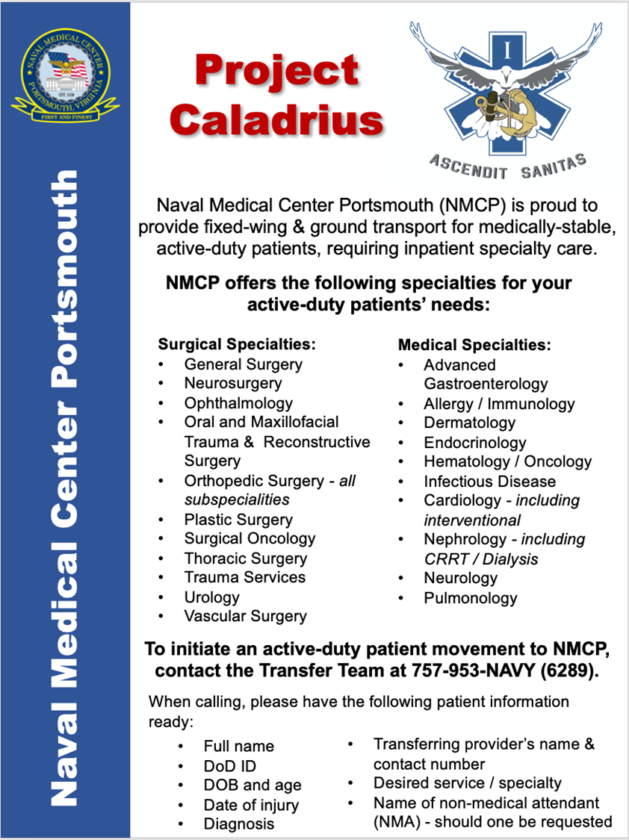

Slide 18
Thank you
Questions

