Slide 1
Medical Care in Contested Distributed Maritime Operations: An AMSUS Panel Discussion
LCDR Scott Hughey, M.D., M.B.A.,
Anesthesiology, Naval Hospital Okinawa
LCDR Kyle Checchi, M.D., M.Sc.
General Surgery, Naval Hospital Okinawa
LCDR Jacob Cole, M.D., M.B.A.
Anesthesiology, Naval Medical Center Portsmouth
LCDR Joshua Kotler, M.D.
Orthopedic Surgery, III Marine Expeditionary Force

Slide 2
Disclosures
Scott Hughey has no relevant financial or non-financial interests to disclose.
Kyle Checchi has no relevant financial or non-financial interests to disclose.
Josh Kotler has no relevant financial or non-financial interests to disclose.
Jacob Cole has no relevant financial or non-financial interests to disclose.
Disclosure will be made when a product is discussed for an unapproved use.
This continuing education activity is managed and accredited by AffinityCE, in collaboration with
AMSUS. AffinityCE and AMSUS staff, as well as planners and reviewers, have no relevant financial interests to disclose. AffinityCE adheres to the ACCME’s Standards for Integrity and Independence in Accredited Continuing Education. Any individuals in a position to control the content of a CME activity, including faculty, planners, reviewers, or others, are required to disclose all relevant financial relationships with ineligible entities (commercial interests). All relevant conflicts of interest have been mitigated prior to the commencement of the activity.
Commercial support was not provided for this activity.

Slide 3
Learning Outcomes
At the end of this activity, participants should be able to:
Understand the geographic challenges with medical care in CDMOs.
Discuss some of the current doctrinal capabilities of the Role 1, Role 2, Role 3 facilities, medical and casualty evacuation
Discuss potential mechanisms to mitigate these challenges

Slide 4
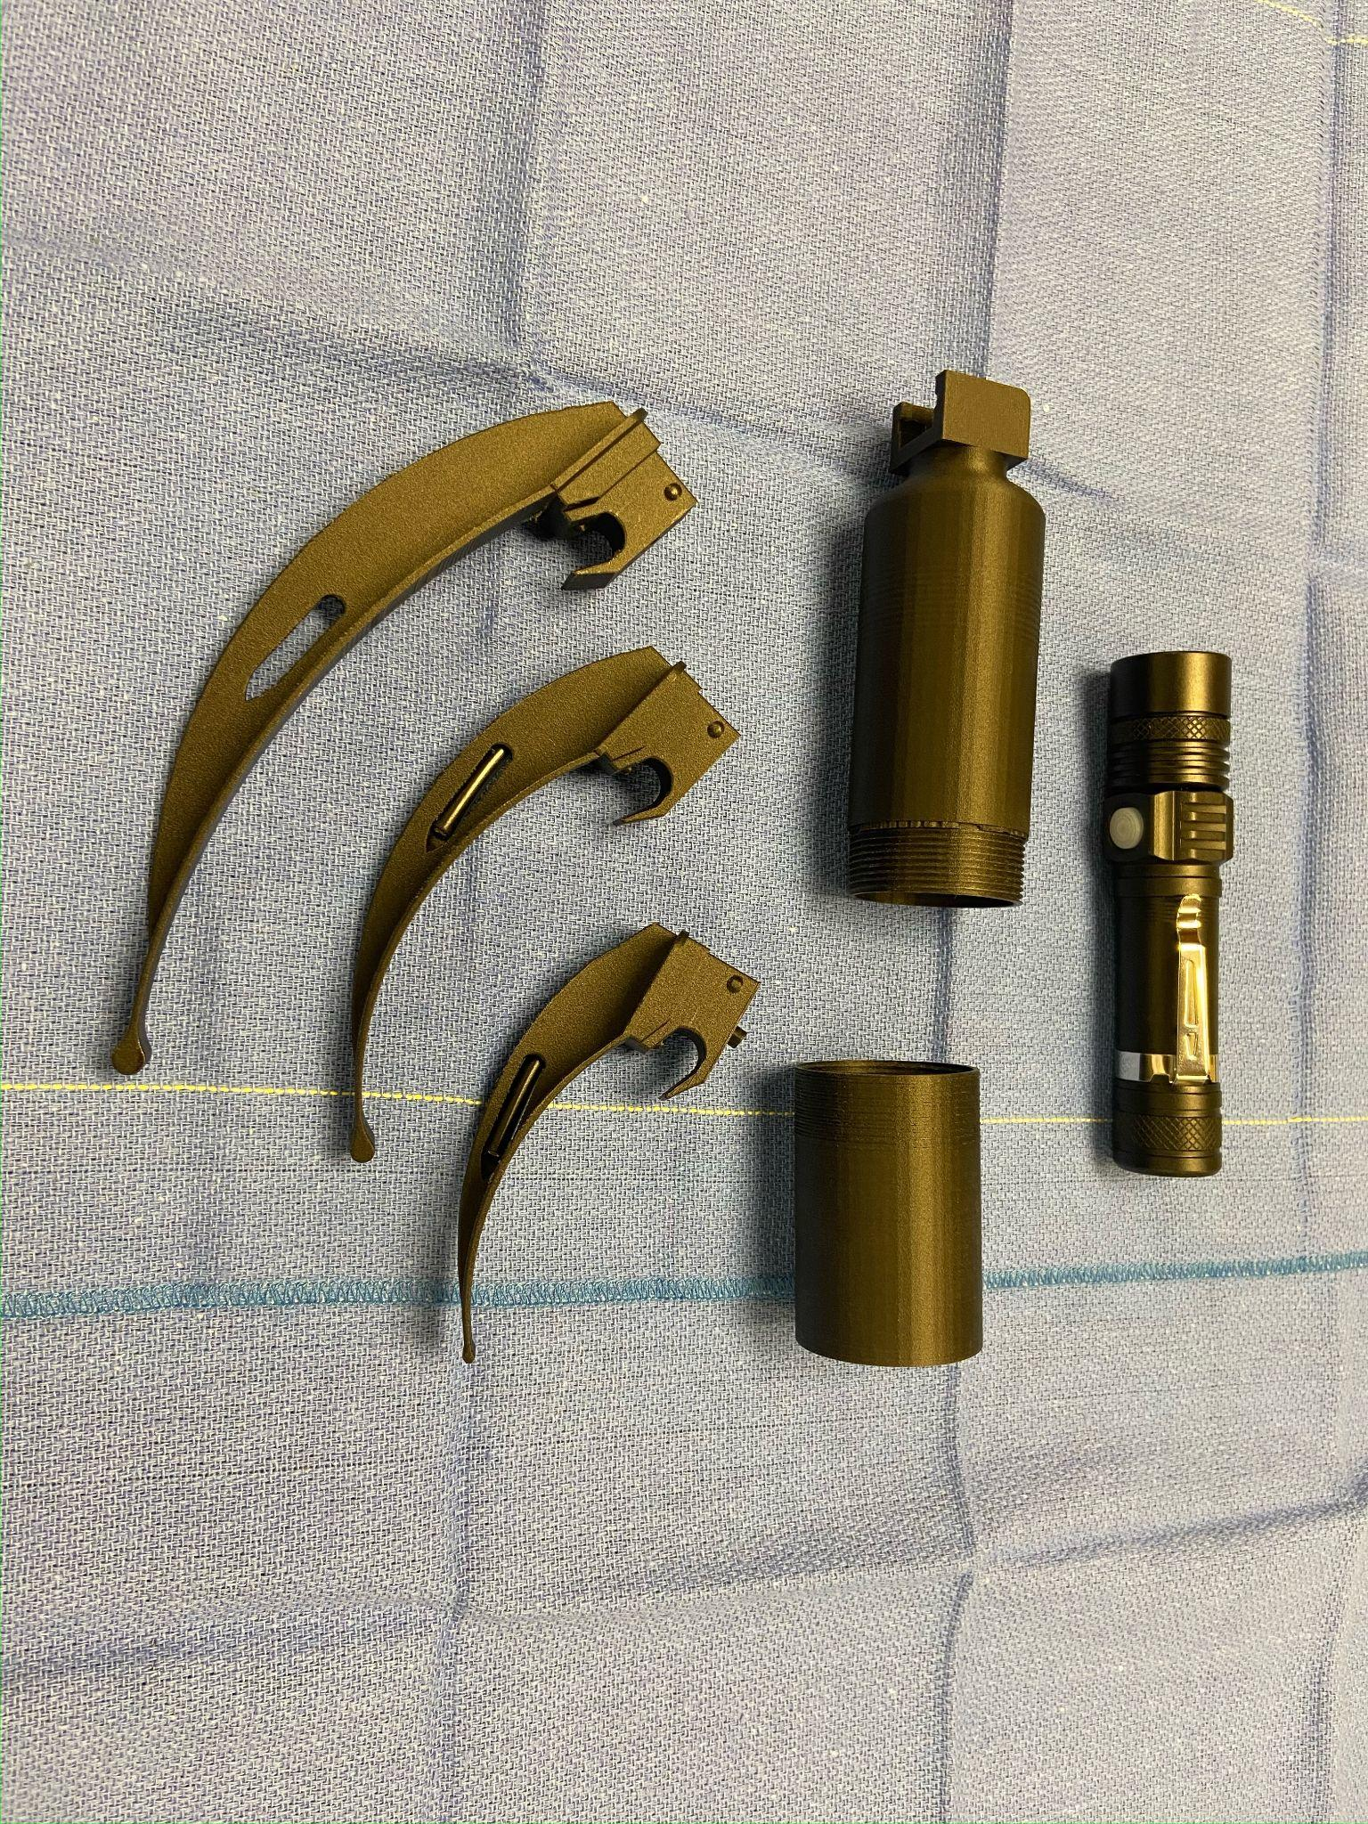
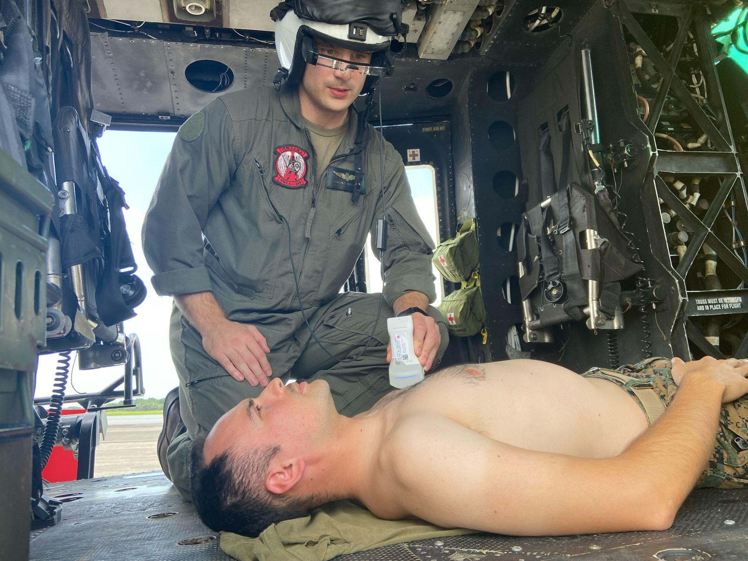
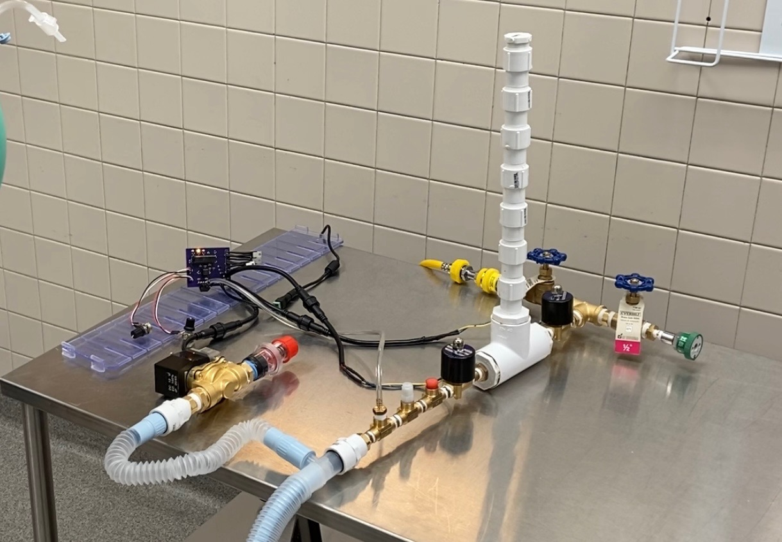
Naval Biotechnology Group

Slide 5
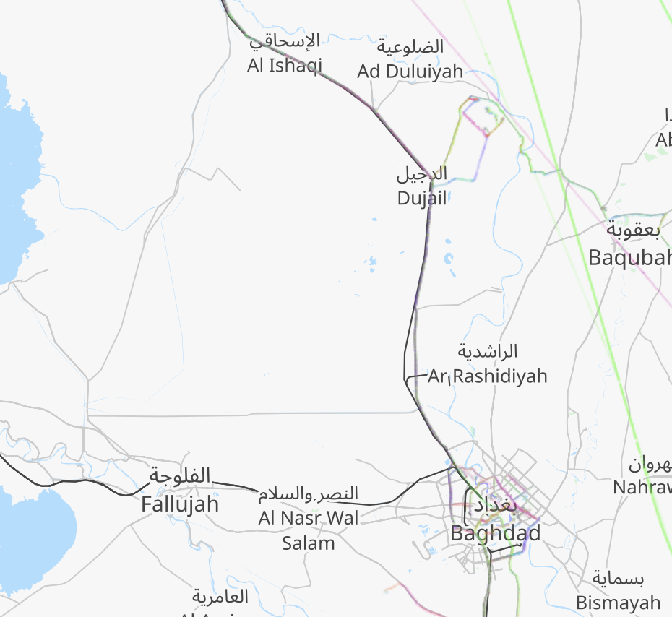
Balad
52 Miles
43 Miles

Slide 6
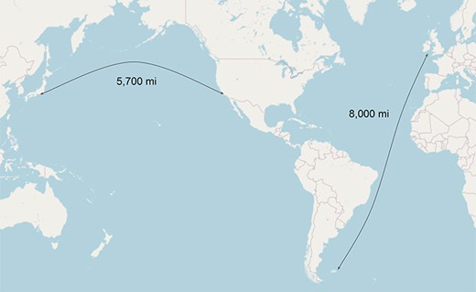
London to Falklands: 8,000 miles
Washington, D.C. to Mumbai: 8,000 miles (to the east)
Washington, D.C. to Hong Kong: 8,000 miles (to the west)
Scott Hughey, Jacob Cole, Adam Brust, Kyle Checchi, Joshua Kotler, Andrew Lin, Surgical Casualty Care in Contested Distributed Maritime Operations: Lessons Learned From the Falklands War, Military Medicine, 2023;, usad304, https://doi.org/10.1093/milmed/usad304

Slide 7
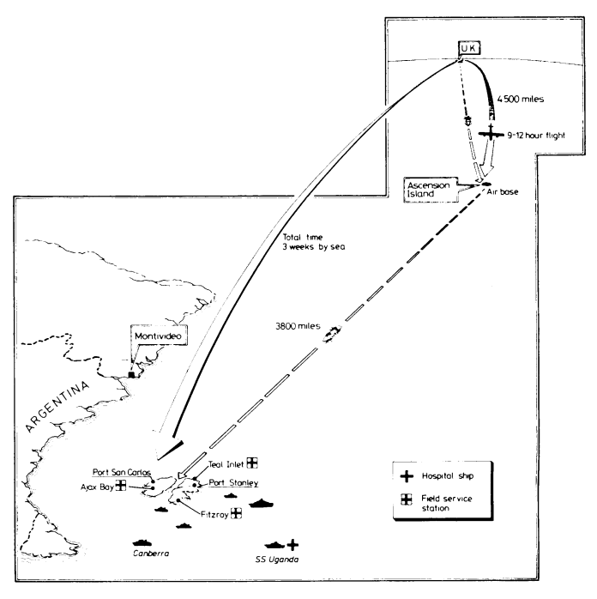

Slide 8
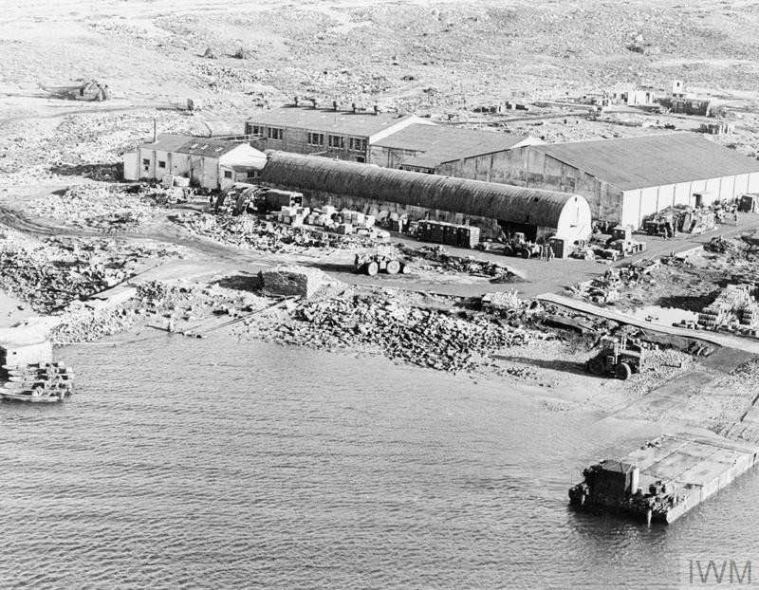
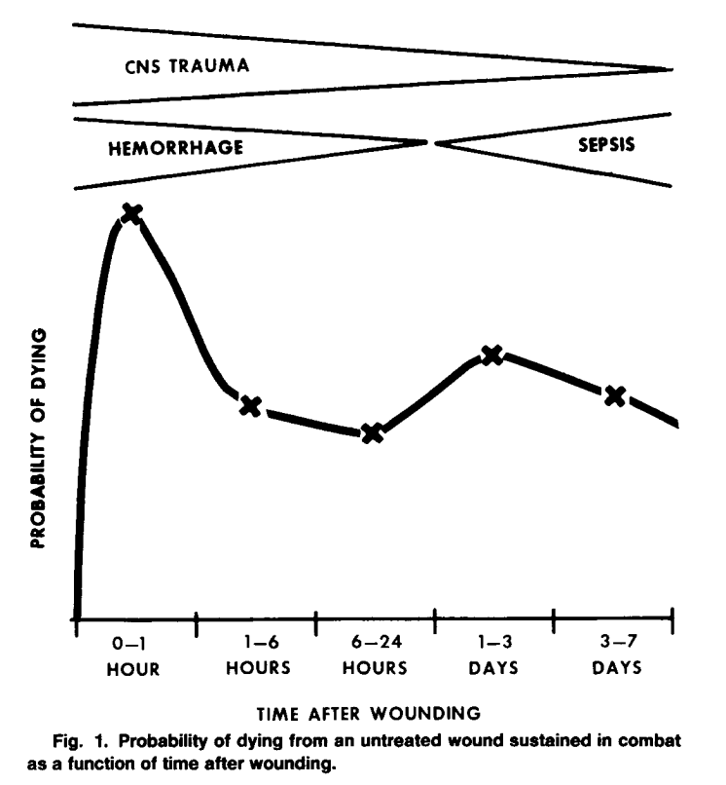
*Limited aeromedical evacuation
777 wounded; 255 killed
241 patients arrived to the FST
3 died
Bellamy, Ronald F.. “The causes of death in conventional land warfare: implications for combat casualty care research.” Military medicine 149 2 (1984): 55-62 .
Batty, Charles G. "Changes in the care of the battle casualty: lessons learned from the Falklands campaign." Military medicine 164.5 (1999): 336-340.

Slide 9
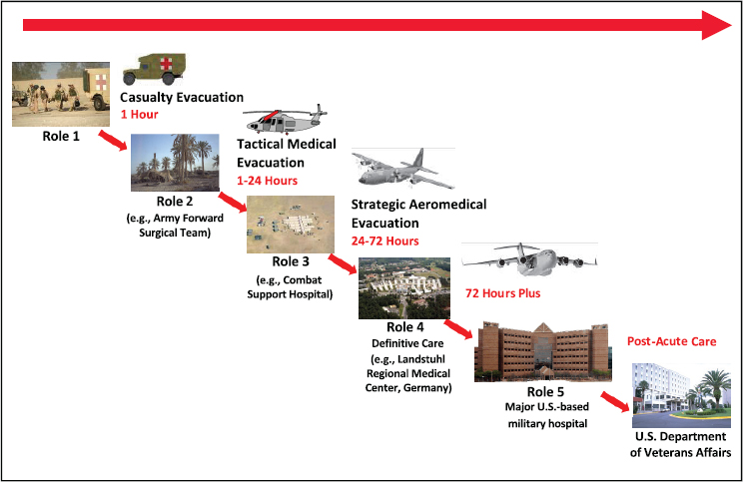
LCDR Scott Hughey, M.D., M.B.A.,
Anesthesiologist, Naval Hospital Okinawa
LCDR Kyle Checchi, M.D., M.Sc.
General Surgeon, Naval Hospital Okinawa
LCDR Jacob Cole, M.D., M.B.A.
Anesthesiologist, Naval Medical Center Portsmouth (Michaud Role 2)
LCDR Joshua Kotler, M.D.
Orthopedic Surgeon, III Marine Expeditionary Force

Slide 10
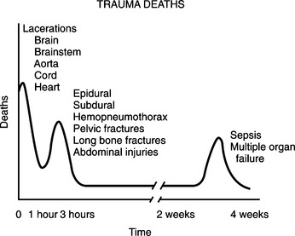
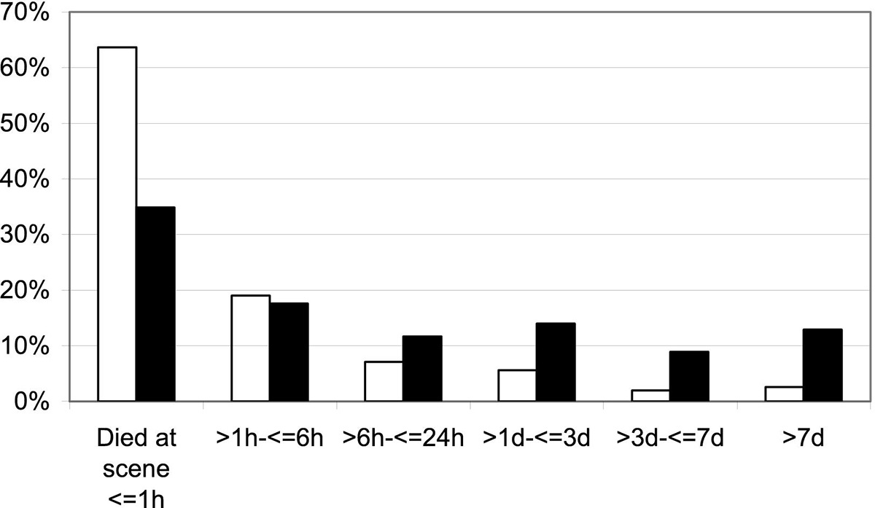
Mature Trauma System with Definitive Care

Slide 11
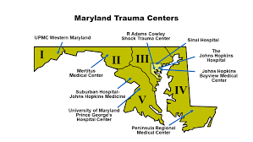
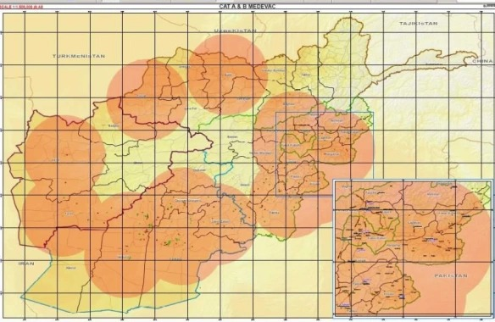
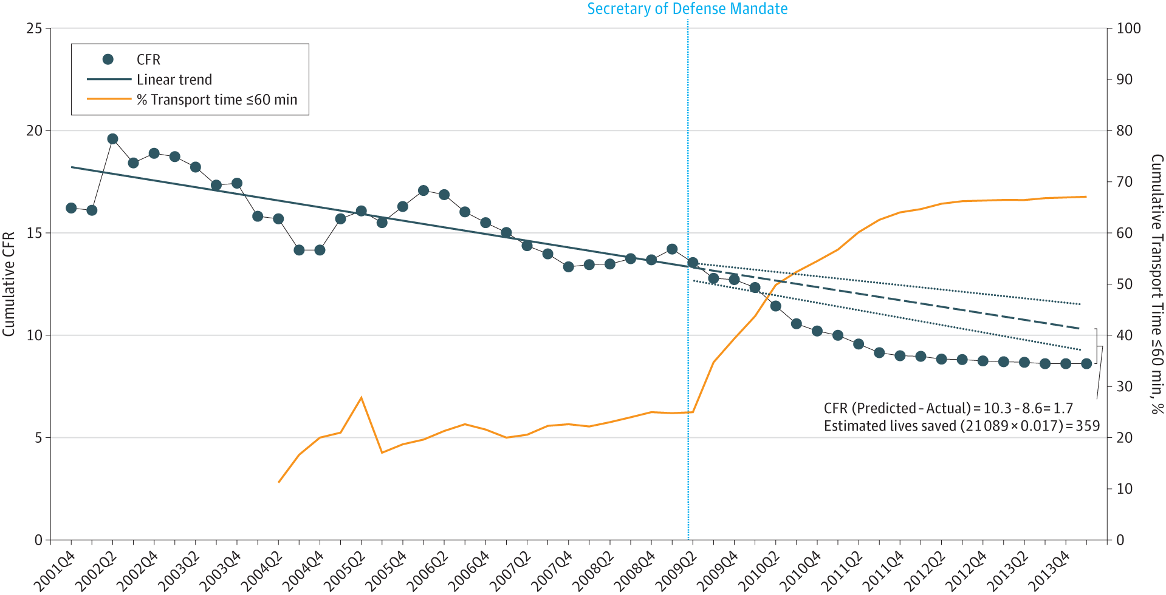
Prehospital care optimized (TCCC)
Definitive surgical care at Role 3 in Theater, or Role 4
Require Golden Hour and extend with Role 2 damage control surgery

Slide 12
LCDR Scott Hughey, M.D., M.B.A.,
Anesthesiologist, Naval Hospital Okinawa
LCDR Kyle Checchi, M.D., M.Sc.
General Surgeon, Naval Hospital Okinawa
LCDR Jacob Cole, M.D., M.B.A.
Anesthesiologist, Naval Medical Center Portsmouth (Michaud Role 2)
LCDR Joshua Kotler, M.D.
Orthopedic Surgeon, III Marine Expeditionary Force

Slide 13
Questions?

Slide 14
How To Claim CE Credit
If you would like to receive continuing education credit for this activity, please visit:
amsus.cds.affinityced.com

