Slide 1
Public Health Implications of Climate Change: The Role of Youth, Mental Health, and Health Equity
Building Local Climate Health Equity into a Resilience Hub Framework
CDR Jason Wilken, CDC Career Epidemiology Field Officer
February 2024
Notes:
Good morning and thank you for the opportunity to present on a framework for building climate resilience at the community level.

Slide 2
AMSUS Disclosure
CDR Jason Wilken has no relevant financial or non-financial interests to disclose.
This continuing education activity is managed and accredited by AffinityCE, in collaboration with AMSUS. AffinityCE and AMSUS staff, as well as planners and reviewers, have no relevant financial interests to disclose. AffinityCE adheres to the ACCME’s Standards for Integrity and Independence in Accredited Continuing Education. Any individuals in a position to control the content of a CME activity, including faculty, planners, reviewers, or others, are required to disclose all relevant financial relationships with ineligible entities (commercial interests). All relevant conflicts of interest have been mitigated prior to the commencement of the activity.
Commercial support was not provided for this activity.
Building Local Climate Health Equity into a Resilience Hub Framework

Slide 3
Learning Objectives
List the five foundational areas of community benefits provided by a resilience hub
Explain how a resilience hub addresses the same social determinants of health that predict risk of poor outcomes from climate emergencies
Discuss the importance of incorporating healthcare and public health resources in a resilience hub
Describe the value added of a Promise Zone partnership in developing a resilience hub
Building Local Climate Health Equity into a Resilience Hub Framework

Slide 4
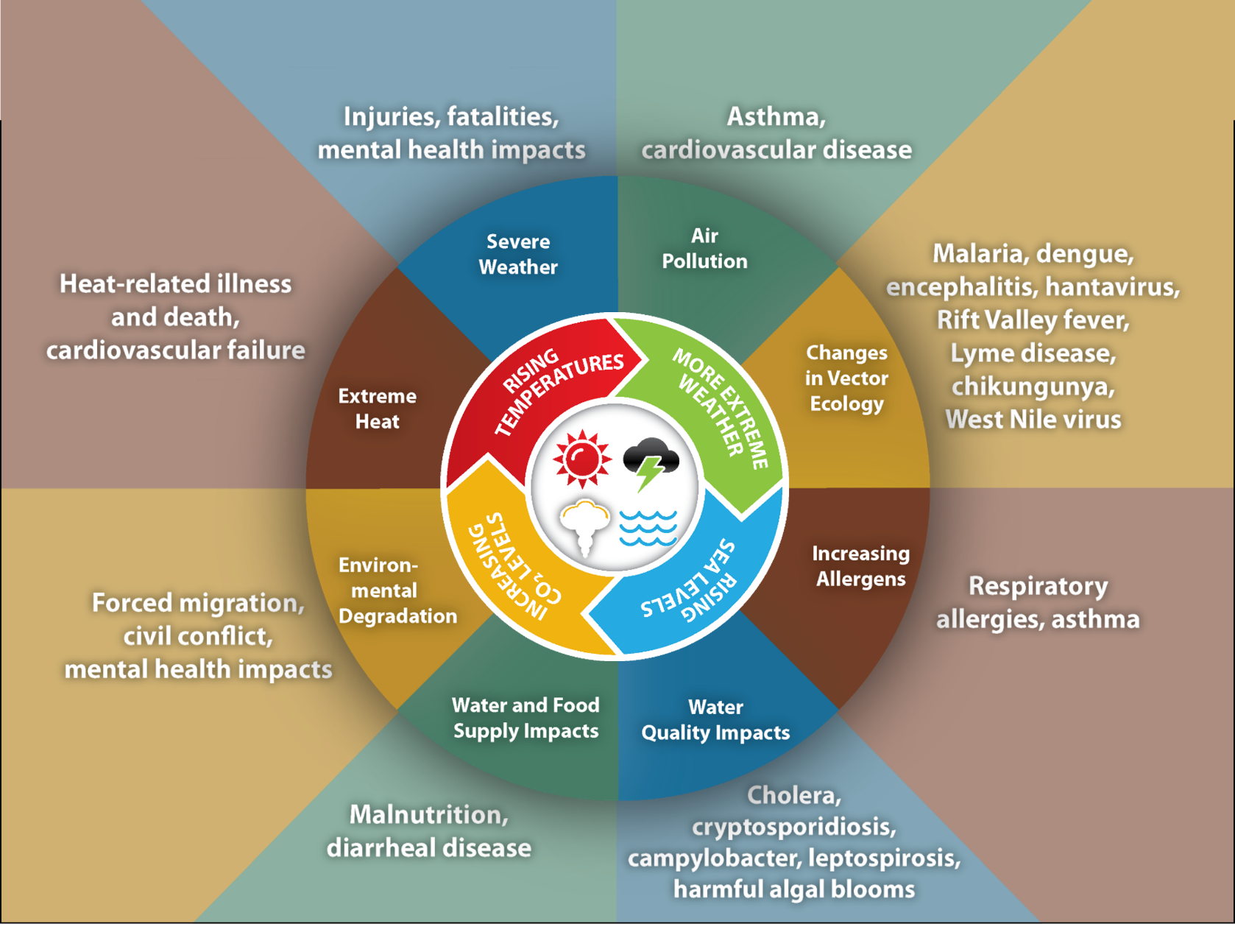
Impact of Climate Change on Human Health
“The impacts of climate change will not be borne equally or fairly, between rich and poor, women and men, and older and younger generations” United Nations Sustainable Development Goals
Slide courtesy of CDC’s Climate and Health Program
Building Local Climate Health Equity into a Resilience Hub Framework
Notes:
President Biden has referred to climate change as an existential threat. A cycle of increasing atmospheric CO2, resulting in rising temperatures, more extreme weather, and sea level rise results in broad human health impacts:
Increased air pollution, exacerbating asthma and cardiovascular disease
Changes in vector ecology including expanded ranges of diseases such as Lyme and West Nile
Increasing allergens such as pollen and mold
Changes to the supply and quality of water and food, resulting in increase incidence of food and waterborne diseases, malnutrition, and diarrheal diseases
Environmental degradation such as desertification and sea water inundation resulting in crop failure, forced migration, civil conflict, and mental health problems
And of course, extreme heat, resulting in heat illness and cardiovascular failure
Everyone is exposed to the health risks associated with climate change. Quoting the United Nations Sustainable Development Goals: “the impacts of climate change will not be borne equally or fairly, between rich and poor, women and men, and older and younger generations.”

Slide 5
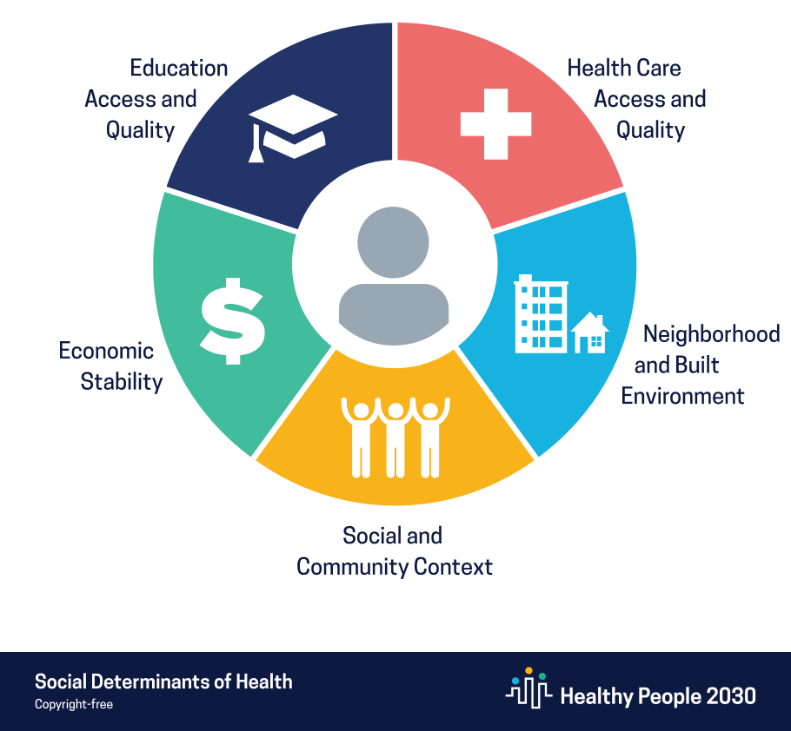
Social Determinants of Health
The nonmedical factors that influence health outcomes. They are the conditions in which people are born, grow, work, live, and age, and the wider set of forces and systems shaping the conditions of daily life. These forces and systems include economic policies and systems, development agendas, social norms, social policies, racism, climate change, and political systems.
https://www.cdc.gov/about/sdoh/
Building Local Climate Health Equity into a Resilience Hub Framework
Notes:
The disparity between exposure and health outcome, the question of who will suffer most from the health impacts of climate change, is rooted in the social determinants of health. The CDC defines the Social Determinants of Health as the nonmedical factors that influence health outcomes. They are the conditions in which people are born, grow, work, live, and age, and the wider set of forces and daily systems shaping the conditions of daily life. These include economic policies and systems, development agendas, social norms, social policies, racism, and political systems. You might have heard other summary examples of the social determinants of health, such as how the zip code in which a person is born in is a better predictor of health outcomes than genetics or even access to healthcare services.
Healthy People 2030 highlights the social determinants of health across 5 broad categories: health care access and quality, the neighborhood and the built environment, social and community context, economic stability, and education access and quality. Addressing the social determinants of health is a key priority of the US Department of Health and Human Services.

Slide 6
Unequal Climate Vulnerability
Root Causes¹
Environmental justice factors that may increase climate vulnerability²
Racism, historical and current disenfranchisement, unequal distribution of power and resources rooted in institutions and processes
Proximity and exposure to environmental stressors
Unique exposure pathways
Physical infrastructure, such as poor housing
Multiple stressors, cumulative, and compounding impacts
Capacity to participate in decision making
Unequal climate vulnerability
1) Adapted from Climate Change, Health and Equity: A Guide for Health Departments, Public Health Institute and American Public Health Association, 2018
2) Adapted from Guidance on Considering Environmental Justice During Development of Regulatory Actions, EPA, 2015
Slide courtesy of CDC’s Climate and Health Program
Building Local Climate Health Equity into a Resilience Hub Framework
Notes:
The social determinants of health are similarly linked to climate-related vulnerability.
Who lives near sources of air pollution? Who lives near major roads and highways exposing them to high concentrations of diesel combustion, thereby increasing risk of asthma? Who lives in flood prone housing that harbors mold and other allergens? And then there is of course the question of capacity to participate in decision making. Those with the fewest resources are typically those with the least amount of social and political capital, and with the least amount of control over decisions made about their environment.
It is the neighborhood and the community that largely determine the environmental stressors and the mitigating factors that determine climate vulnerability. And disparities in these neighborhood and community factors therefore create unequal climate vulnerability.

Slide 7
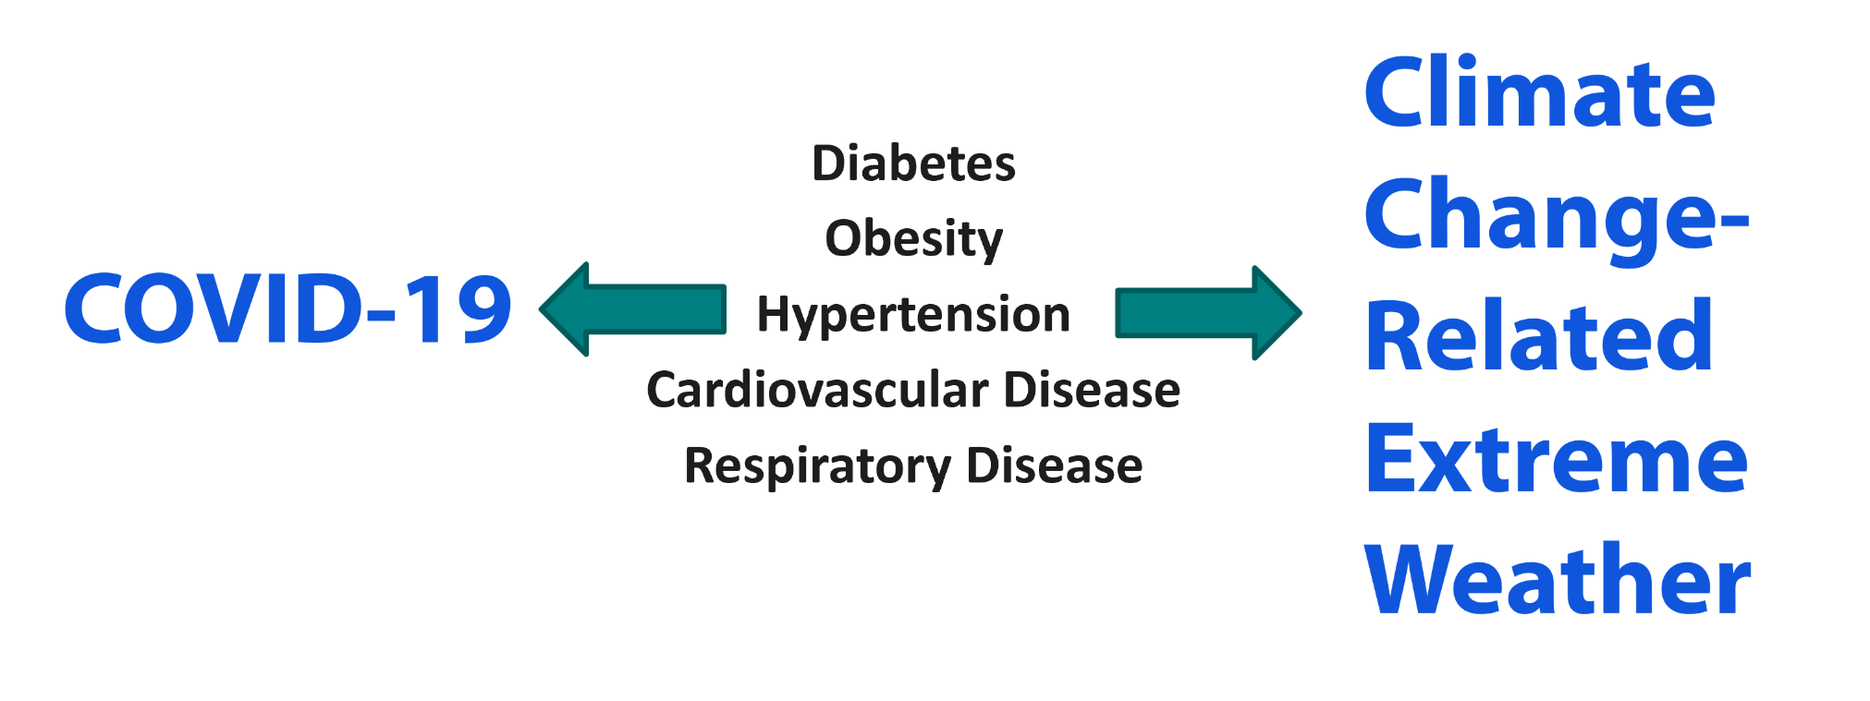
Chronic Disease Prevalence Predicts Population Vulnerability
Building Local Climate Health Equity into a Resilience Hub Framework
Notes:
We observed that chronic conditions like diabetes, obesity, hypertension, cardiovascular disease, and respiratory disease contribute to poor outcomes from COVID-19. We also know that those underlying chronic diseases contribute to poor outcomes from climate change related extreme weather events such as heat waves, floods, and wildfire smoke.
Societal factors and the environment in which we are born, work, live, and age contribute to chronic conditions that determine outcomes from multiple risks, whether those risks are COVID-19 or whether they are climate change related.

Slide 8
Health Equity Requires Community-Led Solutions
Building Local Climate Health Equity into a Resilience Hub Framework
Notes:
Since health outcome disparities are a product of social determinants of health, it follows that effective solutions targeting the social determinants of health need to be locally designed and locally managed.
Indeed, first on the list of the 2021 Presidential COVID-19 Health Equity Task Force’s list of recommendations is to invest in community-led solutions to address health equity with flexible funding options to address the specific needs of the community.
Effective interventions must address the social determinants of health.

Slide 9
A Holistic Definition of Resilience
“Communities should be resilient year-round, not just in the event of a major disturbance but in the face of all stressors, challenges and disruptions. However, to create resilient communities, acknowledgment of power dynamics, systemic racism, and intentional disenfranchisement must be at the core of the work; centering healing, reparative action, power shifting, and community health and well being.”
Baja K, Resilience hubs: shifting power to communities through action. In: Rajkovich NB, Holmes SH, eds. Climate adaptation and resilience across scales: from buildings to cities. 2022
Building Local Climate Health Equity into a Resilience Hub Framework
Notes:
Resilience is a bit of a buzzword, and can mean different things to different agencies. Among the more common definitions of resilience is the ability of a community to bounce back after hazardous events rather than simply reacting to impacts.
However, that definition does not account for the underlying social determinants of health. Resilience is not simply the ability to bounce back to steady state, because we know that often that steady state is simply insufficient. Returning to an inequitable environment fails to address the health needs of the community.
Consider this more holistic definition of resilience. Communities should be resilient year round, not just in the event of a major disturbance but in the face of all stressors. That is community resilience must address the social determinants of health during all times, not just during emergencies.

Slide 10
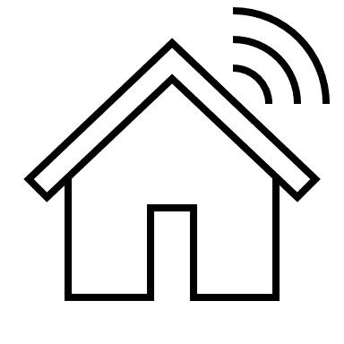
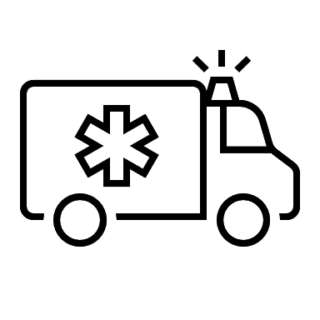
Resilience Hub
Place-based, trusted location(s)
Climate information, education, and civic engagement (esp. youth)
Clinical and/or public health services (or has direct links/referrals)
Local control and locally identified needs.
Linked to local hazard mitigation plan. Resources during disruptions, e.g.: power, broadband, heating/ cooling, clean air, water
Year-round community benefits (foundational areas)
Services and programming
Communications
Building and landscape
Power systems
Operations
Building Local Climate Health Equity into a Resilience Hub Framework
Notes:
And here we highlight a resilience model championed by the Urban Sustainability Directors Network, a “resilience hub”.
Resilience hubs provide direct health and societal benefit to communities at disproportionate risk of climate change-related health impacts. No two hubs are the same because no two communities are the same, but nevertheless resilience hubs share several key components.
They are locally controlled, address local needs, and leverage local trusted structures. Year-round, they provide benefits to the community including services and programing, communications, building and landscape, power systems, and operations. And during times of disruption, the hub should be a physical resource for the community. It could be a distribution point for food and materiel and goods, but beyond that the hub should have some degree of energy independence and be able to provide power and broadband access, could serve as a heating or cooling or clean air shelter, and have emergency water reserves.
The hub should have a clinical and/or public health component. The hub might be co-located with a community health center or have a satellite office for preventative services. Alternatively, the hub might have close ties with a safety net health center for patient identification and referral. Regardless, the hub exists in the community in partnership with health—bringing health into a hub connected to all these other services is what allows the hub to address the social determinants that affect climate related health outcomes.
And the hub should provide community education and trusted information about climate change, including referrals to weatherization and energy efficiency services. Ideally, the hub can house civic and youth engagement programs.
The hub should also be an integrated component of emergency management; the hub can efficiently assist the community during emergency responses as part of the local hazard mitigation plan.

Slide 11
Resilience Modes
Everyday (non disruption)
All infrastructure and services are available
No major disruptions are present
Primary focus is on community services, programming, and relationship building
Disruption
Disruption to normal everyday function for any duration
Disruptions can include natural disasters, health disasters, and human-influenced disruptions
Disruption can vary from minutes to months or years
Recovery
Process of returning to everyday mode
The aftermath of the disruption during which the community works to restore normal or better conditions
Can last days to years
Adapted from: Baja K, Resilience hubs: shifting power to communities through action. In: Rajkovich NB, Holmes SH, eds. Climate adaptation and resilience across scales: from buildings to cities. 2022
Building Local Climate Health Equity into a Resilience Hub Framework
Notes:
There are three modes of operation of a resilience hub. The first Mode is everyday operations. Services and resources that address everyday stressors, such as food insecurity or childcare can be provided through the hub when there is no major disruption.
Disruption mode, is when an incident impacts the majority of the served community . This can be a short term disruption such as a severe weather event, or long term disruption such as COVID-19, or could also be concurrent disruptions. Resilience hubs can provide a location where response partners can bring resources and supplies to the community in a space the community trusts and has a sense of ownership. They can also serve as staging and coordination areas for Emergency Management.
Recovery mode is when resources and support are available, but the community may be experiencing barriers to access. The hub can facilitate recovery activities by again serving as a focal point for delivering resources to the community in a trusted space and identifying residents in need of additional support.

Slide 12
Resilience Hubs—Foundational Areas
Services and Programming | Communications | Building and Landscape | Power Systems | Operations
The Hub has additional services and programs that build relationships, promote community preparedness, and improve the residents’ health and well-being Examples: Maker space How-to courses Job trainings and recruitment Health Services Nutrition Services | Building relationships and respect within the neighborhood (service area) year-round. Ensuring the ability to communicate within and outside the service area during disruptions. Examples: CERT training with extra section for proactive outreach Radio Translated info Culturally relevant | Strengthening the resilience of the facility to ensure that it meets operational goals in all conditions. Identify opportunities to utilize surrounding landscape for resilience benefits. Examples: Air filtration Water capture and reuse Weatherization Earthquake-proof Urban gardening | Ensuring uninterrupted power to the facility during a hazard while also improving the cost effectiveness and sustainability of operations in all three resilience modes. Examples: Hybrid power solutions including battery back up and generator Solar panels | Ensuring personnel and processes are in place to operate the facility year-round and also continue operating during disruption and recovery. Examples: Site leadership Accessibility Site retrofits and assigned task management Roles in all three resilience modes.
Adapted from: Baja K, Resilience hubs: shifting power to communities through action. In: Rajkovich NB, Holmes SH, eds. Climate adaptation and resilience across scales: from buildings to cities. 2022
Building Local Climate Health Equity into a Resilience Hub Framework
Notes:
An ideal hub is resilient across 5 foundational areas:
*CLICK*
Resilient services and programs are determined by the community members to meet the community’s needs, and adjust to theirneeds over time.
*CLICK*
Resilient communications ensures accessible, reliable, and easily understood information is available in all three resilience modes.
*CLICK*
Resilient Building and Landscape ensure that the physical space addresses the needs of the community and is physically resilient to disruptions such as extreme weather. This may include expanding or retrofitting older, trusted spaces.
*CLICK*
Resilient power systems address community needs year round. The hub may include community space for charging stations and wifi. Resilient power systems may include renewable energy and storage systems or even a microgrid approach that reduces power bills and generates revenue, and also ensures sufficient backup power during times of disruption.
*CLICK*
Resilient operations means that the hub is accessible and its functions are supported by team members under different operating conditions; this could also be thought of as ConOps. For example, a hub might have to serve as a temporary warming shelter while also providing everyday childcare functions, in which case these two functions might have to occur in separate spaces of the hub for safety and security reasons.

Slide 13
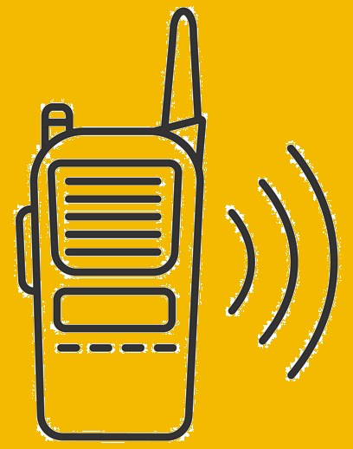
Building a Resilience Hub
Emergency preparedness/services
Public health and medical services
State and local government & services
Co-locate clinical/public health services
Leverage safety net health centers.
Utilities prioritization/microgrid
Social services
Active transportation
Housing/employment assistance
Mass testing/vaccination sites
Cooling and clean air shelter
Resource distribution point
Services and programming
Communications
Building and landscape
Power systems
Operations
Community-identified needs. Ex:
Adult education
Counseling services
Job training/placement
Meal services
After-school programming
Outputs
Climate health resilience hub
Inputs
Community
Building Local Climate Health Equity into a Resilience Hub Framework
Notes:
Resilience hubs are built and controlled by the community and serve the community’s needs.
*CLICK*
Through its foundational areas, the hub addresses the social determinants of health through everyday community support, during disruptions, and during recovery.
*CLICK*
The hub builds resilience by providing services to those at greatest risk. This can be realized by collocating a hub with an existing clinic, having a clinic satellite office, or leveraging safety net health centers, which are often places that people naturally turn to during crises and are well-versed in targeted outreach. A public health presence can also take the form of a satellite office for local community engagement such as immunization or maternal child health.
*CLICK*
The hub also serves the community during times of disruption. Examples might include serving as a mass testing or vaccination site, being a clean air shelter, or serving as a staging point for distribution of resources. This requires integration into local emergency management.
*CLICK*
Finally, the hub brings in state and local government services to help transform the surrounding community, and provide service access to historically underserved groups.
Government agencies can address the social determinants of health and build resilience to climate change by supporting but not dictating a community-owned, community led hub. I’ll spend the remainder of this presentation outlining an exciting new collaboration between the US Departments of Housing and Urban Development (or HUD), and Health and Human Services.

Slide 14
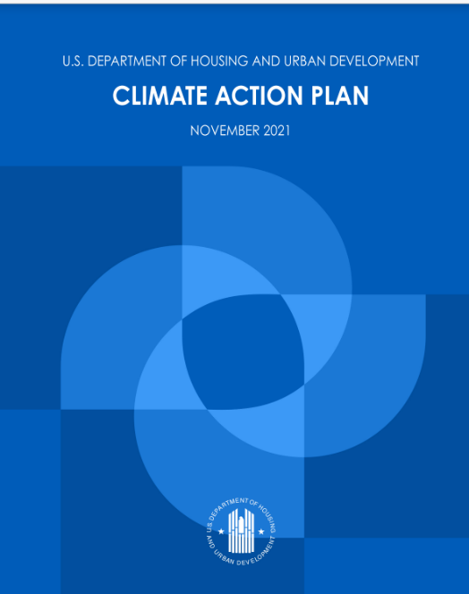
U.S. Department of Housing and Urban Development (HUD) Climate Action Strategy
Historic shift in HUD spending and policies toward using low- and zero-carbon energy. Each HUD program office has committed specific, time-bound actions on climate and environmental justice
Strategic Plan
Goal 4: Advance Sustainable Communities describes how HUD advances sustainable communities by strengthening climate resilience and energy efficiency, promoting environmental justice, and recognizing housing’s role as essential to health
Climate Action Plan (Nov 2021)
Reduce agency’s carbon footprint
Put our nation’s communities on the path to building more resilient, equitable, efficient, and sustainable housing infrastructure.
https://www.hud.gov/climate
Building Local Climate Health Equity into a Resilience Hub Framework
Notes:
HUD has embraced an ambitious shift on spending and policies favoring zero-carbon energy, and on addressing climate and environmental justice issues in each of its program offices. These are outlined in HUD’s strategic plan, to advance sustainable communities by strengthening climate resilience and energy efficiency, promoting environmental justice, and recognizing housing’s role as essential to health; and in HUD’s climate action plan to reduce the agency’s footprint and advance the building of more resilient, equitable, efficient, and sustainable housing infrastructure.

Slide 15
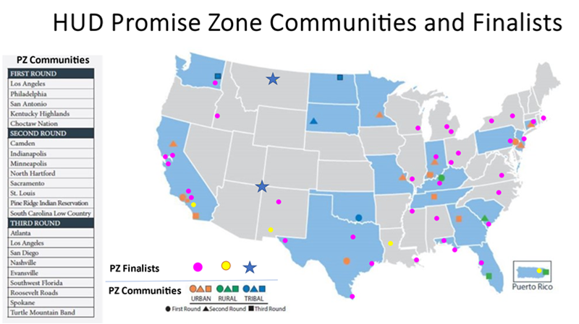
Promise Zones (PZ)
In 2014 USG designated 22 PZs to facilitate community development in vulnerable, high poverty urban, rural and tribal communities.
The program is run through HUD with leadership and collaboration from community partners.
Today, 2/3 of the 50 states have a PZ (designee or finalist).
Building Local Climate Health Equity into a Resilience Hub Framework
Notes:
Predating HUD’s climate action strategy was the Promise Zone initiative, launched during the Obama Administration, targeted to high poverty urban, rural, and tribal communities.
The Promise Zone supports…not leads but supports…applicant communities for 10-years, and supports 22 communities and numerous finalist communities.

Slide 16
Promise Zones: Place-Based and Collective Impact
PZs represent a coalition aligned to:
Boost economic activity and job growth,
Improve educational opportunities,
Reduce crime,
Leverage private investment to improve the quality of life.
PZ bring power of convening and technical assistance to communities
HUB lead agency
Non-profits
Faith-based organizations
Federal, state, and local public advocates
Academic and philanthropic partners
Business
Residents
Private businesses
Building Local Climate Health Equity into a Resilience Hub Framework
Notes:
The Promise Zone follows a place based and collective impact model, supporting a local coalition with goals of economic development, improving educational opportunities, reducing crime, and leveraging private investment to improve the quality of life for all. Promise Zones accomplish this through intensive in-person technical assistance and bringing the power of convening. Each promise zone brings an experienced program liaison, and several Americorps Vista staff, all of whom are assigned to and dedicated to a specific Promise Zone. Their duties include coordination and convening, both across local agencies and NGOs but also state and federal government and academia. Each Promise Zone therefore has dedicated staff for community organizing and coordination, for finding grant and other funding opportunities, for facilitating connections across government; they bring the power of convening and collective impact to their assigned communities.
And so we reached a perfect alignment of goals of HHS and HUD in the context of climate change—using a collective impact model and the power of convening to support resilience of a vulnerable community.

Slide 17
Resilience Hub Pilot: HHS and HUD Collaboration
La Familia Counseling Center (LAFCC), Sacramento, CA
Longtime community fixture, offered services for 50 years
Located within the HUD Sacramento PZ
Serves a predominantly disadvantaged neighborhood in need of multiple modes of social and economic support
Acts as a public partner helping local government roll out social services, often during periods of public crisis
HHS Secretary Xavier Becerra tours La Familia Counseling Center where UC Davis Health provides COVID-19 vaccinations, May 21, 2021.
Photo credit: UC Davis Health
Building Local Climate Health Equity into a Resilience Hub Framework
Notes:
Our pilot resilience hub is centered at La Familia Counseling Center in Sacramento, California. For more than 40 years, they’ve provided counseling, job training and placement, parenting, and health services programs to assist at-risk youth and disadvantaged families in a historically underserved community. La Familia also has a long history of partnering with city government, serving as a trusted site for delivery of needed services; for example, La Familia pivoted to respond to the shocks of the COVID-19 pandemic, serving as a testing and vaccination site and providing food assistance.
Sacramento is no stranger to climate-related emergencies, including floods, and also poor air quality from wildfire smoke. La Familia is within the HUD Sacramento Promise zone, and our efforts over two years have been an intentional decision to preposition financial and technical resources to build community resilience to the health impacts of climate change.

Slide 18
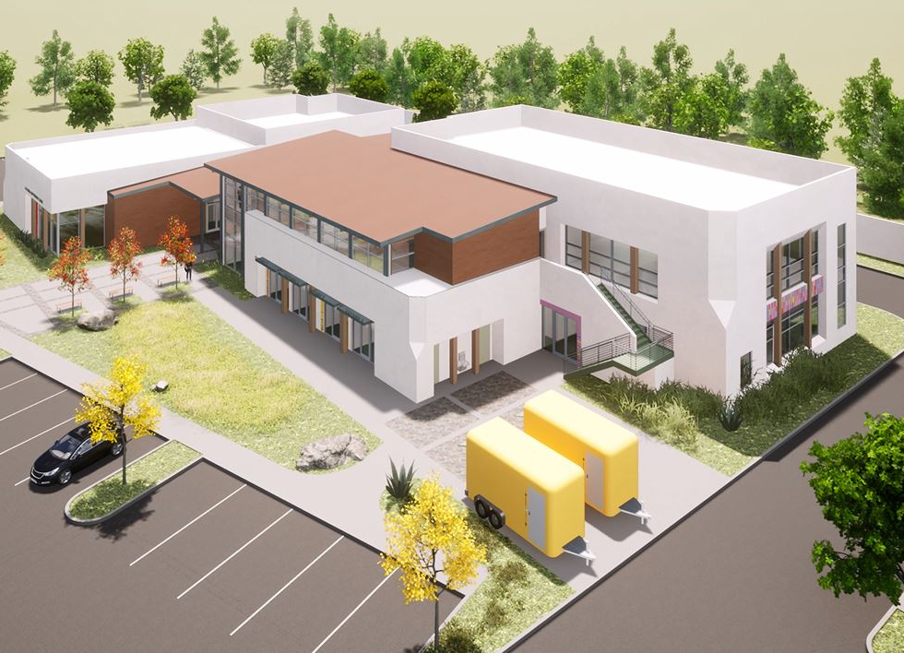
LAFCC Resilience Hub Goals
Integrate health and social service delivery with climate change resilience-focused planning.
Year-round services:
Social services
Mental and public health services
FQHC satellite office
Legal assistance
Employment, internships, and workforce-related skill building
Education attainment through direct instruction and emergency intervention
Emergency preparedness capacity:
Solar and backup battery storage
Capability for overnight shelter, hospital grade air filtration
Potable water, showers, laundry facility
Broadband access
Food storage
La Familia Counseling Center’s planned Opportunity Center expansion.
Image credit: La Familia Counseling Center
Building Local Climate Health Equity into a Resilience Hub Framework
Notes:
La Familia’s goals for building resilience are an excellent match to the resilience hub framework. La Familia is already a trusted fixture in their community, delivering year round services matched to the needs of the community. They plan to expand their behavioral health services, and they also plan to increase their health and public health footprint by incorporating a satellite office of a partner FQHC. They also plan to increase their employment, internship, education, and workforce skill building programs; for example, the neighborhood has an enormous number of vehicle servicing shops, and La Familia is interested in building workforce capacity for servicing zero emissions vehicles. As another example, La Familia is interested in using young people to help prepare their community for emergencies, a “youth resilience corps” for building neighborhood cohesion and preparedness.
La Familia has also prioritized the expansion of their own emergency preparedness capacity—they are interested in power solutions, in being capable of serving as an emergency shelter for extreme temperature or poor air quality events, for building out broadband access and food storage and preparation capacity.

Slide 19
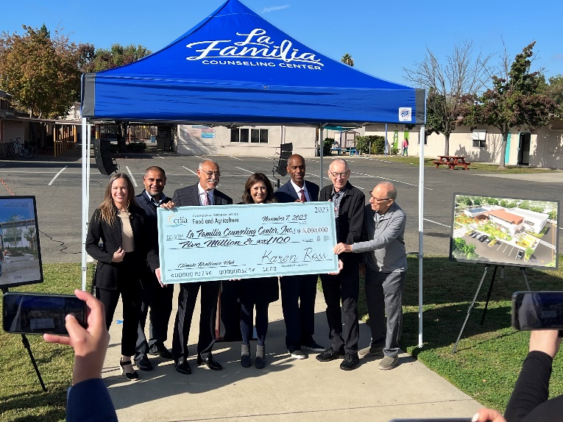
Promise Zones and the Power of Convening
SAMHSA & MOU with local CHC
Regional food network
SF Federal Reserve, CA Strategic Growth Council
City and County Emergency Management
Sacramento Regional Transit
RAND Youth Resilience Corps model
Expand clinical services
Food insecurity
Power and broadband
Emergency preparedness
Improve transit and walkability
Youth engagement
LAFCC Climate Resilience Hub 2nd annual convening, Sep 6, 2023. Photo credit: HUD
Awarding of $5M grant to LAFCC from California Department of Food and Agriculture, Nov 7, 2023
Building Local Climate Health Equity into a Resilience Hub Framework
Notes:
HUD and HHS have used a “stone soup” approach to bring in partners, to identify opportunities, to convene meetings with key government officials and funders. And La Familia is well on their way to being a fully capability resilience hub. Last September we held our second annual convening meeting, including city elected officials, HUD, and HHS representatives. La Familia is breaking ground next month on a new facility across the street from its main campus to house the expanded community services and emergency preparedness functions previously described. They received a $5M grant last November from the California Department of Food and Agriculture to help fund construction of this center. We are convening with the Office of the Governor’s “California Volunteers” program to identify options for making a sustainable youth climate resilience training program.
And we are getting attention. We are working through an initial request from elected officials and local CBOs to help support the development of a second resilience hub in the Sacramento promise zone.
There are many good directions that La Familia would like continue, and HUD and HHS are pleased to bring the power of convening to support them. However, it would be disingenuous to take too much credit—this is a community led, community owned venture, with partners from the private sector, city, county, state and federal government and academia, all working to bring resources to address the social determinants of health and build climate resilience in the La Familia neighborhood.

Slide 20
HHS Climate and Health Outlook
Sign up at ocche@hhs.gov
Building Local Climate Health Equity into a Resilience Hub Framework
Notes:
Let me end by highlighting an HHS climate and health resource. Please consider signing up for the monthly Climate and Health Outlook produced by the HHS Office of Climate Change and Health Equity. The Outlook was created to inform health professionals and the public on how our health may be affected in the coming months by climate events, and to provide resources for proactive action. It’s easy to sign up, just email ocche@hhs.gov to be added to their distribution list.

Slide 21
References
Arnold L et al. Mortality associated with extreme heat in Washington State: the historical and projected public health burden. Atmosphere. 2022;13(9):1392.
Baja K. Resilience hubs: shifting power to communities through action. In: Rajkovich NB, Holmes SH, eds. Climate adaptation and resilience across scales: from buildings to cities. 2022
Fawcett E et al. Vulnerable and trapped: a look at those lost in Hurricane Ian. The New York Times. October 21, 2022. Accessed May 18, 2023.
Liu JC et al. Who among the elderly is most vulnerable to exposure to and health risks of fine particulate matter from wildfire smoke? Am J Epidemiol. 2017;186(6):730-735.
Rappold AG et al. Cardio-respiratory outcomes associated with exposure to wildfire smoke are modified by measures of community health. Environ Health. 2012;11:71.
Santos-Burgoa C et al. Differential and persistent risk of excess mortality from Hurricane Maria in Puerto Rico: a time-series analysis. Lancet Planet Health. 2018;2(11):e478-e488.
Wilken et al. Building local climate health equity into a resilience hub framework. Public Health Reports. 2023; in press
Vaidyanathan A et al. Heat-related deaths—United States, 2004-2018. MMWR Morb Mortal Wkly Rep. 2020;69(24):729-734.
Building Local Climate Health Equity into a Resilience Hub Framework

Slide 22
How to claim CE credit
If you would like to receive continuing education credit for this activity, please visit:
https://amsus.cds.affinityced.com/hub.php
Building Local Climate Health Equity into a Resilience Hub Framework

Slide 23
Thank You!
CDR Jason Wilken, CDC Career Epidemiology Field Officer
vxj9@cdc.gov
The findings and conclusions in this report are those of the authors and do not necessarily represent the official position of the Centers for Disease Control and Prevention or the California Department of Public Health.
Link to Wilken et al. Building local climate health equity into a resilience hub framework. Public Health Reports. 2023; in press
usphs.gov
Notes:
Shown here is a QR code linking to our article currently in press describing our model for building health equity into a climate resilience hub.
And with that, I thank you for your attention.

