Slide 1
VA Health Outcomes Military Exposure (HOME): Updates on PACT Act and Other Military Environmental Exposures Research
Health Outcomes Military Exposure Living Evidence Analysis Program
(HOME-LEAP)
Michael J. Falvo, PhD
Co-Director, VHA Airborne Hazards and Burn Pits Center of Excellence
Associate Professor, Rutgers New Jersey Medical School

Slide 2
Disclosures
Michael Falvo receives grant and/or research support from VA’s Office of Research & Development (I01CX001329, I01CX001329, I01BX004740) and the DoD’s Congressionally Directed Medical Research Program (W81XWH-19-2-0059).
No relevant financial or non-financial interests to disclose
The contents of this presentation do not represent the views of the VA or the United States Government.
Work presented herein relates to a contract between Airborne Hazards and Burn Pits Center of Excellence and Rutgers University (36C24222C0138)
HOME-LEAP project led by Dr. J. Scott Parrott

Slide 3
Is there evidence linking exposure X to health effect Y?
What is Known
Integrate all Evidence
Evaluate and Synthesize
Environmental health research ≠ clinical research
Exposures are complex
Randomized controlled trials are not possible
Multiple data streams (human, animal, in vitro, …)

Slide 4
Is there evidence linking exposure X to health effect Y?
Systematic Review
Weight of Evidence
Systematic Literature Review
Question
Hypothesis Testing (Meta-Analysis)
Conclusion and Confidence
Searching
Screening
Data Extraction
Investigative Literature Review
Other Information Sources
Derive Evidence
Inference by weighing evidence (Bradford Hill’s Considerations)
Conclusion and Confidence
Question
Assemble Evidence
Redrawn from: Suter et al. 2020 (US EPA) Integr Environ Assess Manag

Slide 5
NASEM 2008 – Presumptive Service Connection
The following evidence should be considered (p. 137):
Measurements and estimates of exposures of military personnel during their service, if available;
Direct evidence on risks for disease in relation to exposure from epidemiologic studies of military personnel;
Other relevant evidence, including findings from epidemiologic studies of nonmilitary populations who have had exposure to the agent of interest or to similar agents;
Findings relevant to plausibility from experimental and laboratory research.

Slide 6
“Based on the epidemiologic studies of military personnel and veterans reviewed in this and previous National Academies reports, the committee concludes that there is inadequate or insufficient evidence of an association between airborne hazards exposures in the Southwest Asia theater and…”
Rhinitis and sinusitis
Vocal cord dysfunction
Sleep apnea
Asthma
COPD, emphysema, chronic bronchitis
Constrictive bronchiolitis
Sarcoidosis
Hypersensitivity pneumonitis
Idiopathic interstitial pneumonias
Acute eosinophilic pneumonia
Pulmonary alveolar proteinosis
Acute bronchitis
Pneumonia
Tuberculosis
Respiratory cancers
Mortality from respiratory disease

Slide 7
Reconsidering the Totality of Evidence: New Internal VA Process
HOME and AHBPCE led effort
Supplemental review on asthma, sinusitis, rhinitis
Considered multiple data streams
Civilian epidemiologic studies, experimental and laboratory research
Structured approach (PECOTS, grading of evidence, …)
Presumptive service connection (Aug 2021)
Federal Register / Vol. 86, No. 148 / Thursday, August 5, 2021 / Rules and Regulations

Slide 8
PACT Act – Review and Assess Presumptive Decision Process
From a scientific aspect, NASEM committee recommends:
VA model its scientific evaluation after standard approaches
Include protocol development and research question (PECOTS)
Formalize search strategy (inclusion/exclusion)
Synthesis reporting
Include full body of evidence
Structured approach to determining levels of evidence (synthesis of GRADE, OHAT, US National Toxicology Program methods)
National Academies of Sciences, Engineering, and Medicine. 2023. Review of the Department of Veterans Affairs Presumption Decision Process. Washington, DC: The National Academies Press. https://doi.org/10.17226/27166.

Slide 9
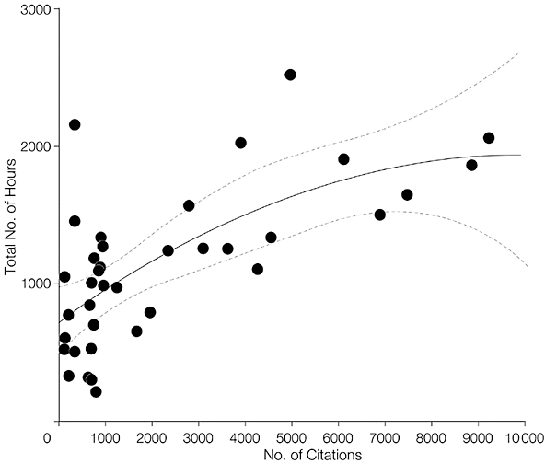
Resource Intensive
Well-performed systematic review and meta-analysis can take between 1000 to 2000 person hours
Opportunities for Efficiency
Reduce start-up time
Standardize approach/throughput
$$Total Time=721+0.243x −0.0000123x^{2}$$
x = total # citations
Allen & Olkin 1999, JAMA
Figure from: Allen and Olkin JAMA. 1999;282(7):634-635.
Notes:
https://jamanetwork.com/journals/jama/fullarticle/2682927
The predicted start-up time is 721 hours (95% confidence interval, 478-964 hours) as can be seen in Figure 1. Variability increases when the number of citations is less than 1000, in part because some parts of the initial stages of the analysis require relatively constant periods of time. However, the scatterplot does convey the major time investment required to conduct a meta-analysis.

Slide 10
HOME-LEAP Schematic
Identify
Screen
Extract
Synthesize
Share
Develop and refine search criteria based on system of questions
Screen and triage articles (enhanced by machine learning)
Extract data from article, assess risk of bias
Evaluate strength of evidence for each question and across levels
Perform meta-analyses, publish evidence maps

Slide 11
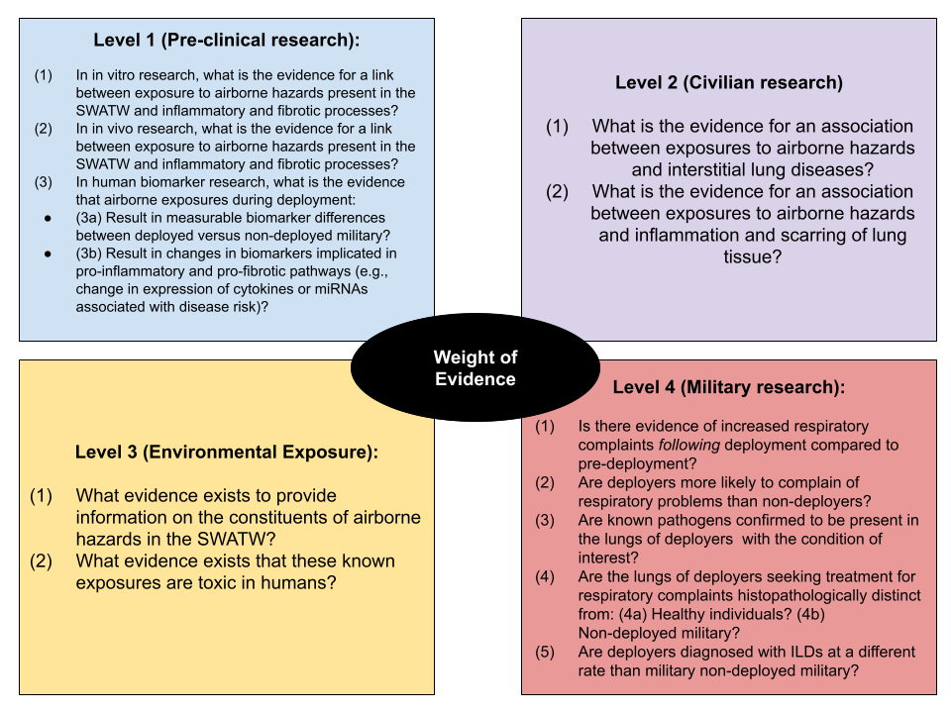
System of Questions to Provide a Weight of Evidence
Notes:
https://jamanetwork.com/journals/jama/fullarticle/2682927
The predicted start-up time is 721 hours (95% confidence interval, 478-964 hours) as can be seen in Figure 1. Variability increases when the number of citations is less than 1000, in part because some parts of the initial stages of the analysis require relatively constant periods of time. However, the scatterplot does convey the major time investment required to conduct a meta-analysis.

Slide 12
Level 4 (Military research):
Is there evidence of increased respiratory complaints following deployment compared to pre-deployment?
Are deployers more likely to complain of respiratory problems than non-deployers?
Are known pathogens confirmed to be present in the lungs of deployers with the condition of interest?
Are the lungs of deployers seeking treatment for respiratory complaints histopathologically distinct from: (4a) Healthy individuals? (4b) Non-deployed military?
Are deployers diagnosed with ILDs at a different rate than military non-deployed military?
For each article: extract data and evaluate Risk of Bias
Synthesize the data for each question and draw a conclusion
Evaluate the Strength of Evidence for each conclusion
Do the same for all questions in all Evidence Streams
Identify research relevant for each question
Draw a conclusion and evaluate the total Weight of Evidence
Notes:
https://jamanetwork.com/journals/jama/fullarticle/2682927
The predicted start-up time is 721 hours (95% confidence interval, 478-964 hours) as can be seen in Figure 1. Variability increases when the number of citations is less than 1000, in part because some parts of the initial stages of the analysis require relatively constant periods of time. However, the scatterplot does convey the major time investment required to conduct a meta-analysis.

Slide 13
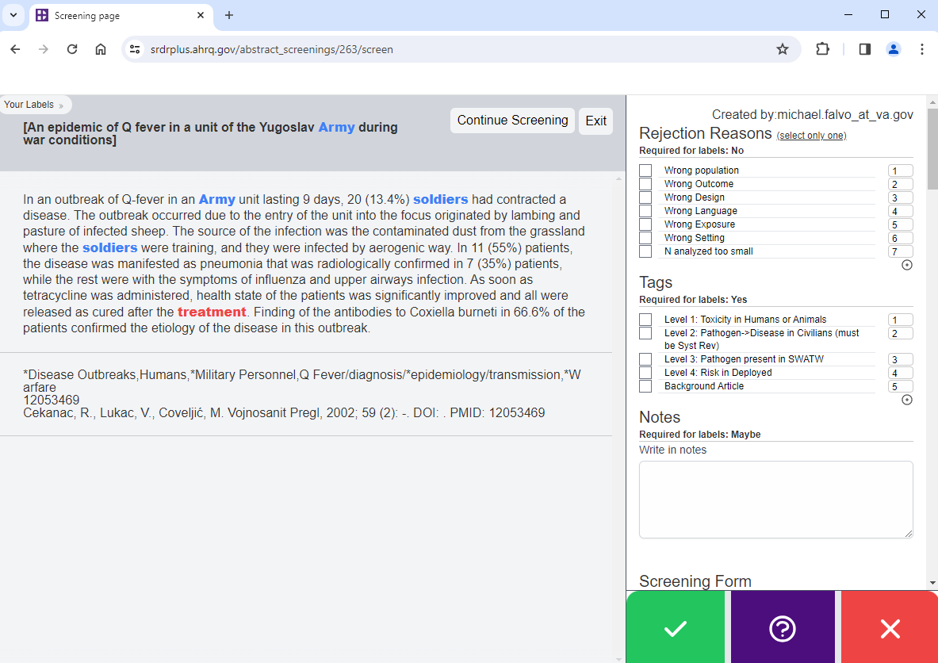
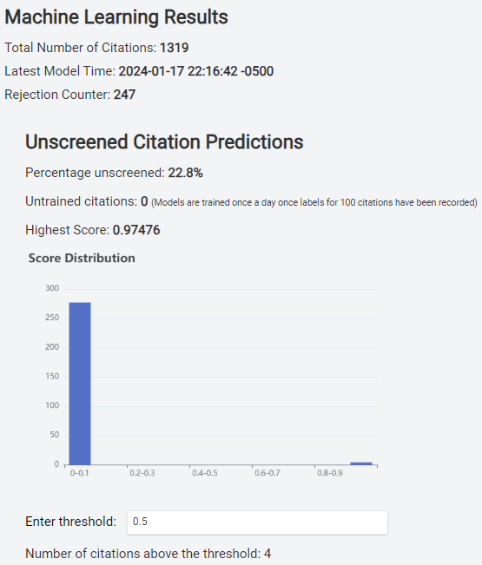
Enhanced Article Screening
Name | Algorithm | Model Features
Abstrackr | BioLinkBERT-base model pretrained on PubMed | Transformer encoder model
 |  | Neural network architecture
Current testing indicates that only about 30% of identified studies need be screened by humans.

Slide 14
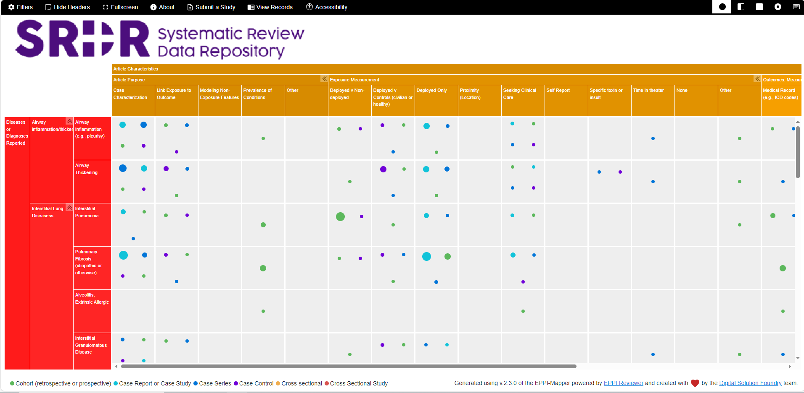
Is there evidence linking exposure X to health effect Y?

Slide 15
Conclusion
Veterans, clinicians, scientists, and policy makers require (and deserve) accurate scientific assessments of the available evidence for decision making
HOME-LEAP Features:
Flexible framework
Able to accommodate multiple data sources
Can be tailored to any health condition(s)
Rigorous and structured approach (article screening → synthesis)
Optimized for efficiency and “up-to-dateness”
Outputs for various stakeholder groups
Notes:
https://jamanetwork.com/journals/jama/fullarticle/2682927
The predicted start-up time is 721 hours (95% confidence interval, 478-964 hours) as can be seen in Figure 1. Variability increases when the number of citations is less than 1000, in part because some parts of the initial stages of the analysis require relatively constant periods of time. However, the scatterplot does convey the major time investment required to conduct a meta-analysis.

Slide 16
Acknowledgements
HOME-LEAP Team
J. Scott Parrott, PhD
Lt. Col. (Ret.) Jane Heetderks-Cox, MS
Lt. Col. (Ret.) Tami Piemont, MS
Yingting Zhang, AHIP
Frederick Coffman, PhD
Al Heuer, PhD
Shobhik Chakraborty, MPH
VSFS Interns

