Slide 1
Are We There Yet? The Enlisted Perspective
Moderator
HMCM Troy Brown, Defense Health Agency
Panelists
HMCM Joe H. Espinosa III, The Navy Bureau of Medicine and Surgery
CMSgt Tanya Y. Johnson, Defense Health Agency
CMSgt Dawn M. Kolczynski, Office of the Surgeon General, US Air Force
CSM Timothy J. Sprunger, Office of the Surgeon General/CG, Army Medical Command
Notes:
Title Slide Design

Slide 2
Disclosures
The Presenters have no relevant financial or non-financial interests to disclose.​
This continuing education activity is managed and accredited by AffinityCE, in collaboration with AMSUS. AffinityCE and AMSUS staff, as well as planners and reviewers, have no relevant financial interests to disclose. AffinityCE adheres to the ACCME’s Standards for Integrity and Independence in Accredited Continuing Education. Any individuals in a position to control the content of a CME activity, including faculty, planners, reviewers, or others, are required to disclose all relevant financial relationships with ineligible entities (commercial interests). All relevant conflicts of interest have been mitigated prior to the commencement of the activity.​
Commercial support was not provided for this activity.

Slide 3
Disclaimers
The views expressed in this presentation are those of the presenters and do not reflect the official policy or position of the Department of Defense or of the U.S. Government.

Slide 4
Learning Outcomes
Discuss the value of utilizing SELs’ experiences and influence as part of the MHS executive leadership team.
Describe key areas where SELs can provide support to MHS Directors/Commanders, and Staffs to help build relationships and solve problems across the organization.
Illustrate how key SEL tasks support Directors’ and Commanders’ mission, vision, and intent.
Discuss how SELs can best balance healthcare delivery business operations with Service readiness requirements.

Slide 5
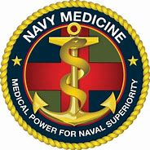
Military Health System (MHS)

Slide 6
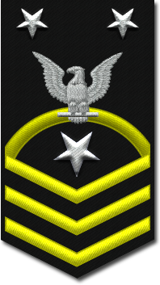
MHS Key Areas of Focus
Leading with and without authorities
Decision making
Mission command
Building relationships
Support to the MHS Directors and/or Commanders

Slide 7
SEL Relationships
More critical in complex MHS environment
SELs possess the ability to establish, leverage and foster relationships
Grow and maintain trust to harmonize staff
Work with staff to provide best care for Warfighters and Families
Serve as a champion for the MHS
SEL can be a problem solver
Help shape mission requirements
Influence positive change and partnerships across the MHS

Slide 8
DISCUSSION

Slide 9
Summary
Successful SELs recognize that successful mission command greatly depends on understanding commander’s intent, communication, and trust.
As an asset and champion for the MHS, SELs can be a “directed telescope” by providing a grounded “down and in” perspective, while remaining keenly aware of the “up and out” of the organization.
Focusing on the “Why” and highlighting the “How to” of the mission, the SEL can be a problem-solver at all levels of the force to shape mission requirements and influence positive change and partnerships across the MHS.

Slide 10
How to Claim CE Credit
Thank you for your participation!
If you would like to receive continuing education credit for this activity, please visit:​
amsus.cds.affinityced.com​

