Slide 1
Aiming for the Moon(shot):
How VA is Making the Future of
Cancer Care a Reality
Michael Kelley, MD
Kara Maxwell, MD, PhD
Carolyn Menendez, MD
Vida A Passero, MD, MBA
February 15, 2024
AMSUS

Slide 2
Disclosures
Drs. Kara Maxwell, Vida Passero, and Carolyn Menendez have no relevant financial or non-financial interests to disclose.
Dr. Michael Kelley receives grant and/or research support from:
Novartis
Bristol Myers Squib
Regeneron
Mirati Therapies
Disclosure will be made when a product is discussed for an unapproved use.
This continuing education activity is managed and accredited by AffinityCE, in collaboration with
AMSUS. AffinityCE and AMSUS staff, as well as planners and reviewers, have no relevant financial interests to disclose. AffinityCE adheres to the ACCME’s Standards for Integrity and Independence in Accredited Continuing Education. Any individuals in a position to control the content of a CME activity, including faculty, planners, reviewers, or others, are required to disclose all relevant financial relationships with ineligible entities (commercial interests). All relevant conflicts of interest have been mitigated prior to the commencement of the activity.
Commercial support was not provided for this activity.

Slide 3
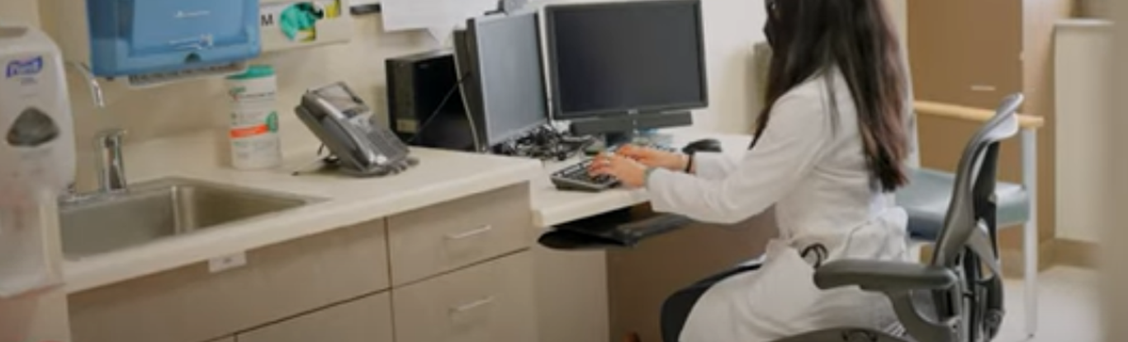
Learning Objectives
Discover how VA’s research in mutational signatures of cancer contributes to the broader medical community and advances our understanding of cancer genetics.
Recognize the potential future implications of mutational signature research for improving cancer care and outcomes for Veterans and the general population.
Learn about VA’s service delivery model for clinical cancer genetics services.
Understand how VA maintains the highest levels of safety and quality while delivering anti-cancer therapies outside of high-complexity VA medical centers.

Slide 4
Agenda
01
Introduction – Dr. Michael Kelley
02
VA’s Cutting-Edge Research on Mutational Signatures in Cancer – Dr. Kara Maxwell
03
Innovating for Effective Treatments through VA’s Clinical Care Genetic Service –
Dr. Carolyn Menendez
04
Equity in Action: Revolutionizing Veteran Cancer Care through National TeleOncology and Close to Me – Dr. Vida Passero
05
Thank you – Dr. Michael Kelley

Slide 5
Mutational Signatures in Cancer Treatment
Kara N. Maxwell MD, PhD
Staff Physician, Corporal Michael Crescenz Veterans Affairs Medical Center, Assistant Professor of Medicine and Genetics, Perelman School of Medicine, University of Pennsylvania; Director, Men and BRCA Program, Basser Center for BRCA, University of Pennsylvania

Slide 6
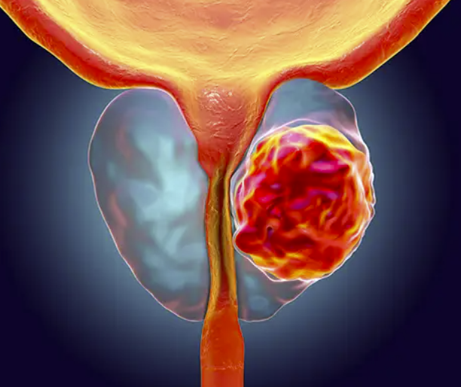
Precision oncology biomarkers in cancer can affect all modalities of treatment
Germline Genetic Testing
“Germline” = genetic changes that lead to a risk of cancer
e.g BRCA1, BRCA2
Expression Profiling of Tumor (eg Oncotype)
Tumor genomic profiling
Mutational Analysis
“Somatic” = acquired “driver” changes that lead to cancer development and progression
e.g EGFR mutations
Protein marker expression in tumor (ER, HER2)

Slide 7
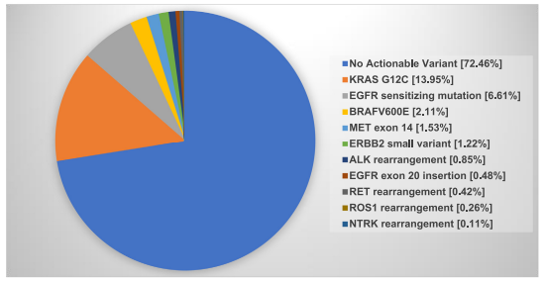
Current tumor genomic profiling still fails to identify a precision oncology target in the majority of cancer patients
Lung Cancer in Veterans
72% of lung cancers do not have a precision oncology target
n=3376 Lung cancer patients in NPOP
Jalal et al Sem Oncology 2022

Slide 8
But what are we missing?
~1-100 mutations
~30-3000 mutations
~1000-300,000 mutations

Slide 9
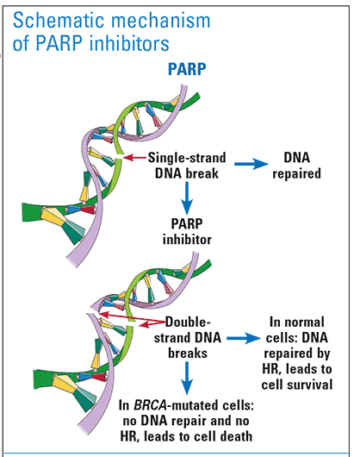
Mutations themselves are only part of the story
Example: PARP inhibitors in “BRCA” deficient tumors
Aberrations/Scores | Tumor material needed | Platform | Limitations
BRCA1/2 and other HR gene mutations | DNA | Targeted DNA sequencing panel | Mutation may not lead to phenotypic HRD; correct interpretation of variant and whether biallelic needed
BRCA1ness and BRCA2ness signatures | DNA | Array comparative genomic hybridization (aCGH) | aCGH not clinically performed; interpretation may be challenging
HRD Score (TAI+LST+gLOH) Or Individual scores | DNA | SNP array | Phenotypic “scars” may remain when tumor no long HR deficient; requires either SNP array, WES or WGS
HRD Score (nTAI+LST+gLOH) | DNA | Whole exome sequencing (WES)
Mutational signature 3 | DNA | Whole exome sequencing (WES/WGS)
HRDetect (microhomology-mediated indels + HRD score + mutational signature 3 + rearrangement Signature 3&5) | DNA | Whole genome sequencing (WGS)

Slide 10
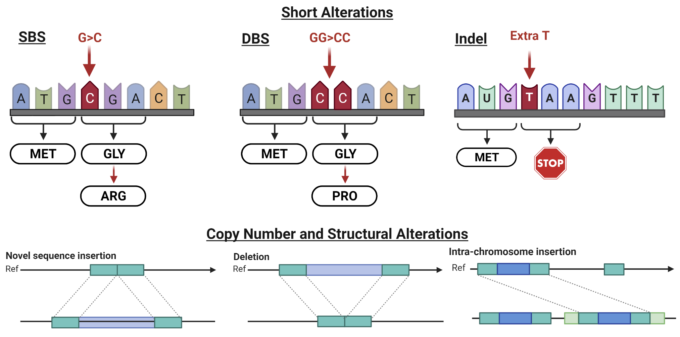
What are mutational signatures?
Mutational signatures are changes in the DNA of a tissue that reflect the processes that caused it to be a tumor.
These are not changes that drive the tumor, but are instead the scar of those drivers

Slide 11
Mutational Signature Types
SBS: Single Base Pair Substitution Signatures
96 elements -> 60 signatures, 19 sequencing artifact signatures
(Science 2022 added 40 new)
DBS: Doublet Base Pair Substitution Signatures
78 elements -> 11 signatures
(Science 2022 added 18 new)
ID: Small insertion/deletion (indel) Signatures
83 elements -> 18 signatures
CN: Copy number variation Signatures
32 elements -> 21 signatures, 3 sequencing artifact signatures
https://cancer.sanger.ac.uk/signatures/
Notes:
https://cancer.sanger.ac.uk/signatures/

Slide 12
Mutational signatures can be associated with tumor intrinsic processes and exposures
Mutational signatures associated with extrinsic exposures
Mutational signatures associated with intrinsic processes
Signature | Coexisting signatures | Changes | Exposure
SBS4 | DBS2 ID3 | C>A delC (<5 C repeats) | Tobacco smoke
SBS7 | DBS1 ID13 | C>T (CCN/TCN) CC>TT delT (at TT) | UV
SBS22 | None | T>A | Aristocholic acid
SBS113 | None |  | ?Other compounds that cause adducted adenines
SBS31 | DBS5, DBS18 | C>T at CCC/CCT C>A at ACC/CCT/GCC T>A at CTN | Platinum
Signature | Gene (Pathway) | Risk syndrome
SBS3, SBS18 ID6, ID8 HRDetect high | BRCA1, BRCA2, PALB2, RAD51C, RAD51D (HR) | Hereditary breast/ovarian syndrome
SBS6/15/44 SBS26 | MLH1, MSH2, MSH6 (MMR) PMS2 (MMR) | Lynch syndrome
SBS18 SBS108 | MUTYH (BER) OGG1 G308E (BER) | MAP MSS colorectal cancer
SBS30 SBS14 SBS20 | NTHL1 (BER) POLE POLD1 | Hereditary colorectal cancer
SBS96 | MDM4 (BER) | ?
SBS: Single base substitution; DBS: Double base substitution; ID: indel
https://cancer.sanger.ac.uk/signatures/

Slide 13
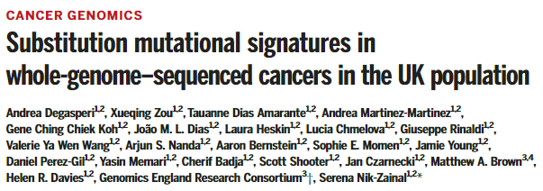
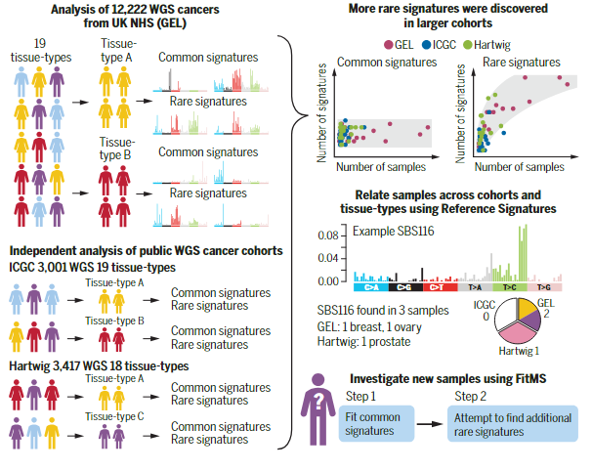
Existing data has not translated into clinical utility
Most mutational signature data comes from the UK and on freshly prepared tumor specimens
Fresh tumor tissue is rarely collected in real-world scenarios
All precision oncology testing for tumors is done on FFPE (formalin fixed paraffin embedded) pathology specimens

Slide 14
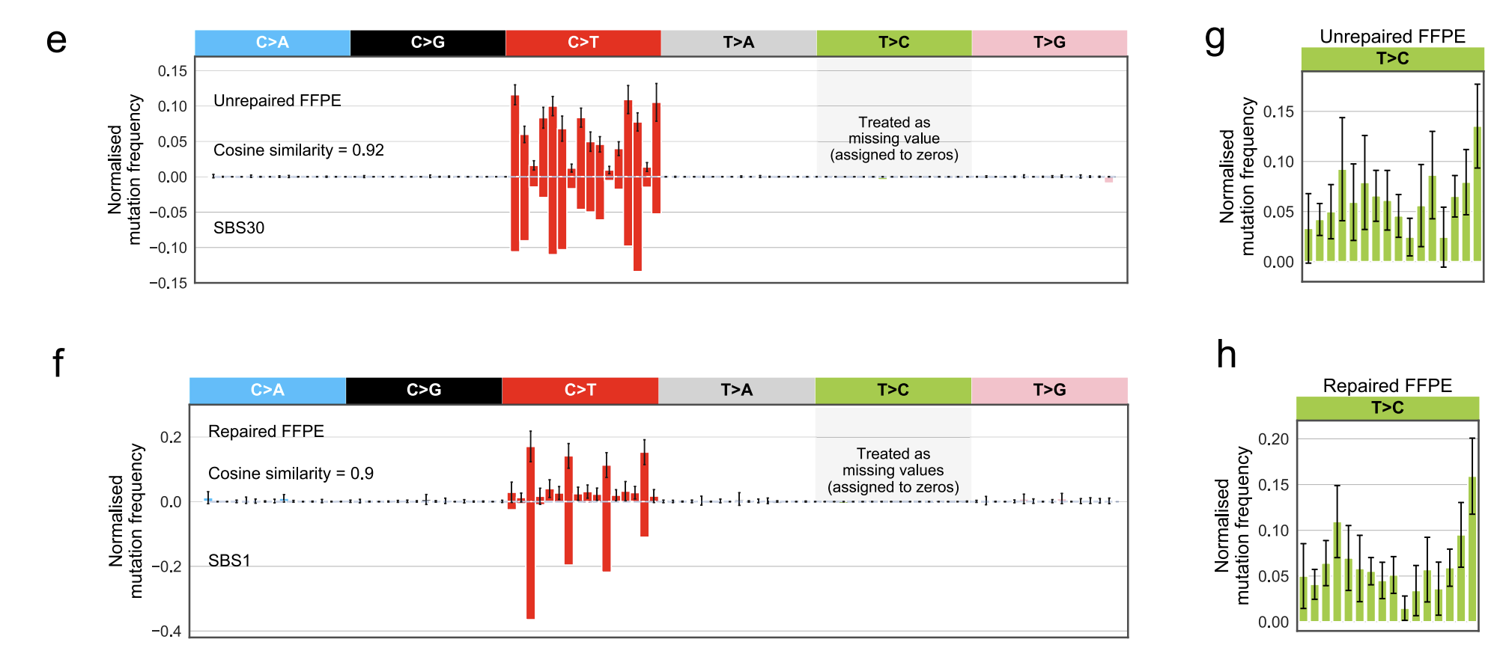
The FFPE issue
FFPE-signature: Formalin causes hydrolytic deamination of C>U -> U:G mismatches -> DNA polymerase during amplification incorporate A -> Leads to C:G>T:A substitutions (similar ot SBS30 - BER/NTHL1 deficiency)
FFPE sequencing library preparations use uracil DNA glycosylase (UDG) to remove uracil bases
Formalin also causes deamination of 5-methylcytosine (at CG dinucleotides)
Not corrected by UDG
Similar to signature 1 (clock-like signature due to spontaneous deamination of methylcytosine)
Development of FFPESig package
C>T mutations are dominant among FFPE-induced artefacts, whereas occasional T>C or C>A artefacts are batch effects -> so these are removed
Guo et al Nat Comm 2022, The mutational signatures of formalin fixation on the human genome

Slide 15
Overview of NPOP/MVP Mutational Signatures Project
VA Mutational Signatures Study
Contact PD/PI: Maxwell (Philadelphia VA)
National Precision Oncology Program
Available “Discarded” DNA
from Clinical Tumor Sequencing
N=13,752 tissue specimens
WHOLE GENOME SEQUENCING
De-identified and Linked
Raw Sequencing Data
FASTQs
VA Mutational Signatures Prostate/Bladder Cancer Biomarkers Group
Mutational
Signature
Repository
Tumor tissue DNA
Successful short read NGS
N=11,256
VA Mutational Signatures Bioinformatics Group
Boston VA
GenISIS
MPI: Pyarajan
Montgomery (Seattle VA)
Rettig, Garraway (GLA VA)
Fojo (Bronx VA)
Aligned Data
BAMs
Clinical Correlations Tumor Types (Lung, Prostate, Bladder, Colon)
VA Mutational Signatures Lung Cancer Biomarkers Group
DNA of sufficient quantity
N=8,299
Tumor genome variants
VCFs
Kelley (Durham VA
Herman (Pittsburgh VA)
Klein (Minneapolis VA)
DNA of sufficient quality
N=4,783
Known Mutational Signatures
Novel Derived Mutational Signatures
VA Mutational Signatures Gastrointestinal Cancer Biomarkers Group
Maxwell (Philly VA)
Pyarajan (Boston VA)
Pritchard (Seattle VA)
Neff (Durham VA)
Durham VA, MPI: Kelley
Kratz (Madison VA)
Fojo (Bronx VA)

Slide 16
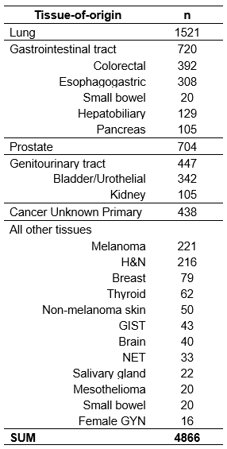
Tumor DNA of NGS quality is ready to go from NPOP
11256
Tumor tissue derived DNA
PASS NGS
4866
Pathology
>25% tumor nuclei
(all FMI confirmed)
NPOP
18171
DNA
samples
13752
Tumor tissue derived DNA
8299
>200ng DNA
4419
liquid biopsy
3446
liquid biopsy
PASS NGS
1050 +1578
FMI
>25% tumor nuclei
1192
>200ng DNA
Future aims
Future aims

Slide 17
Bioinformatics analysis pipeline for NPOP/MVP Mutational Signatures Project
Bioinformatic Analyses
While DNA is available, this is tumor-only sequencing
GATK, Varscan
Mutect
Mutect
Sequenza
CNVKit
ascatNGS
FACETS
MVP WGS Data
Veteran Tumor DNA
Tumor Whole Genome Sequencing ~30X
SigProfiler Suite
deconstructSigs
FitMS
MSISensor
ANNOVAR
OncoKB
HRDex
SigProfiler Suite
MVP WGS Normals Matched to Tumor
Tumor-Normal Matching
Ancestry specific Bioinformatic Panel of Normals
Identification of genetic ancestry from tumor
Oncogenic and tumor suppressor mutational profiles
TMB
MSI Status
SBS, DBS and Indel Mutational Signatures
CN Mutational Signatures
AIM 1a: Compare spectrum of known signatures to PCAWG results.
AIM 1b: extract novel signatures
QC: Compare to FMI mutational profiles to determine accuracy of 30X WGS, esp TMB & MSI
AIM 2: Compare FMI mutational profiles vs signatures in predicting treatment response using g-values

Slide 18
Analysis Plan
Clinical variable construction
Preparation of DNA samples
Pilot 1 WGS and Analysis
Pilot 2 WGS and Analysis
Clinical variable database
Real-world clinical trials
Pull and re-quantify tumor DNA
Plate samples
Ship to Personalis
Create GenISIS study mart with de-identified list and match to MVP, CDW
WGS on FMI-MVP n=200 matched samples
Bioinformatic analysis (variant calling)
Signature extraction and decomposition
Concordance analysis
WGS on somatic MMRd and HRD, lung and melanoma pilot samples, n=180
Bioinformatic analysis (variant calling)
Signature extraction and decomposition
Collection of clinical variables for pilot samples
Collection of clinical variables for prostate, lung, GU and GI tumor patients
Building tumor growth rate g models
Clinical/pathological and treatment response association studies with mutational signatures

Slide 19
Clinical Relevance
The VA NPOP/MVP Mutational Signatures project will answer:
Can known mutational signatures be extracted from some or all tumor types from real-world clinical FFPE specimens?
Are any of mutational signatures prognostic or predictive to treatment response?
Are there tumor types for which novel mutational signatures can be extracted that can inform prior military exposures?

Slide 20
VA NPOP/MVP Mutational Signatures Team
Person | VA | Role
Kara Maxwell MD PhD | Philadelphia | Contact PI
Michael Kelley MD | Durham (Director NPOP) | MPI
Saiju Pyarajan PhD | Boston | MPI
Jadee Neff MD PhD | Durham | Co-I
Antonio Fojo MD PhD | Bronx | Co-I
Jeremy Kratz MD PhD | Madison | Co-I
Isla Garraway MD PhD | Greater LA | Co-I
Matthew Rettig MD PhD | Greater LA | Co-I
James Herman MD | Pittsburgh | Co-I
Mark Klein MD | Minneapolis | Co-I
Bruce Montgomery MD | Puget Sound | Co-I
Colin Pritchard MD PhD | University of Washington | Co-I

Slide 21
Innovating for Effective Treatments through VA’s Clinical Cancer Genetics Service (CCGS)
Carolyn Menendez, MD, FACS
Director, VA Clinical Cancer Genetics Service

Slide 22
CCGS: Redefining Cancer Care for Veterans
VHA serves over 9 million Veterans
Network of 1,321 locations
Unique needs including psychosocial and environmental exposures considerations
Multifaceted approach necessary to ensure access
Traditional counseling model
Streamlined point of care model for expedited testing
Longitudinal follow-up care for highest risk
Multi-disciplinary collaborations for highest level care
Exceptional opportunities for service unlike any other

Slide 23
CCGS Mission: Timely, world-class cancer genetic counseling and testing that is accessible to all Veterans
Clinical Service
Once fully staffed, anticipate approx. 300 New Consults per week
Certified Genetic Counselors
Advanced Practice Providers
Medical Geneticist
Surgical Oncologist
Research collaborations throughout enterprise
Educational offerings
CCGS Education

Slide 24
Germline Testing: Improving Detection, Diagnosis, Treatment, Tailored To Each Veteran
Germline status may inform surveillance strategies leading to earlier detection
Example: addition of annual breast MRI to annual mammography
Surgical decisions
Example: unilateral versus bilateral mastectomy
Radiation considerations
Example: lumpectomy versus mastectomy
Systemic therapy considerations
Example PARPi
Notes:
MK questions

Slide 25
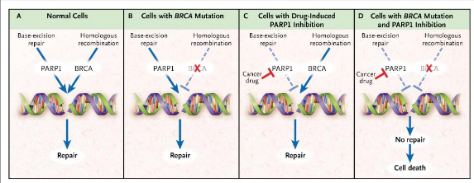
Clinical Example of Systemic Cancer Therapy Informed by Germline Test Results: PARP Inhibitors
Iglehart and Silver, NEJM 2009 361:189-191

Slide 26
Clinical Utility of Hereditary Test Results Rapidly Advancing
33 of 50 FDA approved drugs in 2021 have direct genetic evidence

Slide 27
Empowering Providers and Patients with Insight
and Support
Hereditary cancer testing has relevance throughout the cancer care spectrum
Common Issues in Breast Cancer Survivors A Practical Guide to Evaluation and Management (pp. 305-318). Springer
doi:10.1007/978-3-030-75377-1_20
Notes:
remove

Slide 28
Streamlining Delivery of Personalized Care at the Forefront of Precision Oncology
CCGS from Zero to >1500 in first 12 months
March-December 1020 new consults for traditional GC visit
1/3 unaffected
553 with testing
217 additional tests by treating providers through expedited pathway
41 (8.1%) clinically significant variant in autosomal dominant hereditary cancer predisposition gene
Notes:
Graph of zero to 1000+ first 9 months, then has plateaued. The rate is more important.

Slide 30
TeleOncology provides Veterans and their local VA facilities with access to the highest quality cancer care, regardless of their location.
SERVICES
Hub Site :
Physician Oncologists (Disease specific, from multiple NCI-affiliated VAMCs)
RN Care Coordinators
APPs
Genetic Counselors
Oncology Clinical Pharmacy Practitioners
Local Clinic / Infusion Site:
(may or may not have)
Providers
Registered Nurses
APPs
On-Site Pharmacy
Facilities
Home
Hub
Complex Care
Basic Care

Slide 31
National TeleOncology
Vida A. Passero, MD, MBA
Chief Medical Officer, VA National TeleOncology
Clinical Associate Professor of Medicine, University of Pittsburgh
Associate Fellowship Program Director, University of Pittsburgh Medical Center
Staff Physician, Hematology/Oncology, VA Pittsburgh Healthcare System

Slide 32
TeleOncology provides Veterans and their local VA facilities with access to the highest quality cancer care, regardless of their location.
SERVICES
Hub Site :
Physician Oncologists (Disease specific, from multiple NCI-affiliated VAMCs)
RN Care Coordinators
APPs
Genetic Counselors
Oncology Clinical Pharmacy Practitioners
Local Clinic / Infusion Site:
(may or may not have)
Providers
Registered Nurses
APPs
On-Site Pharmacy
Facilities
Home
Hub
Complex Care
Basic Care

Slide 33
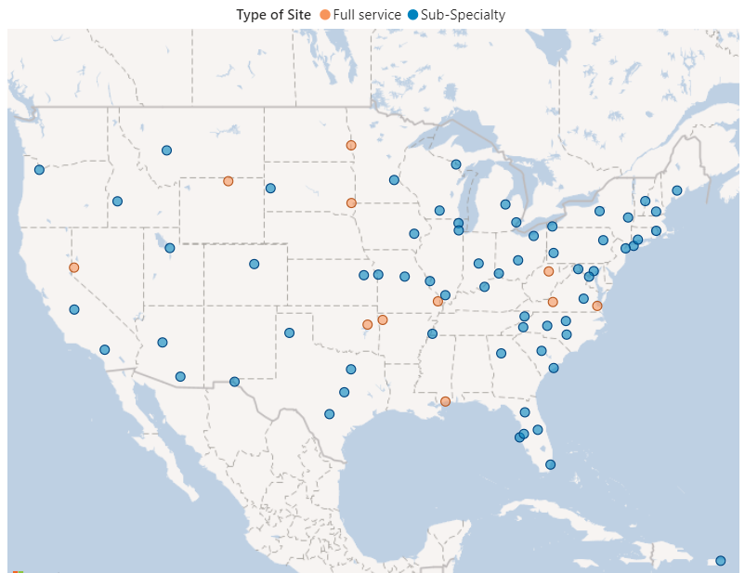
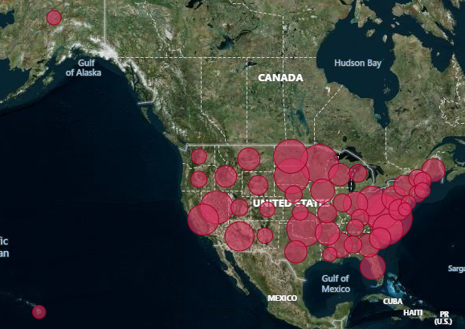
VA National TeleOncology (NTO)
EXPANDING ACCESS TO SPECIALIZED HEALTH CARE FOR VETERANS
Key Milestones
84 partner VA sites
55,000+
encounters completed through NTO
Patient Locations by Zip Code
13,500+ Veterans
Have received care through NTO
4100+
Provider-to-provider e-consults completed through NTO
47% Rural Veterans
84 VAMCs
Actively partnering with NTO
Aggregate FY20-1/29/2024. All services

Slide 34
NTO: Sites by Year Established
EXPANDING ACCESS TO SPECIALIZED HEALTH CARE FOR VETERANS
2021 (12)
Reno, NV
Iron Mountain, MI
Black Hills, SD
Fresno, CA
Sheridan, WY
Fargo, ND
Pensacola, FL
Minneapolis, MN
Clarksburg, WV
North Chicago, IL
Columbia, MO (Heartland)
Prescott, AZ
2020 (3)
Sioux Falls, SD
Salem, VA
White River Junction, VT
Notes:
Souix Falls before 2020? Graph show the growth YoY, rather than 3 slides. CCGS being the additions in the end.

Slide 35
NTO: Sites by Year Established
EXPANDING ACCESS TO SPECIALIZED HEALTH CARE FOR VETERANS
2022 (15)
Loma Linda, CA | Pittsburgh, PA
Fayetteville, AR | Durham, NC
Tulsa, OK | Hampton, VA
Martinsburg, WV | Providence, RI
Columbus, OH | Asheville, NC
Iowa City, IA | Togus, ME
Indianapolis, IN | Salisbury, NC
South Texas, TX

Slide 36
NTO: Sites by Year Established
EXPANDING ACCESS TO SPECIALIZED HEALTH CARE FOR VETERANS
2023 (49)
Louisville, KY | Baltimore, MD | Memphis, TN | Mountain Home, TN
Charleston, NC | Manhattan, NY | El Paso, TX | Detroit, MI
Orlando, FL | Poplar Bluff, MO | Fayetteville, NC | Dallas, TX
Erie, PA | Ft Harrison, MT | Eastern Colorado, CO | Nashville, TN
Salt Lake City, UT | West Haven, CT | Boise, ID | Battle Creek, MI
Marion, IL | Syracuse, NY | Wilkes-Barre, PA | Dayton, OH
Cincinnati, Ohio | Cleveland, Ohio | Portland, OR | Milwaukee, WI
Madison, WI | Atlanta, GA | Tucson, AZ
Richmond, VA | Central Texas | Washington, DC
Bay Pines, FL | St. Louis, MO | Columbia, SC
Gainesville, FL | San Juan, PR | Kansas City, MO
Albany, NY | Northport, NY | Amarillo, TX
Hines, IL | Miami, FL | Topeka, KS
Tampa, FL | Saginaw, MI | Manchester, NH
2024 (5)
Anchorage, AK
Las Vegas, NV
Long Beach, CA
Buffalo, NY
Philadelphia, PA
Number of partner VA sites: 84

Slide 37
NTO: Types of Services
2nd opinion (disease-specific)
Benign hematology
Clinical pharmacy practitioner services
Treatment plan review
Drug information consults
Breast and Gynecologic Oncology System of Excellence (BGSOE) Care Coordination services
ASYNCHRONOUS (E-CONSULT)
Continuity of care
With/without antineoplastic therapy ordering
Care coordination (“gap coverage”)
Clinical pharmacy services
2nd opinion (disease-specific)
Clinical Cancer Genetic Services (CCGS)
Breast and Gynecologic Oncology System of Excellence (BGSOE)
SYNCHRONOUS
Notes:
Clinical Pharmacy services work in conjunction with the NTO teamlet to support the NTO patients.

Slide 38
NTO: Sub-Specialties
Teams
Thoracic Cancer
Head and Neck Cancer
Genitourinary Cancer
Gastrointestinal Cancer
Melanoma and other cutaneous malignancies
Central Nervous System
Sarcoma
Rare Cancers
Malignant Hematology
Benign Hematology
Gynecologic Cancer
Breast Cancer
Oncologist(s)
Advanced Practice Provider(s)
Clinical Pharmacy Practitioner
RN Care Coordinator(s)

Slide 39
Breast & Gynecologic Oncology System of Excellence (BGSOE)
Identify Veteran with breast or gynecologic cancer via BGSOE Dashboard
Navigation team contacts Veterans
Identifies potential barriers to care and provides resources
Collects medical records and document in EHR
Provides ongoing services through care continuum
Connects Veteran to support group services
NTO BGSOE team reaches out to local providers
What We Do
Patient navigation services
Tele-Oncology
E-Consults
Co-management with local oncologist
Obtain community records to input in Electronic Health Record
Quality assessment of treatment
Notes:
Need to clarify with BGSOE how BGSOE team will reach out to local providers (email, CPRS, phone, etc?)
Does provider get notified at same time as veteran is contacted? Is it simultaneous or what happens first?
Documentation into EMR – note does not have data fields but in background information is routed to CDW
Support Groups – is the coming in the future? Or is it something in current state?
This service is not changing anything within the facility. It is veteran support focused.

Slide 40
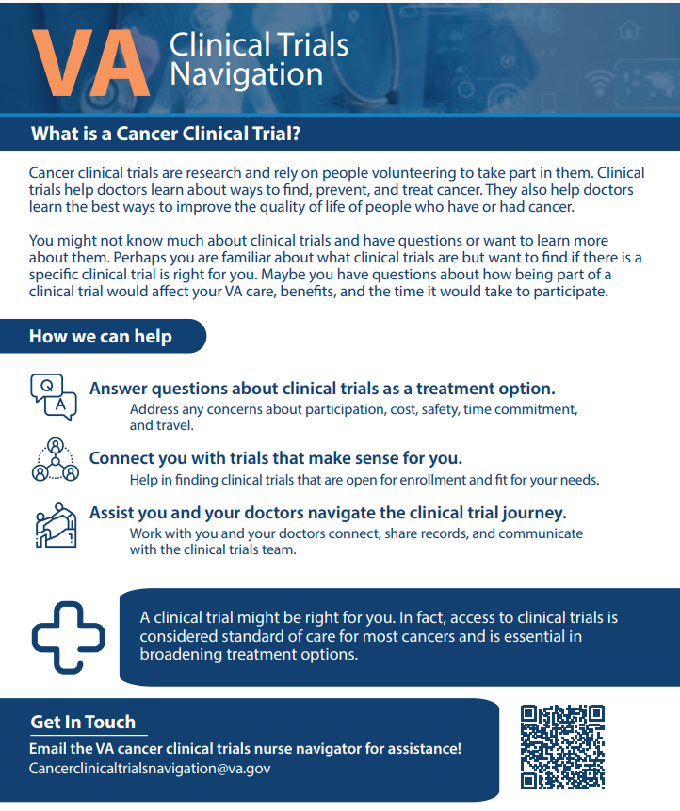
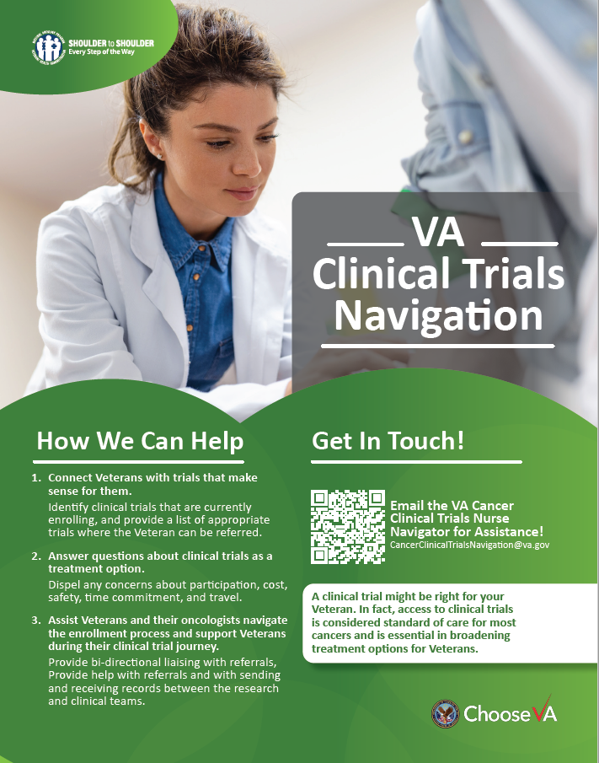
Clinical Cancer Research Service (CCRS)
Cancer Clinical Trial Navigation (CTN) Program
Support to patients and providers interested in pursuing a clinical trial treatment option.
Education to patients, guidance through entire process, facilitating communication between teams, addressing logistical concerns.
Trial searches conducted by the nurse navigator are for studies internal to and external to the VHA.
Decentralized Clinical Trials (DCT) Program
Clinical trials that are conducted with telemedicine.
Remote study activation, monitoring, and data collection. Research visits may occur via telehealth.
Single IRB approves the studies. Local VA facility may not need to be engaged in research, depending on the study.
NCI-VA collaboration for Veteran referrals
Identify trials at NCI clinical center for patients.
Staff can help with obtaining/sending records to NCI.
Notes:
Cancer Clinical Trial Navigation (CCTN) Program
The process of finding appropriate clinical trials can be time-consuming. Information on clinical trials websites may not be up to date and/or difficult to understand for a layperson. Specifically, the CCTN program helps Veterans and providers navigate the process by educating them about open and enrolling CTs, performing searches for applicable CTs, and providing CT coordination to any Veteran with cancer and to their VA oncology providers. Further, the CCTN team can provide bi-directional liaising with referrals, records and documentation between research teams and clinical teams.
Decentralized Clinical Trials (DCT) Program
What is a Decentralized Clinical Trial? DCTs are patient-centric studies conducted through telemedicine and mobile/local healthcare providers, using processes and technologies that differ from the traditional clinical trial model. Decentralized trials are known by other names such as: remote trials, virtual trials, and site-less clinical trials. The different types of DCTs include hybrid (participants may come on-site for some trial activities, such as screening and enrollment, while completing the rest of the trial at home or remotely) or fully-remote (every aspect of the trial is handled remotely with the trial organizer working with sites, direct to patient shipping teams, care nurses, and more to ensure the trial is run smoothly without the patient ever needing to leave home). In a decentralized model participants can be monitored remotely and engage in clinical trials they might otherwise not have the opportunity to whereas in a traditional setting, patients must be within travel distance to the clinical trial site in order to participate.
Research support varies across VA facilities resulting in uneven access to cancer CTs. In addition, veterans often live in rural areas or have transportation challenges, which are barriers to participation in CTs. We are reaching out to you to introduce the DCT services. VA oncology providers may interact with these services for: 1) Opening hybrid DCTs at their VA facility, in which case the provider may be a study team member. 2) Offering Veteran patients to participate in a remote DCT where the provider is not a study team member
Clinical Trial Navigation (CTN) Program
Provides education to Veterans about clinical trials
Performs searches for applicable clinical trials for Veterans and VA oncology providers
Navigates the connection between clinical and research care in the VA system
Decentralized Clinical Trials (DCT) Program
Provides access to oncology clinical trials for all Veterans via telehealth and mobile/local healthcare providers
Clinical Trials
Mirati: pharma, targeted KRAS G12C inhibitor, NSCLC
Selinexor: IIT, myeloma and lymphoma
HALO: pharma, myeloma
REALMIND: pharma, lymphoma
CASE: pharma, basal cell skin cancer – no longer enrolling.

Slide 41
Virtual Tumor Boards (VTB)
>230 individual patient cases from 50 VA locations have been discussed
Since March 2022, >100 VTBS have been conducted
VTBs are available in five oncology specialties
Hematologic
Breast/Gynecologic
Central Nervous System
Thoracic
Cutaneous
Notes:
Average number of participants in the boards themselves:
Attendance varies by board, from approximately 20 to 60 participants
We suspect attendance variance may be tied to the prevalence of the cancer in the VA

Slide 42
Close to Me; Infusion Care Delivery Service
INNOVATION: BRINGING ANTI-CANCER THERAPY SERVICES CLOSER TO VETERANS
The Problem
The Solution
Infusion and injection treatments are typically offered solely at VAMCs, which leads Veterans to…
Providing anti-cancer therapy services at CBOCs/ patient homes, increasing access to care, and…
Travel long distances
Experience long wait times on day of treatment
Assume cost of gas, tolls, lost wages
Seek care outside of VA
Reducing travel times
Improving VA care continuity
Providing Veteran-centric care
Encouraging high-level treatment adherence

Slide 43
CBOC Infusion Model
Treatments compounded at VAMC Pharmacy and transported to CBOC
Oncology-trained RNs administer infusions/injections to patients
Home Care
Treatments administered by oncology-trained RNs or patient/caregiver, with appropriate training
Close to Me Overview
Clinic Build
Establishes dedicated clinic space for infusions at existing CBOCs or Health Care Centers (HCC)
Compounding Expansion
Increases or establishes VAMCs ability to compound hazardous and non-hazardous sterile compounds
Ann Arbor
Erie
Minneapolis
Syracuse
419 Veterans Enrolled
1,568 Treatment Encounters
170,300 Veteran Drive Miles Saved
$1,585,871 Medication Cost Avoidance
0 Medical Emergencies
98.8% Treatment Adherence
2,773 Veteran Drive Hours Saved
Reno
Pittsburgh
Sacramento
Salt Lake City
Northern Indiana
Cleveland
Durham
Fayetteville
Salisbury
Houston
*FY21-FY24Q1
Puerto Rico
Minneapolis
Pittsburgh
Reno
Erie
Northern Indiana
SLC
Durham
Cleveland
Puerto Rico
Ann Arbor
Ann Arbor
Fayetteville
Houston, Syracuse, Sacramento
Salisbury
Oct. 2021
June 2022
2023
Aug.
Nov.
Dec.
2024
Feb.
March
April
May
July
Aug.
Pre-Decisional – For Internal VA Use ONLY

Slide 44
Close to Me: Insights
“You coming out here is the best Christmas present you could ever give me.”
“It’s so good to be able to come here to take off my pump, it saves me so much time! It’s so close for me.”
“I never want to go back to Oakland again, this has been great!”

Slide 45
National TeleOncology EMPLOYING EQUITY TO GUIDE FRAMEWORK FOR CANCER CARE
Creating an adaptable team
Recruitment of physicians: working with academic affiliates
Across-the-nation clinical and administrative staff
Understanding the needs of the field
Collaboration with the Veterans Experience Office
Learning about telehealth and clinical care
THRIVE: Telehealth Research and Innovation for Veterans with Cancer (THRIVE) Research through NCI Telehealth Research Centers of Excellence (TRACE)
Value-based analysis
Applying a national operational clinical infrastructure
to ensure responsive healthcare delivery solutions
Virtual Tumor Boards, Clinical Cancer Genetics, Clinical Cancer Research,
Breast and Gynecologic Oncology, Treatment “Close to Me”
Patient Navigation, Cancer Survivorship
Continuity of Care

