Slide 1
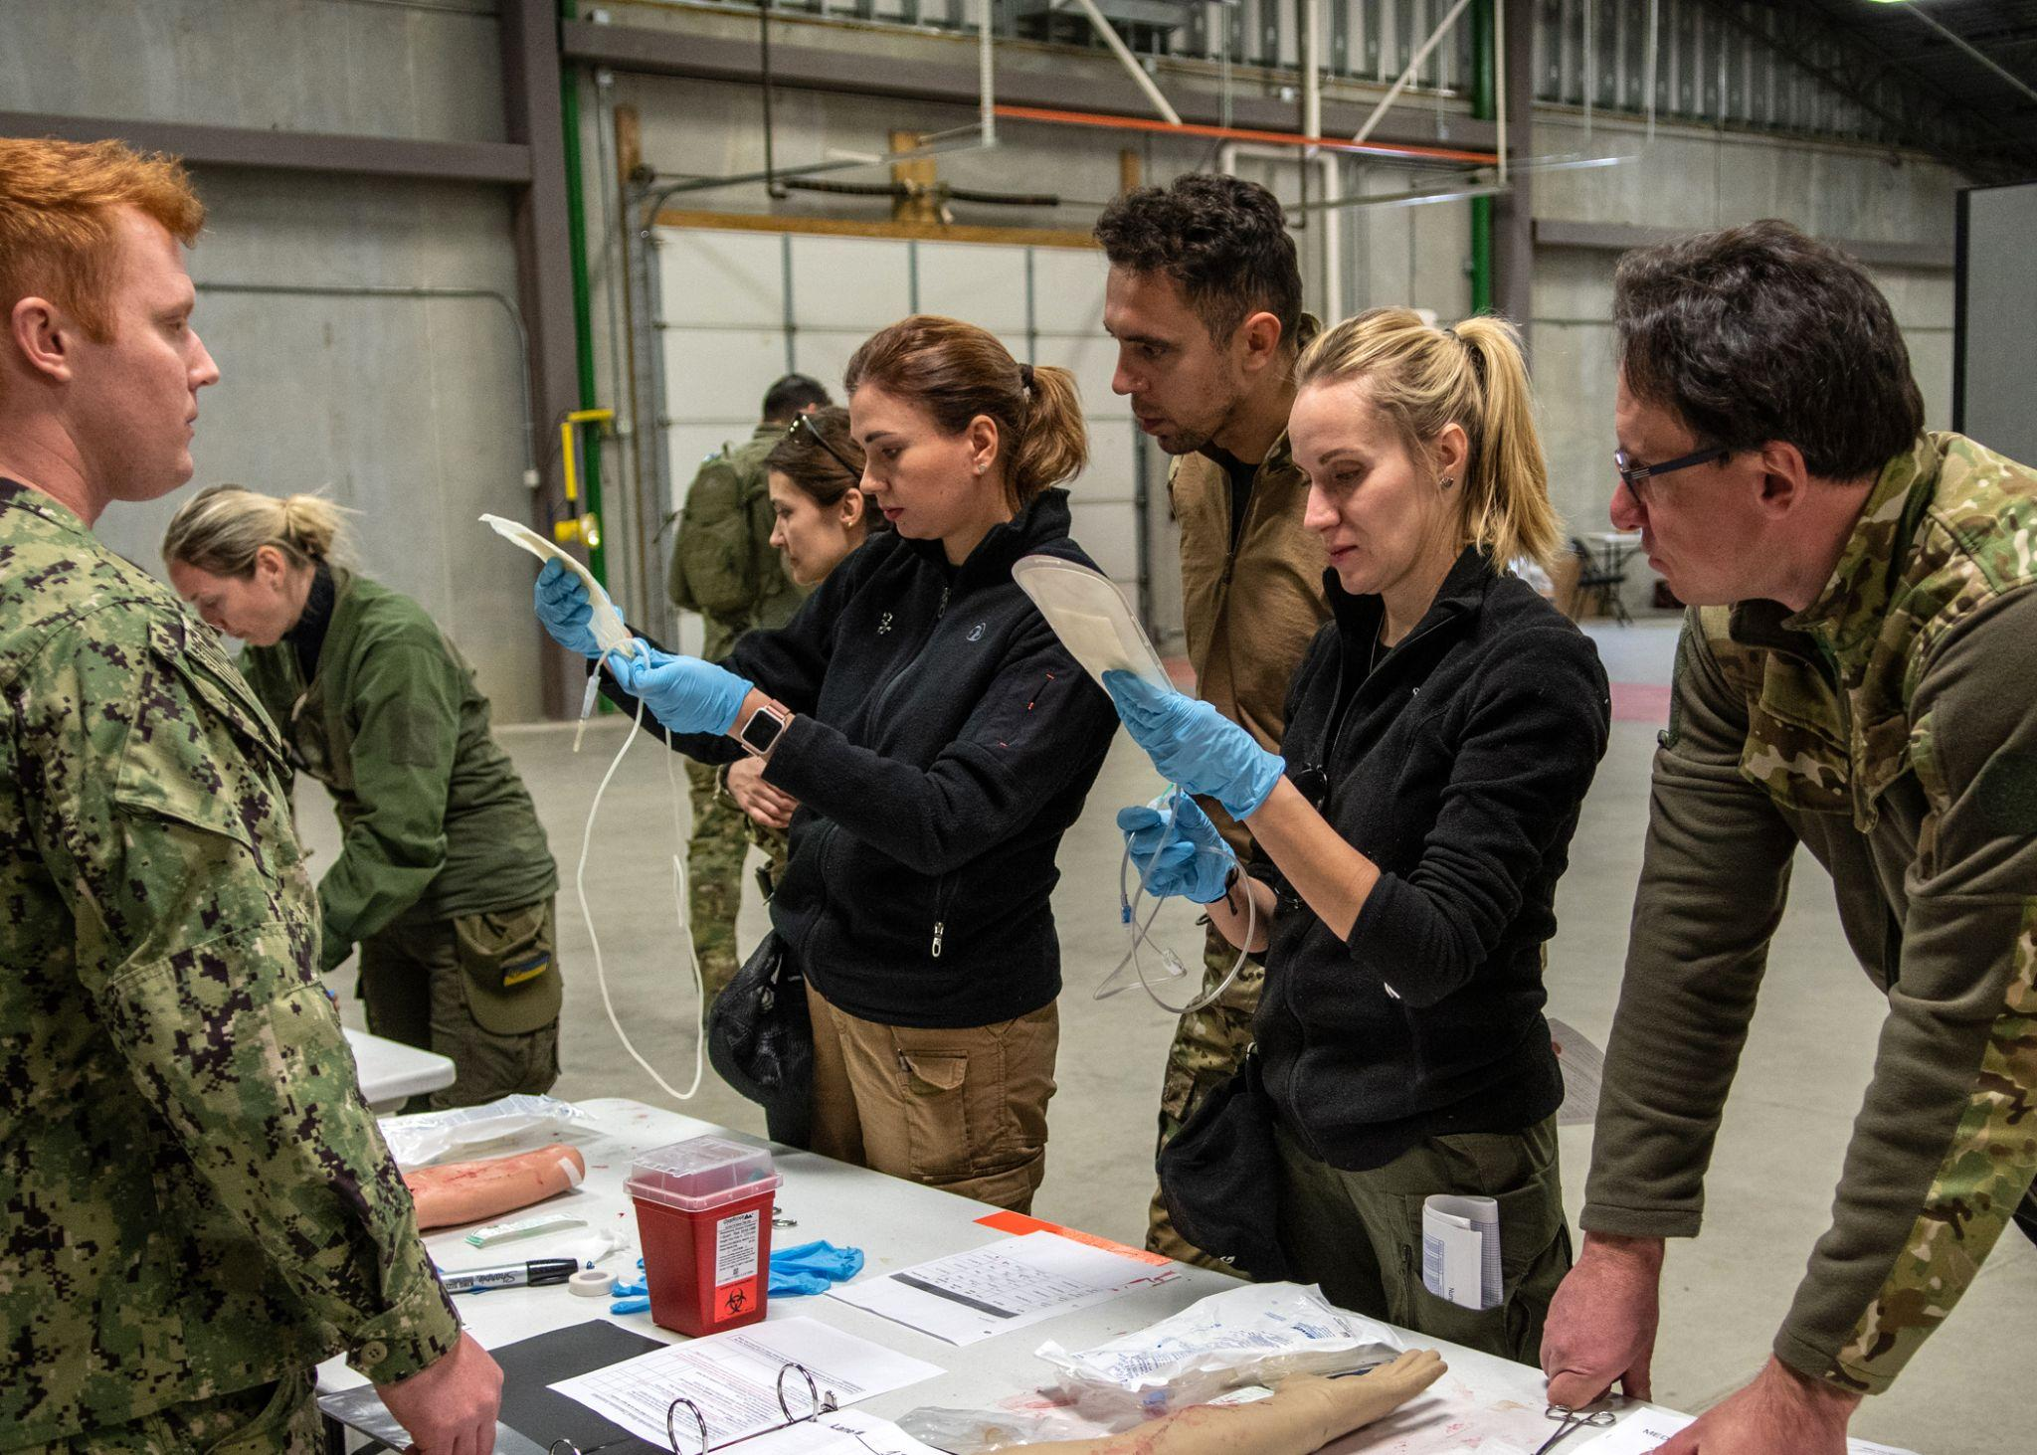
Emergency Fresh Whole Blood Transfusion Training For Ukrainian Medical Professionals in Austere Environments
Notes:
Good Afternoon. My name is SFC Zac Brown, I am a prior special operations medical sergeant from the 75th Ranger Ranger, and it is my privilege to moderate this presentation on the use of Emergency Fresh Whole Blood Transfusion Training for Ukrainian Medical Professionals in Austere Environments.​
​

Slide 2
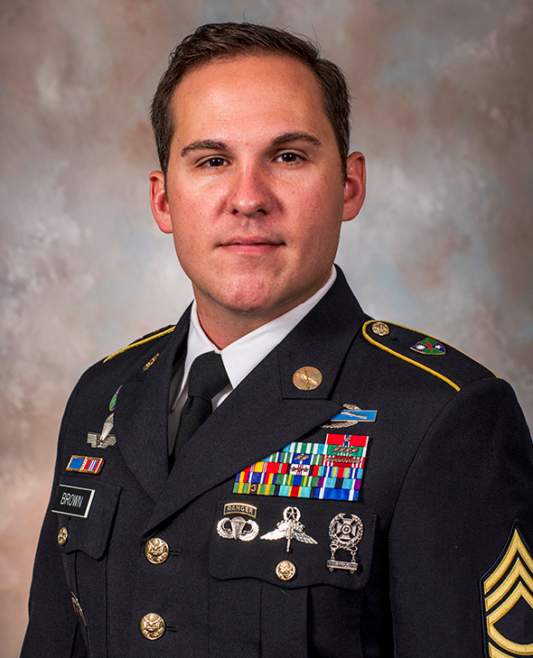
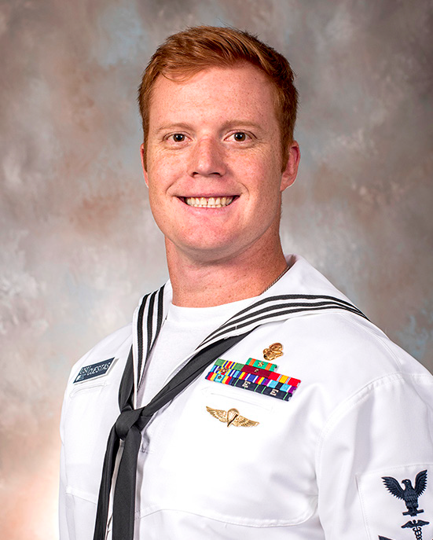
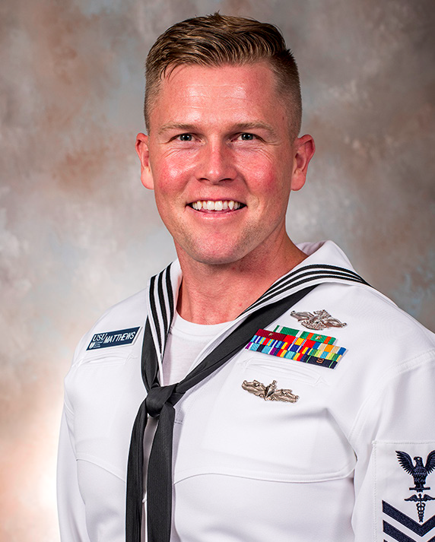
SFC Zachery Brown
EMDP2, USUHS
Special Operations
Medical Sergeant
HM1 Joshua Cuestas
EMDP2, USUHS
Special Operations
Independent Duty Corpsman
HM1 Kevin Matthews
EMDP2, USUHS
Fleet Marine
Force Corpsman
Disclosures: No relevant financial or non-financial interests to disclose. Commercial support was not provided for this activity. Funding Source: FY 2023 USU Intramural Award. Institutional Review Board (Human Subjects): This study was approved by the Uniformed Services University of Health Sciences (USUHS) Institutional Review Board (IRB). DBS.2022.362. Non-FDA-approved use of blood products is discussed in this presentation, including the risks, known and unknown, of such off-label use of human-derived products. Institutional Clearance: Institutional Clearance approved. This continuing education activity is managed and accredited by AffinityCE, in collaboration with AMSUS. AffinityCE and AMSUS staff, as well as planners and reviewers, have no relevant financial interests to disclose. AffinityCE adheres to the ACCME’s Standards for Integrity and Independence in Accredited Continuing Education. Any individuals in a position to control the content of a CME activity, including faculty, planners, reviewers, or others, are required to disclose all relevant financial relationships with ineligible entities (commercial interests). All relevant conflicts of interest have been mitigated prior to the commencement of the activity.
Notes:
My fellow speakers today include HM1 Joshua Cuestas, a Navy Special Operations Independent Duty Corpsman and prior Instructor at the Special Operations Combat Medic Course;
and HM1 Kevin Matthews, a Fleet Marine Force Corpsman and prior Program Director of Training for the 1st Marine Division's Valkyrie Program
​
​

Slide 3
Learning Objectives
Identify the medical training requirements for Ukrainian Medical Professionals and the use of Emergency Fresh Whole Blood Transfusions (EFWBT) on the battlefield
Evaluate the EFWBT program design and training outcomes
Understand the projected way forward in implementing the EFWBT program at scale
Notes:
At the end of this presentation, we hope that all attendees will be able to: ​
Identify the training requirements for Ukrainian Medical Professionals and their use of Emergency Fresh Whole Blood Transfusions on the battlefield
Attendees will also be able to Evaluate the program design and training outcomes
And lastly, Attendees will be able to understand the projected way forward in implementing the program at scale

Slide 4
Background and Significance
The War in Ukraine has led to over 18,500 deaths and 125,000 casualties.
Reliance on ground evaluations due to the Russian air-defense threat prevents timely casualty evacuation.
Increased need for Fresh Whole Blood from prescreened Low-Titer Group-O blood donors on the battlefield
An established Ukrainian EFWBT program is paramount in preventing adverse transfusion reactions, mismatched blood type, atrophy of skills, and ultimately increasing battlefield patient survivability
Notes:
As our nation's military transitions from the Golden Hour sequence of rapid casualty evacuation to postering for Large-scale Combat operations, our frontline healthcare professionals will undoubtedly find themselves treating casualties in a prolonged field care environment. This operational environment comes with its own unique challenges in maintaining a hemodynamically stable patient.​
As we look at current Large Scale Combat Operations such as the ongoing War in Ukraine, our aim was to develop an Emergency Fresh Whole Blood Transfusion Program that is effective but, more importantly, a program that is sustainable.​
The high volume of casualties and force disposition in Ukraine have driven the need for advanced training in Remote Damage Control Resuscitation – with recent Ukrainian policy changes that now authorize the implementation of walking blood banks on the battlefield. This is increasingly important when operating in a resource-limited environment where logistical constraints result in increased casualty evacuation times.
For the implementation of an Emergency Fresh Whole Blood Transfusion Program, it is paramount that the program is effective in maintaining administrative oversight with a strong adherence to guidelines to reduce adverse transfusion reactions, mismatched blood type, or the atrophy of skills
​

Slide 5
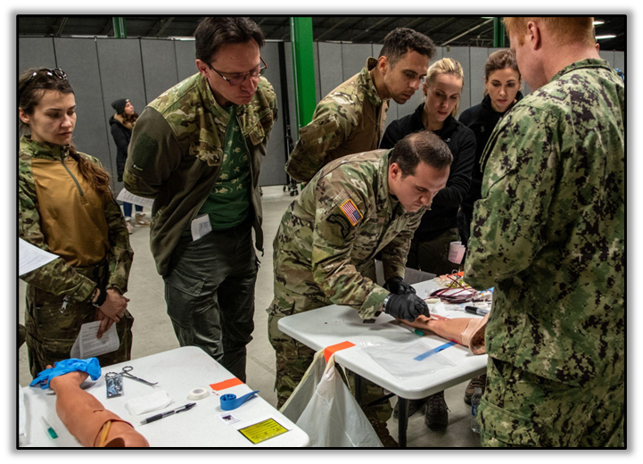
Training Participants
8 Ukrainian Healthcare Professionals (UHPs) from various occupational backgrounds prior to the war
The UHPs visited the Uniformed Services University (USU) in Spring-2023 and completed our EFWBT program, initially designed for third-year medical students
Notes:
Taking a deeper look at our training program and understanding the unique medical requirements in Ukraine, many frontline Ukrainian healthcare professionals have varying degrees of medical experience prior to the War in Ukraine. Representative of the Ukrainian frontline medical community, our training participants consisted of a pediatrician, an infectious disease specialist, two general surgeons, an anesthesiologist, a pathologist, and two medics – of which 1 was an engineer and the other a construction manager prior to redirecting their respective disciplines to treating casualties on the battlefield.
In the spring of 2023, our team Ukrainian healthcare professionals took part in Operations Gunpowder at the Uniformed Services University, where they participated in our Emergency Fresh Whole Blood Transfusion Program originally developed for 3rd-year medical students. This unique opportunity to train Ukrainian medical professionals and assess the validity of replicating this program for larger-scale implementation has shown to be sustainable and cost-effective in a resource-limiting operating environment, with nearly 3000 Ukrainians being trained in this life-saving procedure.
So now, without further ado, I will hand over the presentation to HM1 Cuestas to discuss the program’s development and implementation...Thank you.

Slide 6
EFWBT Training Development
The EFWBT program was developed to address capability gaps in Damage Control Resuscitation (DCR) for future generations of military physicians and providers on the battlefield in a contested environment
EFWBT assessment and didactics were employed following guidelines and recommendations:
- Joint Trauma System Clinical Practice Guideline (JTS-CPG) for Prehospital Blood Transfusion
- JTS-CPG for Whole Blood Transfusion
- JTS-CPG for Damage Control Resuscitation
- JTS-CPG for Damage Control Resuscitation in Prolonged Field Care
- Tactical Combat Casualty Care Guidelines
- 75th Ranger Regiment Ranger O-Low Titer Program
- Marine Corps Valkyrie program
Notes:
Thank you SFC Brown. Hello everyone, I am HM1 Joshua Cuestas. The purpose of the EFWBT training was to educate UHPs. The purpose of this study was to validate the efficacy of the EFWBT curriculum as a universal concept Blood Transfusion training. As military medical professionals, it's considered crucial that all possess the skill of performing Whole Blood Transfusions. This necessity is evidenced by a specific case involving one of our UHPs who found herself as the lone "medic" in a Mass Casualty situation involving 64 individuals most of whom needed EFWBTs. This particular UHP was the railway manager. We've witnessed several instances in this sample size alone who have transitioned from inherently non-emergent medical roles to emergent ones, such as a plastic surgeon assuming the role of a general surgeon to assist in the resuscitation of combat casualties, a construction manager that was thrusted into the role of combat medic, and a microbiologist who became a self-taught medic. These instances reinforce the necessity for a repeatable and effective training.

Slide 7
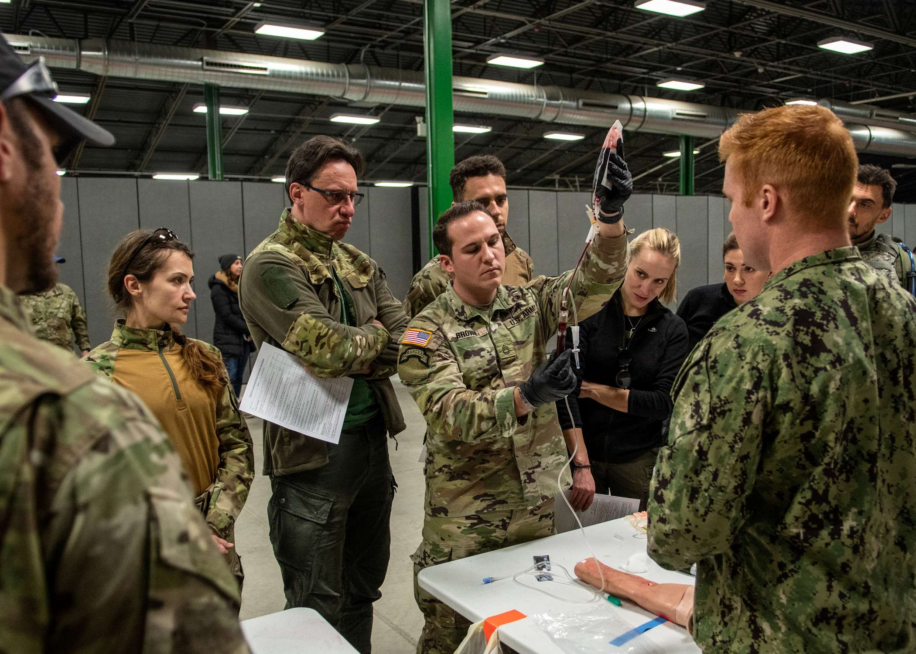
EFWBT Program Design
Eight UHPs, including six physicians and two medics, completed our training
Participants were assessed on their confidence in both the practical application and administrative oversight requirements of an EFWBT program
A cross-comparison was conducted between third-year medical students from USU and the UHPs to determine the statistical significance
Notes:
Participants were given a Confidence pre-assessment questionnaire in order to develop a base line prior to training and participation. Such questions inquired about self-assessed proficiency, ability to identify the need for Fresh Whole Blood Transfusion, and current stress level. Following training, UHPs were given the same assessment and a comparison of data was made. Additionally, a cross comparison with a data set collected with 3rd year medical students from USU was conducted.​
​

Slide 8
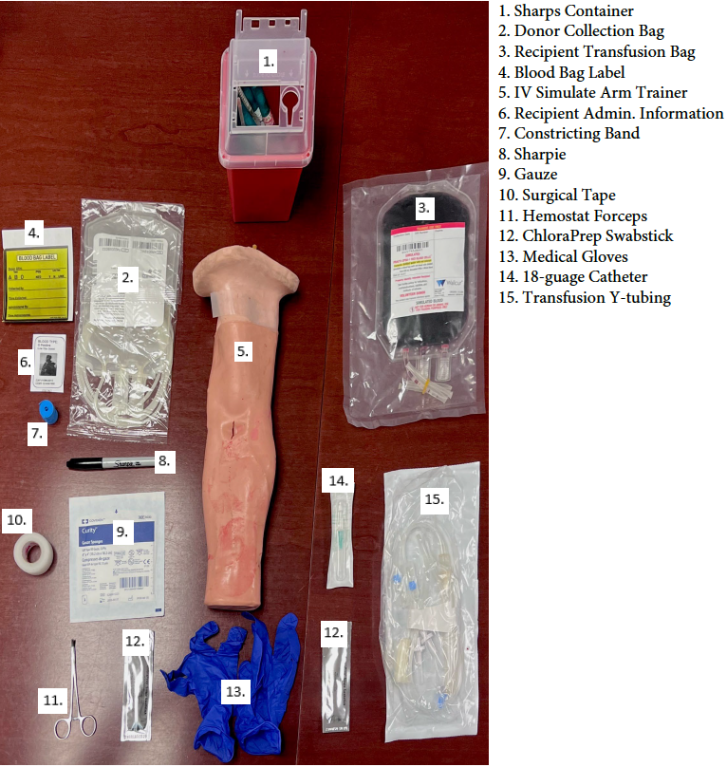
EFWBT Training Implementation
Prior to the start of training, UHPs conducted a self-reported questionnaire
Next, a didactic presentation was led by a multi-service medical team
Oversite was provided by two board-certified Emergency Medicine Medical Physicians and the Director of Research - Department of Military and Emergency Medicine at USUHS
Notes:
Moving on to Implementation. In order to standardize training and data collection a repeatable set up was used for both demonstration as well as practical application. The presentation outlined all relevant transfusion procedures from donor collection to transfusion of FWB, utilizing donor-collection and patient-transfusion equipment used during the latter practical-application phase. Participants were given read in on the respective patient's Z-mist and scenario leading up to the incident as the opportunity to chose donors from a generated list.​
Main key points that were emphasized throughout the training were, but not limited to: ascetic technique, proper documentation, proper handling of blood collection bags, proper administration, as well as monitoring of post treatment care.​
-UHPs were given a step by step guided demonstration on proper technique and then given the opportunity to practice skill set with oversight in order to achieve familiarity​
​
Figure Title: EFWBT medical training equipment (Photo credit: Joshua Cuestas)​
​

Slide 9
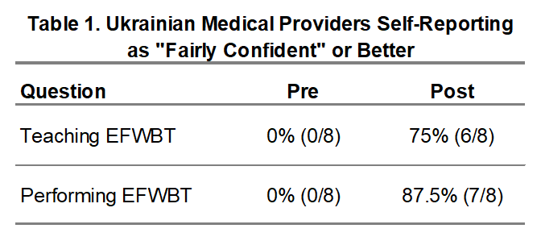
EFWBT Training Evaluation and Assessment
The confidence level was evaluated by cross-examination of pre- and post- self-assessments
The theory of evaluating an increased confidence level is indicative of proficiency in EFWBT
The mean baseline score of the pre-training self-assessment for UHPs increased from 34.17% to 77.50%
Pre- and Post- self-assessment scores for USUS students increased from 58.25% to 77.54%
Notes:
Prior to the training, no participants rated themselves as ‘fairly confident’ or ‘completely confident’ in their ability to teach an EFWBT course or to perform an EFWBT in an austere environment​
​
To determine the statistical significance, pre- and post-training self-assessments of UHPs were compared to a larger sample of third-year medical students from USU who completed identical training​

Slide 10
Assessment Questionnaire
Pre/Post Questionnaire
A multi-question questionnaire was administered both pre and post training
Question selection criteria stressed ease of understanding and lack of nuance
UHP's were given no time limit during completion of questionnaire

Slide 11
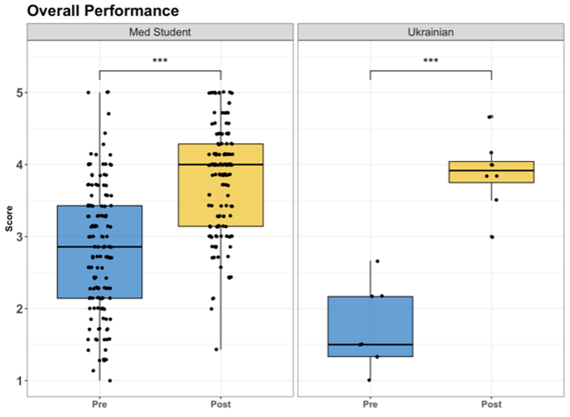
Outcomes
Statistically significant was identified (p-value < 0.0001)
The difference in mean scores was statistically significant (p-value < 0.0001)
The average rate of improvement was greater for the UHPs compared to third-year medical students
Notes:
Figure Title: Overall confidence of medical students and Ukrainian trainees​

Slide 12
Limitations
Simulation of Real-World Conditions: The testing conditions for the EFWBT course involved the use of a simulated arm/IV trainer which does not accurately simulate the challenges of training in real-world applications
Language Barrier: Since the EFWBT program was instructed in English, which was the Ukrainian participants’ second language, the duration of didactics and hands-on EFWBT training was expanded to allow for adequate translation of certain topics

Slide 13
Future Research
Longitudinal Study: Ukrainian participants should be assessed in a long-term study conducted to assess the long-term effectiveness and sustained development of organic Ukrainian EFWBT programs
Ukrainian-specific EFWBT training program: Ukrainian EFWBT program capabilities should be assessed to determine if UHPs trained in a Ukrainian-specific EFWBT program are able to retain long-term confidence and competence in EFWBT
Increased Realism: future research should evaluate the differences in performing autologous EFWBT versus simulated arm/IV trainers to enhance realism and provide high-fidelity medical training that more accurately simulates real-world conditions

Slide 14
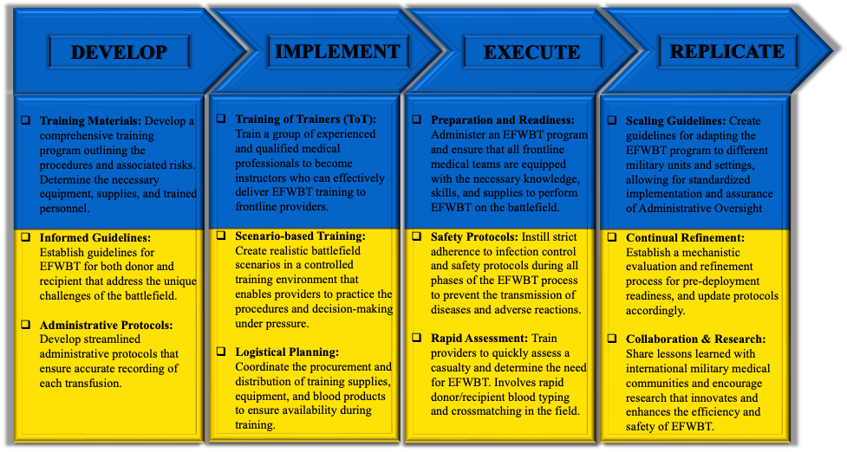
The Way Forward
Notes:
Figure title: The way forward for EFWBT training programs​

Slide 15
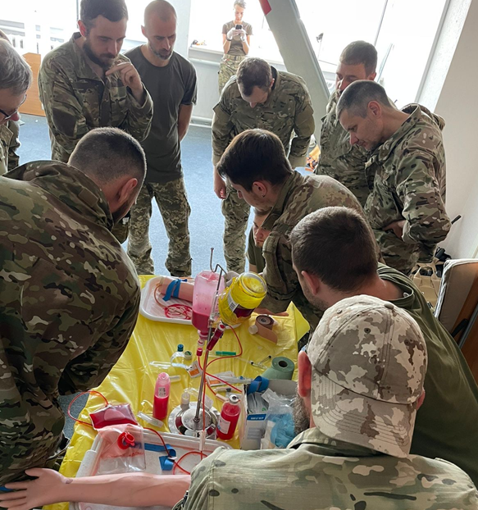
The Way Forward (cont.)
The Russo-Ukrainian War has recently spurred a wealth of research in capability assessments of Ukrainian medical systems, but there remains a demand to resolve these multifaceted healthcare disparities
"Recently, Ukrainian legislation was changed and the government has allowed service members to conduct EFWBTs but only if they passed a course like yours. So we need to build up our education potential that we can use for continuation of research" - Oleksandr, Head of the ICTM Educational Center

Slide 16
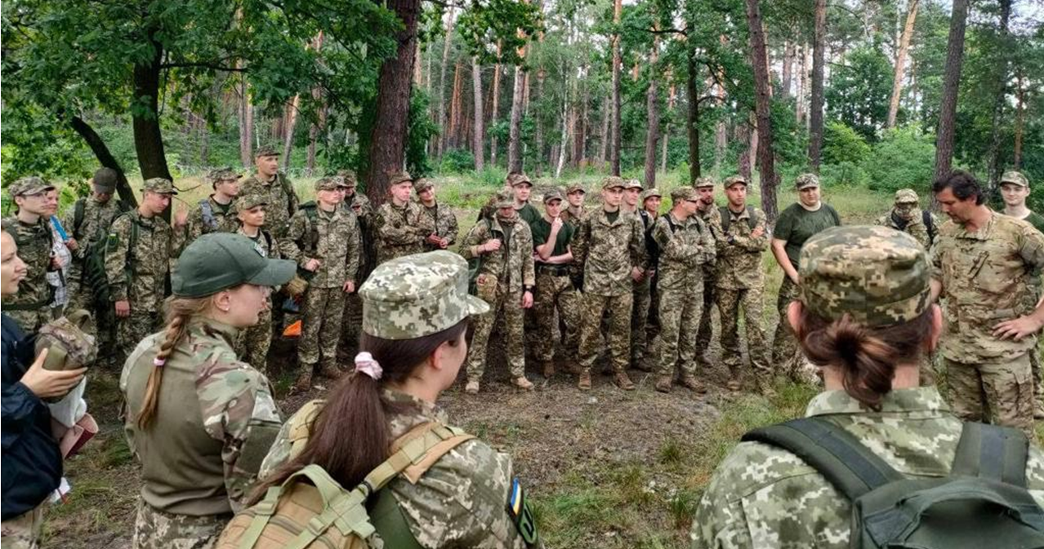
The Way Forward (cont.)
Limited medical logistic infrastructure: accessibility to Cold-Stored Whole Blood close to the frontlines, compounded with limited proficiency in EFWBT training in Ukraine, creates systemic challenges to the employment of an effective DCR strategy
To resolve these limitations, our research team established a curriculum that assessed the confidence of UHPs in the application of managing an EFWBT program; this program serves as a pilot for replicating previous successes in US DoD EFWBT programs and resolving training disparities in DCR in preparation for increased volume of casualties during future LSCO
EFWBT program oversight requires a curriculum that encompasses training for all levels of medical practice, from physicians to advanced first responders, in both hospital and prehospital settings

Slide 17
Conclusion
Our study revealed that the creation and implementation of a novel EFWBT training program for UHPs provides an expedient and efficient way to rapidly and significantly increase perceived confidence in their ability to conduct EFWBTs on the battlefield
However, this program does not "certify" providers but instead establishes a strong foundation of didactic and hands-on training to facilitate more intensive EFWBT training in the future. This curriculum provides a promising template for improving EFWBT capabilities with U.S. military partner forces
Further larger-scale research and strategic collaboration with key stakeholders is needed to determine the impact of this training on performance outcomes

Slide 18
Military Resources
Joint Trauma System – Clinical Practice Guidelines
TCCC Guidelines
75th Ranger Regiment ROLO Program
Marine Corps Valkyrie Program

Slide 19
Discussion Questions
How do you see the results of this being implemented into future research and DoD training initiatives?
What are some of the current challenges to establishing similar programs with other partner nation forces?

Slide 20
References
Joint Trauma System. (2020). Prehospital Blood Transfusion. CPG ID: 82. https://jts.health.mil/assets/docs/cpgs/Prehospital_Blood_Transfusion_30_Oct_2020_ID82.pdf
Joint Trauma System. (2018). Whole Blood Transfusion. CPG ID: 21. https://jts.health.mil/assets/docs/cpgs/Whole_Blood_Transfusion_15_May_2018_ID21.pdf
Joint Trauma System. (2019). Damage Control Resuscitation. CPG ID: 18. https://jts.health.mil/assets/docs/cpgs/Damage_Control_Resuscitation_12_Jul_2019_ID18.pdf
Joint Trauma System. (2018). Damage Control Resuscitation (DCR) in Prolonged Field Care (PFC). CPG ID: 18. https://jts.health.mil/assets/docs/cpgs/Damage_Control_Resuscitation_PFC_01_Oct_2018_ID73.pdfhttps://jts.health.mil/assets/docs/cpgs/Damage_Control_Resuscitation_PFC_01_Oct_2018_ID73.pdf
TCCC Guidelines. (2021). Deployed Medicine. https://books.allogy.com/web/tenant/8/books/b729b76a-1a34-4bf7-b76b-66bb2072b2a7
Fisher, Andrew MD et al. (2015). Tactical Damage Control Resuscitation. Journal of Military Medicine. 10.7205/MILMED-D-14-00721
Epstein et al. (2023). Putting Medical Boots on the Ground: Lessons from the War in Ukraine and Applications for Future Conflict with Near-Peer Adversaries. Journal of the American College of Surgeons. 10.1097/XCS.0000000000000707
Brill, Jason et al. (2023). Is Low-Titer Group O Whole Blood Truly a Universal Blood Product? Journal of the American College of Surgeons. 236(3): 506-513. 10.1097/XCS.0000000000000489

