Slide 2
Mental Health Impact of the COVID-19 Pandemic on U.S. Service Members in Health Care
LCDR Ngozi Mezu-Patel, MD
LT Ojowa, PharmD
LT Adrienne Villareal, NP
CAPT Nina Mezu-Nwaba, PharmD, MPH, MSc
Darshan Patel, MD
Notes:
Good afternoon, everyone!
I am LCDR Ngozi Mezu-Patel and I am accompanied by CAPT Nina Mezu-Nwaba and LT Adrienne Villareal .

Slide 3
Disclosures
The presenters have no relevant financial or non-financial interests to disclose.
Notes:
We have nothing to disclose!

Slide 4
Objectives
Identify unique challenges faced by active-duty health care providers during the COVID-19 pandemic.
Describe the mental health consequences of the COVID-19 pandemic on U.S. service members providing health care.
Discuss strategies for promoting the mental health and well-being of active-duty healthcare providers.
Notes:
By the conclusion of this presentation, you will have gained a deeper understanding of:
- Some of the challenges faced by U.S. service members during the COVID-19 pandemic. This will include examples of the specific hardships and stressors they encountered, both on and off deployment.
- The mental health impact of COVID-19 on military personnel: We will briefly explore some of the psychological effects of the pandemic on service members, including anxiety, depression, and post-traumatic stress disorder (PTSD)
- Strategies for promoting mental well-being among active-duty healthcare professionals: This section will highlight effective strategies implemented to address the unique challenges faced by this critical population, while also discussing approaches that can further enhance the mental well-being of all service members.
By the end of this presentation, you will know some of the challenges faced by US service members during the COVID-19 Pandemic;
- you will be able to address the mental health impact of COVID-19 on military personnel.
And finally, we will discuss some strategies that have helped and can further promote the mental well being of all, especially active-duty healthcare professionals..

Slide 5
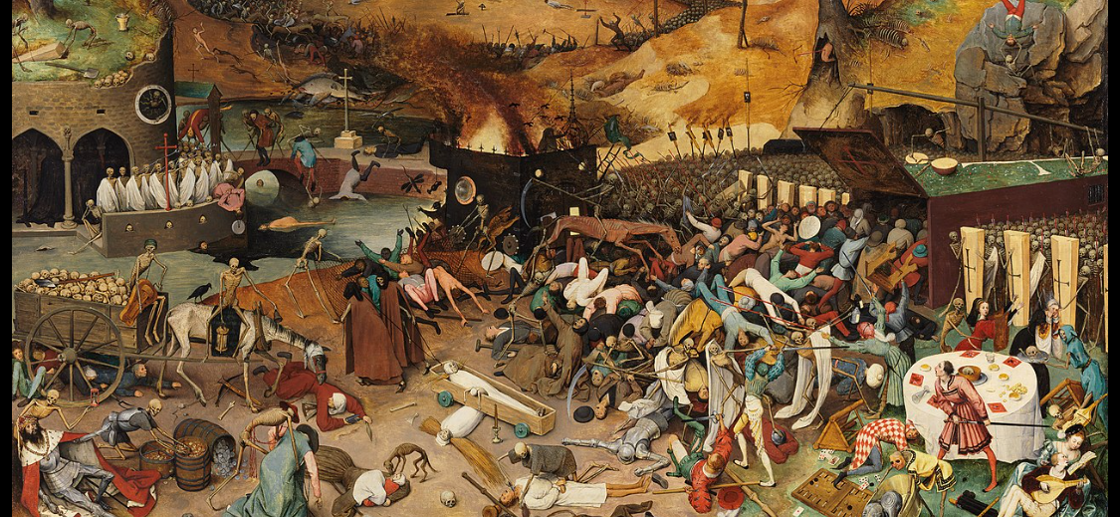
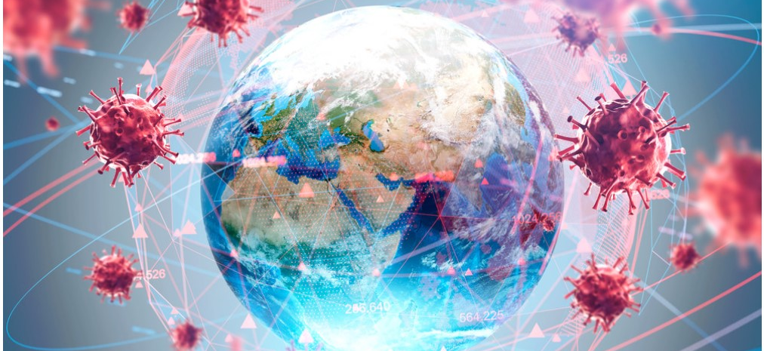
Introduction
Pieter Bruegel’s The Triumph of Death.
A widespread occurrence of an infectious disease over a whole country or the world at a particular time.
Notes:
This oil panel painting, titled "The Triumph of Death" was created circa 1562 by Pieter Bruegel the Elder, serves as a potent allegory for the social upheaval and terror that followed the plague's devastation of medieval Europe. Since 1827, it has been in the Museo del Prado in Madrid.
As defined by the Oxford English Dictionary, a pandemic denotes a widespread and severe infectious disease outbreak affecting a large geographical area, potentially encompassing an entire country or even the globe. The 21st century has witnessed several pandemics, including SARS, Ebola, and Zika, yet none have resonated quite as profoundly as COVID-19. Indeed, COVID-19 stands as the defining pandemic of our modern era.
By juxtaposing "The Triumph of Death" with the experiences of COVID-19, we gain a deeper understanding of the enduring human struggle against pandemics. Both historical and contemporary accounts reveal similar themes of fear, loss, and societal breakdown. While the specific circumstances and disease characteristics differ, the shared experience of confronting an overwhelming and unpredictable threat resonates across centuries.
This is an oil panel painting by Pieter Bruegel called The Triumph of Death (c. painted in 1562) reflects the social upheaval and terror that followed the plague, which devastated medieval Europe. It has been in Museo del Prado in Madrid since 1827.
The Oxford Dictionary defined a pandemic: a widespread occurrence of an infectious disease over a whole country or the world at a particular time.
The 21st century has had a number of pandemics such as SARS, Ebola, Zika but none like COVID-19.
COVID-19 was our modern day 21st century pandemic

Slide 6
Introduction
COVID-19 negatively affected the mental health of healthcare workers worldwide.
U.S. service members in health care were negatively impacted.
Notes:
The emergence and subsequent global spread of the COVID-19 pandemic has resulted in an unprecedented and significant negative impact on the mental health of healthcare workers worldwide. This effect is exacerbated for US service members in healthcare, who face additional stressors and psychological burdens due to their unique roles and responsibilities.
- Elevated levels of stress, anxiety, and fear, particularly related to the witnessing of patient morbidity and mortality on a significantly amplified scale.
- Moral distress and ethical dilemmas stemming from resource scarcity and difficult care decisions during peak surge periods.
- Increased exposure to trauma associated with caring for critically ill patients and confronting the uncertainty of a novel disease.
- Disrupted work-life balance due to extended shifts, altered deployment schedules, and the potential for personal infection risk.
- Stigma and social isolation stemming from their association with COVID-19 and heightened public anxieties.
By acknowledging these unique stressors and vulnerabilities, we can better understand and address the mental health needs of U.S. service members in healthcare settings, promoting their overall well-being and resilience.
The COVID-19 pandemic has had a significant and unprecedented impact on the mental health of healthcare workers worldwide.
US service members in healthcare have been particularly vulnerable to the mental health consequences of the pandemic due to their unique roles and responsibilities.
These include - high levels of stress, anxiety, and fear, especially pertaining to the death and suffering of many so patients.

Slide 7
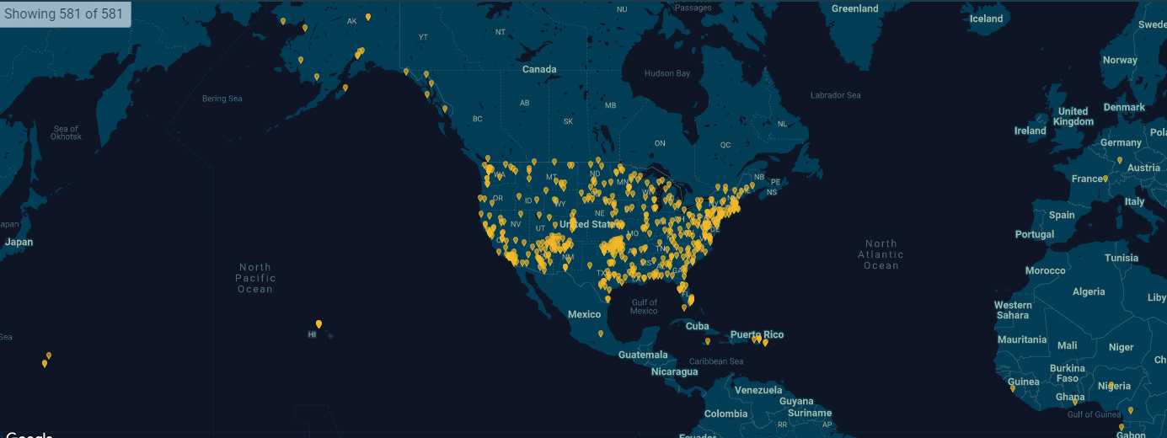
U.S. Public Health Service Officers Worldwide
Notes:
As a United States Public Health Officer, the COVID-19 pandemic profoundly impacted my professional trajectory and personal life. Witnessing the immense challenges and devastation firsthand, particularly as an Infectious Disease Physician, instilled within me a fervent commitment to contribute more actively to public health preparedness and response. This conviction ultimately fueled my decision to transition from civilian practice to become an Active-Duty Officer.
Embarking on this new path necessitated significant personal sacrifices. Relocating across the country, from New York to Texas, meant leaving behind the familiar support system of my young family – husband and children. However, the gravity of the pandemic underscored the paramount importance of prioritizing public health, and I knew this shift could empower me to make a broader impact.
While my story is unique, it also resonates with the experiences of other Active-Duty Officers. We share the common thread of dedicating ourselves – our time, expertise, and even personal sacrifices – to fulfilling critical Temporary Duty Missions (TDYs), often leading to extended periods away from loved ones.
As we emerge from the immediate throes of the pandemic and enter the Peripandemic Era, critical learnings and reflections must guide our preparation for future public health challenges. What strategic insights have we gleaned from this unprecedented experience? How can we leverage these lessons to fortify our defenses, enhance preparedness, and mitigate the impact of potential future pandemics?
These are crucial questions demanding collective reflection and decisive action. By sharing our individual experiences and collaborating, we can create a more resilient and responsive public health infrastructure, safeguarding the well-being of our communities and mitigating the impact of future outbreaks.
I am a United States Public Health Officer: How did the pandemic affect me? How has it affected you? As an Infectious disease physician, the effects / consequences of the pandemic fueled me to make the transition from civilian practice to becoming an Active-Duty officer.
This meant leaving my young family – husband and kids behind to relocate/settle across the country, From New York to Texas.
Yes, this is my particular story but it is also your story. We as active-duty officers are tasked with TDY mission this can mean being away from family and loved ones but more importantly, giving of ourselves- our time, our expertise
We are now in the Peri-pandemic era: what have we learned and how do we use it to prepare for the future, for the next pandemic.

Slide 8
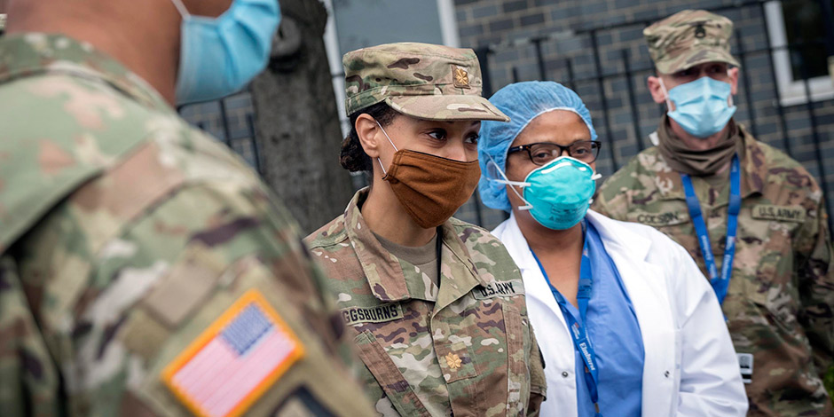
Heroes
Worry about an unknown virus.
Challenges in care of the unknown.
Need for self-isolation.
Notes:
The early phase of the COVID-19 pandemic was characterized by significant uncertainty and resource scarcity. With limited knowledge about the virus and its transmission dynamics, healthcare professionals faced an unprecedented challenge. Amidst critical supply shortages, many resorted to improvising personal protective equipment (PPE) to manage patient care.
This period, aptly recognized as the "Hero Phase," witnessed an outpouring of public appreciation for healthcare workers who bravely confronted the unknown enemy on the frontlines. However, this sense of heroism was often accompanied by deep anxiety and concern for personal safety as well as the well-being of loved ones.
The Pandemic did have different phases: No one knew what we were fighting or the means to fight it. Self /home made PPE’s due to the lack of supply. Healthcare professionals were hailed as heroes – where we battled the unknown virus. This was the Hero phase of our Pandemic fight.
This was accompanied by the concern for self and loved ones.
IMAGE: https://www.nychealthandhospitals.org/pressrelease/city-partners-with-department-of-defense-to-address-covid-19-trauma-in-healthcare-workers/

Slide 9
Stress and Trauma in U.S. Service Members
Feeling anxiety, stress and fear.
Worrying about contracting COVID-19 from infected patients.
Witnessing death and suffering of patients.
Working long hours under pressure.
Dealing with shortages of personal protective equipment (PPE) and other resources.
Notes:
U.S. service members in healthcare were confronted by several unique stressors during the pandemic. These included:
(Intensified exposure to stress and trauma:) They navigated heightened anxiety, fatigue, and an increased workload while confronting the fear instilled by the novel and lethal virus.
(Looming threat of self-infection and transmission): Depending on their location, service members carried the constant burden of potentially infecting themselves and their loved ones. This resulted in practices like stripping work clothes outside and showering before embracing loved ones, highlighting the psychological weight of potential transmission.
Some of the unique Challenges Faced by U.S. Service Members in Healthcare were triggered by :
Increased exposure to stress and trauma: They faced increased anxiety, fatigue, increased workload and fear of this unknown deadly virus-
Depending on where one was located, the Fear of infecting self and loved ones was a burden that was carried.
- Striping off work clothes in the garage then showering prior to hugging loved ones after work became a natural occurrence for many.

Slide 10
Social Isolation and Stigma
Quarantine measures.
Discrimination from association with COVID-19 patients.
Notes:
Following the initial wave of public recognition, U.S. service members in healthcare may have transitioned into a phase marked by:
- Potential social isolation: Quarantine measures or the fear of post-exposure transmission could lead to social isolation, impacting their sense of connection and support.
- Stigma and discrimination: Their association with COVID-19 patients, despite their dedicated care, could subject them to stigma and discrimination, adding another layer of emotional burden.
After the Hero phase wore off:
- They (Service members in healthcare) may have experienced social isolation due to quarantine measures or fear of spreading the virus, post exposure.
They may also have faced stigma and discrimination due to their association with COVID-19 patients – in treating them.

Slide 11
Mental Health Consequences
Increased prevalence of mental health disorders including:
Anxiety.
Post-traumatic stress disorder (PTSD).
Substance abuse.
Suicidal ideations.
Sleep disturbances.
Notes:
LT Villareal:
Some of the potential Mental Health Consequences of the COVID-19 Pandemic on US Service Members in Healthcare included
Elevated rates of anxiety and depression: The constant pressure, uncertainty, and exposure to suffering significantly impacted their emotional well-being.
Increased prevalence of post-traumatic stress disorder (PTSD): Witnessing trauma and death on a regular basis could lead to the development of PTSD, affecting their long-term mental health.
Rise in substance abuse: Some individuals may have turned to substances as a coping mechanism for the overwhelming stress and emotional exhaustion.
Some of the Mental Health Consequences of the COVID-19 Pandemic on US Service Members in Healthcare included:
Increased rates of anxiety, depression, post-traumatic stress disorder (PTSD),
and substance abuse among US service members in healthcare during the pandemic

Slide 12
Mental Health Consequences
Impact on work performance and well-being:
Decreased productivity.
Impaired decision-making.
Increased absenteeism.
Difficulty maintaining healthy relationships.
Notes:
LT Villareal:
Mental health disorders, if left untreated, can significantly impact individuals across various domains, including their work performance, personal and professional relationships, and overall well-being. For U.S. service members specifically, mental health challenges can manifest in the following ways:
-( Impaired decision-making:)) The cognitive effects of certain disorders, such as anxiety or depression, can hinder clear thinking and sound judgment, potentially affecting their job performance.
- (Difficulties maintaining healthy relationships:)) Emotional dysregulation, social withdrawal, or communication challenges associated with mental health disorders can create strain in both personal and professional relationships.
- (Reduced overall well-being: ) Untreated mental health issues can significantly diminish quality of life, leading to decreased personal satisfaction, motivation, and resilience.
Mental health disorders can have a significant impact on a person's work performance, relationships – personal and at work, and overall well-being. Especially if unaddressed/ treated.
Service members with mental health problems may experience: Poor decision making, difficulty maintaining healthy relations.

Slide 13
Promoting Mental Health
Individual-level interventions.
Provide access to mental health services, including therapy and medication.
Promote self-care practices, such as exercise, relaxation techniques and healthy sleep habits.
Encourage peer support and connection within the health care community.
Notes:
CAPT Mezu-Nwaba:
Addressing the mental health needs of U.S. service members necessitates the implementation of multifaceted strategies that promote general well-being. These can be categorized as follows:
1. Individualized Support:
Self-care practices: Encouraging engagement in activities like regular exercise, maintaining a healthy diet, prioritizing adequate sleep, and dedicating time for relaxation and connection with loved ones can significantly bolster emotional resilience.
Structured routines: While working remotely, establishing a consistent schedule with built-in flexibility can provide a sense of normalcy and control, mitigating feelings of overwhelm and isolation.
2. Enhanced Access to Mental Health Services:
Expand service accessibility: Increasing availability of mental health services through diverse modalities, including online and phone consultations, alongside traditional in-person appointments, ensures timely and convenient access to care.
3. Building Supportive Networks:
Peer support programs: Fostering peer support networks within the service member community allows individuals to connect with others who understand their unique challenges and provide emotional validation and practical resources.
Mentorship initiatives: Implementing mentorship programs can connect service members with experienced professionals who offer guidance, support, and a sense of community belonging.
There are Strategies for Promoting Mental Health and general Well-being: These include:
Individualized support –
- Self care – exercise and a healthy diet, time for rest – uncompromised, time spent with loved ones and friends
- Making a schedule with some variations – while working at home (during this period)
Increase access to mental health services – much needed: online via phone and now in person appointments.
Providing peer support and mentorship programs

Slide 14
Promoting Mental Health
Organizational-level interventions:
Create a culture of resilience and support within the military and healthcare community.
Implement policies to reduce stress and burnout.
Provide resources for workplace accommodations for service members with mental health conditions.
Notes:
CAPT Mezu-Nwaba:
Organizational -level strategies for promoting Mental health services: include
1. Implement comprehensive stress management and resilience training programs equipping service members with the skills and tools to effectively manage stress and build emotional resilience.
2. Cultivate a culture of openness and support within the military and healthcare communities by promoting open communication, reducing stigma, and fostering peer support networks.
3. Address and dismantle stigma and discrimination surrounding mental health through targeted education campaigns, promoting the accessibility and utilization of available resources like Employee Assistance Programs (EAPs), Corps Care, and peer support programs within each agency.
Implement stress management and resilience training
Create a culture of openness and support in the military and healthcare community
Address stigma and discrimination related to mental health: Employee Assistance Programs (EAP ), Corps Care, and Peer support programs within the different agencies are available and should be encouraged.

Slide 15
Promoting Mental Health
System-level interventions:
Increase funding for mental health research and services.
Address stigma associated with mental health conditions.
Promote public awareness of the mental health needs of health care workers.
Notes:
CAP Mezu-Nwaba:
Systemic interventions :at a Higher level which is obviously champion by our ASH and surgeon general: by advocating for increasing funding for services and reach for mental health programs.
- Addressing mental health conditions to destigmatize them and encourage others/ any one in need to seek help.
- Most importantly, promoting public awareness of the mental health needs of healthcare workers as - it can be a thankless job.

Slide 16
Pandemic Impact on U.S. Service Members
Recognize challenges faced by service members.
Implement strategies to promote mental health and well-being.
Consider individual-, organizational-, and system-level interventions.
Notes:
CAPT Nina or Me:
Inconclusion:
The COVID-19 pandemic undeniably exerted a profound and far-reaching impact on the mental health of U.S. service members in healthcare. While the full scope of this impact remains inadequately explored, existing evidence suggests a concerning prevalence of mental health challenges within this population.
Recognizing the unique stressors and vulnerabilities faced by these service members due to their critical roles and responsibilities is crucial. This necessitates the implementation of comprehensive and multifaceted strategies to promote their mental well-being and resilience. Such strategies could encompass individual-level interventions like stress management training and access to mental health services, alongside broader systemic changes aimed at fostering a culture of support and destigmatizing mental health within healthcare settings.
By prioritizing the mental health needs of U.S. service members in healthcare, we can not only ensure their personal well-being but also guarantee the continued provision of essential care in our communities. This collective effort requires ongoing research to comprehensively understand the scope of the problem and the effectiveness of different interventions, coupled with a sustained commitment to supporting these individuals who have bravely served on the frontlines of this unprecedented pandemic.
The COVID-19 pandemic has had a profound impact on the mental health of US service members in healthcare. This is not widely studied.
It is crucial to recognize the unique challenges faced by these service members and to implement strategies to promote their mental health and well-being.
By addressing the mental health needs of US service members in healthcare, we can ensure that they have the support they need to continue providing essential care in our communities.

Slide 17
References
Ritter M, Vance MA, Iskander JK. Moral Injury Among US Public Health Service First Responders During the COVID-19 Pandemic. Public Health Reports. 2023;138(5):732-735. doi:https://doi.org/10.1177/00333549231176294
Hill ML, Nichter B, Na PJ, et al. Mental health impact of the COVID-19 pandemic in U.S. military veterans: a population-based, prospective cohort study. Psychological Medicine. Published online June 14, 2021:1-12. doi:https://doi.org/10.1017/s0033291721002361
Hannemann Id J, Abdalrahman A, Erim Y, et al. The Impact of the COVID-19 Pandemic on the Mental Health of Medical Staff Considering the Interplay of Pandemic Burden and Psychosocial Resources-A Rapid Systematic Review. Accessed May 31, 2022.
Moreno CR de C, Conway SG, Assis M, et al. COVID-19 pandemic is associated with increased sleep disturbances and mental health symptoms but not help-seeking: a cross-sectional nation-wide study. Sleep Science. 2022;15(1). doi:https://doi.org/10.5935/1984-0063.20220027.
Guo X, Wu L, Yu X, Sun Z, Liu W. Mental Health Care for Military Personnel in the COVID-19 Epidemic. Military Medicine. Published online June 19, 2020. doi:https://doi.org/10.1093/milmed/usaa127.
The Triumph of Death. Wikipedia. Published September 5, 2021. https://en.wikipedia.org/wiki/The_Triumph_of_Death#/media/File:The_Triumph_of_Death_by_Pieter_Bruegel_the_Elder.jpg.
Current Pandemics. News-Medical.net. Published February 25, 2010. https://www.news-medical.net/health/Current-Pandemics.aspx‌.
About Us. Commissioned Corps of the U.S. Public Health Service. https://www.usphs.gov/about-us.
Windows.net. Published 2023. Accessed November 29, 2023. https://hhinternet.blob.core.windows.net/uploads/2020/04/city-partners-with-department-of-defense-to-address-covid-19-trauma-in-healthcare-workers-feature.jpg.

Slide 18
Questions?

