Slide 1
Leveraging MHS Data and Advanced Analytics to Transform DOD Health Care
PROGRAM EXECUTIVE OFFICE
Jesus J Caban, PhD
Chief Data Scientist
Enterprise Intelligence & Data Solutions,
Program Executive Office Defense Healthcare Management Systems
14 FEB 2024
Distribution Statement A: approved for public release

Slide 2
Non-Disclosure
Dr. Jesus Caban, Chief Data Scientist, EIDS, PEO DHMS, has no conflicts to report.
Distribution Statement A: approved for public release

Slide 3
Learning Objectives
Discuss the value of the MHS Data
Elaborate on enterprise capabilities that enable data science and innovation

Slide 4
Military Health System
Medical Centers
Medical Clinics
Hospital Ships
45
525
2
Veterinary Clinics
Naval Ships
Dental Clinics
107
138
250
Staff members
Eligible Beneficiaries
128K
9.6M
What about the data?

Slide 5
A Day Across the MHS
164K
Outpatient encounters
387K
Dx
MHS
24 hrs
64K
Lab Orders
205K
Procedures
35K
TCONs
143K
Clinical Notes
During the last 10 years
5.2 billion ICD9/ICD10 diagnosis
2.8 billion procedures (CPT)
442 million outpatient encounters
303 million prescription
234 million lab orders
145 million clinical notes
47 million radiology scans
29 million TCONs
2.5 million Brain MRIs
13K
Radiology Orders

Slide 6
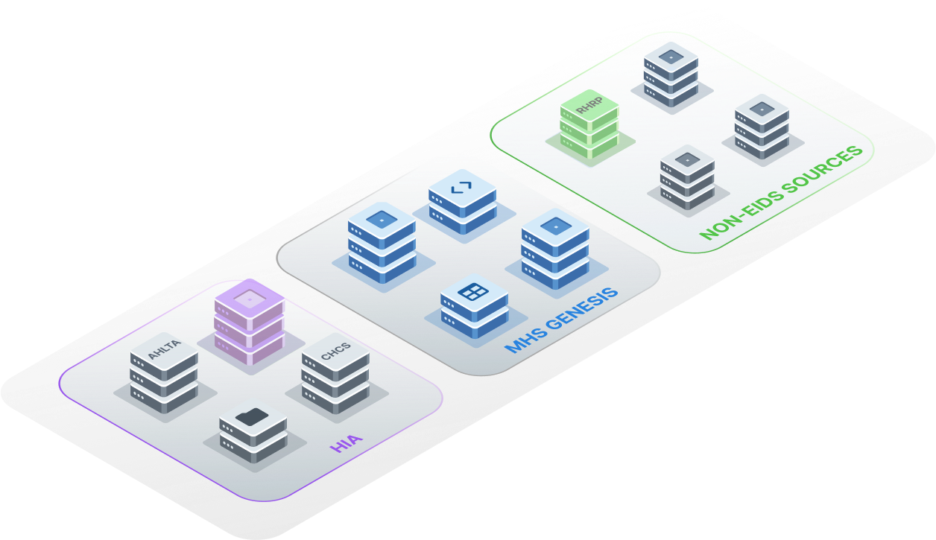
Leveraging MHS Data
Across the MHS, there are hundreds of data sources
MHS GENESIS
AHLTA
CHCS
CIS-Essentris
DMDC / DEERS
Purchased Care
EBMS-T
Etc…

Slide 7
Leveraging MHS Data – Data Layer
Data Layer:
Data Integration: seamlessly combines data from hundreds of sources
Enterprise Data Warehousing: structured data storage for organized and secure access to raw data
Data Lakes: store vast amount of raw, unstructured data
Scalability and Flexibility: designed to handle large-scale data operations
Data Security and Compliance: meets the high standards of data security and patient privacy
Real-time data process: capable of processing real-time data
Continuous Feed
SQL
Enterprise Data Warehouse
Structured Data Storage
Enterprise Data Lake
S3

Slide 8
Leveraging MHS Data – Logic Layer
Logic Layer:
Data Standardization and Harmonization: ensure consistency and compatibility across data types and sources
Common Data Model (CDM): maps data into a common vocabulary
Standardized API integration: offers standardized API to ensure seamless and secure access to data and data exchange
Data Interoperability: enhances data accessibility and interoperability
User-Centric Design: Focuses on users needs
Continuous Feed

Slide 9
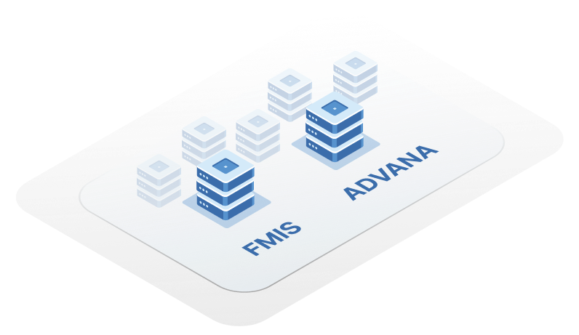
Leveraging MHS Data – External Systems
MOVEit
FHIR
API Gateway
Data Exchange
File Transfer
JSON
HL7
Continuous Feed

Slide 10
Leveraging MHS Data – Internal Apps & Capabilities
MOVEit
FHIR
Enterprise applications and capabilities
JSON
HL7
Continuous Feed

Slide 11
Leveraging MHS Data – External Apps
Continuous Feed

Slide 13
MHS Data + Advanced Analytics

Slide 14
Advanced Analytics Across the MHS
Ongoing AI/ML Work
Emerging Technologies
Future Technologies
Genomic Sequencing
Biobank
Protein Structure Prediction
Large Language Models
Over 50+ nightly risk factors
Population Health
Data and Models in support of VA STORM
Data and Models in support of VA REACHVET2
Natural Language Process Radiology
NLP for screening patients
Predictive Models
Clinical Decision Support
Readiness
Operational Medicine Integration
1
2
3

Slide 15
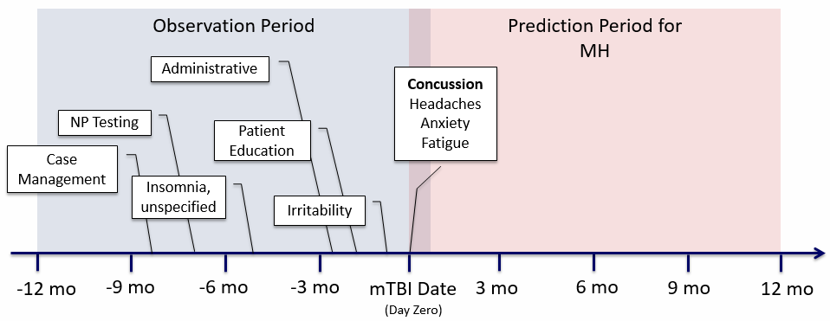
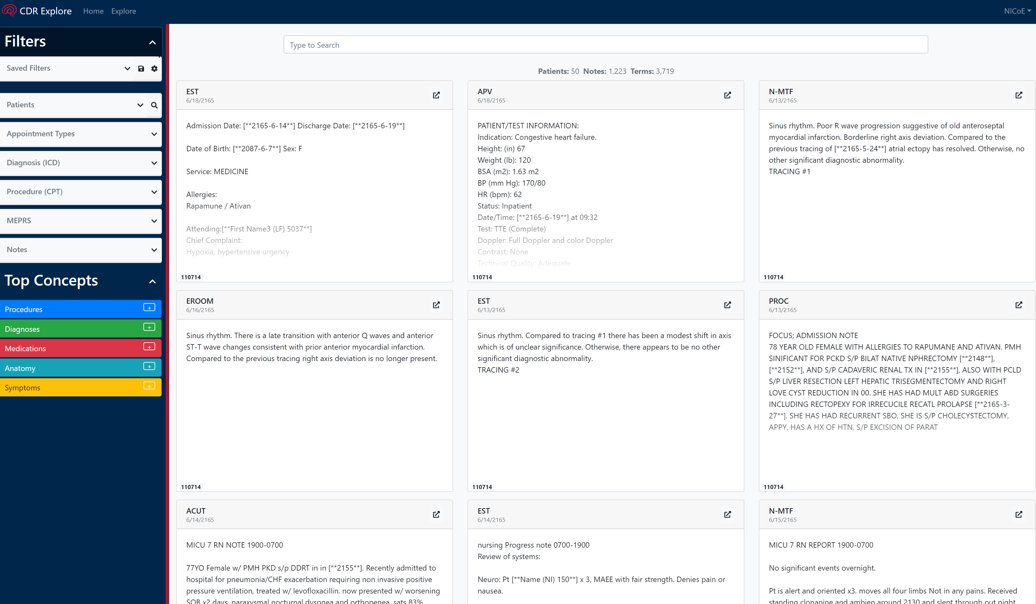
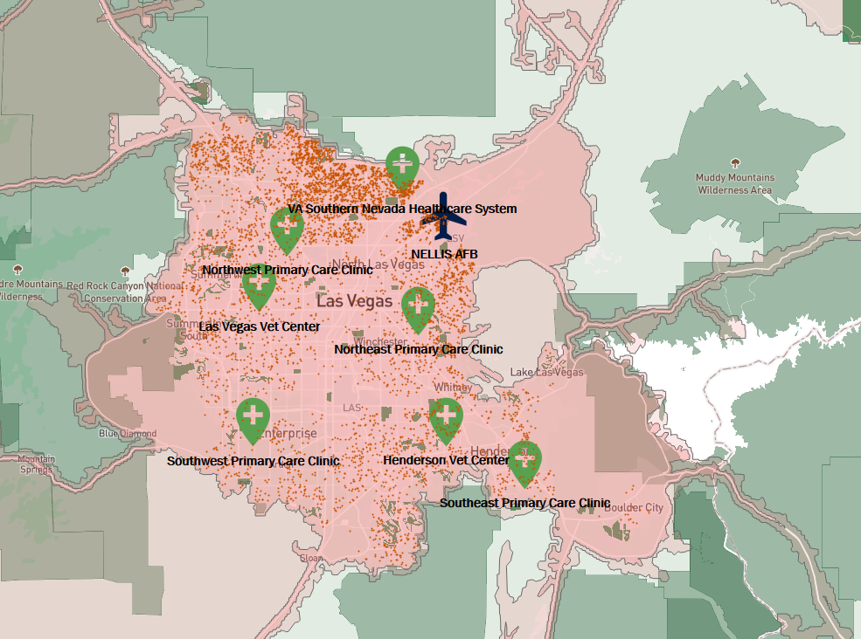
Examples of Advanced Analytics Across the MHS
Predicting Likelihood of Mental Health Conditions
NLP to quickly reviewing clinical notes.
Improving Access to Care through Analytics
Readiness & Deployability
Credit: DHA J5 A&E
Credit: BUMED

Slide 16
Conclusion
Data is at the center of these efforts to enable innovation and transformation in health care
The MIP works as the system to integrate, transform and deliver data
Latest inventory of advanced analytics found over 100 ongoing projects

Slide 17
THANK YOU
PROGRAM EXECUTIVE OFFICE
Jesus J Caban, PhD
Chief Data Scientist
Jesus.j.caban.civ@health.mil
PEO DHMS Communications
dha.dhmscomms@health.mil
Distribution Statement A: for public release.

