Slide 1
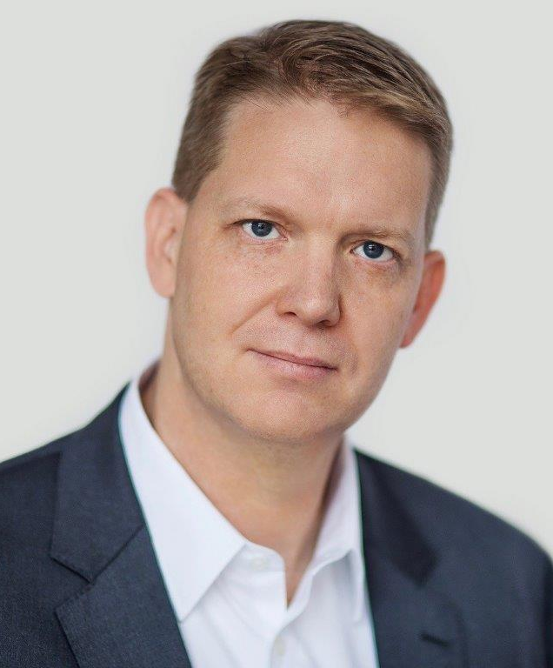
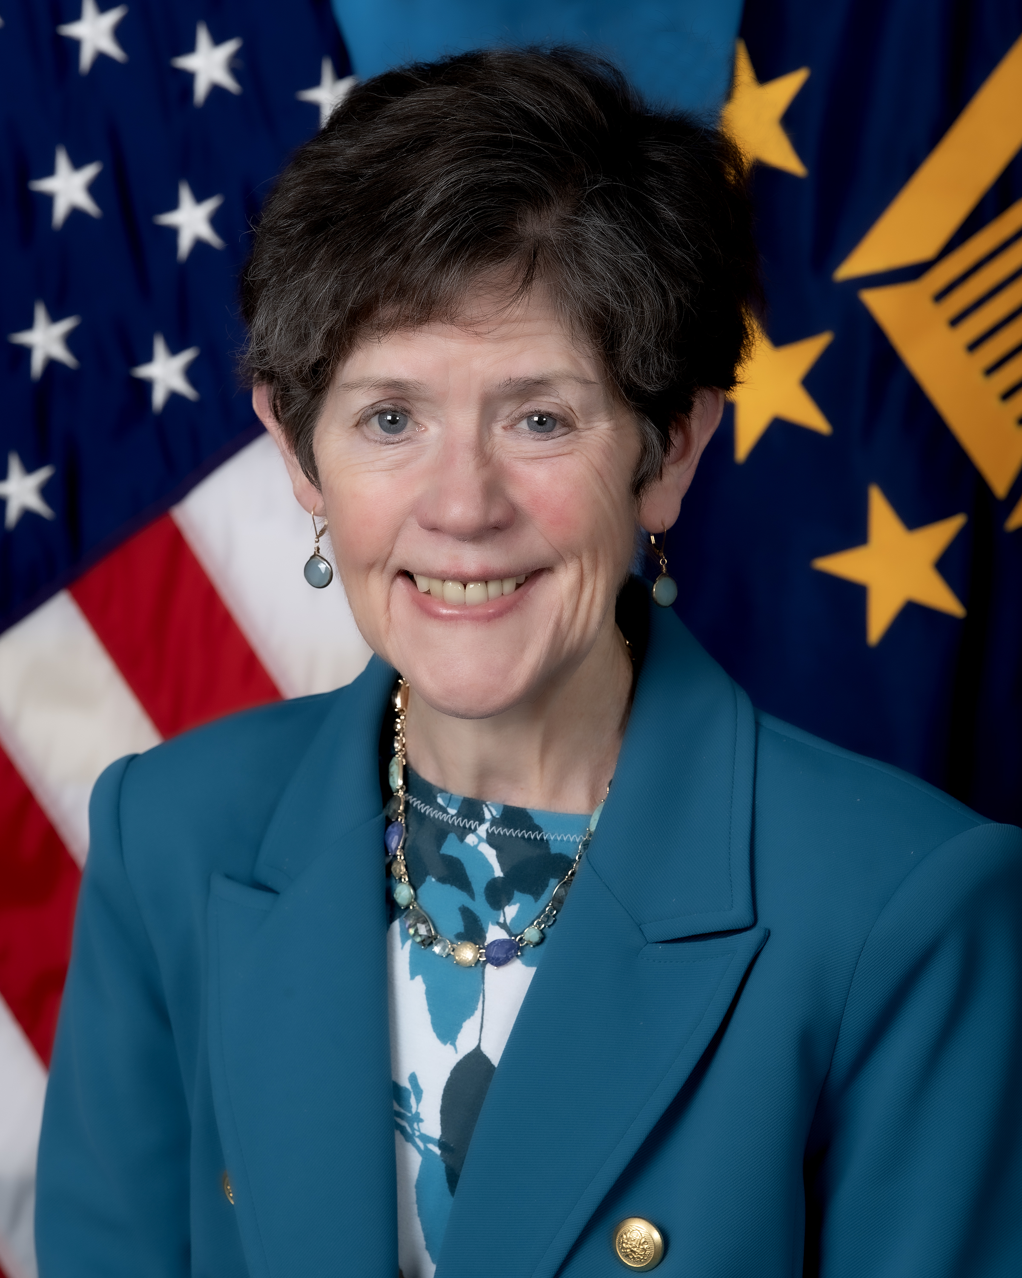
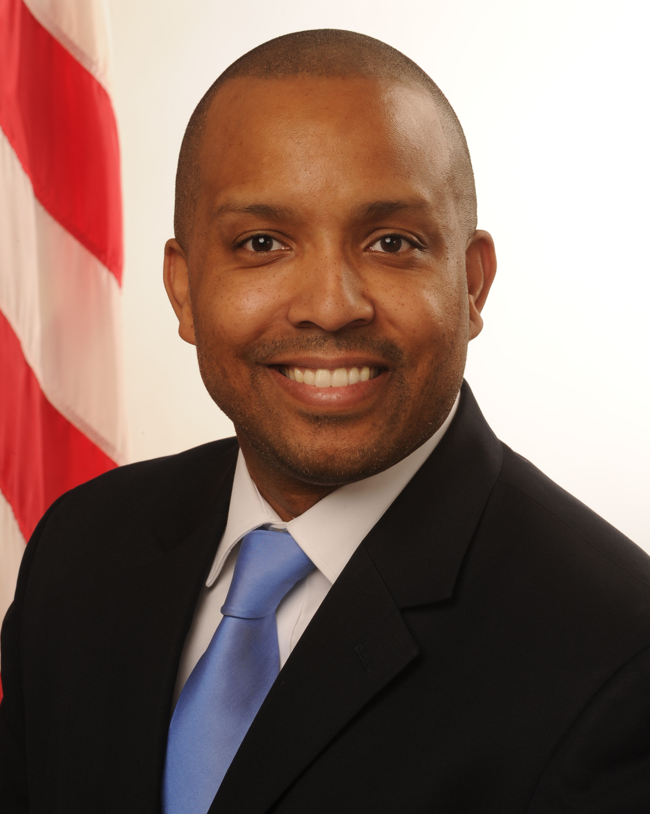
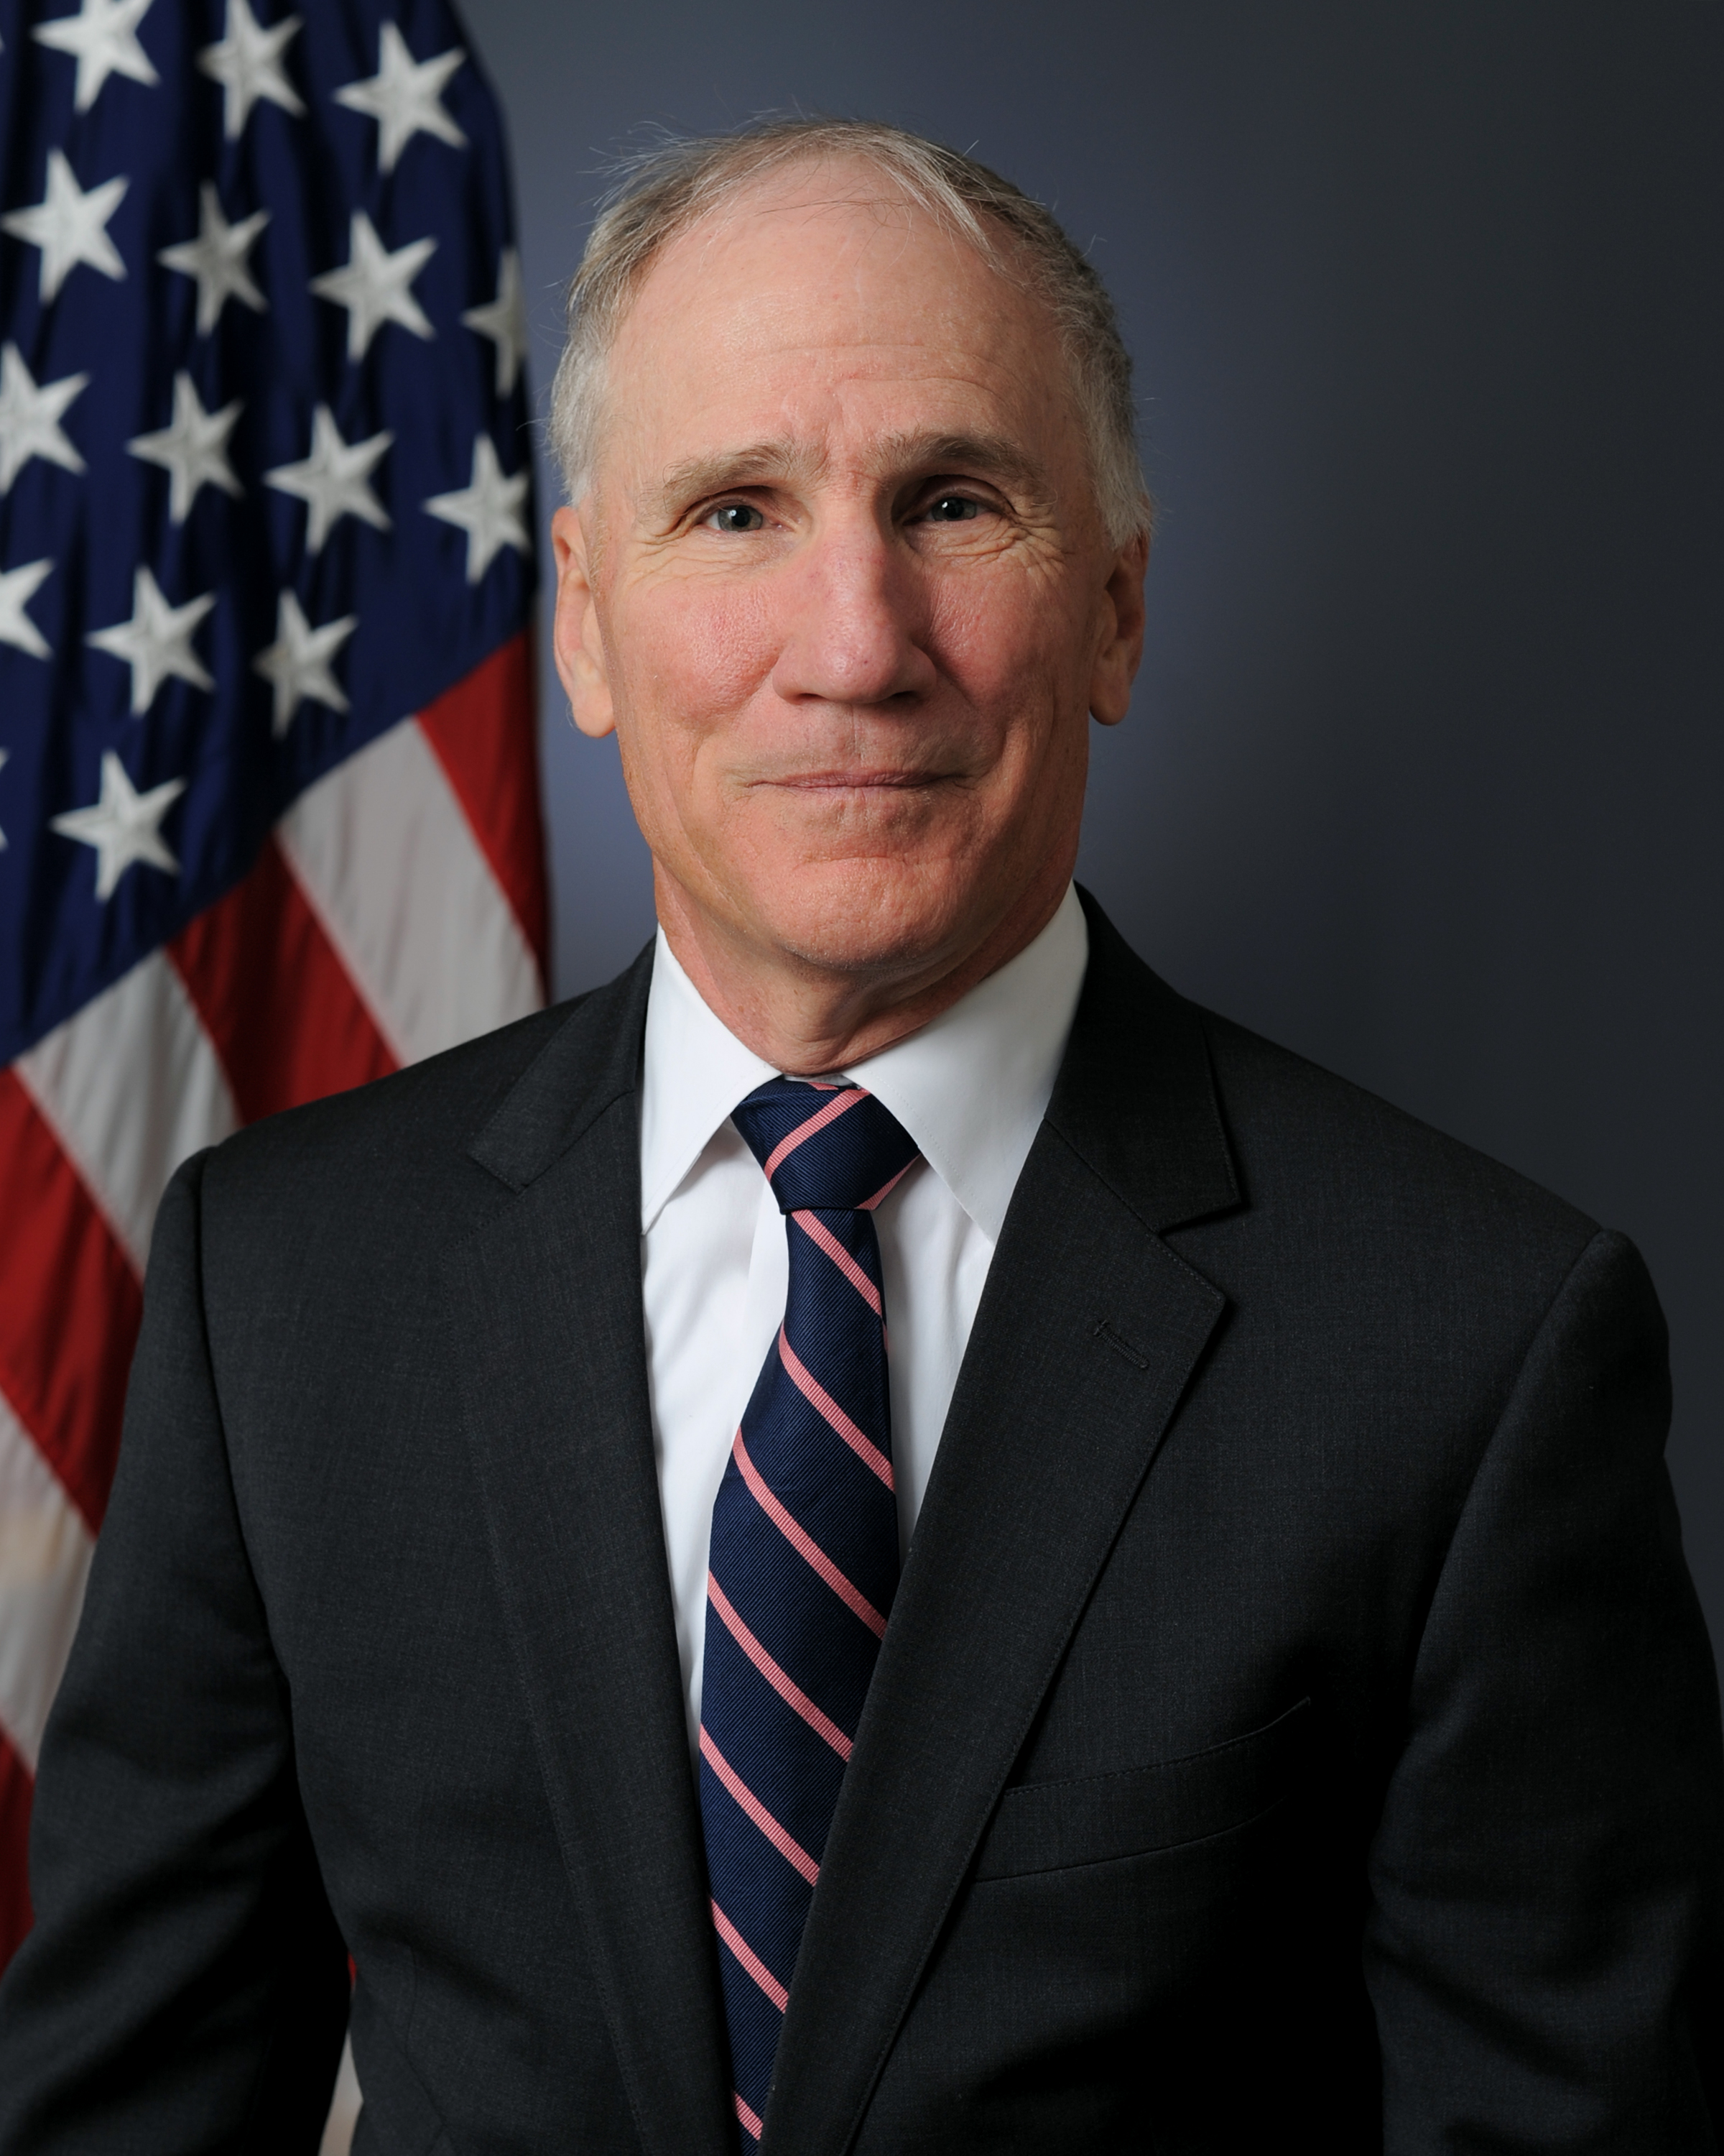
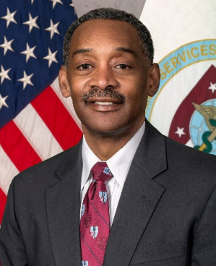
Enterprise Digital Transformation:
Can It Really Happen In Healthcare?
Moderator
Donald Kosiak, M.D.
Chief Medical Officer
Leidos
Thomas Mason, M.D.
Chief Medical Officer
Office of the National Coordinator for Health Information Technology (ONC), U.S. Department of Health and Human Services (HHS)
Carolyn Clancy, M.D., MACP
Assistant Under Secretary for Health, Discovery, Education & Affiliate Networks Veterans Health Administration (VHA)
Michael Malanoski, M.D.
Deputy Director
Defense Health Agency (DHA)
Jonathan Woodson, M.D., MSS, FACS
President
Uniformed Services University (USU)

