Slide 1
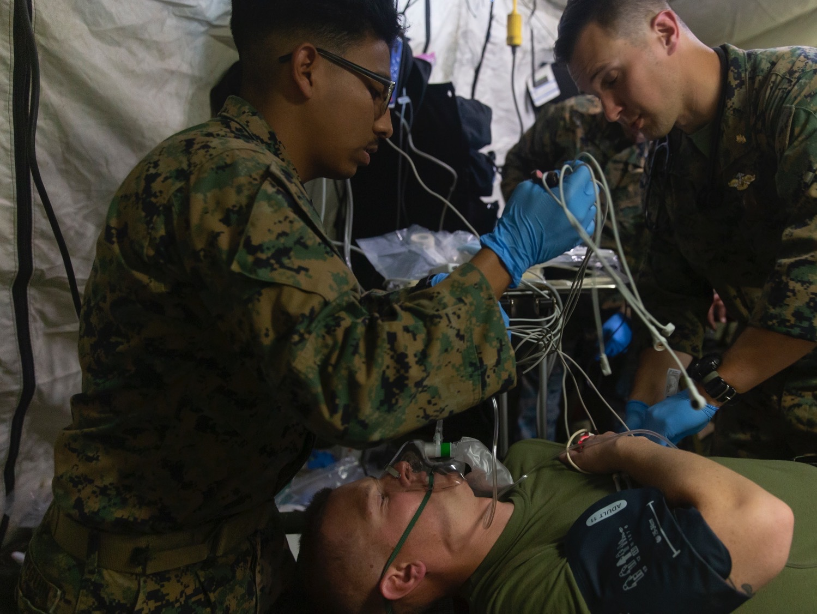
Importance of Data Quality in Transforming Medical Readiness
Tuesday, February 13, 2024
Breakout Session 1
13:00-14:00
IMAGE SOURCE: AF.MIL

Slide 2
Disclosure
Presenters on the Operational Panel have no relevant financial or non-financial interests to disclose.
This continuing education activity is managed and accredited by AffinityCE in collaboration with AMSUS. AffinityCE and AMSUS staff as well as Planners and Reviewers, have no relevant financial or non-financial interests to disclose.
Commercial Support was not received for this activity.

Slide 3
Learning Objectives
This is a headline set in Arial with Bold formatting.
Following this presentation, the participant will be able to:
Describe how data quality and data integrity are foundational to transformation of medical readiness from the tactical to strategic level.
Differentiate how each of the Services are currently utilizing data
Recognize what the opportunities are for the future
Predict at least two tactical steps needed to begin transformation
Identify the role of AI/ML in the medical readiness transformation.
1
This is a sub-headline set in Palatino Regular
2
3
This is your body copy text in Arial Regular
4
5

Slide 4
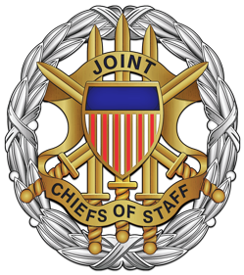
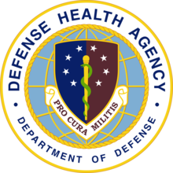
Presenters
This is a headline set in Arial with Bold formatting.
ARMY
JOINT CHIEFS OF STAFF
MG Tony McQueen
Brig Gen John Andrus
DEFENSE HEALTH AGENCY
This is a sub-headline set in Palatino Regular
RESERVE COMPONENT
Dr. Brian Lein, SES
MG Jill Faris
Moderators: George Goodwin, MD, Independent Consultant
Ron Moody, MD, Chief Medical Officer, Accenture Federal Services
This is your body copy text in Arial Regular
AIR FORCE
NAVY
Maj Gen JJ DeGoes
RDML Rick Freedman

Slide 5
MG Tony McQueen
Deputy Surgeon General
United States Army

Slide 6
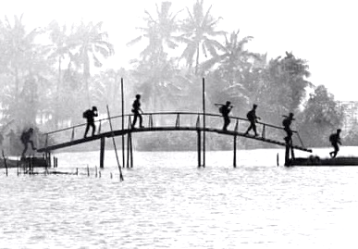
Data Quality and Integrity
Data that is trustworthy supports effective, informed decision making across the Warfighter care continuum by:
Ensuring Data Quality and Data Integrity bridges the data trust gap between the data producer and the data consumer.
Data security, quality and integrity are at the foundation of data that is trustworthy.
Empowering Commanders at echelon with medical aspects of command and control.
Enabling the operational forces by maximizing a healthy and fit force.
Providing medical support forward to enable semi-independent operations.
Optimizing evacuation and maximizing return to duty.
DATA QUALITY
DATA INTEGRITY
Photo by Ken Burns
Notes:
Data quality: degree to which data meets criteria for suitability of use
Data integrity: maintenance of accuracy and consistency of data
1) Empowering commanders at echelon with medical aspects of command and control. by enabling leaders to optimize medical capabilities in support of commanders, executing commander’s intent, and assigning appropriate authorities and capabilities at the right echelon. (AFC Pam 71-20-12)
2) Enabling the operational forces by maximizing a healthy and fit force. The Army Health System develops an effective health surveillance capability that supports operational activities and that enable risk analysis, inform protection decisions, and guide other hazard mitigation and containment activity. It also enables the operational forces by continuously synchronizing and integrating joint and host nation medical assets. (AFC Pam 71-20-12)
3) Providing medical support forward to enable semi-independent operations by aligning capabilities that directly and routinely impact the warfighter survival forward of the corps, decreasing sustainment demand, simplifying class VIII (medical supply) replenishment, and employing lighter, smaller, and modernized equipment. (AFC Pam 71-20-12)
4) Optimizing evacuation and maximize return to duty by synchronizing effective medical treatment and evacuation, rapidly and efficiently clearing casualties from the battlefield, and focusing on maximizing returning Soldiers to duty. Returning Soldiers to duty as far forward as possible sustains combat power and enables forces to maintain the competitive advantage. (AFC Pam 71-20-12)

Slide 7
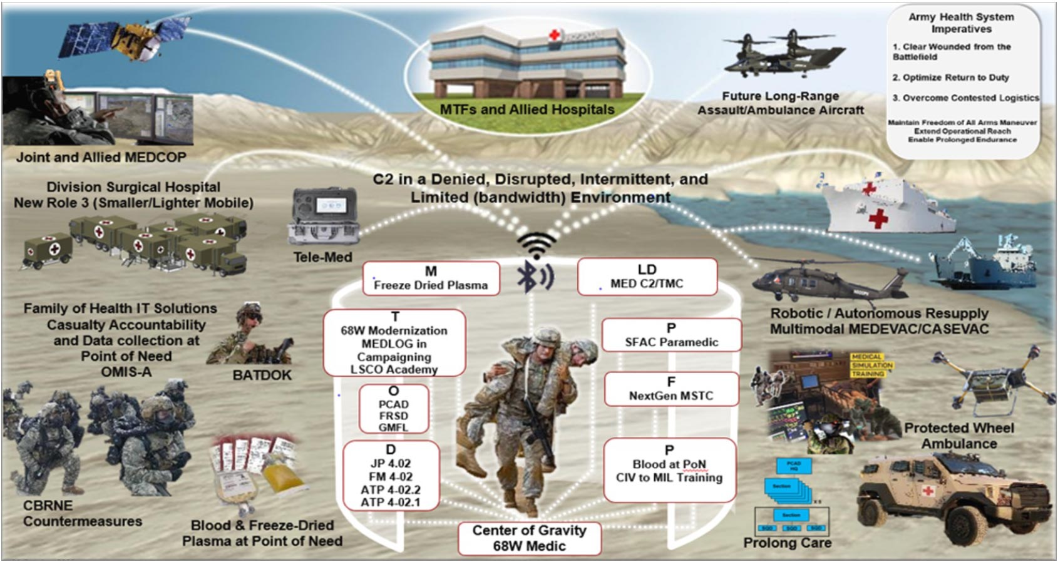
Current State and Future Opportunities
New and emerging technical capabilities can be exploited to agilely deliver data and provide recommendations at the point of need.
Notes:
Currently, MHS Readiness data is captured via variety of sources including theater information systems, Service Readiness systems (including MODS) and MHS GENESIS (garrison) then shared through the MHS Information Portal (MODS sends data to Army Vantage and to OSD Advana via MHS Information Portal)
Shared information is used for variety of initiatives that advance Soldier readiness and health including Army's Holistic Health and Fitness (H2F) program
Opportunities for exploiting data access and sharing include:
Further integration of electronic health data between DOD-VA
Facilitating access to data through modernized policies, processes, and technical solutions in accordance with DoD and Service Modernization Strategies

Slide 8
Steps to Transformation
Develop and operationalize an MHS Data Strategy that supports agile attainment of Joint requirements.
Cultivate partnerships to create synergy of effort and leverage novel capabilities to effectively exploit data.
Notes:
Currently, MHS Readiness data is captured via variety of sources including theater information systems, Service Readiness systems (including MODS) and MHS GENESIS (garrison) then shared through the MHS Information Portal (MODS sends data to Army Vantage and to OSD Advana via MHS Information Portal)
Shared information is used for variety of initiatives that advance Soldier readiness and health including Army's Holistic Health and Fitness (H2F) program
Opportunities for exploiting data access and sharing include:
Further integration of electronic health data between DOD-VA
Facilitating access to data through modernized policies, processes, and technical solutions in accordance with DoD and Service Modernization Strategies

Slide 9
MG Jill Faris
Director, Office of the Joint Surgeon General, National Guard Bureau

Slide 10
Something to Ponder
Grow through what you go through…..

Slide 11
Currently in a Data Explosion...

Slide 12
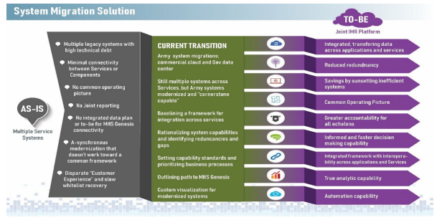
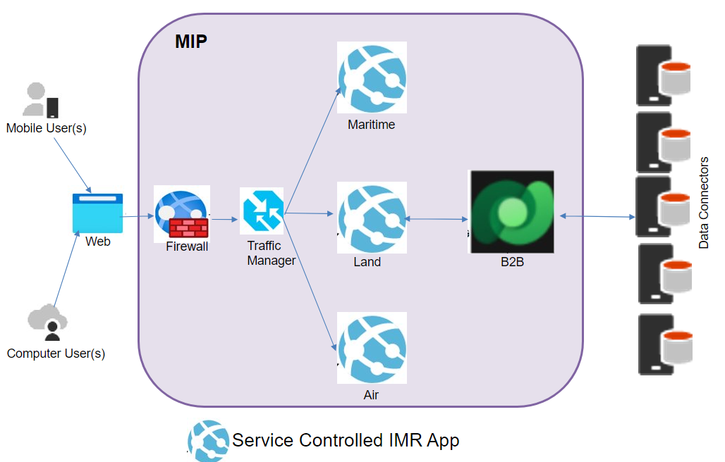
Platforms NGB Uses for the Readiness Data Lifecycle
RC Readiness Data Interoperability with the Total Joint Force
Sharing of DHA Dental Facilities on the weekend
Part One of PHA on Smart Phone
Not all RC SMs have CACs
Joint Individual Medical Readiness System (JIMR)
RC interoperability across the DOD
Continued support for read/ write access into MHS Genesis for RC medical personnel
PHA/Dental Exams completed in DHA Facilities
(DoDI 6025.19(2.2)f)
NGB Health Care for All Initiative
OSD Reserve Affairs TRICARE Study (IDA)
Possibility of TRICARE Network Expansion to support “White Space”

Slide 13
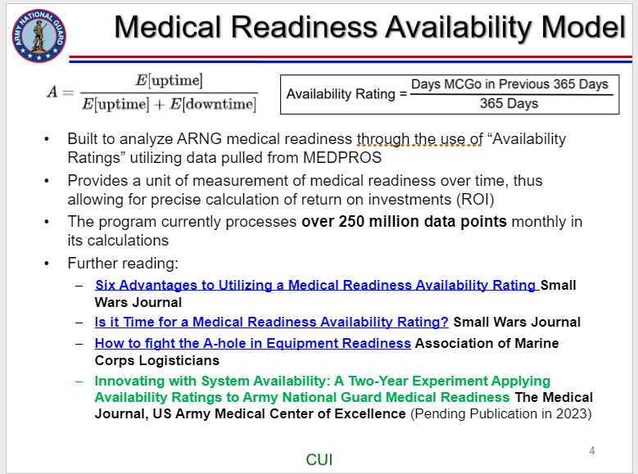
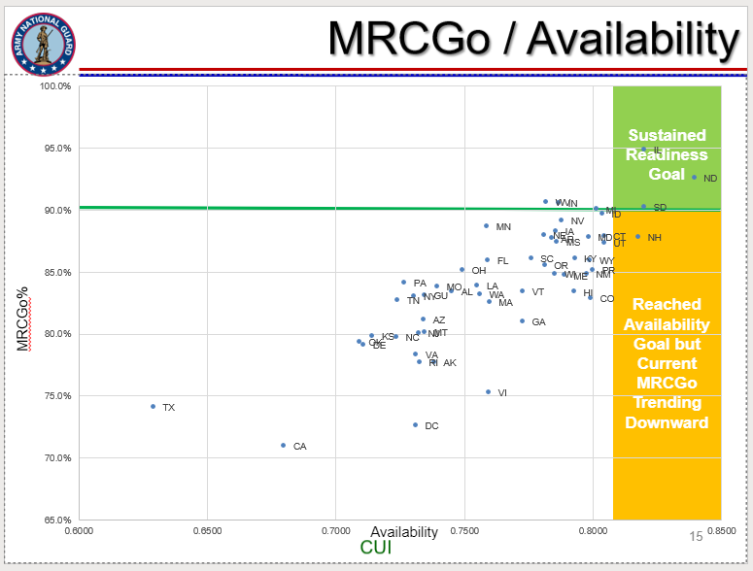
Achieved ROI Using Data as Currency
MEDCHART workflows (MATS, eMMPS, eCase, MEB Prep, HRR, PMT) enable yearly cost avoidance averages of over $760,000 and 270,000 days versus handling via hardcopy documents.
MEDCHART consolidates eleven primary medical readiness management focus areas into a single platform for the Army reserve components (approximately 536,000 Soldiers), significantly contributing to a sustained increase in readiness of approximately 60% compared to rates prior to MEDCHART.
MATS reduced the average processing time per case required to request, review, and determine waivers for medical conditions from 28 days to an average of 3.7 days across 7 years (average processing time savings of 24.3 days per case).
AVS enabled ARNG/USAR to identify over $38.7M in avoidable costs on the Reserve Health Readiness Program Contract over 7 years.
AVS assisted the reserve components to potentially identify and manage cancellations and no-shows charged against the RHRP, leading to a general decrease in avoidable costs over 7 years.
MEB Prep led to a decrease of 89 days in processing time of IDES cases for the ARNG in the first year of its deployment.

Slide 14
Maj Gen JJ DeGoes
Deputy Surgeon General, Office of the Surgeon General, Headquarters U.S. Air Force

Slide 15
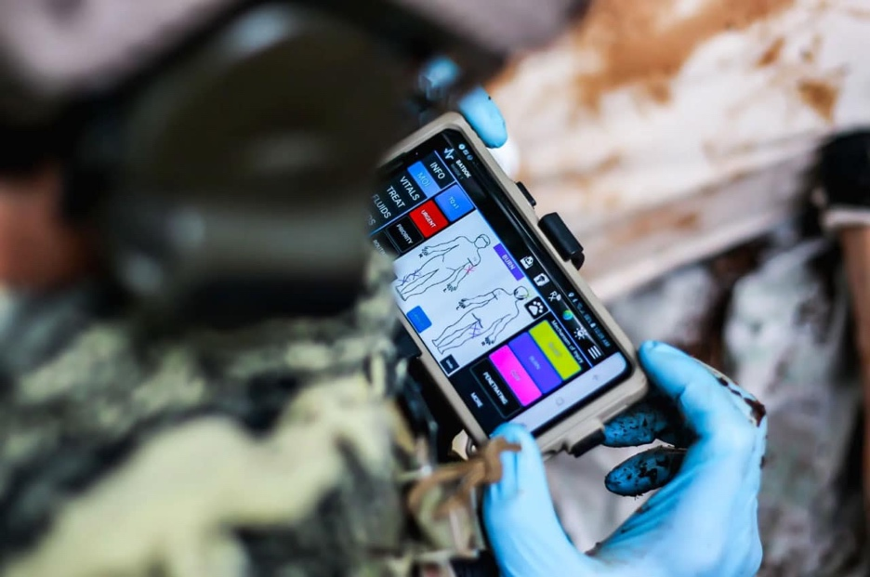
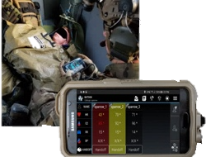
The medical support to great power competition needs actionable healthcare data.
Point of Injury
Great Power Competition: Precision and Healthcare Data
Enhanced Data workflows through the continuum of care
Data availability for OpMed Care
Theater care data transmission/reliability
MedCOP – Medical Common Operating Picture
Trusted Data allows for AI Capabilites
Patient Movement
Trust in data is paramount to increased efficiency, optimized training experiences, improved patient outcomes.
Cyber Triad for medical data must have Integrity, Confidentiality, and Availability
15
Future: AI Monitoring
Notes:
Operational Medicine needs accurate data
Service Data and Information priorities must be advanced, whether TriService or not
Trusting the Data sources is paramount
Data Integrity and Data Quality achieve that trust
Great Power Competition
Needs readiness Data and healthcare data
Foundational for Precision
Predictive Analytics key for flexibility in AFFORGEN
Data Quality and Data Integrity essential for precision decisions
Supports best use of medics time, sets & reps, and efficient healthcare
Enterprise reporting tools
Flatten Data access, more exposure to more healthcare team members
Elevate the Data Culture by increasing buy in from Leaders Top Down to improve workflows and Data Quality
Leverage existing technologies, like PARATUS
Tackles the admin burdens for healthcare teams and patients.

Slide 16
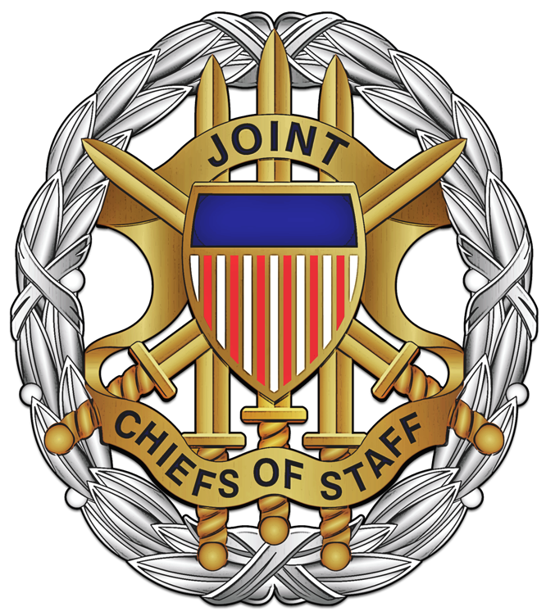
Brig Gen John Andrus
Joint Staff Surgeon

Slide 17
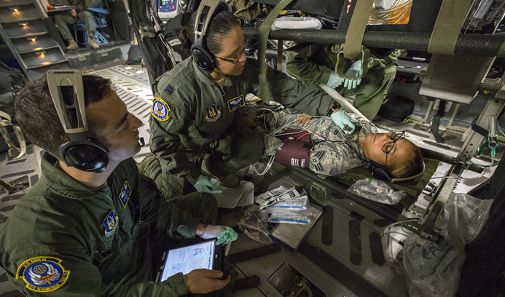
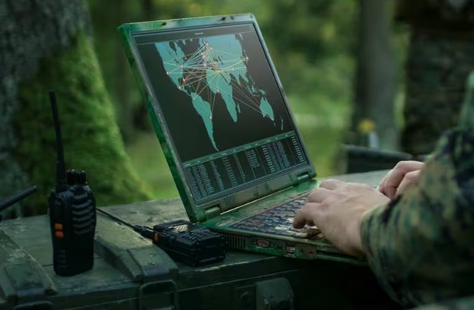
Data Quality: Why It Matters
Joint Staff Surgeon Perspective
Medical Concept of Operations
Accurate, timely data
Inform decisions
OpMEDIT
Digital transformation of MHS
Emerging AI
Interoperability of data systems (Ground, Air, Sea)
Patient Management
Patient Movement
Surveillance of Occupational & Environmental Health concerns
disease surveillance, outbreak detection, and public health research
Medical Logistics
Supply chain management
John R. Andrus, MD, MPH
Brigadier General, USAF, MC
Joint Staff Surgeon
Notes:
Currently, MHS Readiness data is captured via variety of sources including theater information systems, Service Readiness systems (including MODS) and MHS GENESIS (garrison) then shared through the MHS Information Portal (MODS sends data to Army Vantage and to OSD Advana via MHS Information Portal)
Shared information is used for variety of initiatives that advance Soldier readiness and health including Army's Holistic Health and Fitness (H2F) program
Opportunities for exploiting data access and sharing include:
Further integration of electronic health data between DOD-VA
Facilitating access to data through modernized policies, processes, and technical solutions in accordance with DoD and Service Modernization Strategies

Slide 18
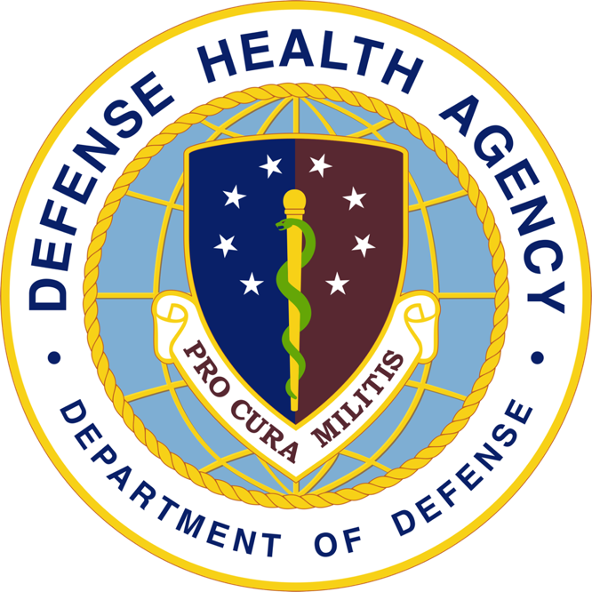
Dr. Brian Lein
Assistant Director, Healthcare Administration Defense Health Agency

Slide 19
Data for DHA
This is a headline set in Arial with Bold formatting.
Workload-What is an FTE?
Access
Quality
Outcomes
MHS G Optimization
Human Capital Management
Implications for AI/ML
Patient Monitors
This is a sub-headline set in Palatino Regular
This is your body copy text in Arial Regular

Slide 20
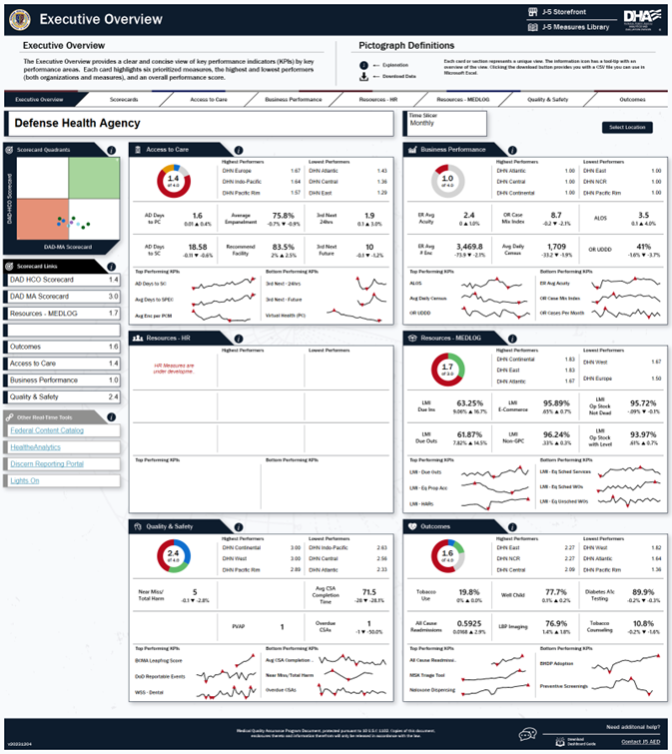
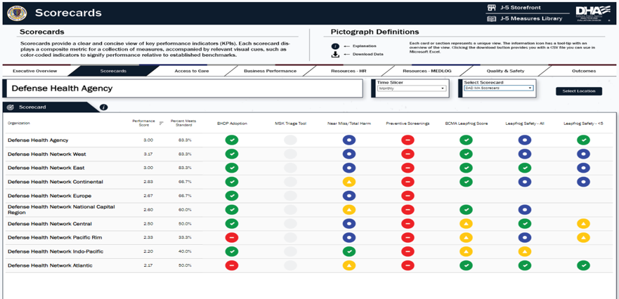
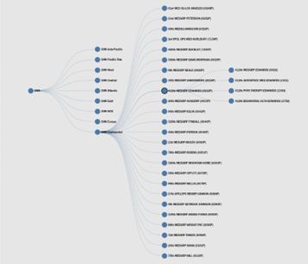
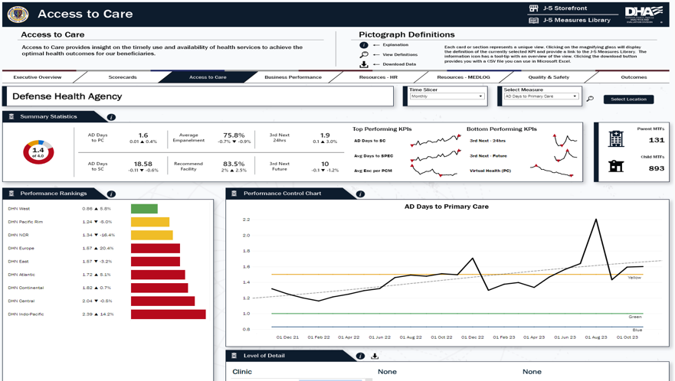
Dashboard Data
Domain-Based KPIs
Scorecards & Analytic Tools
Available to All Levels
Notes:
Currently, MHS Readiness data is captured via variety of sources including theater information systems, Service Readiness systems (including MODS) and MHS GENESIS (garrison) then shared through the MHS Information Portal (MODS sends data to Army Vantage and to OSD Advana via MHS Information Portal)
Shared information is used for variety of initiatives that advance Soldier readiness and health including Army's Holistic Health and Fitness (H2F) program
Opportunities for exploiting data access and sharing include:
Further integration of electronic health data between DOD-VA
Facilitating access to data through modernized policies, processes, and technical solutions in accordance with DoD and Service Modernization Strategies

Slide 21
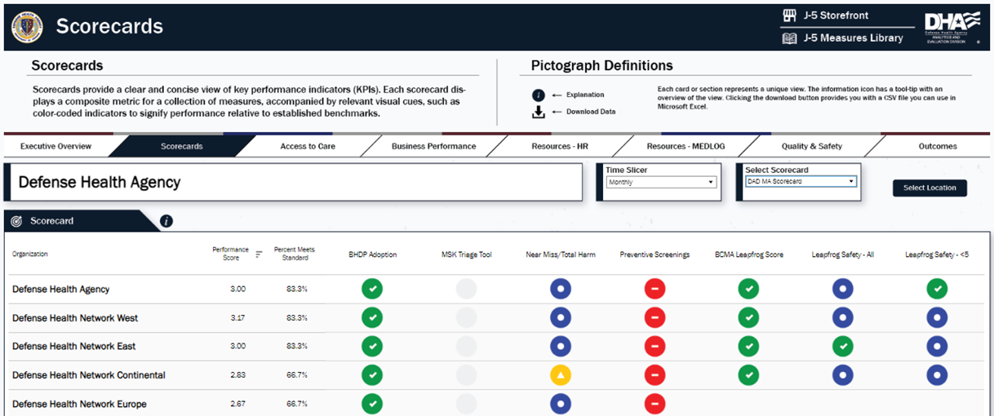
Dashboard Data
Notes:
Currently, MHS Readiness data is captured via variety of sources including theater information systems, Service Readiness systems (including MODS) and MHS GENESIS (garrison) then shared through the MHS Information Portal (MODS sends data to Army Vantage and to OSD Advana via MHS Information Portal)
Shared information is used for variety of initiatives that advance Soldier readiness and health including Army's Holistic Health and Fitness (H2F) program
Opportunities for exploiting data access and sharing include:
Further integration of electronic health data between DOD-VA
Facilitating access to data through modernized policies, processes, and technical solutions in accordance with DoD and Service Modernization Strategies

Slide 22
Rear Admiral Rick Freedman
Deputy Chief, Bureau of Medicine and Surgery
Deputy Surgeon General of the Navy
Director, Medical Resources, Plans and Policy Division, N0931, Office of the Chief of Naval Operations

Slide 23
Navy Medicine Driving Factors
“We will prioritize the readiness and capabilities required to fight and win at sea, and the logistics and shore support required to keep our Navy fit to fight. We recognize that we will never fight alone. We will advance naval integration with the Marine Corps and synchronize and align our warfighting efforts with the Joint Force. We will design and drive interoperability with our Allies and partners to deliver combined lethality.”
Admiral Lisa M. Franchetti, 33rd Chief of Naval Operations
Get Real is about having the courage to self-assess, to build teams that embrace honest, hard, transparent looks at our performance to understand our actual strengths and shortcomings. We must be our own toughest critics.
Get Better is about a commitment to improve, to be self-correcting. It’s about taking pride in high standards and fixing problems together when they’re small, before they grow large and complex. It’s about applying proven methods to get after the things that matter most, in a focused and disciplined way, and not by just adding activity.
Surgeon General’s Executive Rudder
Our North Star: By 2027, Navy Medicine will deliver agile, scalable, trained, and certified medical units to provide enduring support to the Fleet, Fleet Marine Force, and Joint Forces in high-end competition, crisis, and combat. Navy Medicine will be organized to facilitate all phases of Force Development, Force Generation, Force Preservation, and full restoration of the warfighter.
Mission: As a Maritime Medical Force, we develop and deliver manned, trained, equipped, maintained, and certified medical forces that force develop, generate, and preserve the Naval human weapon system.
Line of Effort (LOE) 1: Deliver Expeditionary Medicine Systems (EXMEDS).
LOE 2: Increase Sailor and Marine Deployability.
LOE 3: Provide Quality Healthcare and Patient Safety Programs Across the Naval Force.
LOE 4: Recruit and Retain Navy Medicine Shipmates.
Notes:
Currently, MHS Readiness data is captured via variety of sources including theater information systems, Service Readiness systems (including MODS) and MHS GENESIS (garrison) then shared through the MHS Information Portal (MODS sends data to Army Vantage and to OSD Advana via MHS Information Portal)
Shared information is used for variety of initiatives that advance Soldier readiness and health including Army's Holistic Health and Fitness (H2F) program
Opportunities for exploiting data access and sharing include:
Further integration of electronic health data between DOD-VA
Facilitating access to data through modernized policies, processes, and technical solutions in accordance with DoD and Service Modernization Strategies

Slide 24
The Key to Decision Advantage Outcomes
NAVMED Data Transformation Strategy includes key aspects from DoD Analytics & AI Adoption Strategy Deliver Decision Advantage Outcomes
Notes:
Currently, MHS Readiness data is captured via variety of sources including theater information systems, Service Readiness systems (including MODS) and MHS GENESIS (garrison) then shared through the MHS Information Portal (MODS sends data to Army Vantage and to OSD Advana via MHS Information Portal)
Shared information is used for variety of initiatives that advance Soldier readiness and health including Army's Holistic Health and Fitness (H2F) program
Opportunities for exploiting data access and sharing include:
Further integration of electronic health data between DOD-VA
Facilitating access to data through modernized policies, processes, and technical solutions in accordance with DoD and Service Modernization Strategies

Slide 25
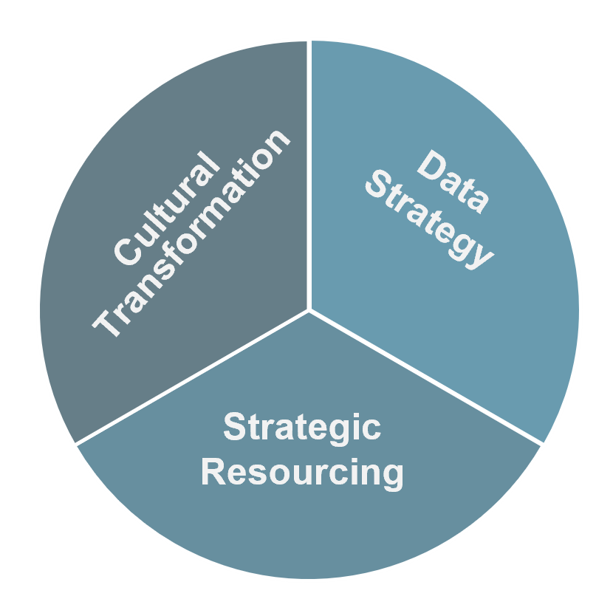
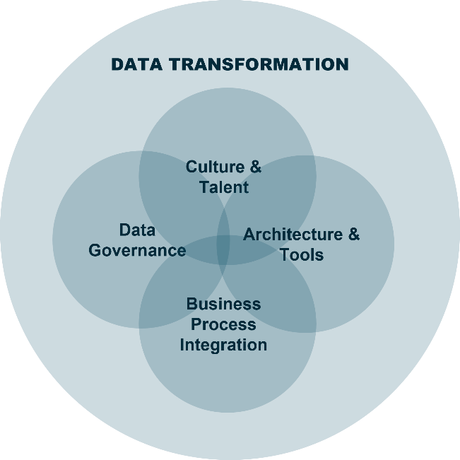
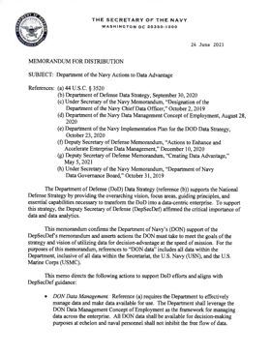
Navy Medicine Data Transformation
Data Transformation
… is a critical priority
… and an extreme challenge.
Creating a data-driven culture for decision advantage at speed of mission
Failure introduces risk to the SG’s primary mission to improve warfighter survivability contributing towards achieving military advantage
70-90% of similar efforts fail to achieve performance goals
Success will require Navy Medicine’s full commitment, starting with executive leadership engagement.
Notes:
Currently, MHS Readiness data is captured via variety of sources including theater information systems, Service Readiness systems (including MODS) and MHS GENESIS (garrison) then shared through the MHS Information Portal (MODS sends data to Army Vantage and to OSD Advana via MHS Information Portal)
Shared information is used for variety of initiatives that advance Soldier readiness and health including Army's Holistic Health and Fitness (H2F) program
Opportunities for exploiting data access and sharing include:
Further integration of electronic health data between DOD-VA
Facilitating access to data through modernized policies, processes, and technical solutions in accordance with DoD and Service Modernization Strategies

Slide 26
Navy Medicine’s Data Transformation Need
Medical Readiness Vignette
Navy Family Physician in a remote Naval Branch Clinic of China Lake, CA is screening a Marine and his family for orders to Okinawa, Japan. The Marine has is being cleared as Fully Deployable today after a shoulder surgery 9 months ago. The spouse has been stable on an SSRI for 1 year after a diagnosis of Post-Partum/Major Depression 18 months ago. Their two year-old daughter has no issues.
In three 20 min appointments (1 hour) the Family Physician and their support staff must complete the following.
MHS GENESIS encounters on all three patients
(LIMDU) SMART – Return to Full Duty
electronic NAVMED Form 6100/6
Overseas Suitability Screenings on all three patients (2 paper forms each)
Paper NAVMED Form 1300/1 – Medical, Dental, Educational Suitability Screenings
Paper NAVMED Form 1300/2 – Medical, Dental, Educational Suitability Screening checklist & worksheet
Email Naval Hospital Okinawa (NHO) to review the positive findings of mental health history for the spouse to ensure that they can support.
Once NHO agrees to accept the patient, sign all paperwork (6 paper forms) and ensure communicate to the Service Member and Family Members to pick up their paperwork.
Gaining and losing command receive notice of recommendations of medically suitability for the assignment once Marine returns the paperwork to their personnel shop.
Notes:
Currently, MHS Readiness data is captured via variety of sources including theater information systems, Service Readiness systems (including MODS) and MHS GENESIS (garrison) then shared through the MHS Information Portal (MODS sends data to Army Vantage and to OSD Advana via MHS Information Portal)
Shared information is used for variety of initiatives that advance Soldier readiness and health including Army's Holistic Health and Fitness (H2F) program
Opportunities for exploiting data access and sharing include:
Further integration of electronic health data between DOD-VA
Facilitating access to data through modernized policies, processes, and technical solutions in accordance with DoD and Service Modernization Strategies

Slide 27
Joint Medical Readiness Data Vision
Requires Six total MTF accessed DoD medical readiness systems
MODS → Army
MEDCHART → National Guard
ASIMS → USAF/USSF
MRRS → USN/USMC/USCG
(LIMDU) SMART → USN/USMC
EHA → USN/USMC/USCG
PARATUS: Profiling And Readiness Action Tracking Unified System
Medical Readiness connected to provider EHR Workflow
Introduces Clinical Decision Support for Readiness Processes
Removes Double-Documentation and improves data quality
MHS GENESIS
JOMIS EHRs
Profiles
IMR
Waivers
Etc.
Healthcare Delivery
Medically Ready Force
DHA
Medical Readiness Support
Navy
USMC
Army
Air Force
Coast Guard
Services Medical Readiness Functions
Centralized Medical Readiness Data
Commander’ information
Deployment
PCS
Supports CCMD missions
Single source of truth

Slide 28
Q & A

Slide 29
How to Claim CE Credit
If you would like to receive continuing education credit for this activity, please visit:
amsus.cds.pesgce.com

Slide 30
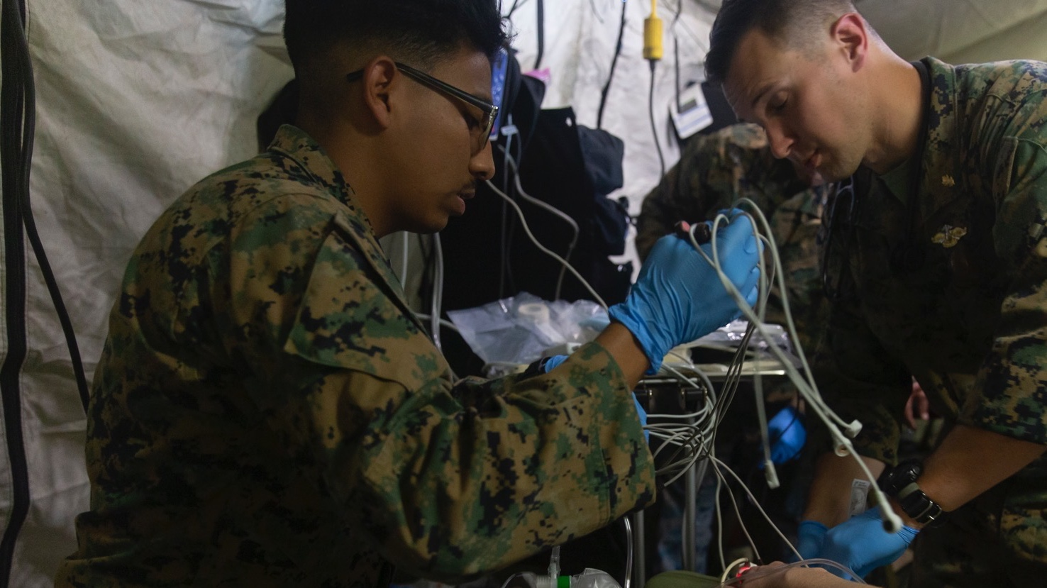
Thank You

