Slide 1
Veterans Health Administration: Strategic Innovation
AMSUS February 2024
Carolyn Clancy, MD, MACP Assistant Under Secretary for Health Discovery, Education, and Affiliate Networks
Susan Kirsh, MD, MPH, CMQ
Deputy Assistant Under Secretary for Health Discovery, Education, and Affiliate Networks
Amanda Lienau, PhD Director of Open Innovation, VHA Innovation Ecosystem
Office of Healthcare Innovation and Learning
Haipeng “Mark” Zhang, DO, MMSc, FAMIA
Chief Innovation Officer
Office of Healthcare Innovation and Learning

Slide 2
Discovery, Education, and Affiliate Networks
Educating current and future Health Care Professionals for VA and the Nation
Improving Veterans’ lives with investigative medical research and evidence-based discovery and innovation;
Collaboration with industry, non-profits, and other Government agencies to provide innovative solutions to systematic issues related to Veterans healthcare services.
Office of Research and Development
Office of Healthcare Innovation and Learning
Office of Academic Affiliations
Healthcare Advancement and Partnerships

Slide 3
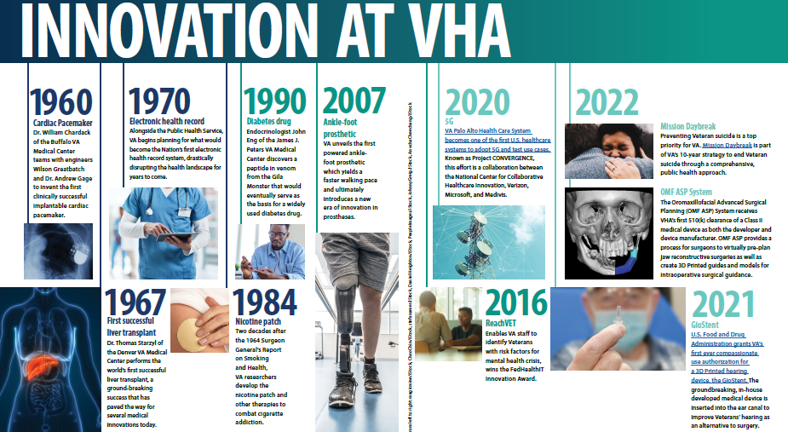
Cardiac Pace-maker
Electronic Health Record
Ankle-foot Prosthetic
5G-enabled Health Care System
Mission Daybreak
3D Printing for Advanced Surgical Planning
Nicotine Patch
Liver Trans-plant
REACHVet
First-ever Compassionate Use Authorization for 3D Printed GioStent
Notes:
History of innovation:
Clinically successful implantable cardiac pacemaker
Liver transplant
Nicotine patches
So far in the 21st Century:
Powered ankle-foot prosthetic
Compassionate use authorization from FDA for a 3D printed hearing device
Leader in clinical implementation of immersive technology (e.g. virtual reality)

Slide 4
Office of Healthcare Innovation and Learning
OHIL bring together health care innovators and educators
to drive transformational change in Veteran health care.
Center for Care and Payment Innovation
Office of Advanced Manufacturing
Simulation Learning, Evaluation, Assessment, and Research Network
Strategic
Initiatives Lab
VHA Innovation
Ecosystem
CCPI builds and leverages diverse coalitions to identify, test, and scale system innovations that address care, policy payment, and resource allocation in VA.
OAM guides the use of advanced manufacturing technologies like 3D printing in health care applications across VHA.
SimLEARN is VHA’s program for simulation in health care training. It provides an ever-growing body of curricula and tools that improve Veteran well-being through simulation-based innovation and emerging technologies.
Strategic Initiatives Lab (Strat Lab) supports VA by taking on early and emerging innovations with both a high risk for failure and high potential for impact.
VHA IE is the catalyst for enabling the discovery and spread of mission-driven health care innovation to advance care delivery and service that exceeds expectations, restores hope, and builds trust within the Veteran community.
Program Reach
11 Employees at 8 VA Sites
Programs at 13 VA Sites
Program Reach
3 Employees, 6 Hub Sites
Producing for 7 VISNs and the VA Central Dental Laboratory
Program Reach
62 Employees
Education Collaborations (SLICE Cells) at 70 VA Sites.
Program Reach
3 Employees at 2 VA Sites
Programs at 174 VA Sites
Program Reach
23 Employees
41 iNET Sites and 4 Centers
Innovations at 160+ VA Sites

Slide 5
OHIL Accomplishments in 2023
Office of Advance Manufacturing (OAM)
VHA's first two FDA 510k-cleared products released to market
Assistive Therapy Design Library launched with NIH
FDA Compassionate Use approval for two customized products
Simulation, Learning, Evaluation, Assessment, and Research Network (SimLEARN)
Updated the Hospital Design Guide, mitigating facility design issues, enhancing Veteran health care and ensuring future cost savings
Vetted and implemented Ceribell, to enable early seizure activity detection
SimVET is actively supporting the AI Tech Sprints, in concert with NAII, Strat Lab, and Office of Primary Care
Center for Care and Payment Innovation (CCPI)
Launched 8 Value-Based Care Centers
Designed and launched a Diabetes Care Management Pilot with several Iowa City VAMC CBOCs and a Respiratory Care Pilot with Charleston VAMC
Innovation Ecosystem (IE)
Implemented PACT PT at 73 VAMC serving over 38k Veterans (12.5k rural Veterans)
Launched the VA Intrapreneurial Product Marketplace to showcase iNET-funded products and kicked off 4 pilots with Mission Daybreak winners
Delivered more than 850,00k Uber/Lyft rides to Veterans in 165 VAMCs
Strategic Initiatives Lab (StratLab)
Deployed 550 virtual reality headsets across 75 sites to help address chronic pain (more than 3000 headsets deployed total)
Expanded VA Immersive engagement to more than 2300 staff across 170 VA facilities
Interagency collaboration
Notes:
OAM)
VHA's first two FDA 510k-cleared products released to the market: the OMF ASP System (March 2023) and the Radiotherapy Bolus (April 2023).
Assistive Therapy Design Library launched August 2023 with NIH. This online repository of assistive technology devices and fabrication instructions allows labs inside and outside the VA to produce commonly requested AT devices.
FDA Compassionate Use approval from for two customized products, the Nose Cone and the Tracheoesophageal Prosthesis, received and were delivered to separate patients in August 2023.
Simulation, Learning, Evaluation, Assessment, and Research Network (SimLEARN)
With the support of VEO, SimLEARN collaborated with surgical teams, architects, and Veterans to update the Hospital Design Guide, mitigating facility design issues, enhancing Veteran health care and ensuring future cost savings.
SimLEARN facilitated the vetting and implementation of Ceribell products, which detect early seizure activity. Collaboration with VA Neurology ensured effective integration into practice.
SimVET explored AI-driven dictation software to reduce VA provider burnout. 20+ simulations led to active support for a Tech Sprint Challenge, which aims to bring this technology to providers.
Center for Care and Payment Innovation (CCPI)
CCPI launched Value-Based Care Centers in 8 initial sites, focusing on strategic projects to improve Veteran health outcomes.
CCPI designed and launched the Diabetes Care Management Pilot in November 2023 in several CBOCs at the Iowa City VAMC in VISN 23.
CCPI designed and launched its Respiratory Care Pilot in January 2024, with an initial cohort of Veterans at the Charleston VAMC.
Innovation Ecosystem (IE)
DOE implemented PACT PT at 73 VAMCs (47 more in progress), served over 38k Veterans (12.5k rural Veterans), and with SimLEARN partnership, trained 67 clinicians representing 17 VISNs.
Launched the VA Intrapreneurial Product Marketplace to tell the story of frontline VA employees who are changing and saving Veteran lives through their iNET-funded products.
In partnership with VHA Office of Suicide Prevention, executed Mission Daybreak, a $20M grand challenge to prevent Veteran suicide, and kicked of 4 pilots with winning solver teams.
Delivered more than 850,00k Uber/Lyft rides to Veterans in 165 VAMCs throughout the country in order to eliminate transportation as a social determinate of health during COVID.
Strategic Initiatives Lab (StratLab)
In early 2023, VA Immersive launched an at-home program, issuing 250 devices in 3 months, and is looking to build this program further in 2024.
VA Immersive partnered with OMHSP to deploy 300 headsets to mental health and non-mental health providers across 60 sites to address chronic pain and suicide prevention.
VA Immersive is now active in over 170 VA facilities and has issued 3,000 headsets around the country.

Slide 6
OHIL and Under Secretary for Health Alignment
OHIL 2024 GOALS
Under Secretary for Health PRIORITIES
Advance care outside the hospital walls
Connect Veterans to the soonest and best care
Foster personalized health care solutions
Connect Veterans to the soonest and best care
Build and empower the health care workforce of the future
Hire faster and more competitively
Forge the path for systemic, value-based care
Accelerate VA’s journey to a High Reliability Organization
Create sustainable health care for the Nation’s Veterans and
generations to come
Support Veterans’ whole health, their caregivers, and survivors

Slide 7
Strategy One: Validation, Evaluation, and Testing

Slide 8
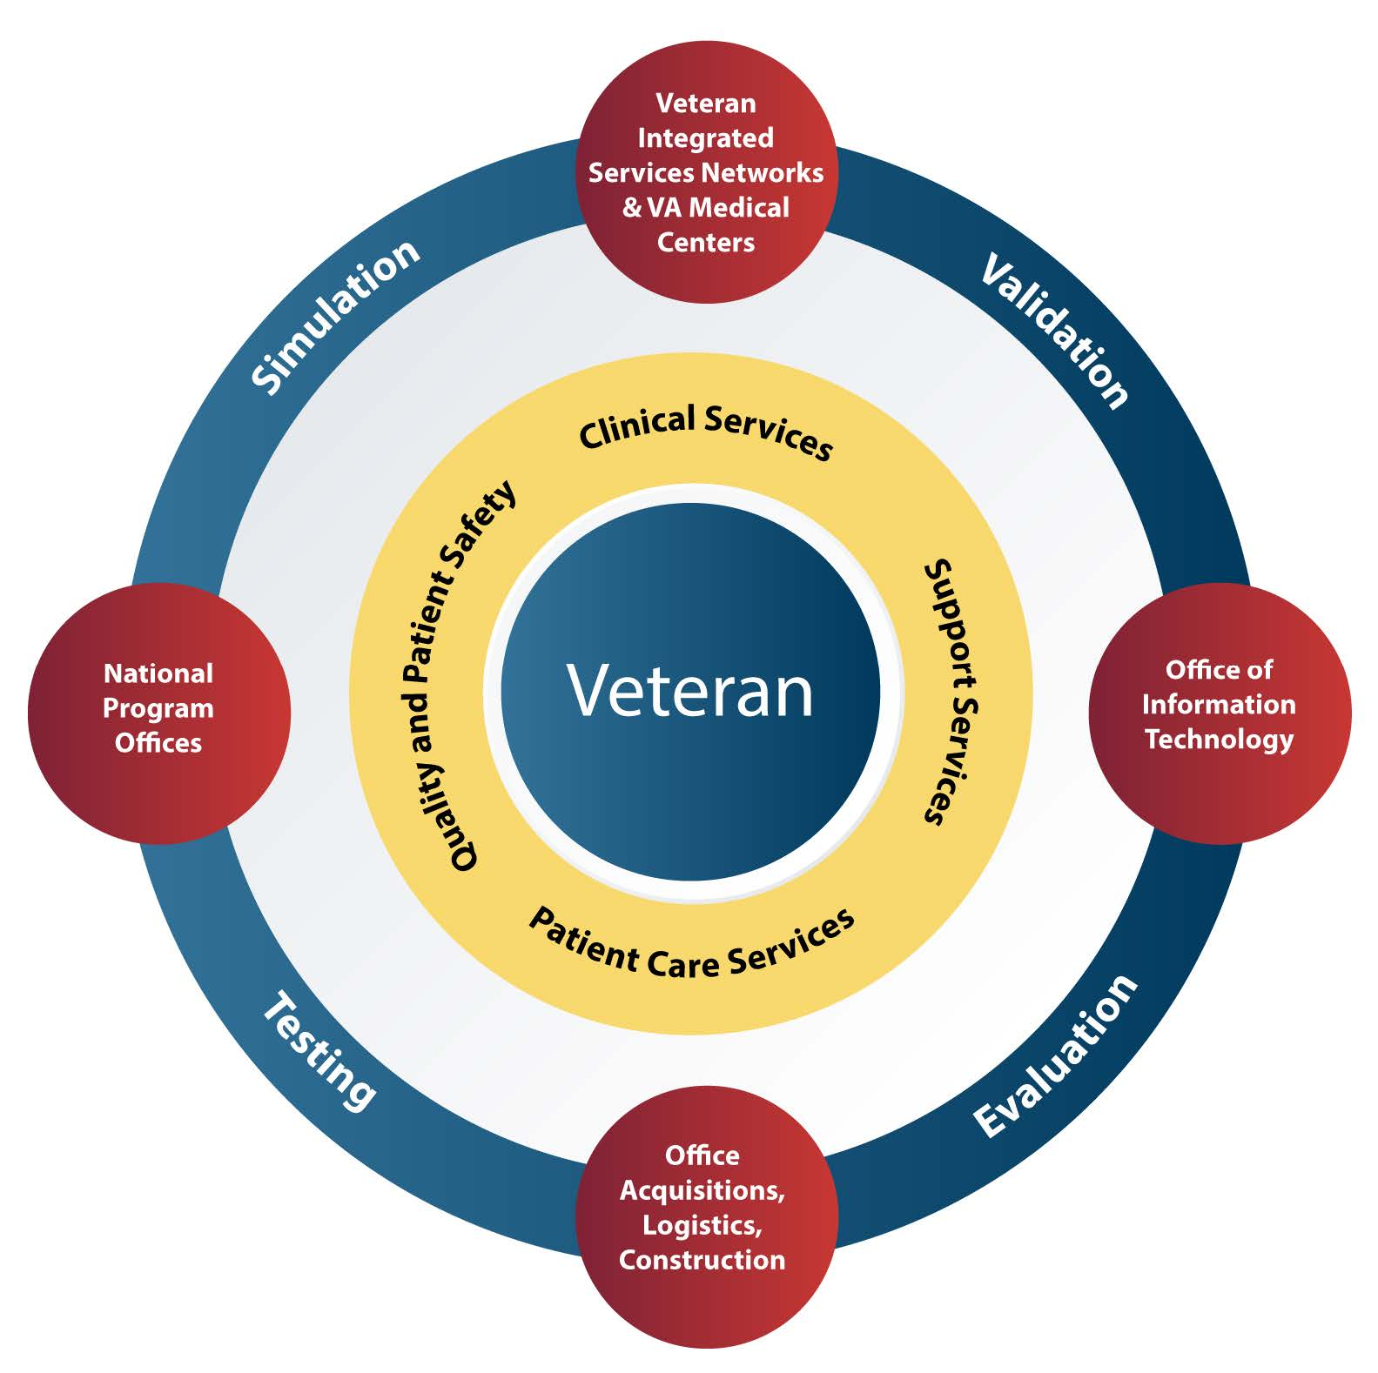
Simulation, Validation, Evaluation, and Testing Model
Simulation, Validation, Evaluation, and Testing (SimVET) is an emerging innovative model and service sponsored by SimLEARN
Validate health care solutions in a fail-safe simulated clinical environment
Ensure nothing touches a Veteran until it is proven safe and effective

Slide 9
Why Simulation?
Simulation is a useful tool with a variety of applications, particularly in the military context
Since World War II, pilots have conducted flight simulations in cockpits to prepare for deployment
Since the 1990s, the Army used clinical simulation as a core element in training combat medics in pre-hospital trauma care to improve survivor outcomes
Military service members go into harm’s way; Veterans should not
Veterans understand the critical role simulation plays, from first-hand experience
Simulation greatly reduces the chance for harmful events that result from new health care solution implementation

Slide 10
Challenges to Simulation as a Service
CAUSE
Lack of a centralized and streamlined process to vet technology
EFFECT
Limitations in supporting the VHA’s mission to provide cost-effective, reliable, world-class health care for Veterans
CAUSE
Lack of standardized technology evaluation systems
EFFECT
Interoperability challenges, potential patient safety hazards, clinical workflow disruptions, and an inefficient use of resources

Slide 11
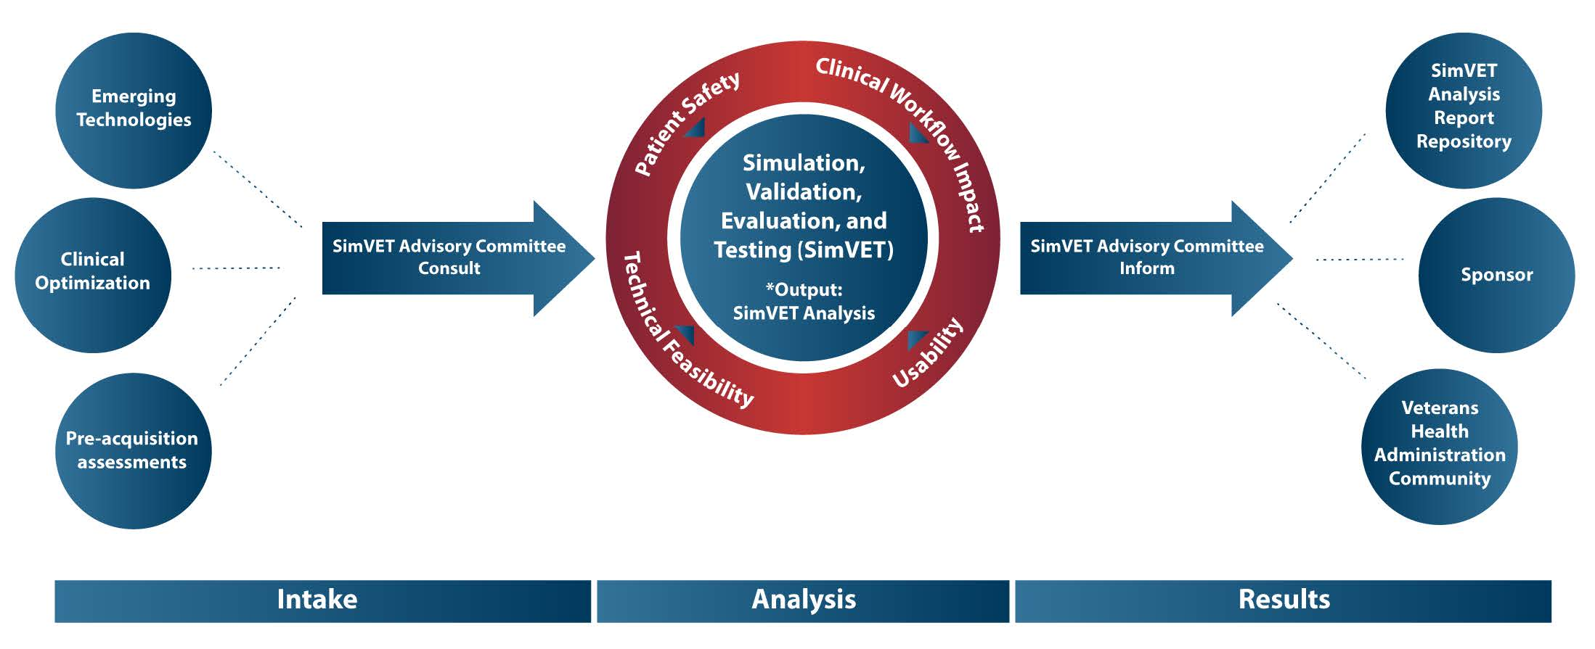
The SimVET Approach

Slide 12
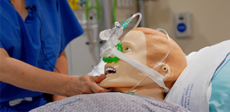
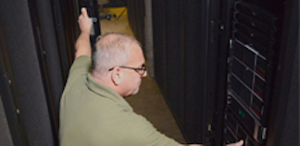
What SimVET Achieves
Reproducible Process
Simulation Environment
High Reliability
Comprehensive Analysis
Implementation Guidance
Resource Library

Slide 13
Strategy Two: Intra-agency Collaboration

Slide 14
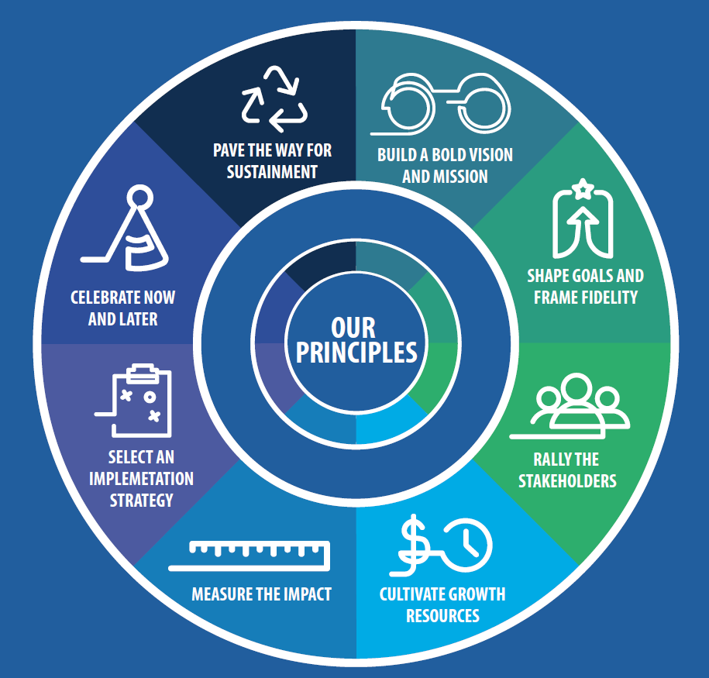
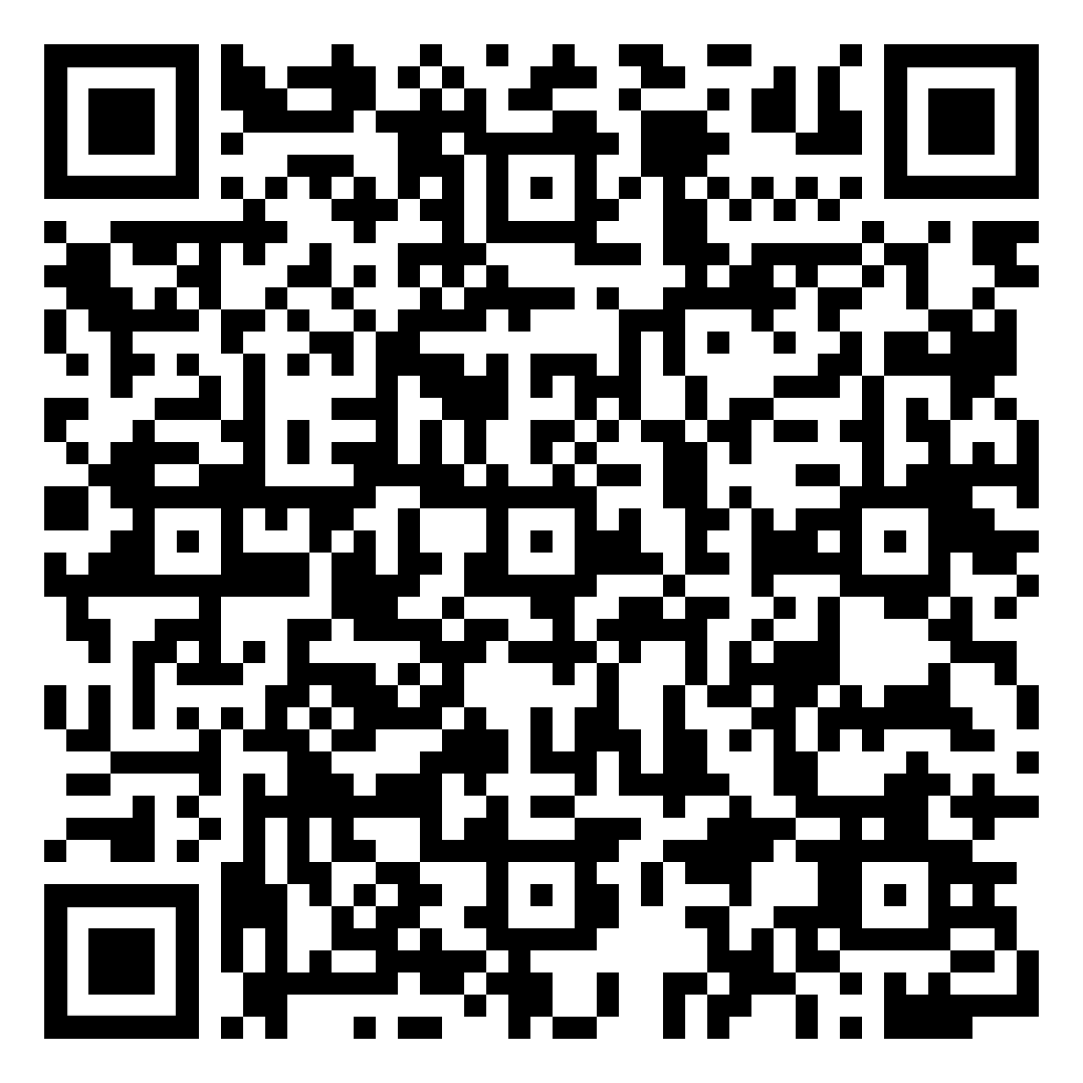
Diffusion Principles
Diffusion Playbook
Notes:
Diffusion of Excellence’s secret sauce is a blend of widely applied concepts from the start-up work, implementation science, and human psychology. These principles are a lens to constantly examine how to best support innovators from the facility level to the broader national scale. These Diffusion Principles are key fundamentals that inform all Diffusion efforts.
If you would like to learn more about the Diffusion Principles or Diffusion of Excellence, feel free to scan the QR code in the top right corner to visit the Diffusion Playbook.

Slide 15
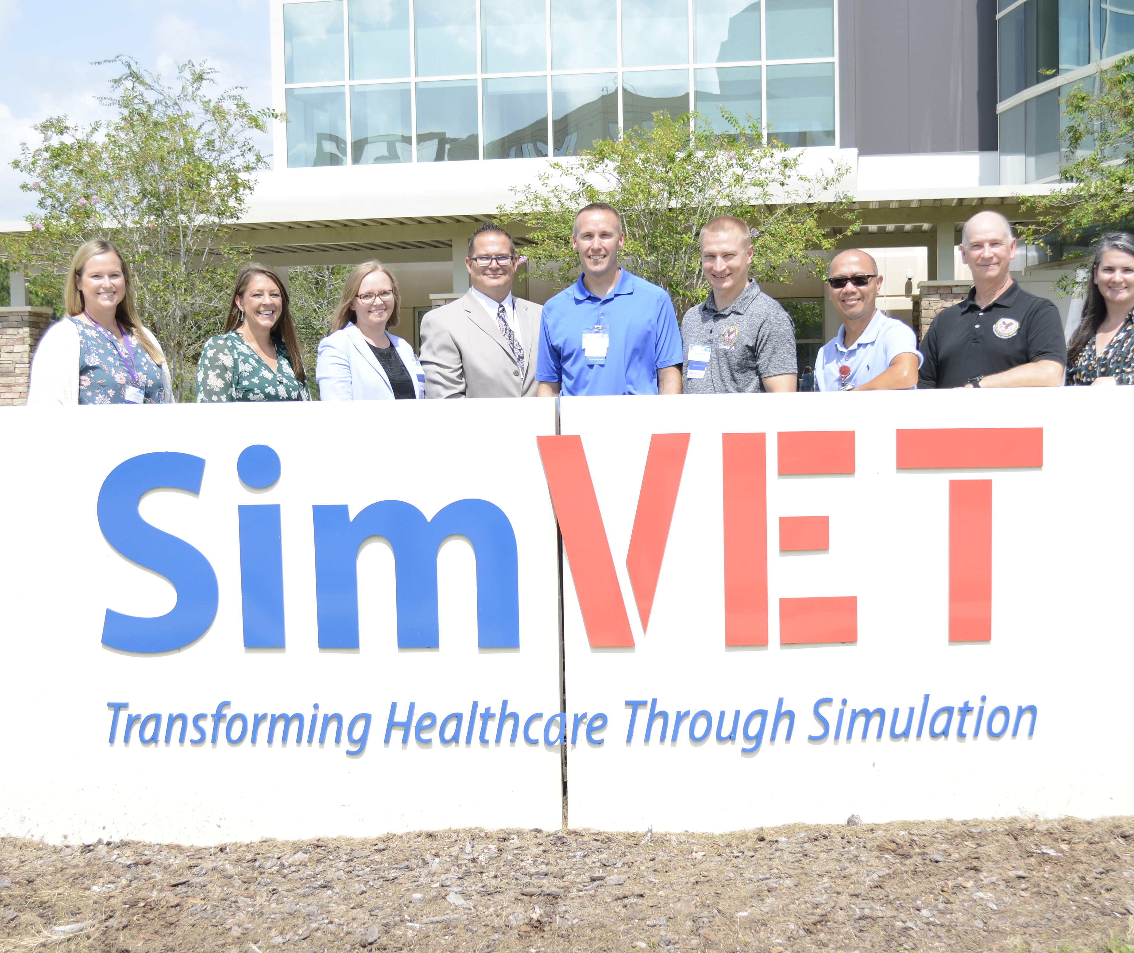
Meet the PACT PT Team
Meet the PACT PT Team
Mark Havran, DPT, ATC, CSCS
Evan Kelly, PT, DPT, OCS, FAAOMPT
Ashley Cassel, PT, DPT, OCS
Amanda Simone, PT, DPT
Brandon Peterson, PT, DPT
Chris Rowedder, PT, DPT
Notes:
Embedding Physical Therapists in Primary Care, or PACT PT, is a model on integrated team care that DOD has been experimenting with for more than 20 years.
PACT PT is spearheaded by a group of physical therapists scattered throughout VISN 23 to include Minneapolis, MN, Sioux Falls, SD, and Des Moines, IA VA Medical Centers. Working with the Physical Therapy Executive for the Office of Rehabilitation and Prosthetic Services, Mark Havran, the group is a 2020 Tank Shark Winner and was selected for National Diffusion in 2022.

Slide 16
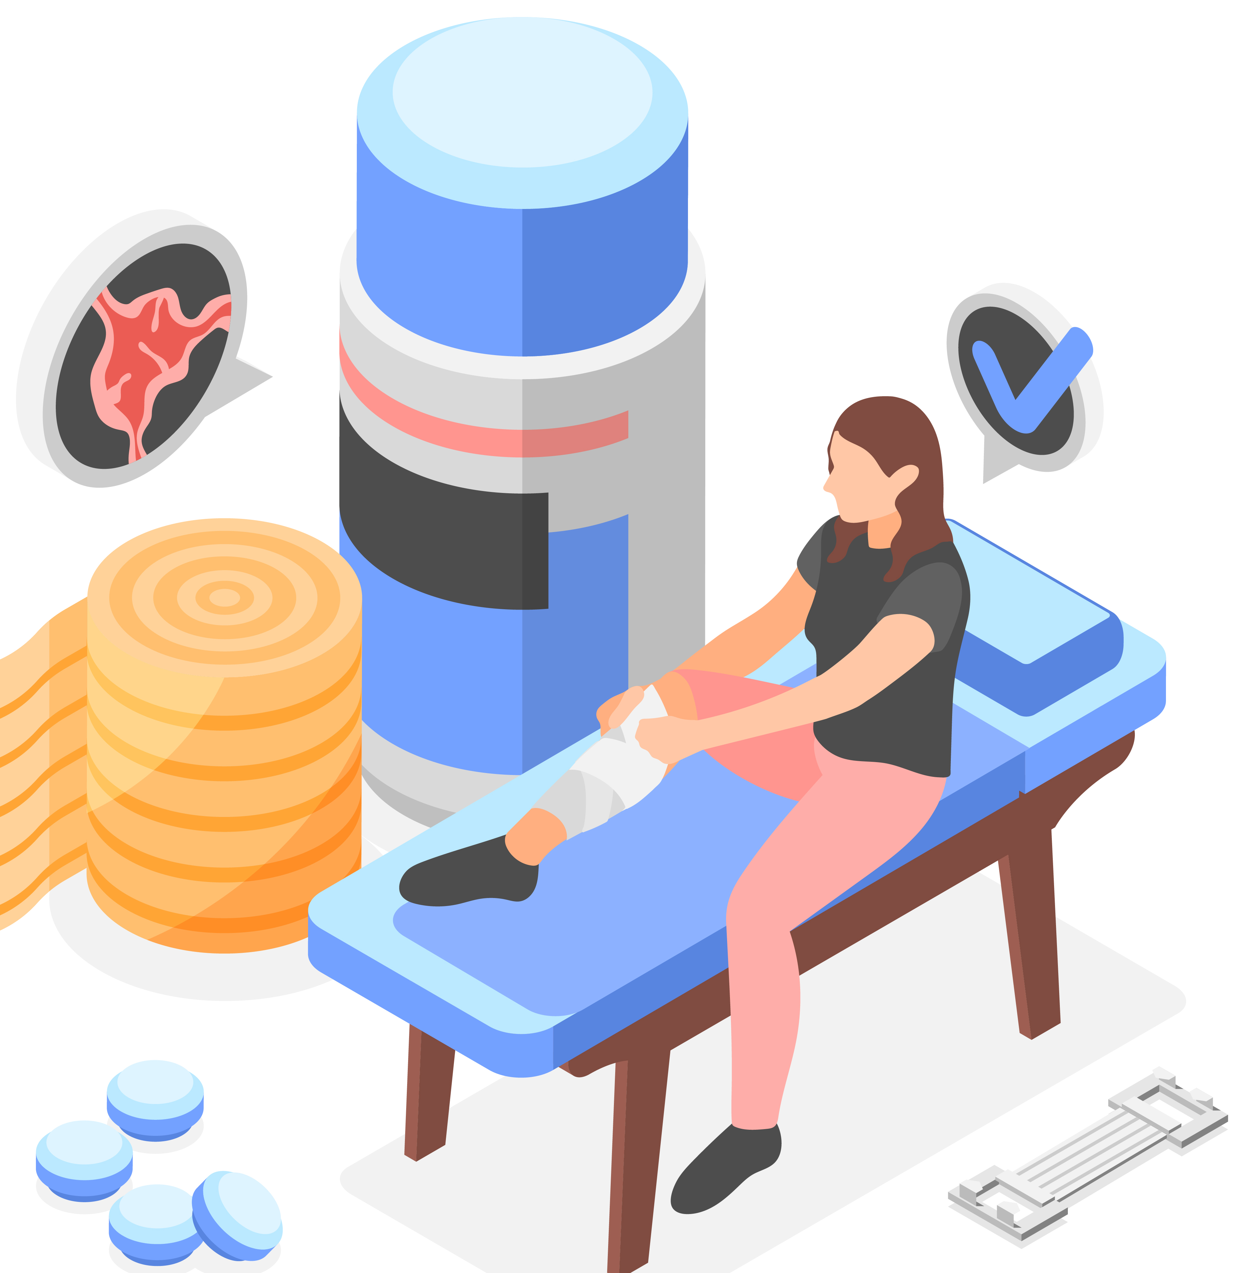
The Problem
40%
Of Primary Care visits are linked to musculoskeletal concerns
20-30 days
To complete care through traditional process
Physical Therapy as a first line treatment is underused
Patients evaluated by a PCP first are more likely to get additional, costly interventions
Notes:
Wu V, Goto K, Carek S, et al. Family Medicine Musculoskeletal Medicine Education: A CERA Study. Fam Med. 2022;54(5):369-375. https://doi.org/10.22454/FamMed.2022.975755.

Slide 17
The Solution
1
PACT PT drives improved access, employee satisfaction, and cost savings
2
Embedded in over 107 sites, with 72 in process, PACT PT is predicted to have an increase of 86% utilization
PRACTICE
IMPLEMENTATION
4
Cost neutral implementation means PACT PT can drive up to $2,200 in costs savings per patient
3
PACT PT services provide same day access increasing convenience and compliance while reducing wait times by 31%
BUDGET
RESULTS
Notes:
Early intervention PT for musculoskeletal complaints has been shown to improve functional outcomes, reduce the incidence of chronic pain, and reduce care costs.
Physical therapists (PTs) play a valuable role in the treatment of neuromusculoskeletal (MSK) conditions​ and leveraging PT as a first line treatment can free up time for PCPS, allowing them to focus on other conditions.
PACT PT’s replication and scaling efforts now has them embedded in 107 VA sites, with an additional 72 sites in process. Their product, same day PT service, reduces wait times for Veterans by 31%. It also has been shown to reduce imaging orders by 77%, pain referrals by 55%, and a 46% reduction in orthopedic and surgical referrals.
Using PTs as a first line treatment can be done cost-neutrally, and PACT PT can drive up to $2200 in cost savings per patient. Bringing back in house just 100 care in the community referrals can pay for a physical therapist.

Slide 18
Diffusion Principles Spotlight
DIFFUSION PRINCIPLE
Rally the Stakeholders
Organizational Sponsorship from seven program offices
DIFFUSION PRINCIPLE
Measure the Impact
Increased access, decreased downstream referrals, dashboard building specific to needs
DIFFUSION PRINCIPLE
Pave the Way for Sustainment
Building coalitions, collecting data to support outcomes, and creating a pipeline of education and training
Notes:
So, what has made this program scale nationally?
There is a multitude of factors, but the organizational support from program offices such as RPS and OPC, collaboration with SimLEARN and the Office of Rural Health to focus on simulation training and rural factors, and the support of VISNs to bring the program into their facilities has enriched this program’s success.
Measuring program impacts as we discussed on the last slide- 31% decrease in wait times, reduction in downstream referrals, and communication of those impacts to our stakeholders has been a key component to the spread of this practice.
Creating implementation guides, hosting community of practice calls, delivering workshops, and building in office hours to network across the enterprise have all been critical to the development of what sustainment will look like for PACT PT.

Slide 19
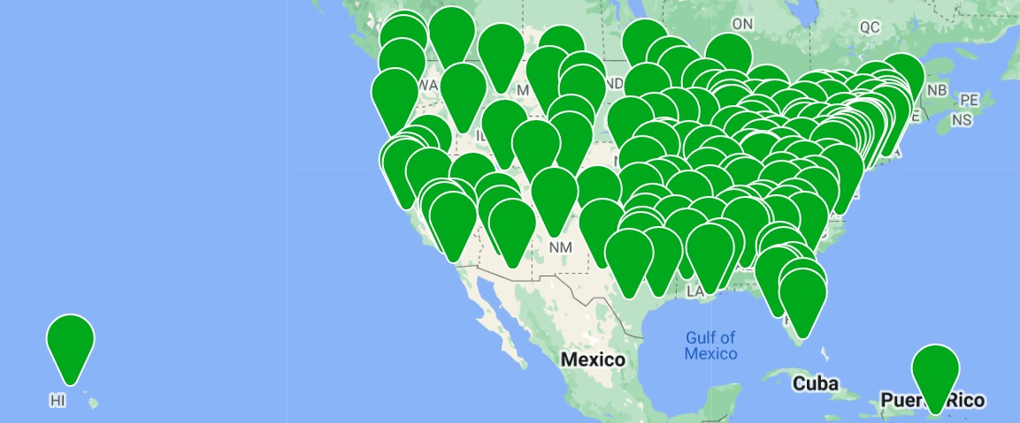
HAPPEN (Hospital Acquired Pneumonia Prevention by Engaging Nurses )

Slide 20
HAPPEN
2016 VHA Shark Tank Competition Winner
155 successful adoptions
2020 Gears of Government Award:
VA wins presidential award for its in-house innovations improving health care services for Veterans - VA News
HAPPEN Diffusion Marketplace Page

Slide 21
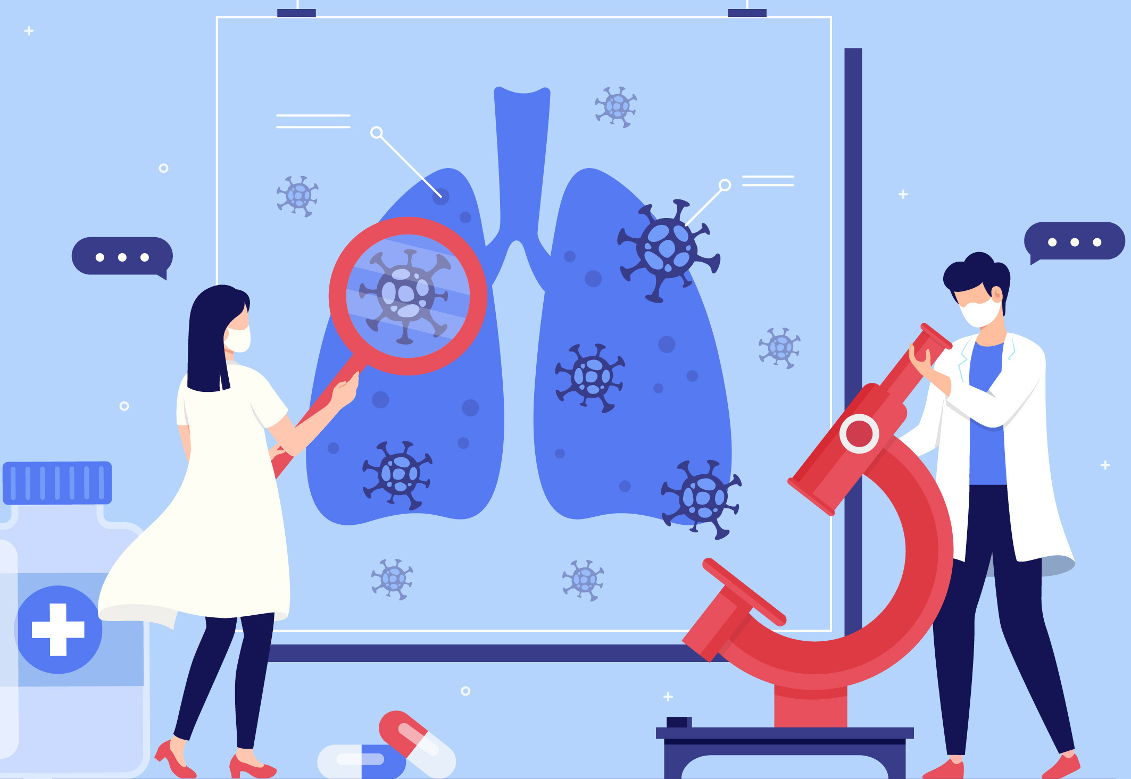
The Problem
4x
Increased mortality rate in the first month after developing NV-HAP (non-ventilator associated hospital acquired pneumonia)
2X
Increase in one-year mortality rate after developing NV-HAP
NV-HAP
A preventable complication associated with increased risk and mortality
All hospitalized Veterans are at risk
Bacteria Aspiration
Bacteria in the mouth is leading source of NV-HAP
Bacteria in the mouth is frequently aspirated in the lungs during sleep
Notes:
Veterans are 4 times more likely to die in the first month and experience twice the one-year mortality rate after developing NV-HAP. All hospitalized patients are at risk, so prevention measures like consistent oral care are essential
Image attributions:
Image by <a href="https://www.freepik.com/free-vector/doctor-examining-patient-clinic-illustrated_12557508.htm#query=hospital%20patient&position=36&from_view=search&track=ais&uuid=277782f7-7b6f-415a-85a4-03833eb64912">Freepik</a>
Image by <a href="https://www.freepik.com/free-vector/coronavirus-pneumonia-concept_7774436.htm#query=pneumonia&position=3&from_view=search&track=sph&uuid=7f6d4dca-06b7-4169-a86d-61b69e26b295">Freepik</a>

Slide 22
The Solution: Prevention
1
Staff provide oral care assistance twice a day during hospital stays
2
40 – 60% decrease in reported cases of NV-HAP in implementing sites
INTERVENTION
RESULTS
4
Each case prevented leads to an average of $100K in savings over 12-months
3
HAPPEN training is highlighted on Diffusion Marketplace and the CDC Oral Health Toolkit
BUDGET
TRAINING
Notes:
Consistent toothbrushing and denture cleaning reduces biofilm in the mouth decreasing the risk of developing hospital acquired pneumonia
HAPPEN improves the health and quality of life of our Veterans by focusing on preventive care; improving access and timeliness of service by reducing patient length of stays; and lowering health care cost.
1) Staff provide patient assistance with oral care a minimum of twice daily during their hospital or long-term care stay. Dentures are cleaned at bedtime.
2) HAPPEN implementing sites have reported declines in NV-HAP of up to 40-60% improving patient safety and quality of life.
3) Each NV-HAP case prevented saves over $100K in 12-month direct healthcare costs on average. Oral care supply costs average less than $5 per patient per stay.
4) Training materials and patient education:
Diffusion Marketplace (va.gov)
https://www.cdc.gov/hai/prevent/Oral-Health-Toolkit.html

Slide 23
Diffusion Principles Spotlight
Overcome challenges to implementation and spread and support long-term sustainment via ongoing education, training, collaboration, and data monitoring
DIFFUSION PRINCIPLE
Pave the Way for Sustainment
Empower frontline staff and leaders to guide continuous process improvements following a value driven framework
DIFFUSION PRINCIPLE
Shape Goals and Frame Fidelity
DIFFUSION PRINCIPLE
Rally the Stakeholders
Defer to the expertise of direct care staff and subject matter experts to provide care that matters to Veterans
Notes:
Here we showcase how HAPPEN utilizes the Diffusion Principles to aid in their success.
They pave the way for sustainment via ongoing education, training, collaboration, and data monitoring
They frame fidelity by following a value driven framework that is put through continuous process improvements by frontline employees and leaders
Finally, they rally their stakeholders by deferring to the expertise of direct care staff and SMEs to provide care that matters to Veterans

Slide 24
Strategy Three: Interagency Collaboration

Slide 25
Relationship Formed in Pandemic
Formed in Pandemic - From the combined Ad Hoc meetings between NIH, FDA and VHA a formalized process was created
MOU was signed in March 25th 2020
During the pandemic VHA produced
Nasal Swabs
Face Masks – Stopgap Face and Clear Talker
Powered Air Purifying Respirator Hood with NIOSH public emergency approval
Face Shields – 50,000 face shields were fabricated and delivered
Collaboration allowed for evaluation of 617 designs submitted to the NIH 3D Print Exchange
VHA/FDA worked to develop testing protocols for nasopharyngeal swabs

Slide 26
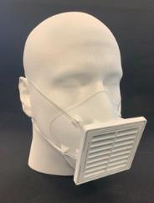
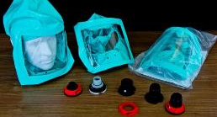
Relationship Formed in Pandemic
Pandemic TRUST - prior Ad Hoc meetings between NIH, FDA and VHA led to a formal inter-agency collaboration to help connect hospitals with 3D printed medical resources & information.
MOU signed March 25th 2020
617 medical products, submitted to NIH 3D Print Exchange, were evaluated by VHA
VHA developed testing protocols for new nasopharyngeal swab designs, and published them on the NIH 3D Print Exchange, following an FDA town hall on 3D printed swabs.
During the pandemic VHA produced
Nasopharyngeal Swabs - 50,000+ swabs were fabricated and delivered
Face Masks – Stopgap Face Mask and Clear Talker Mask, with derivates developed by Army, Navy and commercial entities
Powered Air Purifying Respirator (PAPR) Hood which in collaboration with a blower/filter manufacturer, obtained NIOSH PHE approval. – thousands of hoods delivered to VHA, 85+ PAPRs donated to US healthcare and 200+ for humanitarian efforts in India, Peru, Ethiopia and Africa through collaboration partner.
Face Shields – 50,000 face shields were fabricated and delivered

Slide 27
Continuing the Collaboration
Post Pandemic – Recognizing the value gained from the FDA and VHA a nonemergent partnership has been formed via MOU with the goals of
Accelerating the development, refinement and dissemination of RST geared towards emerging technologies and interoperability, focusing on automation, telemedicine, and personalized healthcare. The colocation of FDA and VHA staff and the sharing of both Parties’ resources will accelerate RST development.
Creating educational training, meetings, outreach materials, and programs to facilitate the implementation and use of tools and best practices surrounding RST.
Fostering a culture of inter-governmental collaboration by placing staff from FDA with VHA in a shared federal space
A second MOU in 2023 was formed with the intent to directly collaborate on digital stockpiles and distributed manufacturing frameworks, sharing information, resources, and subject matter expertise

Slide 28
Continuing the Collaboration
Post Pandemic – Recognizing the value gained from the FDA and VHA, two additional partnership have been formed to:
Develop, refine and disseminate regulatory science tools (RSTs) in emerging technologies and interoperability, focusing on automation, telemedicine, and personalized healthcare – key areas to support Veteran healthcare.
Creating educational training, meetings, outreach materials, and programs to facilitate the implementation and use of tools and best practices surrounding RST.
Fostering a culture of inter-governmental collaboration by placing staff from FDA with VHA in a shared federal space at VA Ventures (Seattle WA).
MOU 225-22-025 | FDA
Develop and pilot a “Digital Stockpile” as well as resilient, distributed manufacturing to protect public health during emergencies, shortages, and pandemics – supporting continuity of Veteran healthcare during crisis.
Develop metrics, validation tools and other standardization protocols to ensure safety and efficacy of products manufactured closer to or at the point of care.
Collaborate with industry, regulatory, logistics, credentialing and healthcare authorities to ensure products of the Digital Stockpile will be clinically trusted.
MOU 225-23-008 | FDA

Slide 29
Strategy Four: Value-based Care Approach

Slide 30
Value-based Care is a Priority
OHIL 2024 GOALS
Under Secretary for Health PRIORITIES
Forge the path for systemic, value-based care
Accelerate VA’s journey to a High Reliability Organization
Focus – How can changes in our healthcare system affect healthcare outcomes and for what unit cost
Intent – Improve rigor around evaluation allowing the organization to make explicit decisions based on evidence
Mechanism – Prioritize interventions that are designed at the health system level with the goal to improve healthcare outcomes while measuring/minimizing cost

Slide 31
Value-based Care Examples
Developing financial incentives for smoking cessation
Value-based care centers
Focused on formal education and system/organizational change
Alignment of financial and clinical care integration
Specialty care demand modeling
Coupled with clinical operations planning and execution

Slide 32
Strategy Five: Open Innovation

Slide 33
Open Innovation can…
Generate inter-departmental leadership support by aligning the Challenge pilot business case with Strategic objectives and establishing the program as worthy of internal advocacy and funding
Incentivize involvement at all levels
Enable leaders to strengthen their offices and workforce by offering awareness, driving a culture of innovation and using internal advocacy to support Challenges as opportunities for professional development
Captivate researchers and field staff by communicating the valuable benefits that participating in Challenges will offer, educating staff on what successful submissions look like, and conveying a sense of excitement and prestige

Slide 34
What is a Challenge?
A Challenge is an innovation competition that shines a spotlight on acute issues and gathers innovators to develop novel solutions.
The Challenge program will harness the expertise of diverse stakeholders, healthcare providers, entrepreneurs, academics, and industry who will lend their distinctive skillset to ensure a better future for Veterans.
34

Slide 35
High-level recommendations for achieving engagement goals:
Stakeholder | Their role in the Challenge Model: | Goals for engagement: | How to engage them:
Inter-Departmental Leadership | Internal advocacy Resource allocation | Generate support by aligning the Challenge pilot business case with VA Strategic objectives and establishing the program as worthy of internal advocacy and funding | Share proof of concept with business case deck
Program Office, Regional, & other Leadership | Internal advocacy Challenge participation | Enable leaders to strengthen their offices and workforce by offering awareness, driving a culture of innovation and using internal advocacy to support Challenges as opportunities for professional development | Blog post(s) Email from Senior Leaders Direct phone calls to Program Office, regional, and other leaders Lead information sessions for their offices
Field Staff & Researchers | Challenge participation | Captivate staff by communicating the valuable benefits that participating in Challenges will offer, educating staff on what successful submissions look like, and conveying a sense of excitement and prestige | Blog post(s) Email from Senior Leaders Email from Program Office and other mailing lists Participation on targeted phone calls

Slide 36
Summary of overarching engagement strategy
Pre-Launch
Identify key stakeholders
Define objectives of Challenge engagement
Create an engagement strategy
Develop messaging
Develop engagement materials
Coordinate with communications offices
Before
Launch broad announcement with appropriate stakeholders
Send an email from Senior Leadership
Host information sessions with staff
Participate in Program Office calls and newsletters
Email notes and reminders to mailing list
During
Email live updates of participant progress to mailing list
Maintain a feedback channel for responses to updates
Address any issues promptly and publicly
Monitor and analyze progress
After
Publicly acknowledge and congratulate participants
Send thank you notes to participants and behind-the-scenes staff
Collect feedback from participants with surveys
Gather testimonials or quotes for future marketing materials
Share a wrap up article on the appropriate communications channels

Slide 37
Open Innovation Examples
PrecisionFDA COVID-19 Challenge
VHA Innovation Ecosystem and precisionFDA COVID-19 Risk Factor Modeling Challenge Phase 1 - precisionFDA Challenge
Mission Daybreak
Home - Mission Daybreak
V-CHAMPS Heart Health Challenge
The Veterans Cardiac Health and AI Model Predictions (V-CHAMPS) Challenge - precisionFDA Challenge

