Slide 1
The Goldilocks Principle: Right-Sizing Health Services Support for the US Marine Corps in Large-Scale Combat Operations
CAPT (Ret) Theodore Edson, MD, FACS, FACRS¹
CAPT Matthew Tadlock, MD, FACS¹
LCDR Justin Beck, MD¹
LCDR Jesse Snider, DO¹
LT Kenneth Marler, DHA, MBA, MS OR²
Medical Corps, US Navy¹
Medical Service Corps, US Navy²
©️ 2023 AffinityCE

Slide 2
Disclosures
The presenters have no relevant financial or non-financial interests to disclose.
This continuing education activity is managed and accredited by AffinityCE, in collaboration with
AMSUS. AffinityCE and AMSUS staff, as well as planners and reviewers, have no relevant financial interests to disclose. AffinityCE adheres to the ACCME’s Standards for Integrity and Independence in Accredited Continuing Education. Any individuals in a position to control the content of a CME activity, including faculty, planners, reviewers, or others, are required to disclose all relevant financial relationships with ineligible entities (commercial interests). All relevant conflicts of interest have been mitigated prior to the commencement of the activity.
Commercial support was not provided for this activity.
©️ 2023 AffinityCE

Slide 3
Learning outcomes
At the conclusion of this activity, participants will be able to:
Better understand the role capability, capacity, and logistical support play in right-sizing Role 2 units to minimize casualty morbidity and mortality while simultaneously providing the Combatant Commanders with maximum flexibility in the future battlespace.
Understand how current capabilities are developed and how real-world experience aligns to better identify gaps and ensure informed risk decisions.
Utilize the clinical data from aviation incidents that mirror expected casualties during Large Scale Combat Operations (LSCO) in the littoral environment to drive the development of future logistical support requirements to maintain surgical resuscitation capability and respond to needs for increased prolonged holding capacity expected when deploying Role 2 units of various sizes in in support of Distributed Maritime Operations (DMO).
Use data from these incidents to determine logistical requirements to sustain “right sized” Role 2 Health Service Support during DMO.
Use data from these incidents to improve the modularity of Role 2 units to support disaggregation and aggregation as needed to meet mission requirements.
©️ 2023 AffinityCE

Slide 4
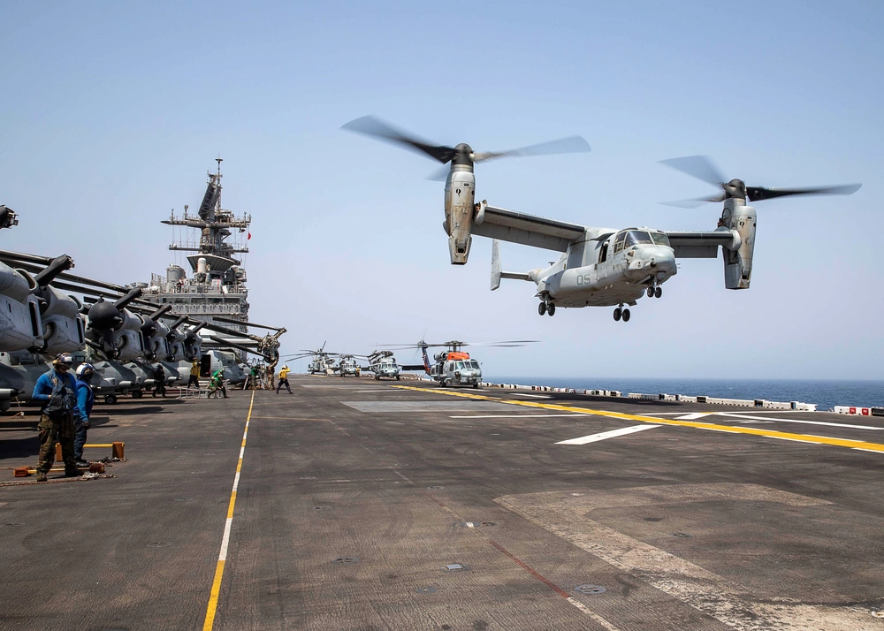
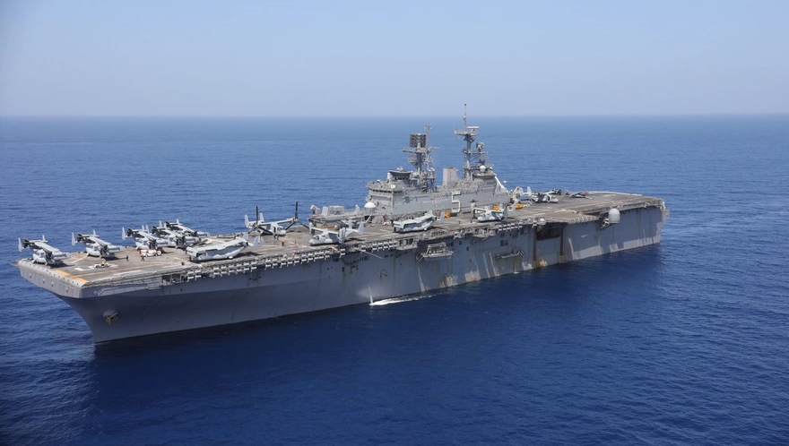
Case study: Red Tide
Year: 2017
Location: USS BATAAN (LHD 5) off the coast in U.S. Central Command
Description: Received 6 simultaneous trauma casualties via MV-22 after the crash of a Blackhawk Helicopter
Embarked Medical Teams:
Fleet Surgical Team 8
Expeditionary Resuscitative Surgical System 18
Surgical Resuscitation Team
Note. The appearance of U.S. Department of Defense (DoD) visual images does not imply or constitute DoD endorsement
Source. Defense Visual Information Distribution Service, Public Domain
https://www.dvidshub.net/image/6233675/uss-bataan-lhd-5-flight-operations
https://www.dvidshub.net/image/3318489/uss-bataan-lhd-5
©️ 2023 AffinityCE
Notes:
Two publications found include this data:
Miller, Benjamin T. MD; Lin, Andrew H. MD; Clark, Susan C. MD; Cap, Andrew P. MD, PhD; Dubose, Joseph J. MD. Red tides: Mass casualty and whole blood at sea. Journal of Trauma and Acute Care Surgery 85(1S):p S134-S139, July 2018. | DOI: 10.1097/TA.0000000000001831
William G Day, Elizabeth Cooper, Khanh Phung, Benjamin Miller, Joseph DuBose, Andrew H Lin, Prolonged Stabilization During a Mass Casualty Incident at Sea in the Era of Distributed Maritime Operations, Military Medicine, Volume 185, Issue 11-12, November-December 2020, Pages 2192–2197, https://doi.org/10.1093/milmed/usaa147
Primary article used for the data is “Red Tides” from (Miller et al., 2018)

Slide 5
Red Tide: patient description list
Patient 1 | Patient 2 | Patient 3 | Patient 4 & 5 | Patient 6
Primary PC: 808.8 Closed unspecified fracture of pelvis Injuries Pelvic fracture Pulmonary contusion Treatment CVC Arterial line Intubation Blood Products 12 | Primary PC: 823_904 Fracture of tibia and fibula & Injury to blood vessels of lower extremity and unspecified sites Injuries Left tibia and fibula fracture Pulmonary contusion Treatment Fasciotomy CVC Arterial line Chest tube Intubation Blood Products 4 | Primary PC: 802_873 Fracture of face bones & Other open wound of head Injuries Facial fractures Mesenteric avulsion Suspected spine injury Cardiac arrest Treatment Thoracotomy CVC Tracheostomy Exploratory laparotomy w SBR Re-exploration of abdomen x2 Blood Products 44 | Primary PC: 805.2 Closed fracture of dorsal [thoracic] vertebra without mention of spinal cord injury Injuries Suspected spine injury Treatment Spine precautions Blood products 0 | Primary PC: 823_904 Fracture of tibia and fibula & Injury to blood vessels of lower extremity and unspecified sites Injuries Suspected spine injury Left open tibia and fibula fractures Treatment Fasciotomy External fixation Blood products 1
Source. Miller, B., Lin, A., Clark, S., Cap, A., & Dubose, J. (2018). Red tides: Mass casualty and whole blood at sea. Joint Trauma and Acute Care Surgery, 85(1S), S134–S139.
©️ 2023 AffinityCE
Notes:
Table provided to NHRC was in (Miller et al., 2018) page S137
These are a basic description of the 6 patients received by the USS BATAAN in 2017 during the incident noted in the Red Tide article.
The primary PCs are the patient codes of the most severe injury that were used when modeling mortality.
When conducting supply modeling, the codes 802_873 (Facial Fracture) & 863.80 (Injury to gastrointestinal tract) were used for the injuries sustained by Patient 3 to appropriately capture the demand on the supply system.

Slide 6
Select Role II Medical Capabilities Explored
Expeditionary Resuscitative Surgical System (ERSS)
Service: U.S. Navy
Role: 2
Primary Use: Maritime Vessel Augmentation
Organic Role 1: No
Note: Limited holding, comes with personnel and equipment
Aircraft Carrier (CVN)
Service: U.S. Navy
Role: 2
Primary Use: Intra-Strike Group Casualty Care
Organic Role 1: Yes
Note: NOT a Casualty Receiving and Treatment Ship
Forward Resuscitative Surgery System (FRSS)
Service: U.S. Marine Corps
Primary Use: Trauma Surgery Support to Maneuver Units
Organic Role 1: No
Note: Treats patients after care is rendered at a Battalion Aid Station, surgical care focused
FRSS with Shock Trauma Platoon (FRSS/STP)
Service: U.S. Marine Corps
Role: 2
Primary Use: Trauma Stabilization with Surgery for Maneuver Unit
Organic Role I: Yes Caveat: No primary care
Note: STP considered a Role I capability by itself, Battalion Aid Station used for primary care.
Surgical Platoon
Service: U.S. Marine Corps
Role: 2
Primary Use: Fixed Location Trauma, & Surgical Care
Organic Role I: Yes Caveat: No primary care
Note: Consists of an FRSS, STP, X-Ray, Lab, Ward, and En-Route Care System
If Role IIs are not built the same, what is the standard definition we should use for Role II?
©️ 2023 AffinityCE
Notes:
These are some basic Role II medical assets for the Navy and the Marine Corps. This list is by no means exhaustive.
These capabilities were explored when conducting supply estimation on the initial casualty stream from Red Tide.
Note: Big take away is no Role II is built the same. Role II is a capability description but does not tell us enough about what medical capacity is being provided.

Slide 7
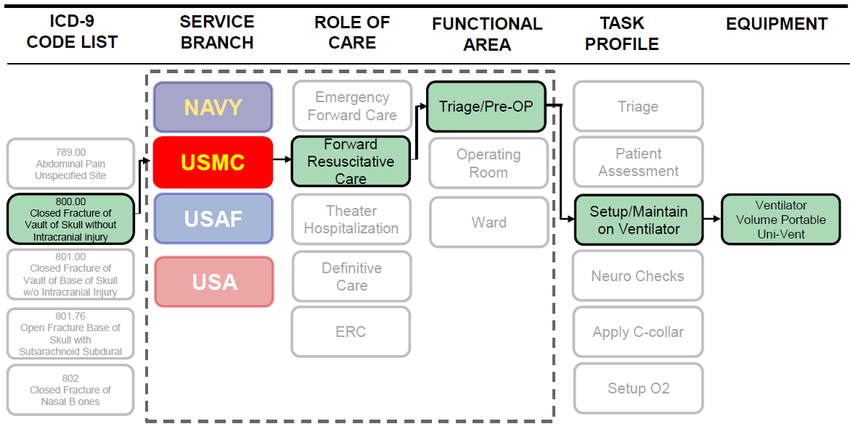
Casualty treatment & Supply Estimation model Overview
Example Treatment Profile with ICD-9 code 800.00
©️ 2023 AffinityCE
Notes:
This is the process of defining the Treatment Profile for the Patient Condition Codes that the Naval Health Research Center uses for modeling the treatment of casualties and estimating supply consumption.
Medical capabilities within the model have been developed based on service level doctrine and supply lists, known by various names across the services. The medical capabilities can be modified to look at novel supplies or structures of the capability, but the baseline build is based on doctrine.
The patient is assigned a Patient Condition Code (corresponding to an ICD-9) and receives care based on the Treatment Profile associated with that Patient Condition Code within that medical capability.
For supply estimation, the Task Profiles within a Functional Area of the medical capability correspond to supply and equipment usage that allows for the estimation of supplies/equipment based on a casualty stream.
A “casualty stream” is defined as a set of Patient Condition Codes that result from modeling an operational scenario.
Supply estimation is conducted in the Expeditionary Medical Knowledge Warehouse (EMedKW) which stores the data used in the Casualty Estimation Tool (Medical Planners’ Toolkit (MPTk)) and the Medical Network Sufficiency Model (Joint Medical Planning Tool (JMPT)).
To ensure continuity, the same Treatment Profiles are used across the estimation tools.

Slide 8
Modeling Limitations
The Joint Medical Planning Tool (JMPT) is intended for large scale medical network modeling
Mortality modeling in JMPT is conducted by Role of Care, not by individual interventions
Current mortality curves are based on a synthesis of data from Operations Iraqi and Enduring Freedom and subject matter expertise
Not all patient condition codes have a treatment profile at the medical treatment facilities in JMPT or the Expeditionary Medical Knowledge Warehouse (Supply Modeling)
Modeling assumes a full authorized list of supplies and personnel for the medical treatment facility are available
Conservative best-case estimate for supplies and personnel availability
©️ 2023 AffinityCE
Notes:
CAPT Tadlock to discuss limitations in LSCO as well as other injury patterns such as burn, TBI, etc.
Anesthesia implications as well

Slide 9
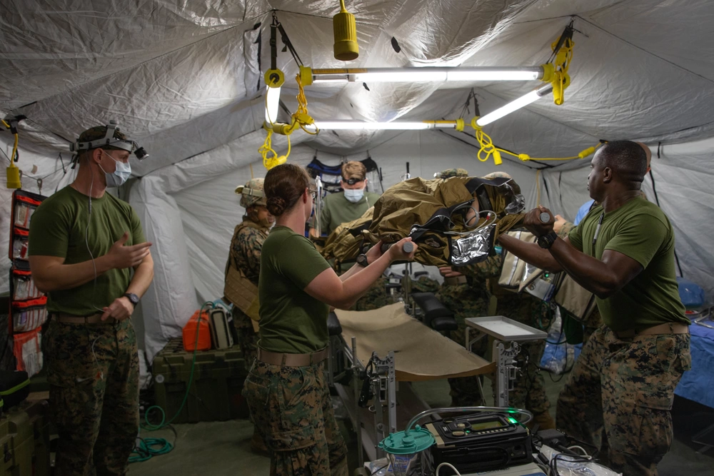
Event 1 background
Role: Medical provider assigned to a Role II medical facility.
The Medical Regulator informs the team that 6 trauma casualties are inbound via MV-22 after a Blackhawk crashes due to adversary fire.
This is the first time your medical capability is receiving casualties.
Your supplies are at full capacity and your medical team is well rested.
The 6 Trauma Casualties are based on the Red Tide Casualty List
Note. The appearance of U.S. Department of Defense (DoD) visual images does not imply or constitute DoD endorsement
Source. Defense Visual Information Distribution Service, Public Domain
https://www.dvidshub.net/image/6929926/3rd-medical-battalion-conducts-role-2-medical-training
©️ 2023 AffinityCE

Slide 10
Event 1 Supply Status
After the 6 trauma patients are treated, your Supply Petty Officer provides you with the following Status Report:
Medical Capability | Supply Lines On Hand | Lines Exceeded | % Line Items Used
Expeditionary Resuscitative Surgical System (ERSS) | 581 | 54 | 9.29%
Aircraft Carrier (CVN) | 2145 | 16 | 0.75%
Forward Resuscitative Surgery System (FRSS) | 580 | 13 | 2.24%
FRSS + Shock Trauma Platoon (FRSS/STP) | 986 | 4 | 0.41%
Surgical Platoon (SP) | 1452 | 10 | 0.69%
Best Outcome¹
FRSS/STP
5 of 1018 Supply block line items exceeded
Worst Outcome¹
ERSS
54 of 581 Supply block line items exceeded
Notes:
1) Based on Red Tide patient stream, modeled using the Expeditionary Medical Knowledge Warehouse
©️ 2023 AffinityCE
Notes:
The patients from the Red Tide scenario were used to explore the supply shortfalls across 5 different Navy and Marine Corps Role II capabilities.
Principle findings were:
Expeditionary Resuscitative Surgical System (ERSS): 54/581 Supply lines were exceeded
Nuclear Powered Aircraft Carrier (CVN): 16/2152 Supply lines were exceeded
Forward Resuscitative Surgery System (FRSS): 15/613 Supply lines were exceeded
Forward Resuscitative Surgery System (FRSS) + Shock Trauma Platoon (STP): 5/1018 Supply lines were exceeded
Surgical Platoon (SP): 10/1490 Supply lines were exceeded
This shows that within the first 6 patients with severe injuries, the supply lines begin to deplete. While there are substitutions that can happen; capabilities, primarily mobile ones like the ERSS, have very limited ability to maintain mission effectiveness from a supply perspective for an extended period of time.
What happens when the next set of casualties comes in on the helo behind these 6? Are these medical facilities able to handle that casualty load? In Large Scale Combat Operations, with limited resupply, how do we sustain operations as these capabilities are currently designed?

Slide 11
Mortality estimation Results: Event 1 with 6 trauma Casualties
6 Hour Hold Time
Facility | Survive | Died Outside | Died Under Care | Died Awaiting Transport
ERSS/FRSS | 3 (3)² | 0 | 0 | 0
CVN | 6 | 0 | 0 | 0
FRSS/STP | 5 | 0 | 1 | 0
SP | 6 | 0 | 0 | 0
96 Hour Hold Time
Facility | Survive | Died Outside | Died Under Care | Died Awaiting Transport
ERSS/FRSS | 3 (3)² | 0 | 0 | 0
CVN | 6 | 0 | 0 | 0
FRSS/STP | 4 | 0 | 1 | 1
SP | 6 | 0 | 0 | 0
24 Hour Hold Time
Facility | Survive | Died Outside | Died Under Care | Died Awaiting Transport
ERSS/FRSS | 3 (3)² | 0 | 0 | 0
CVN | 6 | 0 | 0 | 0
FRSS/STP | 5 | 0 | 1 | 0
SP | 6 | 0 | 0 | 0
Notes:
Based on Red Tide patient stream, modeled using the Joint Medical Planning Tool
Casualties have no treat profile at this medical capability and bypass it.
Notes:
**ERSS/FRSS Note: () indicates casualties not treated at capability. No treatment profile available. Could count as either survived or died depending on severity.
This is the mortality using a large-scale network model (Joint Medical Planning Tool) to get a “rough estimate”. Casualties had 4 disposition categories:
Survived: Final evacuation at the end of the scenario
Died Outside: Never entered the facility and died outside
Died Under Care: Died of wound suffered while in the facility
Died Awaiting Transport: Patient had transport requested for them but died due to transportation delay.
Modeling Notes:
FRSS and ERSS are “Like Capabilities” within JMPT. For mortality modeling, the capabilities are considered equivalent.
Hold times modeled by modifying route availability in JMPT to get a “rough estimate” of mortality given hold times.
Thresholds used were 6, 24, and 96 hours as dictated by the research team.
Casualty Code Mix for Red Tide Runs:
1 – 808.8 Fracture of tibia and fibula & Injury to blood vessels of lower extremity and unspecified sites
2 – 823_904 Closed unspecified fracture of pelvis
2 – 805.2 Closed fracture of dorsal [thoracic] vertebra without mention of spinal cord injury
1 – 802_873 Fracture of face bones & Other open wound of head

Slide 12
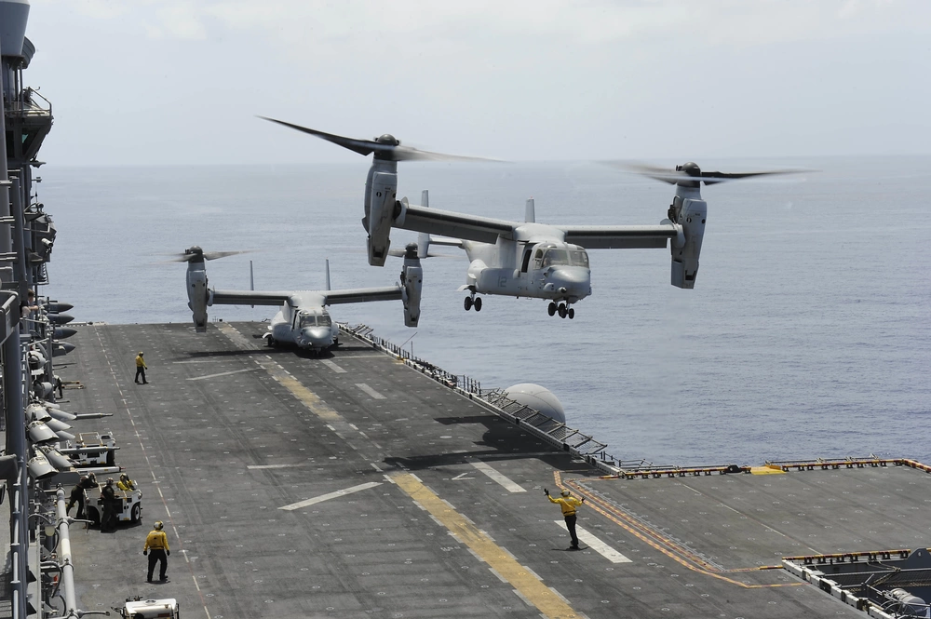
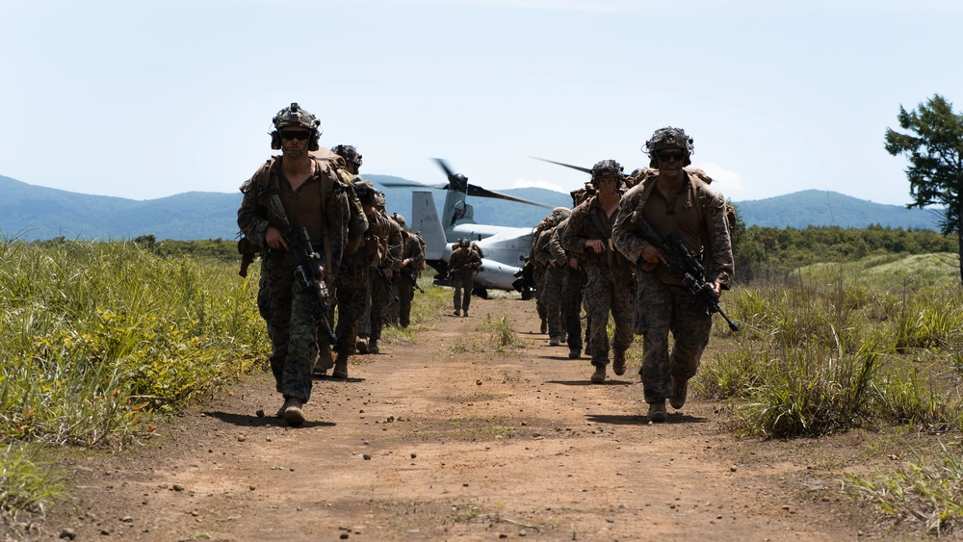
MV-22 transport capacity
Primary Use: U.S. Marine Corps Aerial Assault Transport
Crew: Pilot, Co-Pilot, 2 Flight Engineers
Capacity: 24 Combat Loaded Marines
Red Tide only had 6 casualties. What about a fully loaded MV-22?
Note. The appearance of U.S. Department of Defense (DoD) visual images does not imply or constitute DoD endorsement
Source. Defense Visual Information Distribution Service, Public Domain
https://www.dvidshub.net/image/7297214/shinka-221-mv-22-insert
https://www.dvidshub.net/image/2610367/mv-22-osprey
©️ 2023 AffinityCE
Notes:
What happens to the mortality rate at these medical capabilities if the casualty count is closer to a fully loaded MV-22

Slide 13
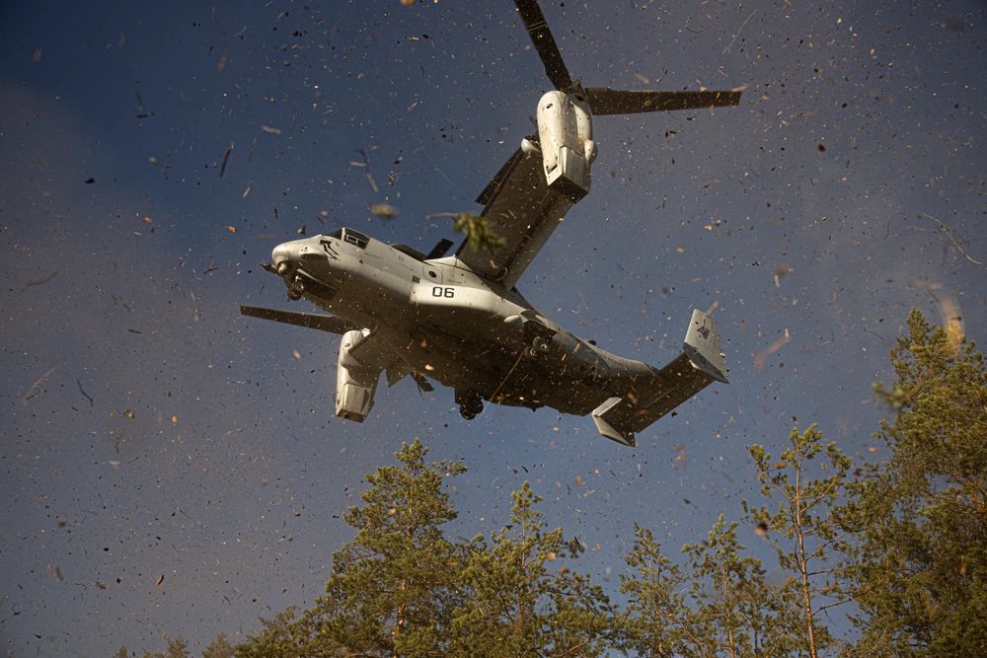
Event 2 Background
Role: Medical provider assigned to a Role II medical facility.
The Medical Regulator informs the team that 24 trauma casualties are inbound via two MV-22s after a fully loaded MV-22 crashes due to adversary fire during an Air Assault Mission.
This is the first time your medical capability is receiving casualties.
Your supplies are at full capacity and your medical team is well rested.
The 24 Trauma Casualties are based on 4 times the number on the Red Tide Casualty List
*This is a separate event from the first.*
Note. The appearance of U.S. Department of Defense (DoD) visual images does not imply or constitute DoD endorsement
Source. Defense Visual Information Distribution Service, Public Domain
https://www.dvidshub.net/image/7370667/medical-evacuation-training
©️ 2023 AffinityCE
Notes:
Method: Multiply the Red Tide casualty count (6 patients) by 4 for a total of 24 casualties
Assumption:
Capacity: 24 Marines + 4 Crew = 28 Total Embarked
Killed in Action: 28 - 24 = 4 Pre-Simulation Killed in Action

Slide 14
Event 2 Supply Status
After the 24 trauma patients are treated, your Supply Petty Officer provides you with the following Status Report:
Medical Capability | Supply Lines On Hand | Lines Exceeded | % Line Items Used
Expeditionary Resuscitative Surgical System (ERSS) | 581 | 140 | 24.10%
Aircraft Carrier (CVN) | 2145 | 70 | 3.26%
Forward Resuscitative Surgery System (FRSS) | 580 | 87 | 15.00%
FRSS + Shock Trauma Platoon (FRSS/STP) | 986 | 59 | 5.98%
Surgical Platoon (SP) | 1452 | 67 | 4.61%
Best Outcome¹
Surgical Platoon
67 of 1452 Supply block line items exceeded
Worst Outcome¹
ERSS
140 of 581 Supply block line items exceeded
Notes:
1) Based on Red Tide patient stream x4, modeled using the Expeditionary Medical Knowledge Warehouse
©️ 2023 AffinityCE
Notes:
The patients from the Red Tide scenario were used to explore the supply shortfalls across 5 different Navy and Marine Corps Role II capabilities.
Principle findings were:
Expeditionary Resuscitative Surgical System (ERSS): 54/581 Supply lines were exceeded
Nuclear Powered Aircraft Carrier (CVN): 16/2152 Supply lines were exceeded
Forward Resuscitative Surgery System (FRSS): 15/613 Supply lines were exceeded
Forward Resuscitative Surgery System (FRSS) + Shock Trauma Platoon (STP): 5/1018 Supply lines were exceeded
Surgical Platoon (SP): 10/1490 Supply lines were exceeded
This shows that within the first 6 patients with severe injuries, the supply lines begin to deplete. While there are substitutions that can happen; capabilities, primarily mobile ones like the ERSS, have very limited ability to maintain mission effectiveness from a supply perspective for an extended period of time.
What happens when the next set of casualties comes in on the helo behind these 6? Are these medical facilities able to handle that casualty load? In Large Scale Combat Operations, with limited resupply, how do we sustain operations as these capabilities are currently designed?

Slide 15
Mortality estimation Results: Event 2 with 24 trauma Casualties
6 Hour Hold Time
96 Hour Hold Time
Facility | Survive | Died Outside | Died Under Care | Died Awaiting Transport
ERSS/FRSS | 8 (10)² | 6 | 0 | 0
CVN | 19 | 3 | 2 | 0
FRSS/STP | 22 | 0 | 2 | 0
SP | 23 | 0 | 1 | 0
Facility | Survive | Died Outside | Died Under Care | Died Awaiting Transport
ERSS/FRSS | 7 (10)² | 7 | 0 | 0
CVN | 18 | 4 | 2 | 0
FRSS/STP | 19 | 0 | 2 | 3
SP | 20 | 0 | 1 | 3
24 Hour Hold Time
Facility | Survive | Died Outside | Died Under Care | Died Awaiting Transport
ERSS/FRSS | 7 (10)² | 7 | 0 | 0
CVN | 18 | 4 | 2 | 0
FRSS/STP | 20 | 0 | 2 | 2
SP | 22 | 0 | 1 | 1
Are we expending critical supplies for patients who may have poor outcomes in prolonged holding?
What is the impact of our triage decisions?
Have you considered how you would make that choice?
Notes:
Based on Red Tide patient stream, modeled using the Joint Medical Planning Tool
Casualties have no treat profile at this medical capability and bypass it.
Notes:
**ERSS/FRSS Note: () indicates casualties not treated at capability. No treatment profile available. Could count as either survived or died depending on severity.
This is the mortality using a large-scale network model (Joint Medical Planning Tool) to get a “rough estimate”. Casualties had 4 disposition categories:
Survived: Final evacuation at the end of the scenario
Died Outside: Never entered the facility and died outside
Died Under Care: Died of wound suffered while in the facility
Died Awaiting Transport: Patient had transport requested for them but died due to transportation delay.
Modeling Notes:
FRSS and ERSS are “Like Capabilities” within JMPT. For mortality modeling, the capabilities are considered equivalent.
Hold times modeled by modifying route availability in JMPT to get a “rough estimate” of mortality given hold times.
Thresholds used were 6, 24, and 96 hours as dictated by the research team.
Casualty Code Mix for x4 Run (6 Pt 1st Mission + 18 Pt 2nd Mission:
4 – 808.8 Fracture of tibia and fibula & Injury to blood vessels of lower extremity and unspecified sites
8 – 823_904 Closed unspecified fracture of pelvis
8 – 805.2 Closed fracture of dorsal [thoracic] vertebra without mention of spinal cord injury
4 – 802_873 Fracture of face bones & Other open wound of head

Slide 16
Discussion Starters: Implication for Large Scale Combat Operation (LSCO)
How do we view our role as Military Medicine?
How do Military Commanders view our role?
How do we right size our medical capabilities for the next fight?
To meet both the operational and medical objectives
How do our triage and treatment decisions change for:
Surgically intensive patient loads?
Uncertain resupply conditions?
Threat environment and limitations on air movement?
Weather/environmental factors (Hot/Cold Weather Medicine)?
How do we use modeling & simulation to inform how we prepare for LSCO?

Slide 17
How To Claim CE Credit
If you would like to receive continuing education credit for this activity, please visit:
amsus.cds.affinityced.com
©️ 2023 AffinityCE

